Slide 1
Estimating Total Particle Formation Using Environmental Chambers
David Cocker
UC Riverside/CE-CERT
March 18, 2016

Slide 2
Traditional Environmental Chambers
Laboratory chambers are indispensable in the study of gas-phase atmospheric chemistry and atmospheric aerosol formation and growth. Because of the difficulty of isolating chemical and microphysical processes in the atmosphere from flow and mixing effects, chamber studies provide the means to develop mechanistic understanding of such processes. In this context, a laboratory chamber constitutes a well-mixed batch reactor in which the chemical processes of interest can be isolated directly.

Slide 3
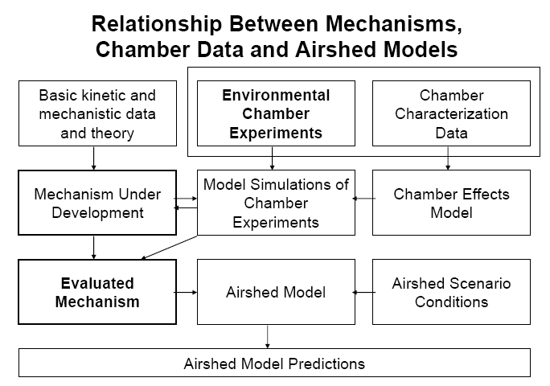
Carter et al., 2006, Mechanism Conference, http://www.cert.ucr.edu/~carter/Mechanism_Conference/17%20C%20carter.pdf
)

Slide 4
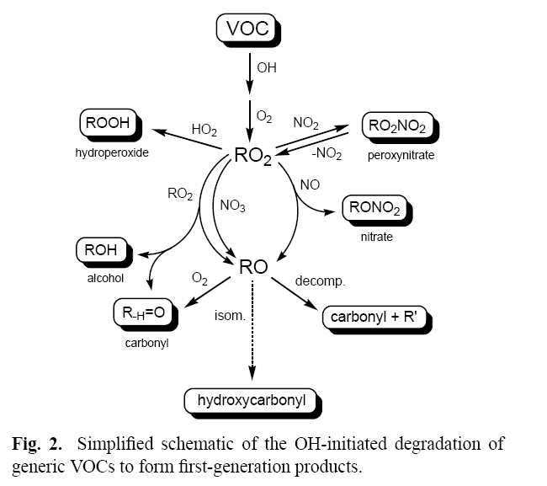
Hallquist et al., 2009, ACP:9, 5155-5236

Slide 5
Indoor vs. Outdoor
Pros (Outdoor) – Natural sunlight provides full spectrum of wavelengths; allows for photolysis of more products
Con (Outoor) – Difficult to control photolysis due to changes in weather, clouds, etc. makes replication of experiment difficult; temperature and relative humidity are dictated by environment and will fluctuate during course of experiment

Slide 6
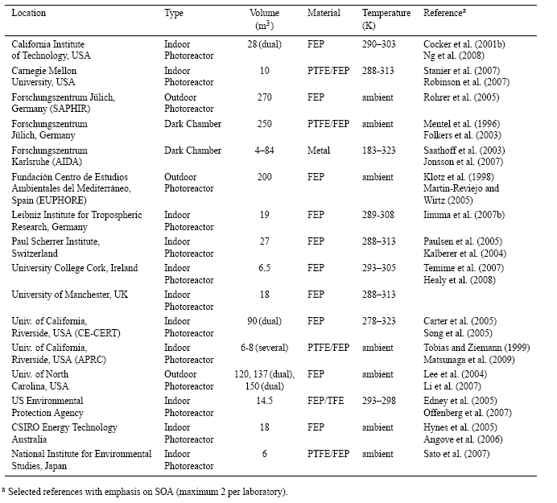
Select Chambers

Slide 7
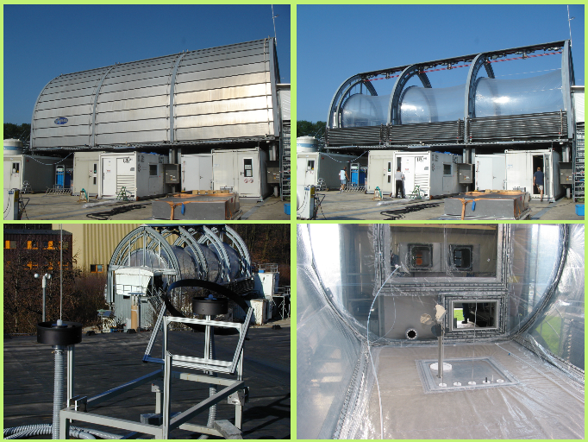
SAPHIR
Simulation of Atmospheric PHotochemistry In a large Reaction (SAPHIR) chamber in Jülich, Germany (http://www.eurochamp.org/chambers/saphir/): 270 m3

Slide 8
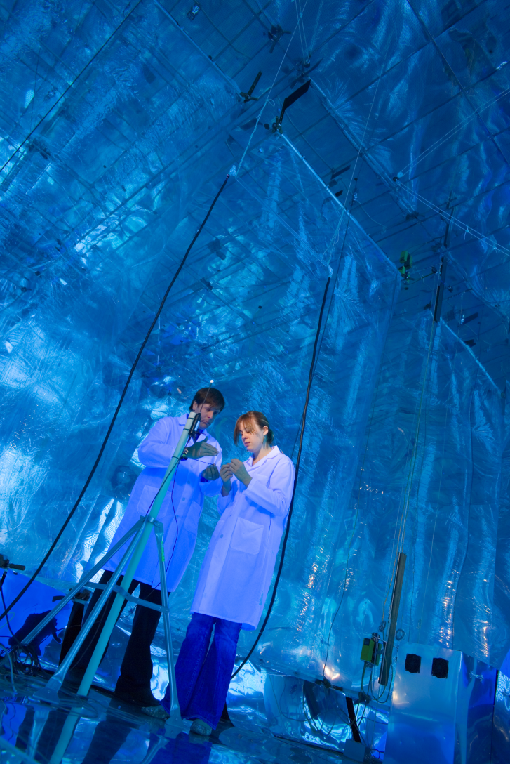
UCR Chamber Facility

Slide 9
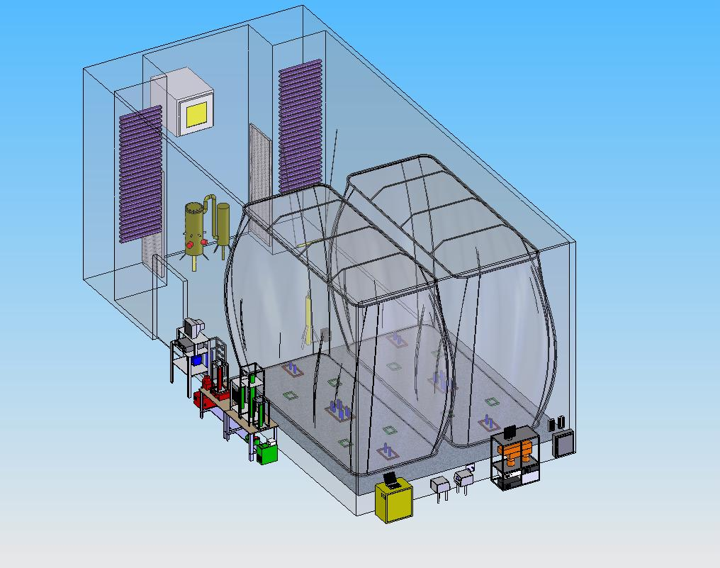
UC Riverside/CE-CERT Environmental Chamber
Air handler circulation system
Purified air flushed 450 m³ enclosure
Descending frames to maintain positive pressure
Argon arc lamp
Dual 90 m³ Teflon reactors
Particle free two chamber humidifier
Black lights
Injection and sample ports
Dual SMPS’s
TDMA – Hygroscopicity Measurement

Slide 10
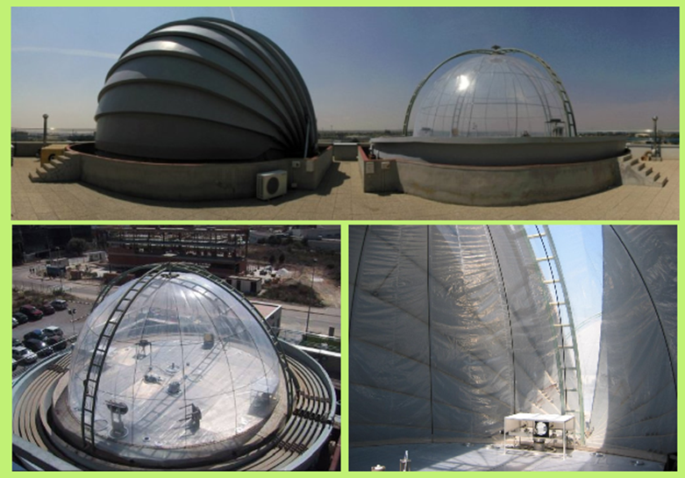
EUPHORE
EUPHORE (European PHOtoREactor) chamber in Valencia, Spain (http://www.eurochamp.org/chambers/euphore): volume = 200m3 each.

Slide 11
Chemical Instrumentation
AMS
CRDS
Products (aerosol)
IR-CRDS
LCMS
+
VOCs
Oxidants
Intermediates
GCxGC
Products (gases)
PTR-MS
GC-FID

Slide 12
Aerosol Instrumentation
AMS
(Chemical
composition)
Atmospheric reactor
TDMA
(hygroscopicity
volatility)
SOA
SMPS
(Size
Distribution)
CPC
(Number
Concentration)
APM
(Single
Particle Mass)
(CCN)
Cloud particle activation
Aerosol Mass Produced

Slide 13
Indoor vs. Outdoor
Pros (Indoor) – Can de designed for excellent temperature and RH control, repeatable photolysis conditions
Cons (Indoor) – Difficult to simulate natural sunlight across the solar spectrum – relative rates of photolysis may be affected

Slide 14
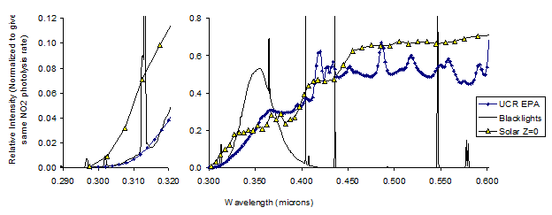
Comparison of Light Spectra
Carter et al., 2004, ARB report
http://www.cert.ucr.edu/~carter/pubs/lnoxrpt.pdf

Slide 15
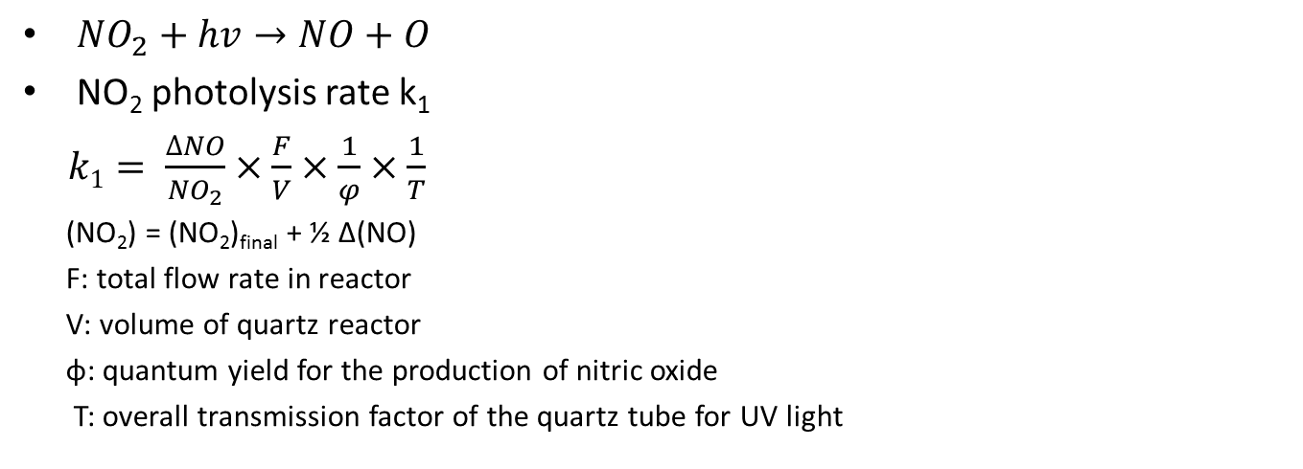
k₁ measurement
hν
NO₂
_{1.00 L/min}
NO_{X}
_{Analyzer}
known volume quartz tube
${NO}_{2}+hv→NO+O$
NO₂ photolysis rate k₁
$k1= \frac{∆NO}{{NO}_{2}}×\frac{F}{V}×\frac{1}{φ}×\frac{1}{T}$
(NO₂) = (NO₂)_{final} + ½ Δ(NO)
F: total flow rate in reactor
V: volume of quartz reactor
φ: quantum yield for the production of nitric oxide
T: overall transmission factor of the quartz tube for UV light

Slide 16

Primary vs. Secondary Particulate
Primary (direct) particulate emissions – defined by source and measurement method
(Focus of PEMS conference)

Slide 17
Kittelson, 2008, AQMD Ultrafine Conference

Slide 18
SOA from POA?
Significant fraction of POA volatilize at higher dilution ratio (~ambient condition)
Traditional SOA precursors cannot explain SOA from diesel exhaust
SOA from “Intermediate/Semi”-volatility Organic Compounds (IVOCs, SVOCs)
Robinson et al., 2007, Science

Slide 19
Primary vs. Secondary Particulate
Primary (direct) particulate emissions – defined by source and measurement method
+ NO_{x}
(Also focus of PEMS conference)

Slide 20
Primary vs. Secondary Particulate
Primary (direct) particulate emissions – defined by source and measurement method
+ NO_{x}
+ organic vapors

Slide 21
Primary vs. Secondary Particulate
Primary (direct) particulate emissions – defined by source and measurement method
+ ammonia
+ NO_{x}
+ organic vapors

Slide 22
Primary vs. Secondary Particulate
Primary (direct) particulate emissions – defined by source and measurement method
+ ammonia
+ NO_{x}
+ organic vapors
Gases undergo subsequent reaction in the atmosphere leading to the formation of additional particulate referred to as secondary particulate

Slide 23
Atmospheric Chemistry Takes Over
Organic vapors + NO_{x} + sunlight → ozone

Slide 24
Atmospheric Chemistry Takes Over
Organic vapors + NO_{x} + sunlight → ozone
AND Organic vapors with decreasing vapor pressure (condensable vapors)

Slide 25
Atmospheric Chemistry Takes Over
Organic vapors + NO_{x} + sunlight → ozone
AND Organic vapors with decreasing vapor pressure (condensable vapors)
AND Nitric acid

Slide 26
Atmospheric Chemistry Takes Over
Organic vapors + NO_{x} + sunlight → ozone
AND Organic vapors with decreasing vapor pressure (condensable vapors)
AND Nitric acid
AND Ammonium nitrate (if ammonia present)

Slide 27
Inorganic Secondary Particulate
.OH
NO + ozone
NO₂
HNO₃
NH₃
NH₄NO₃
Similarly,
^{H}₂^{O}
SO₂ + oxidant
SO₃
H₂SO₄
NH₃
(NH₄)₂SO₄

Slide 28
Secondary Organic Aerosol
Lighter
(fragmentation)
Oxidation
Products
Heavier (functionalization) Oxidation Products
Organic gases
+ .OH
+
Evaporation
Sorption

Slide 29
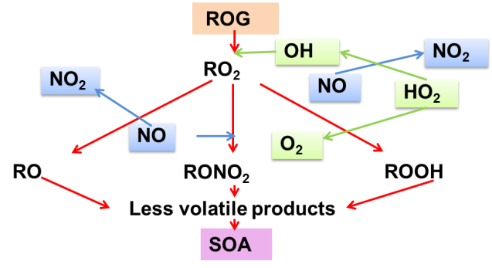
Chemistry of SOA Formation is Complicated!
VOC
Plus additional SOA formation through oligomerization …

Slide 30

Primary/Secondary Organic Aerosol
+
Organic gases
Evaporation (due to
dilution)
.OH
Sorption
Heavier (functionalization) Oxidation Products
Lighter
(fragmentation)
Oxidation
Products
+

Slide 31

How do we look at SOA Formation?
SOA formation is driven by gas-to-particle partitioning, with the gas-to-particle partitioning coefficient defined as:
saturation liquid vapor pressure
activity coefficient

Slide 32
Equilibrium Partitioning of Semi-Volatile Compounds
G₁, G₂,…,G_{n}
α₁(ΔROG)
α₂(ΔROG)
ROG
…
α_{n}(ΔROG)
A₁, A₂,…,A_{n}
K_{om,i}
A_{i}/M_{o}
RT
=
=
G_{i}
MW_{om}γ_{i}pº_{L,i}
γ_{i} = γ_{i}(x₁,x₂,…,x_{n})
pº_{L,i} = pº_{L,i} (T)

Slide 33
SOA formation potential
60
12
50
PM Volume(corrected)
PM Volume(uncorrected)
Hydrocarbon
10
3
)
40
8
/cm
3
ΔM_{o}
ΔROG
m
HC (ppb)
μ
30
6
Volume (
20
4
10
2
0
0
0
100
200
300
400
500
600
Time (minute)

Slide 34
SOA formation as a function of organic aerosol mass
At small M_{o}

Slide 35
General SOA Experimental Protocol
Parent ROG(s)
Seed Aerosol (optional)
Propene (optional)
NO, NO₂
Gas Phase Sampling:
-Hydrocarbon
-Ozone, NO, NO₂
-Relative humidity, T
Aerosol Sampling:
-Number Concentration
-Size Distribution
ΔROG
ΔM_{o}
K_{om,i}
α_{i}
Y_{expt}
Y_{calc}
--Assume two product classes
--Coefficients K_{om.i} and α_{i} values are then varied so that the sum of the residuals between experimental and calculated yields for a single parent is minimized.

Slide 36
SMPS
From
Chamber
Sheath
Aero
Charger
Filter
-
-
-
-
-
-
-
-
DMA
-
-
To pump
Mono
Filter
CNC
(To detector)
Excess

Slide 38
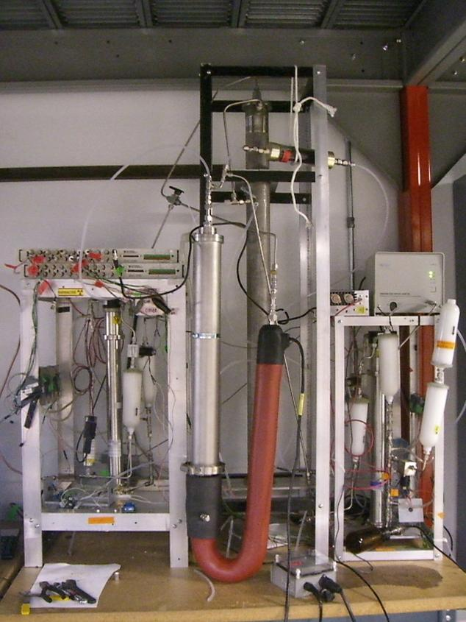
VTDMA
Volatility Tandem Differential Mobility Analyzer
HTDMA
Hygroscopicity Tandem Differential Mobility Analyzer
particle with
specific size
+
-
Residence
chamber
Thermal
denuder
+
-
Drag
force
+
Electrical
force
+
-
+
+
-
size scan
+
SMPS
DMA
Notes:
The volatility of the SOA is continuously measured using a (VTDMA) .A monodisperse aerosol fraction is selected by the first DMA. The particles of specific size goes into a thermodenuder with a temperature setting of 100 C and residence time of 16 sec. Then the change in particle diameter is detected by a SMPS system.
It can determine the Volume remaining fraction by this equation. The VTDMA system is used to detect possible changes in the volatility of SOA with aging time.

Slide 39
TDMA analysis (volatility or hygroscopicity)
Gf=D_{f}/D_{i} or VRF=(D_{i}/D_{f})³

Slide 40
General Emission Protocol
Vehicle exhaust
Propene (optional)
H₂O₂ (optional)
Gas Phase Sampling:
-Hydrocarbon
-Ozone, NO, NO₂
-Relative humidity, T
Aerosol Sampling:
-Number Concentration
-Size Distribution
-Chemical Composition
-Fractal Dimension
ΔROG
ΔM_{o}
K_{om,i}
α_{i}
Y_{expt}
Y_{calc}
--Assume two product classes
--Coefficients K_{om.i} and α_{i} values are then varied so that the sum of the residuals between experimental and calculated yields for a single parent is minimized.

Slide 41
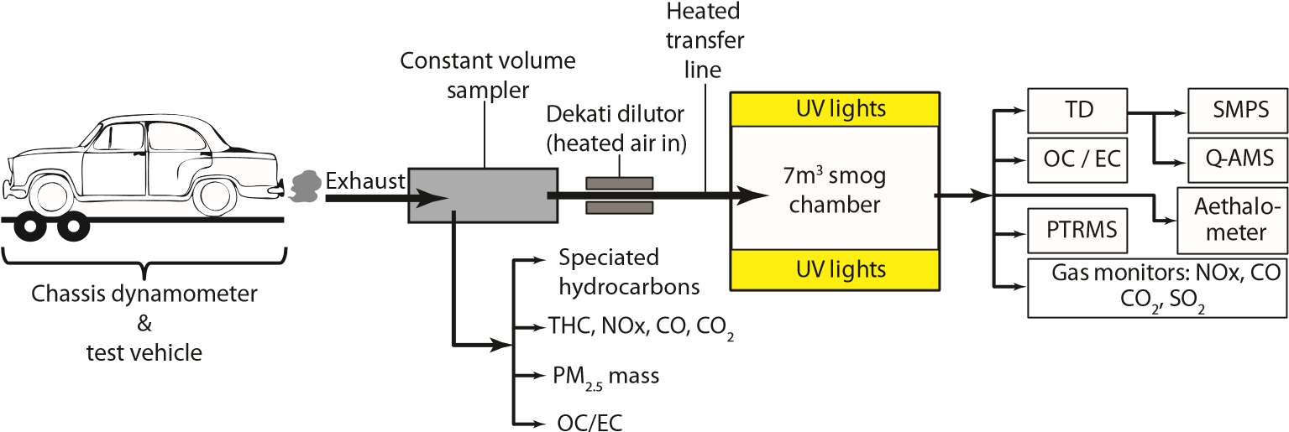
Gordon et al., www.atmos-chem-phys.net/14/4661/2014/

Slide 42
Why fractal dimension matters
Condensing organic material will fill voids while potentially not changing mobility diameter
Must be careful to not use SMPS only and assume constant density
Shape of primary aerosol influenced by dilution….

Slide 43
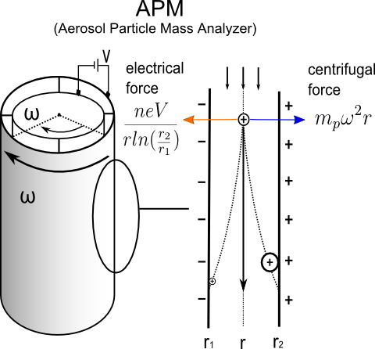
Particle measurement methods
1. SMPS
- volume (based on d_{m})
2. APM – SMPS
- m_{p}, d_{m} → ρ_{eff}
3. HR-ToF-AMS
Non refractory organics
SMPS: Scanning Mobility Particle Sizer
APM: Aerosol Particle Mass Analyzer
HR-ToF-AMS: High Resolution-Time-of-Flight Aerosol Mass Spectrometer
d_{m}: mobility diameter
m_{p}: mass of particle
ρ_{eff}: effective density

Slide 44
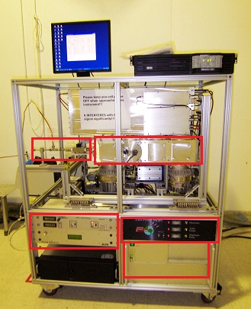
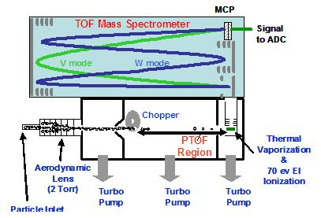
HR-ToF-AMS
Aerodyne High Resolution Time-of-Flight Aerosol Mass Spectrometer
inlet
Electronic box
Power Supply
Higher resolution for W mode
Higher sensitivity for V mode
TPS Box
Source: DeCarlo et al., 2006

Slide 45
Measurement of SOA by AMS
SOA
POA
C₄H₉⁺: tracer of primary organic aerosol*
Run 1 (engine idle,short transfer line, DR: 114)
*Chirico et al. 2010, APCD

Slide 46
Measurement of SOA by AMS
Nakao et al. (2011) AS&T
Robinson et al. (2007) Science

Slide 47
Gordon et al., www.atmos-chem-phys.net/14/4661/2014/

Slide 48
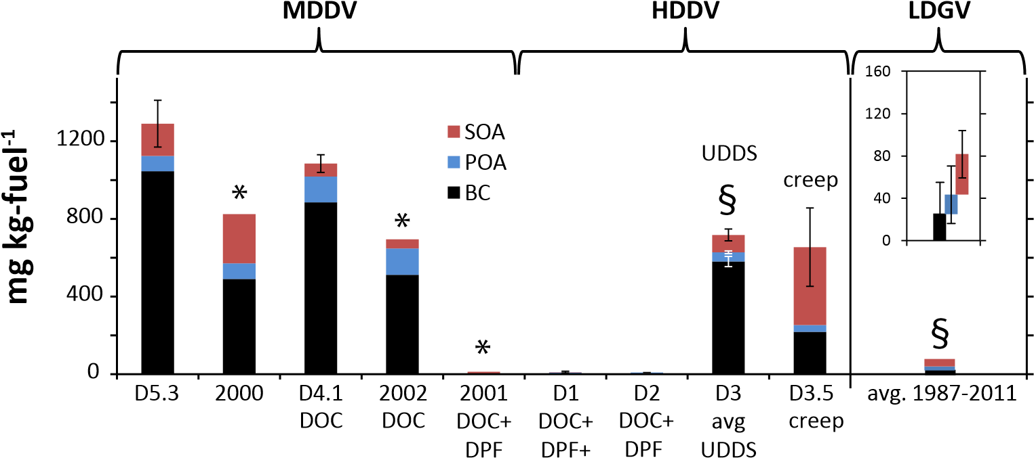
Gordon et al., www.atmos-chem-phys.net/14/4643/2014/

Slide 49
Challenges
Oxidizing environment controlled by exhaust gases (organics and NO_{x})
Limited oxidation time
Wall effects can be important (loss of SOA precursor gases to walls, interaction of sorbing gases to particles on the surface)

Slide 50
Chemistry of SOA Formation is Complicated!
VOC
Plus additional SOA formation through oligomerization …

Slide 51
Kinetics very important
d[C]/dt = k[A][B]
RO₂ + HO₂ → heavier oxidation product (e.g., hydroperoxide)
d[oxidation product]/dt = k[.RO₂][.HO₂]
NO competes for .RO₂ and .HO₂
  [.RO₂] and [.HO₂] very dependent on [NO] as NO quickly reacts with .RO₂ and .HO₂ to form .RO and .HO.

Slide 52
VOC
Plus additional SOA formation through oligomerization …

Slide 53
Sample Gas Phase and PM Trace

Slide 54
Sample Gas Phase and PM Trace

Slide 55
Comparison of Two Experiments with the Same Initial and Reacted m-Xylene Concentrations
Initial NO_{x}: 9 ppb
Initial NO_{x}: 266 ppb

Slide 56
Example of how NO_{x} influences SOA yield
Experiments with increasing NO_{x}

Slide 58
So how do we best mimic atmosphere
Clearly SOA formation is driven by the gas-phase chemistry leading to oxidation of organic vapors, which in turn, can condense/sorb into existing organic matter.
Option 1a: Inject gases and particles directly from tailpipe (after dilution and cooling) and turn on lights. Gas-phase chemistry will be dominated by organic gases and NO_{x} from vehicle
Option 1b: inject organic gases and particles into system with surrogate atmosphere (e.g., VOC dominated by anthropogenic or biogenic sources) already present
Option 1c: reduce NO_{x} during injection into chamber
Option 1d: Alter reactivity of system by injecting propene, H₂O₂, HONO or other species.
Option 2: Mimic total oxidation of atmosphere on days scale in short time by elevating oxidants. (PAMS)

Slide 59
Option 2: PAMS

Slide 60
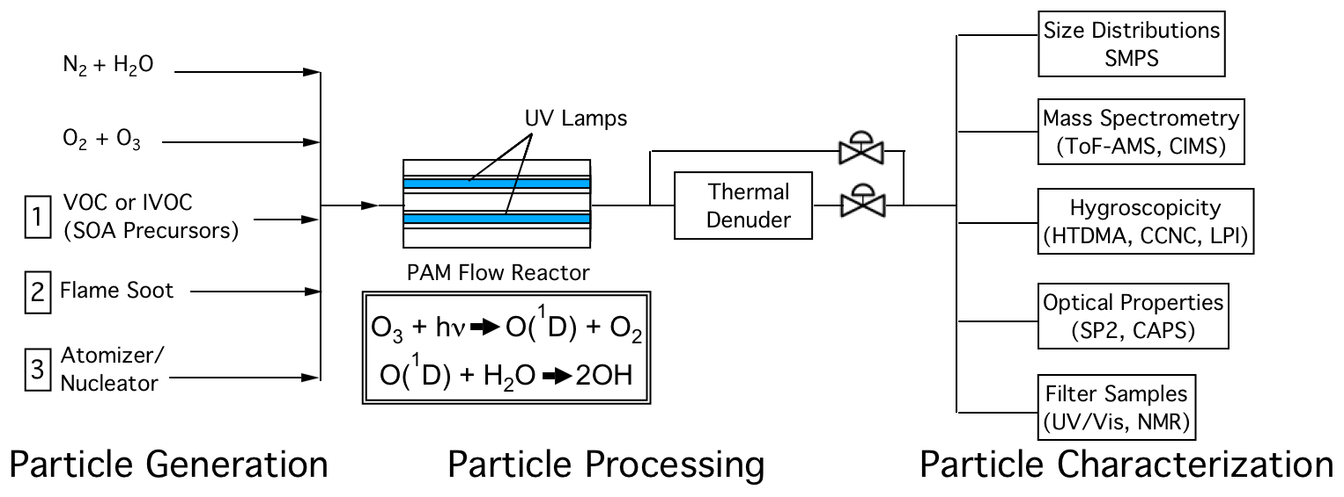
Photochemical Measurement
Example PAM reactor setup/applications (from T.B. Onasch et al., DoE ASR Meeting, Spr 2012).

Slide 61
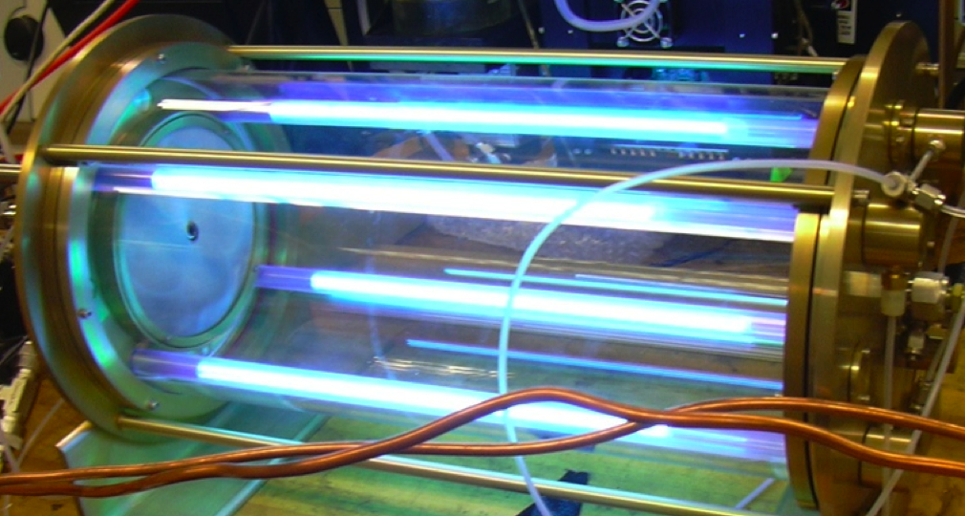
PAMS system

Slide 62
Advantages:
- Wider range of oxidant exposure time (1–30 days vs. 1 day)
- Shorter experiment duration (minutes vs. hours or days)
Disadvantages:
- High OH concentrations required to simulate atmospherical aging timescales (10¹⁰ - 10¹² vs. 10⁶ - 10⁷ molec cm⁻³)
- High (parts-per-million) levels of O₃ required for OH production
- UV emission spectrum different than troposphere (peak λ = 254 nm vs λ > 300 nm)

Slide 63
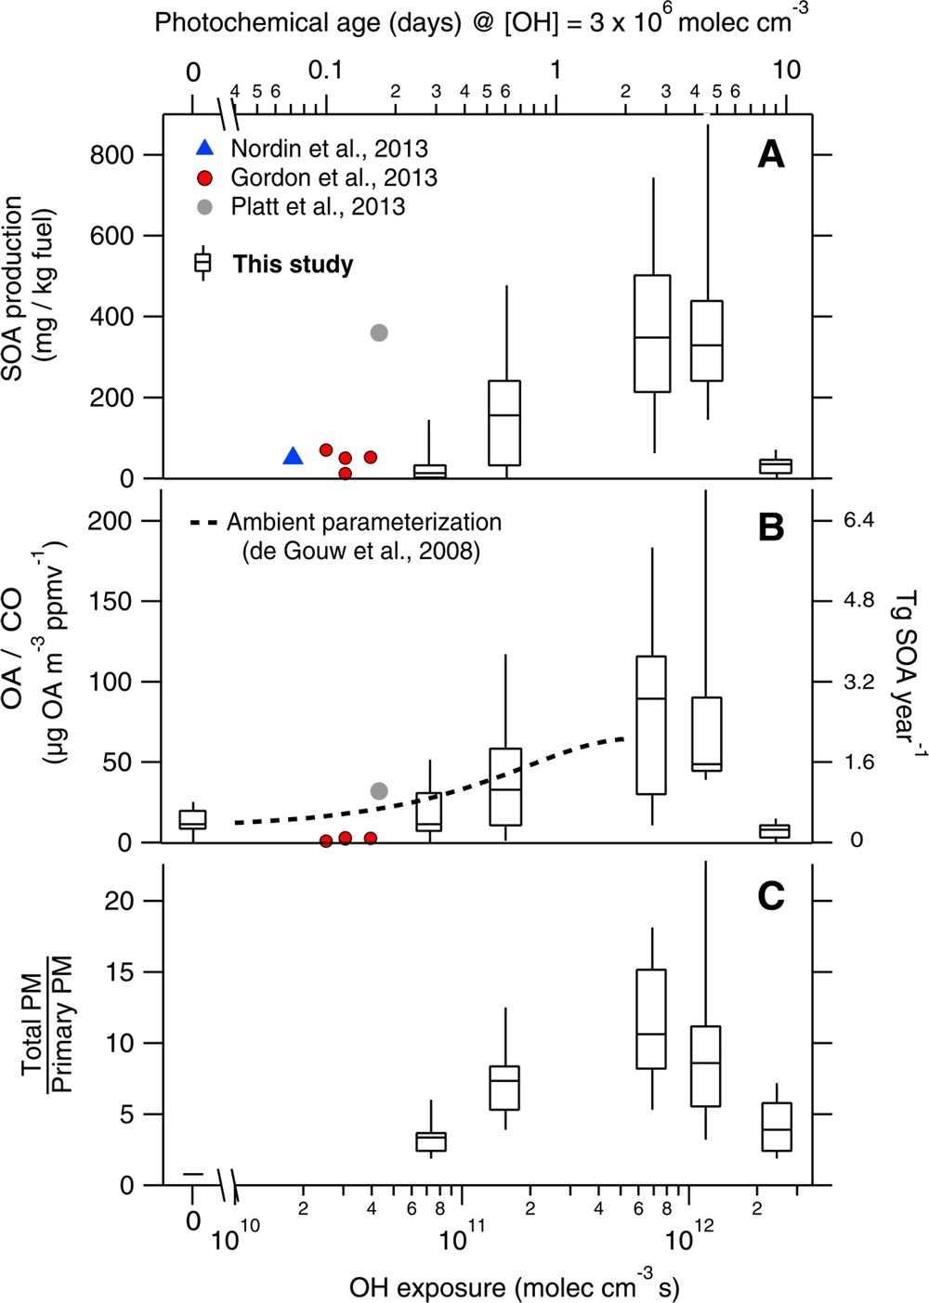
OH exposures ranged from 7.4 × 10¹⁰ to 2.4 × 10¹² molecules cm⁻³ s or approximately 0.3−9.3 days of equivalent photochemical aging at a typical urban OH concentration of 3 × 10⁶ molecules cm⁻³
Tkacik et al., Environ. Sci. Technol. 2014, 48, 11235−11242

Slide 64
VOC
Plus additional SOA formation through oligomerization …

Slide 65
SOA formation as a function of organic aerosol mass
At small M_{o}

Slide 66
So what did we learn?
How environmental chambers and PAMS used to study secondary aerosol formation
Difficulties in simulating atmosphere and interpreting results
  Regardless of measurement challenges, secondary PM formation clearly important and may dominate PM from engines in many situations with respect to atmospheric particle mass loadings
Need to better mimic atmospheric processes

Slide 67
Come by for tour!

Slide 68
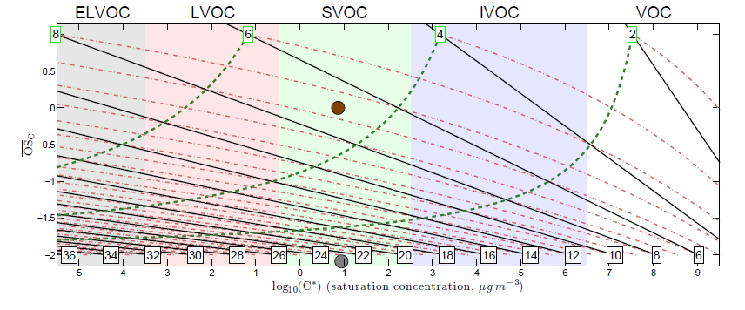
Donahue et al., AAAR, 2010

