Slide 1
Developing Survey Forms for Data Analysis of HDVs
6th PEMS Workshop
March 17-18, 2016
Kent Johnson ¹, Tom Durbin ¹, Michael Sabish², and Carl Fulper³
¹University of California, Riverside
² U.S. Environmental Protection Agency (EPA)
³ Easter Research Group (ERG)

Slide 2
Goals of This Research
Understand Inventory
Provide researchers quick access to high quality data with context of the fleet, emissions, and activity
Provide data to help make air quality decisions

Slide 3
Understanding Inventory
Vehicle measurements
  Emissions
  Activity
Fleet information
  Inventory
  Daily usage
  Vocation
  DMV databases

Slide 4
What Surveys are Needed?
Fleet Interview
Detailed vehicle survey (photos)
Daily driver survey
Trailer survey (Aero)

Slide 5

Photo Data Logging Story

Slide 6
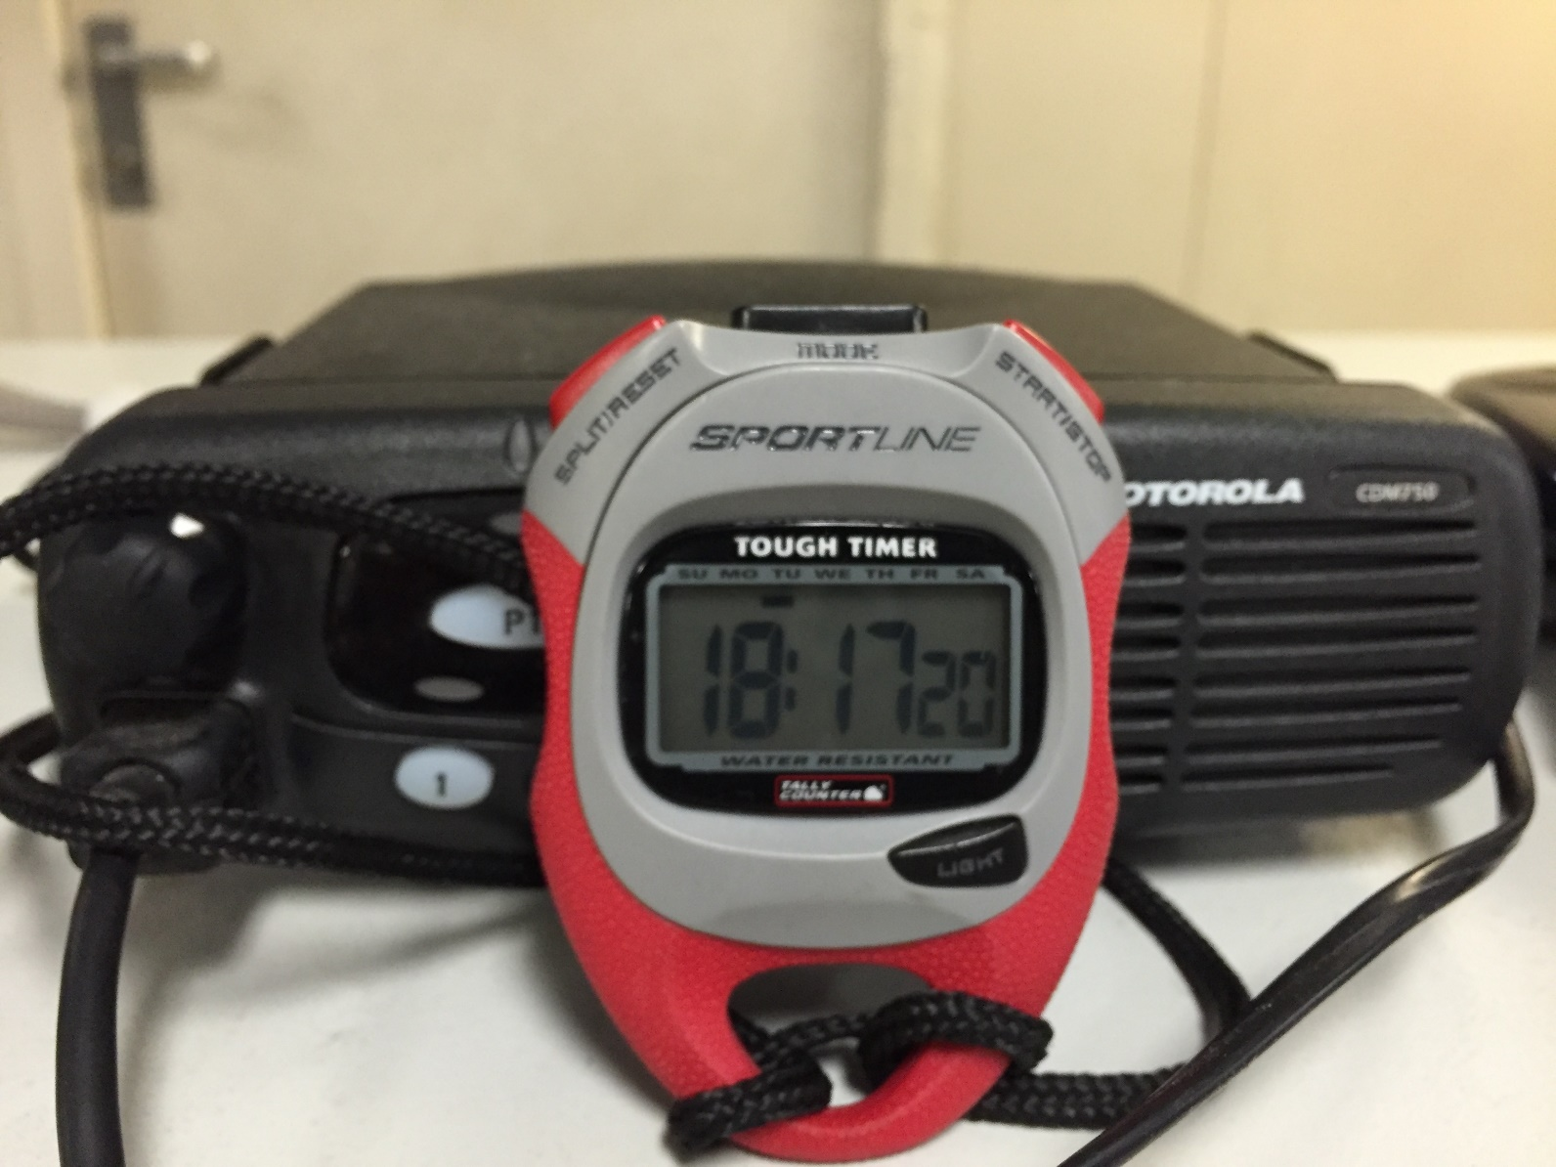
Photo Logging Story

Slide 7
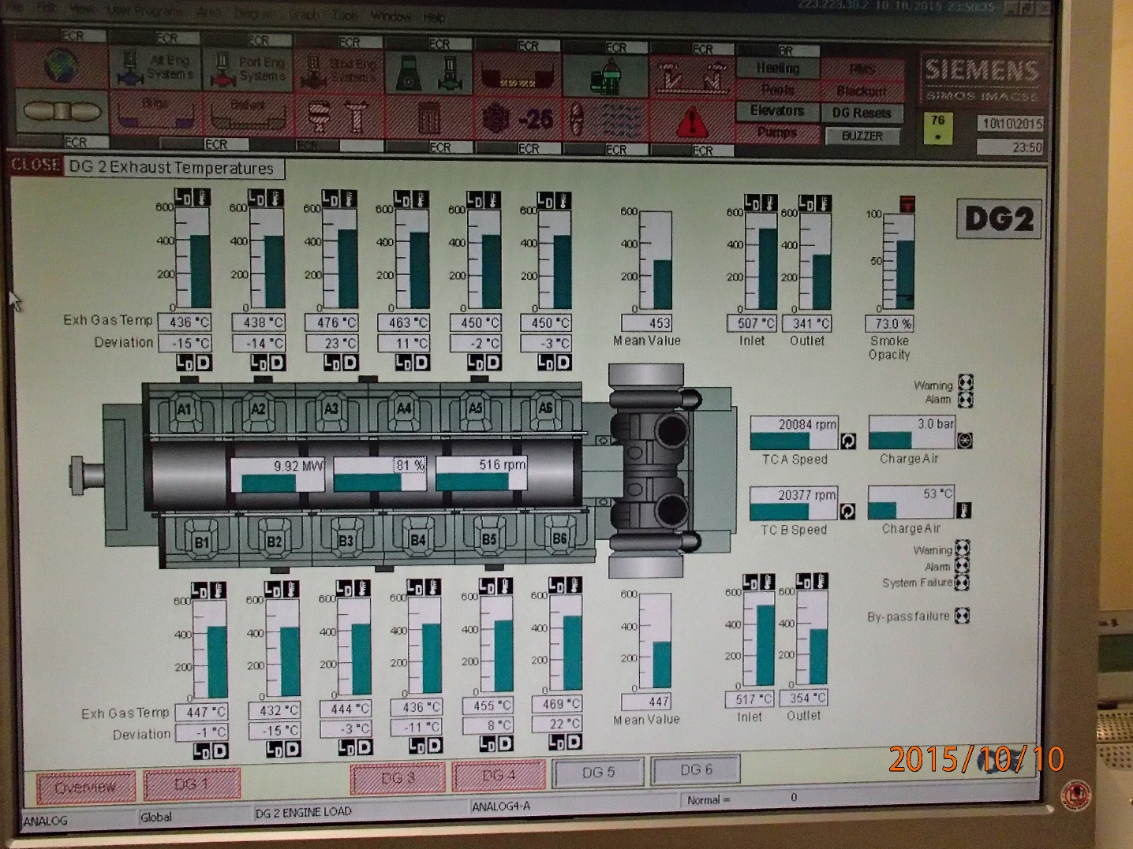
Photo Logging Story

Slide 8
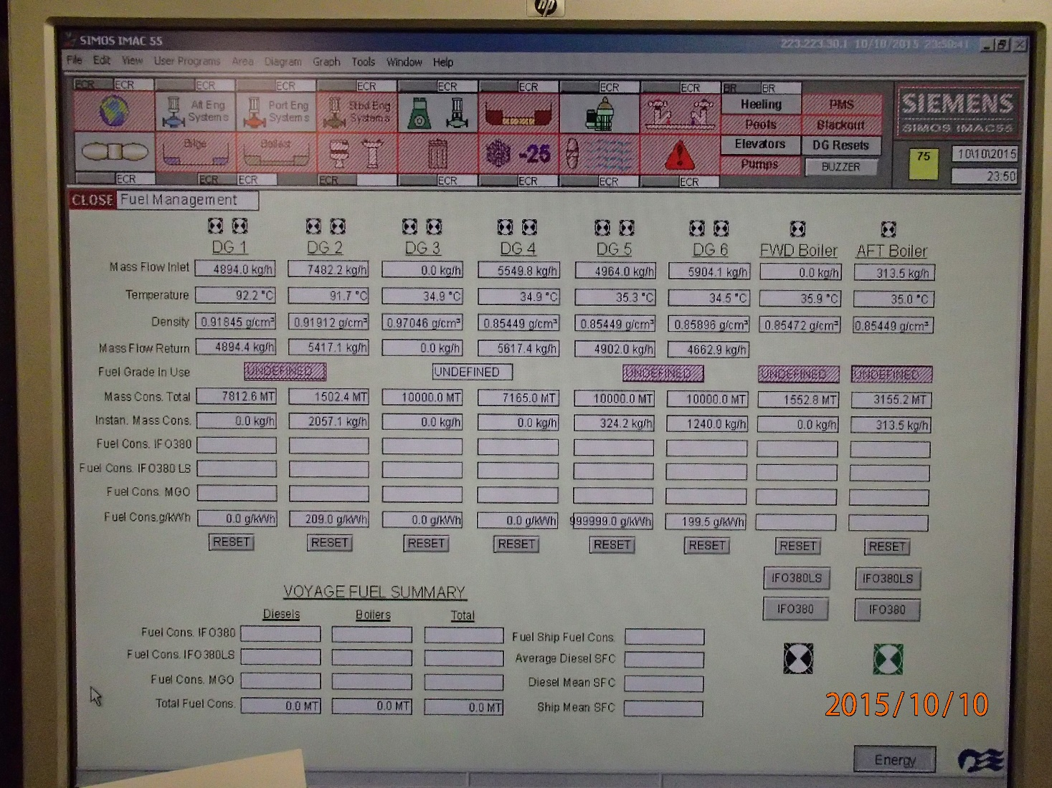
Photo Logging Story

Slide 9
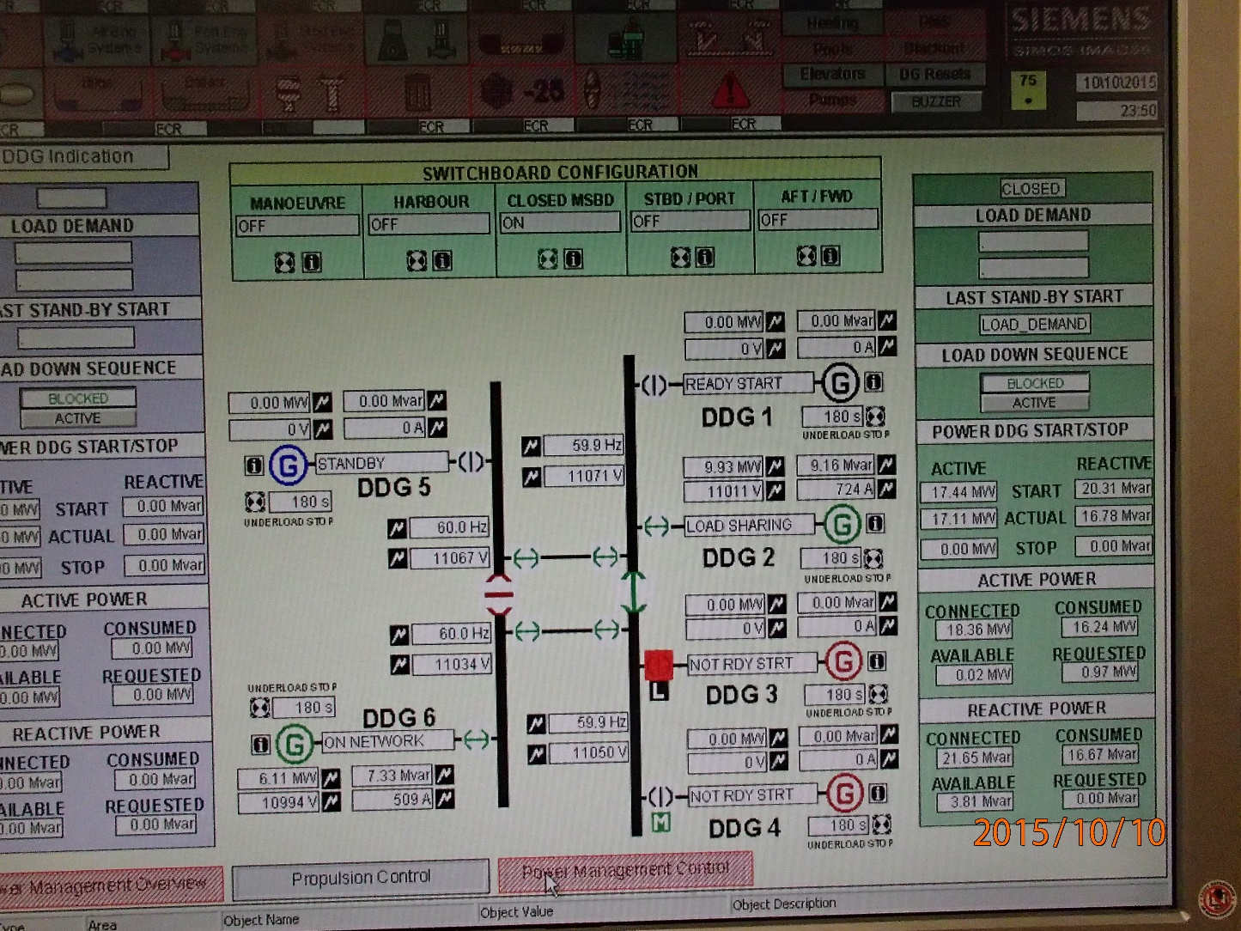
Photo Logging Story

Slide 10
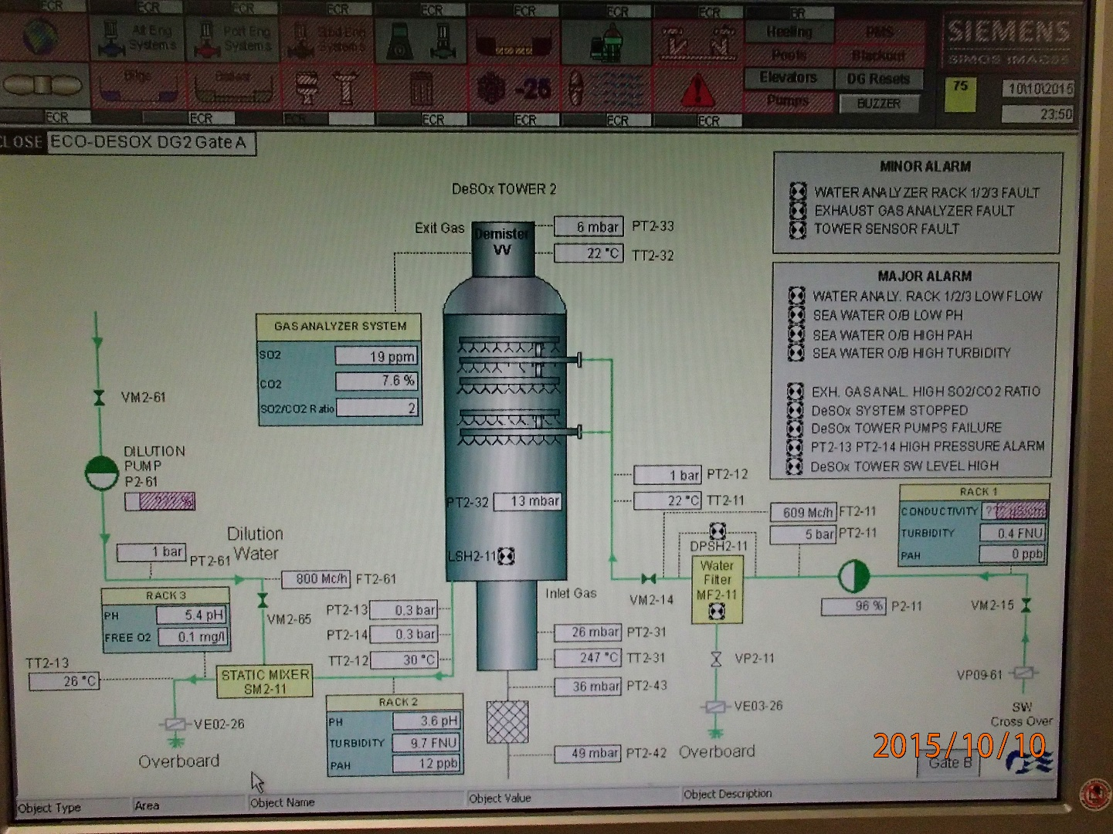
Photo Logging Story

Slide 11
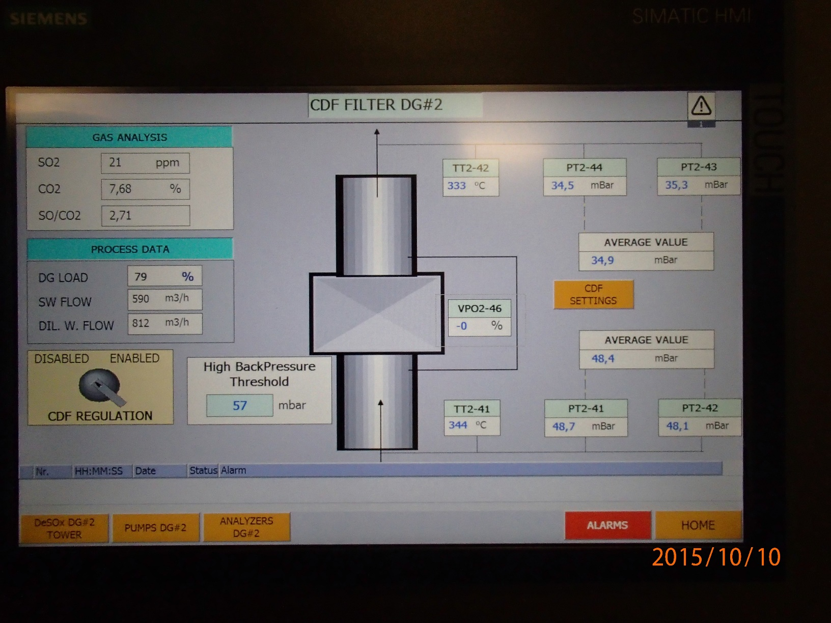
Photo Logging Story

Slide 12
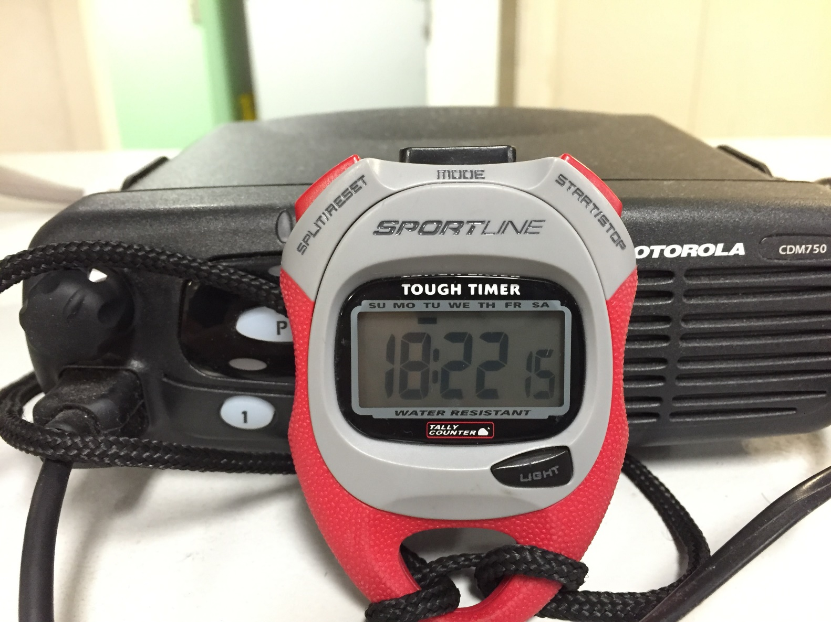
Photo Logging Story

Slide 13
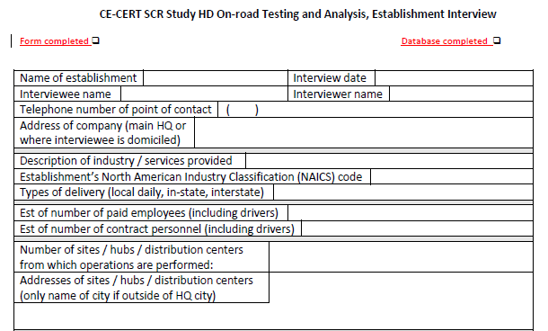
Fleet Interview Form: 1 of 4

Slide 14
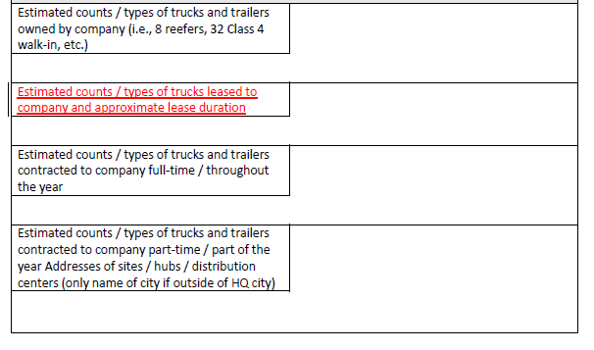
Fleet Interview Form: 2 of 4

Slide 15
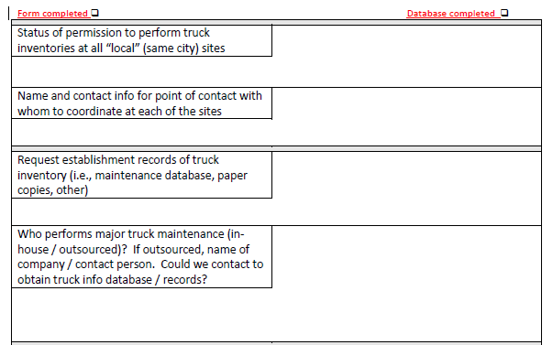
Fleet Interview Form: 3 of 4

Slide 16
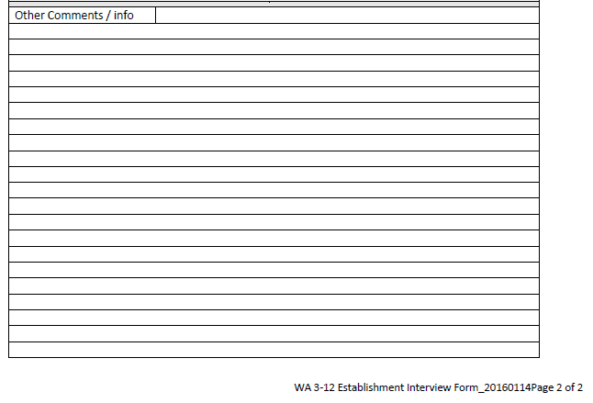
Fleet Interview Form: 4 of 4

Slide 17
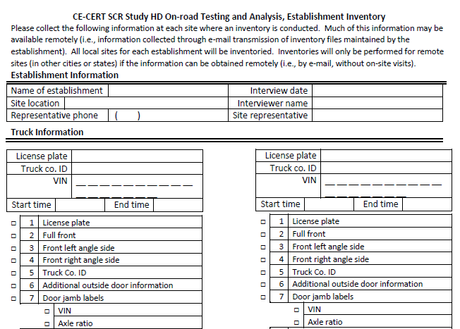
Detailed Photo Survey : 1 of 4

Slide 18
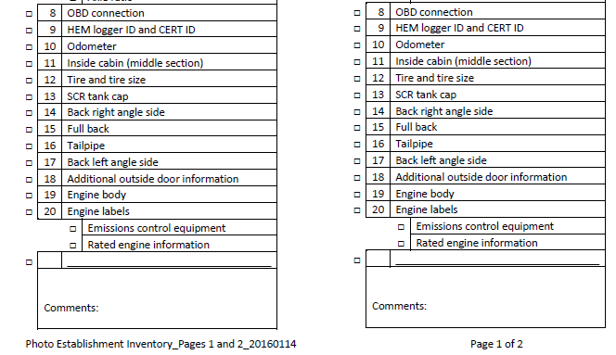
Detailed Photo Survey: 2 of 4

Slide 19
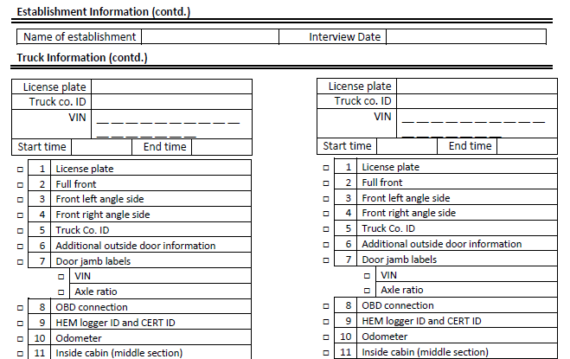
Detailed Photo Survey : 3 of 4

Slide 20
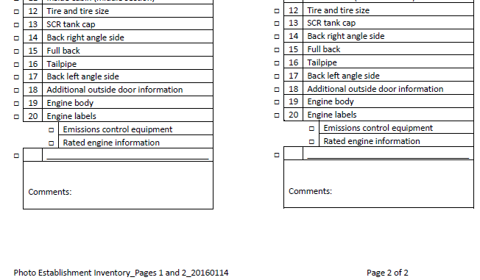
Detailed Photo Survey : 4 of 4

Slide 21
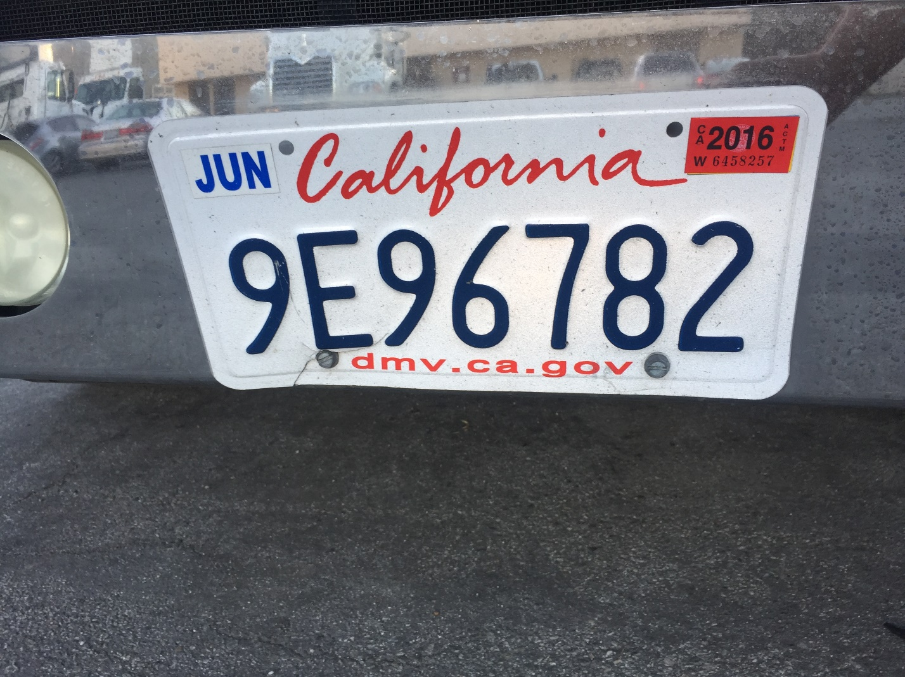
Detailed Photo Survey: Pictures

Slide 22
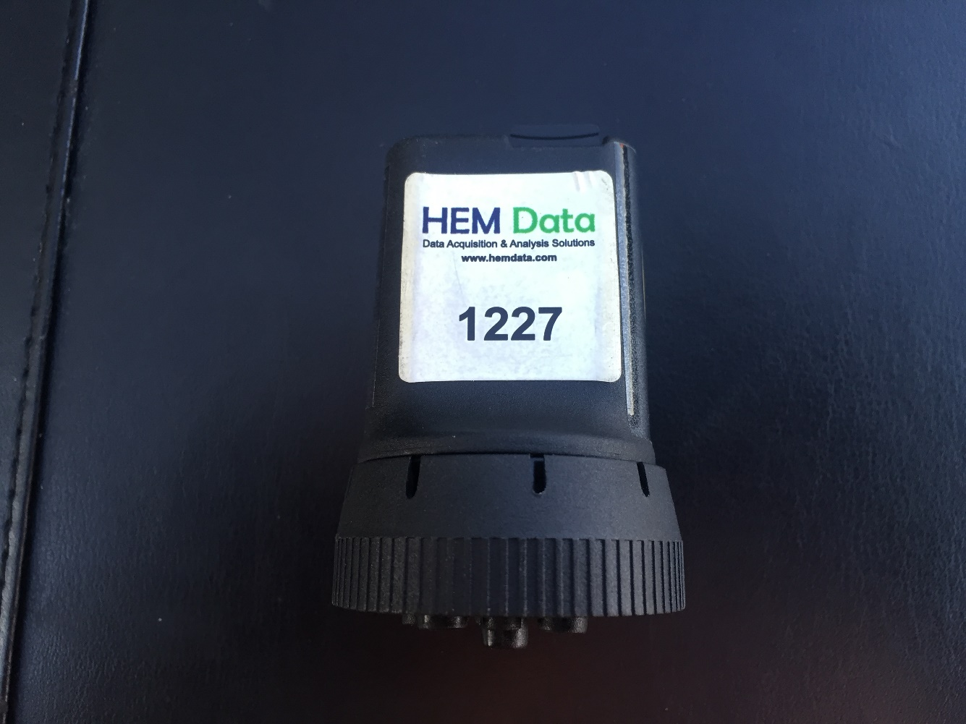
Detailed Photo Survey: Pictures

Slide 23

Detailed Photo Survey: Pictures

Slide 24
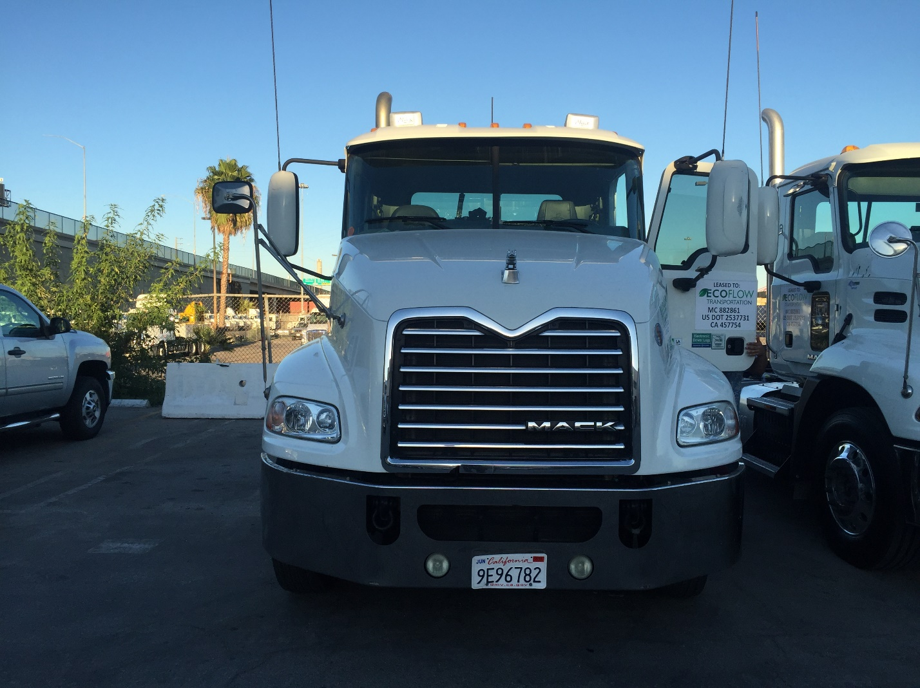
Detailed Photo Survey: Pictures

Slide 25
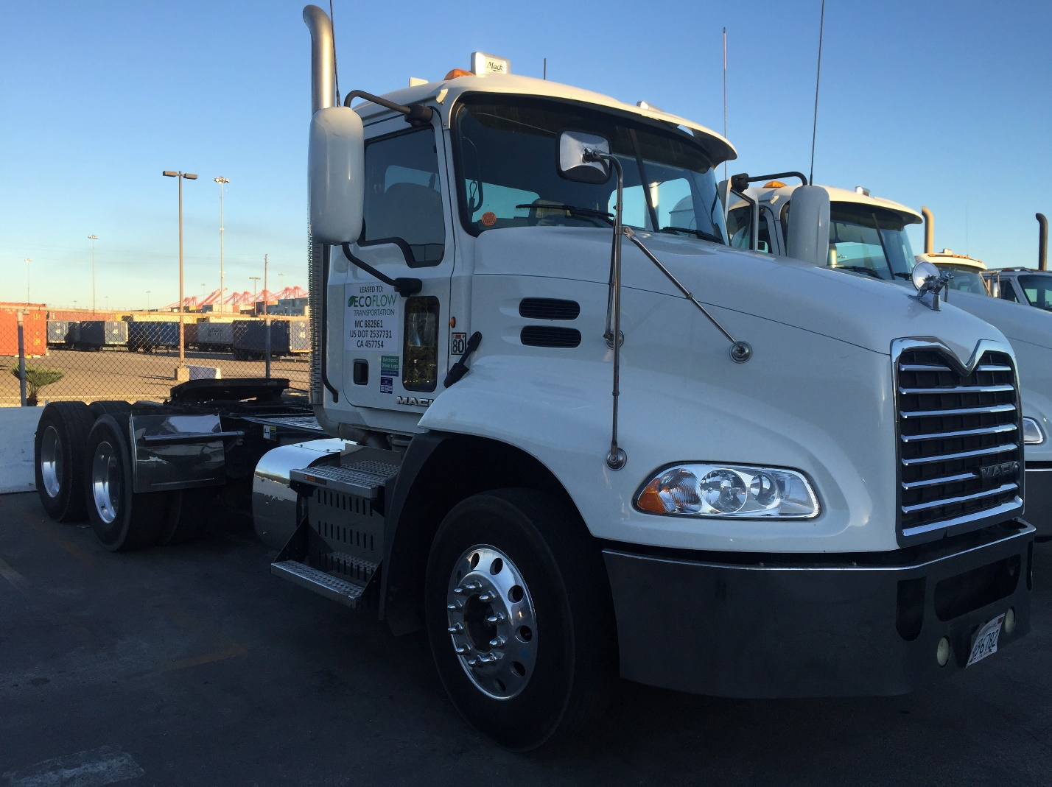
Detailed Photo Survey: Pictures

Slide 26
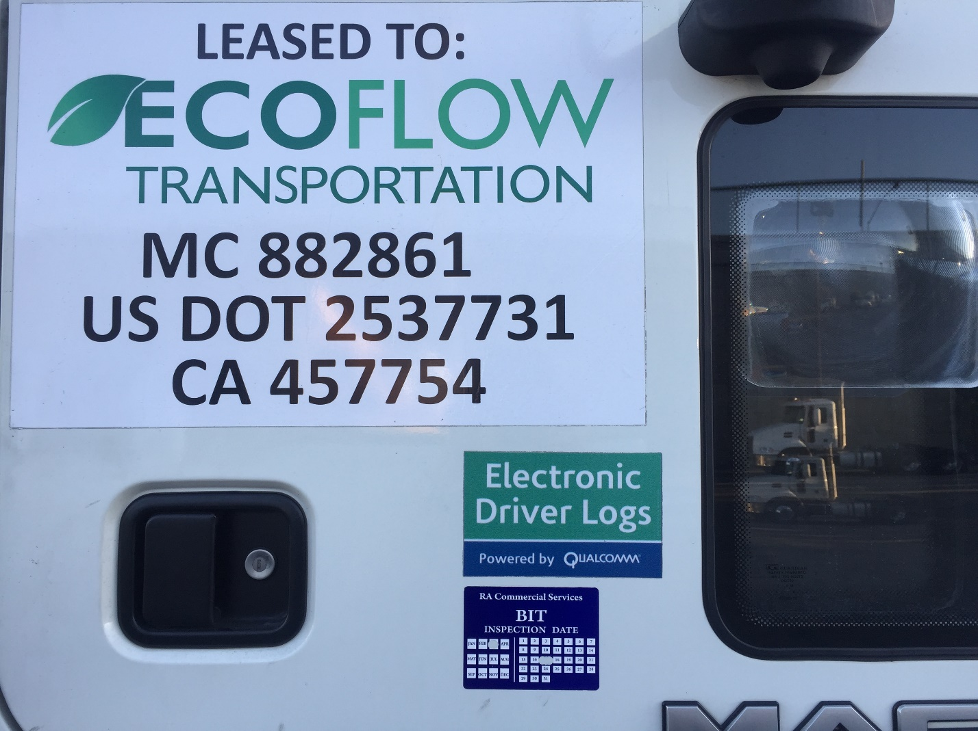
Detailed Photo Survey: Pictures

Slide 27
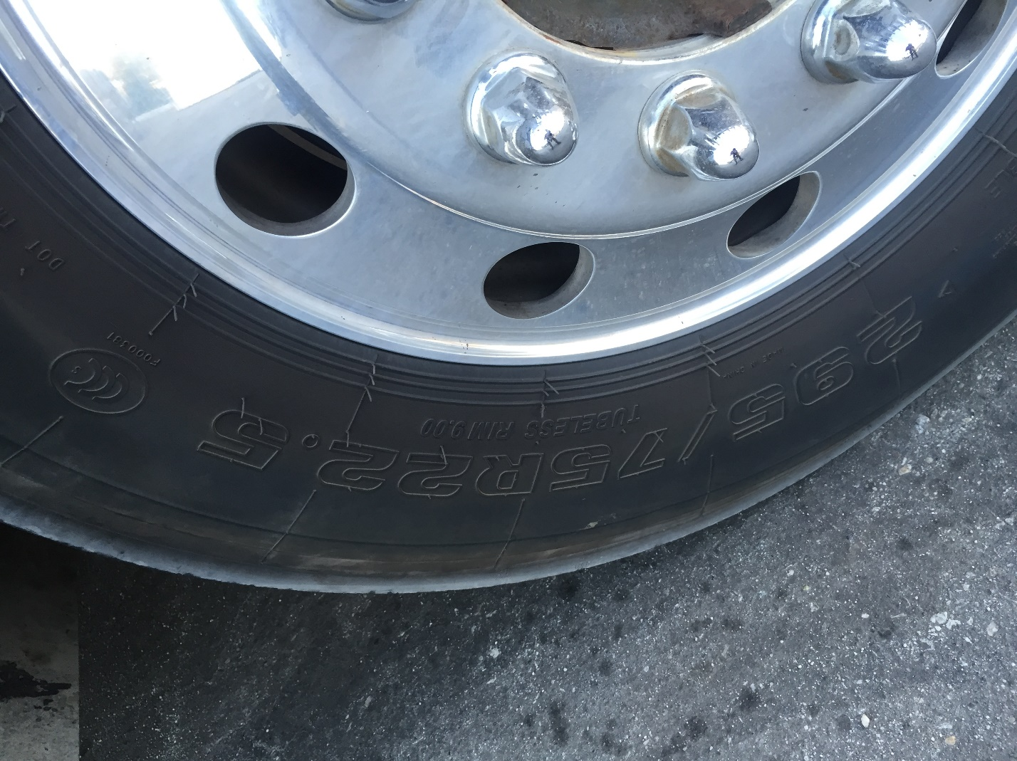
Detailed Photo Survey: Pictures

Slide 28
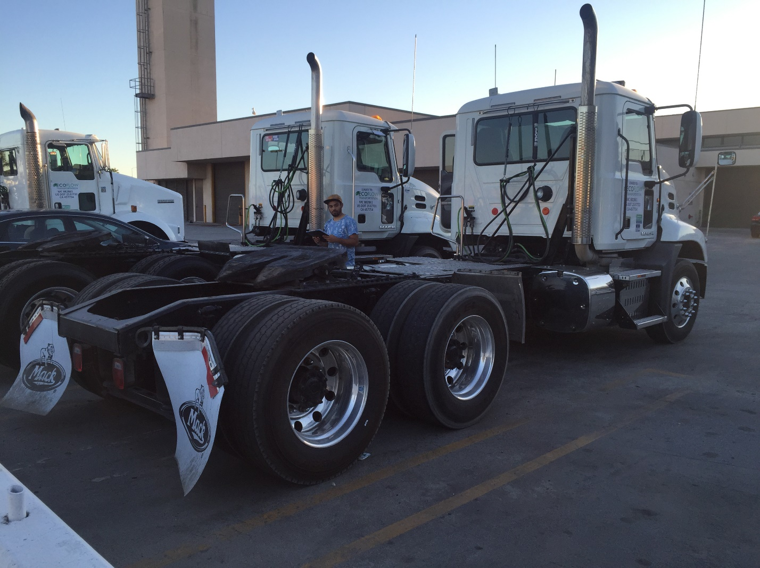
Detailed Photo Survey: Pictures

Slide 29
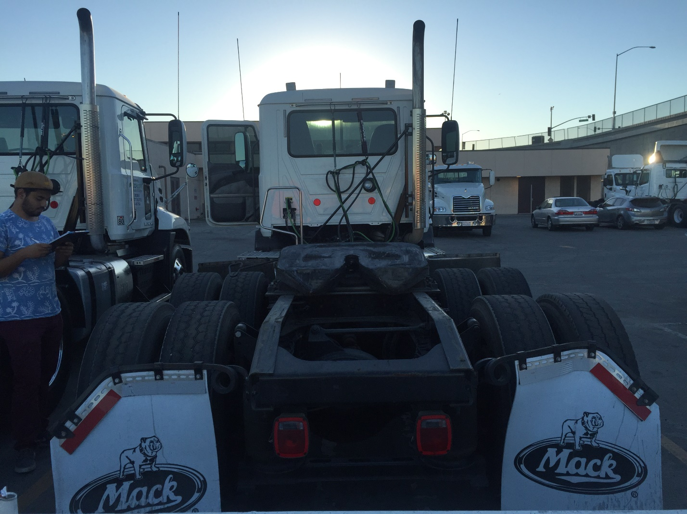
Detailed Photo Survey: Pictures

Slide 30
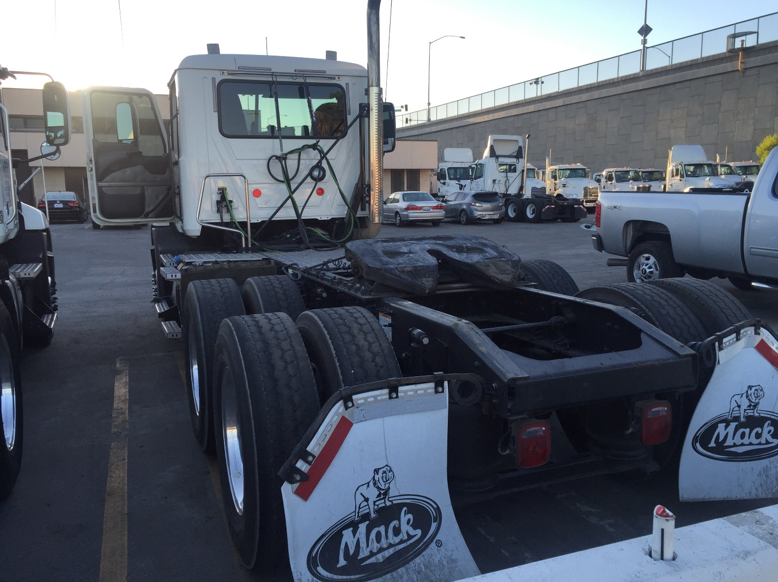
Detailed Photo Survey: Pictures

Slide 31
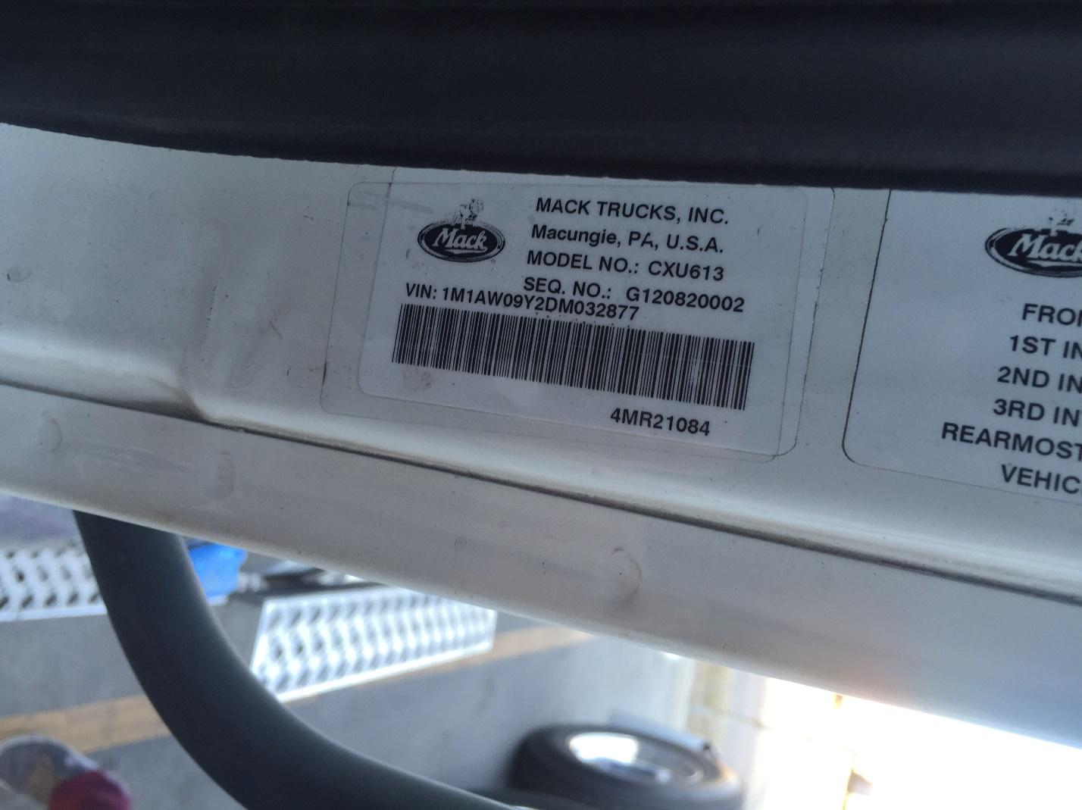
Detailed Photo Survey: Pictures

Slide 32
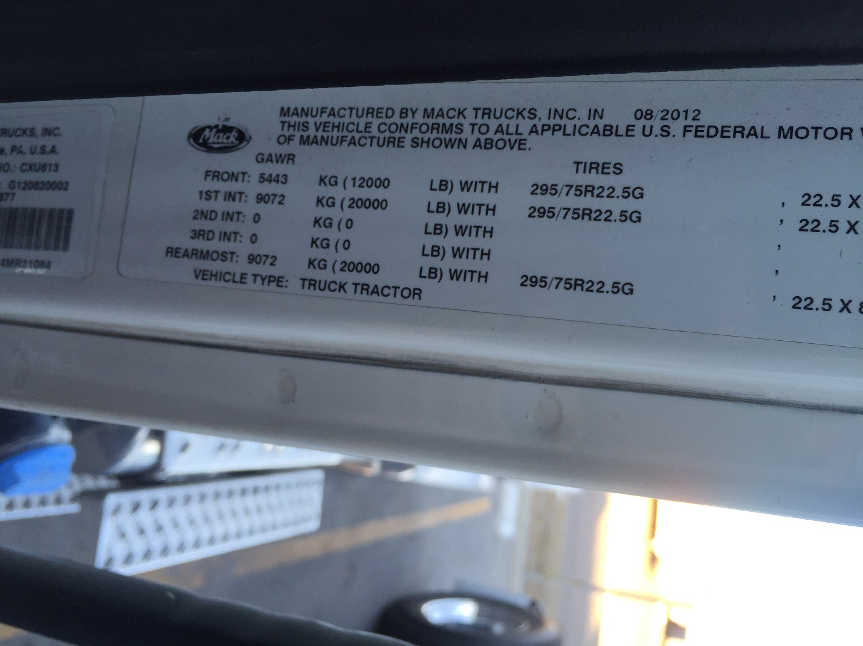
Detailed Photo Survey: Pictures

Slide 33
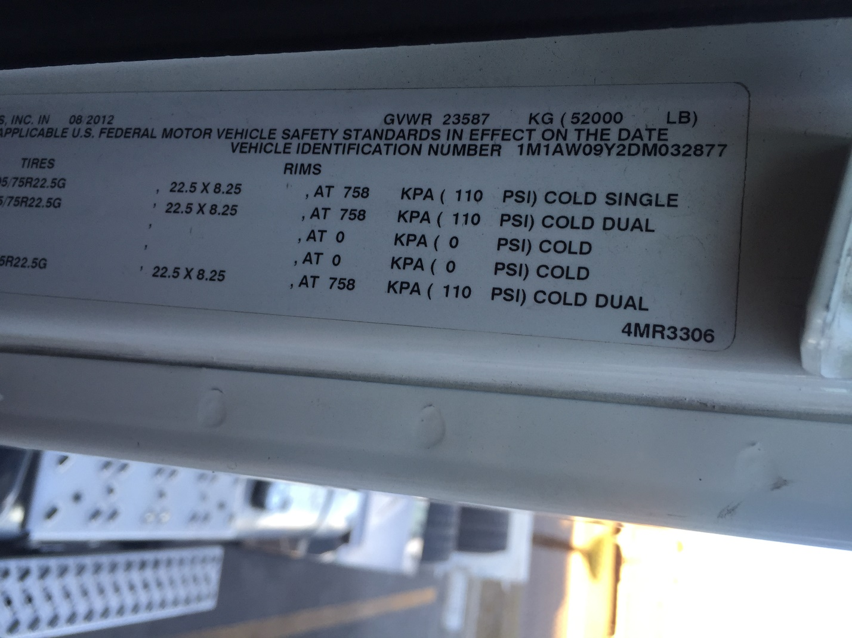
Detailed Photo Survey: Pictures

Slide 34
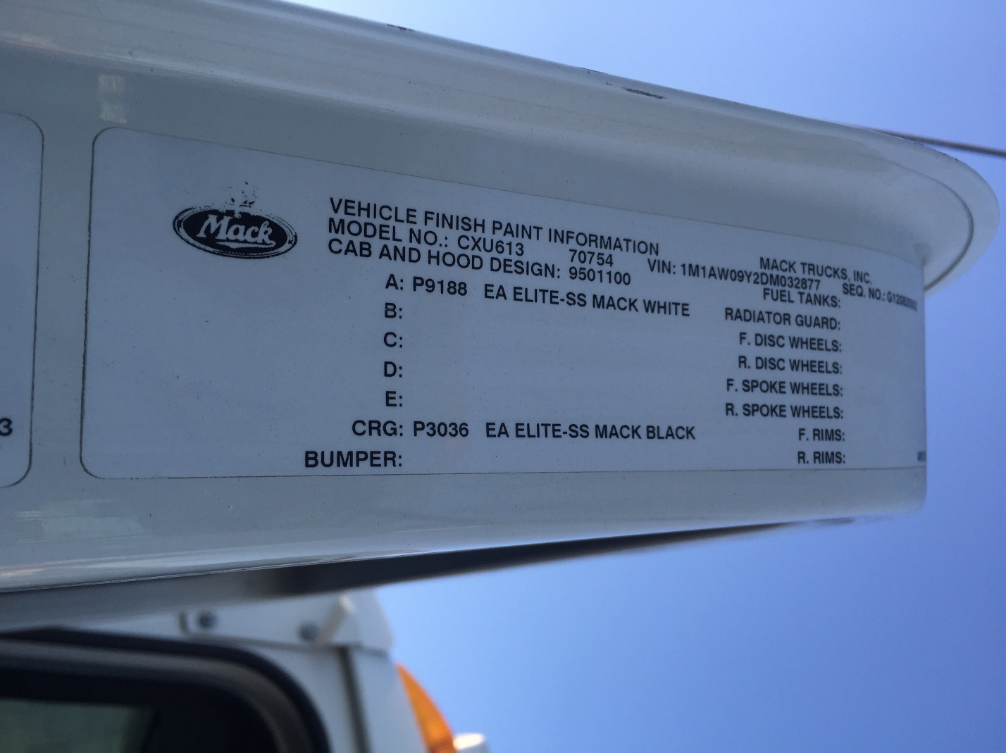
Detailed Photo Survey: Pictures

Slide 35
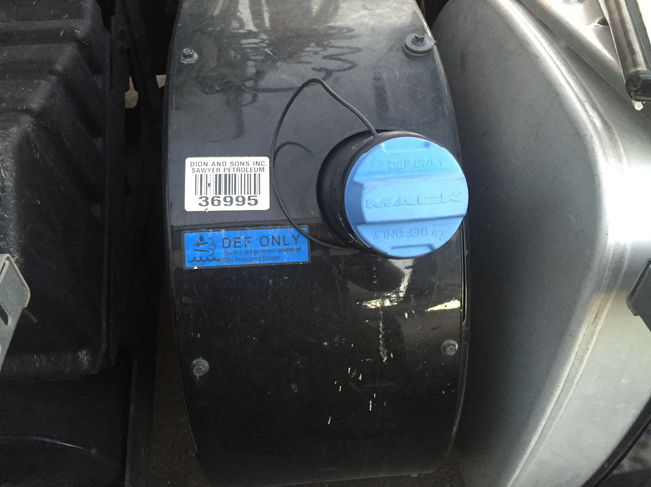
Detailed Photo Survey: Pictures

Slide 36
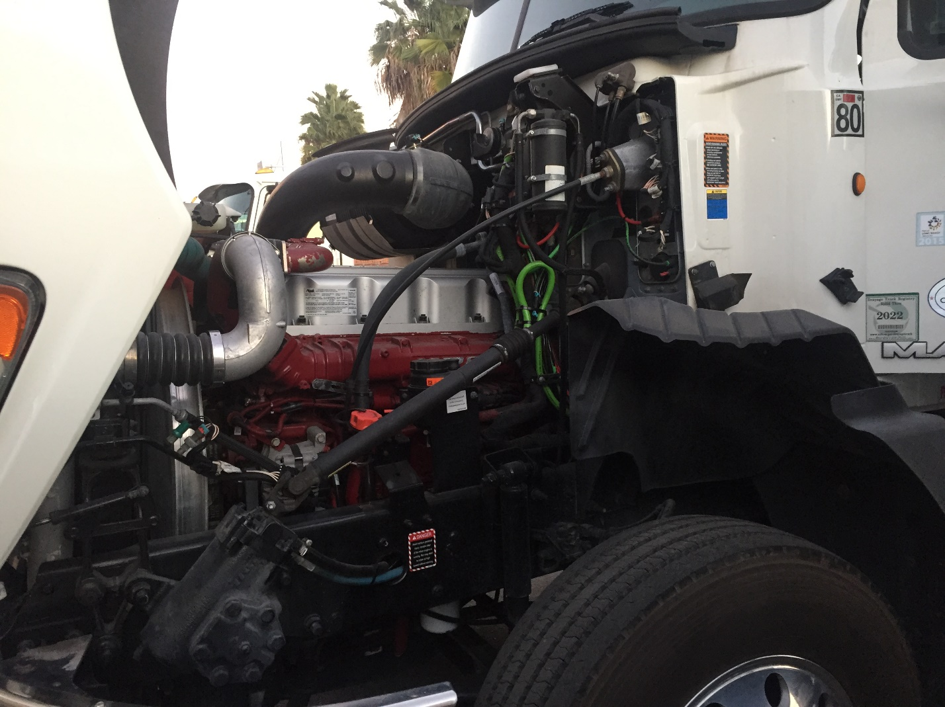
Detailed Photo Survey: Pictures

Slide 37
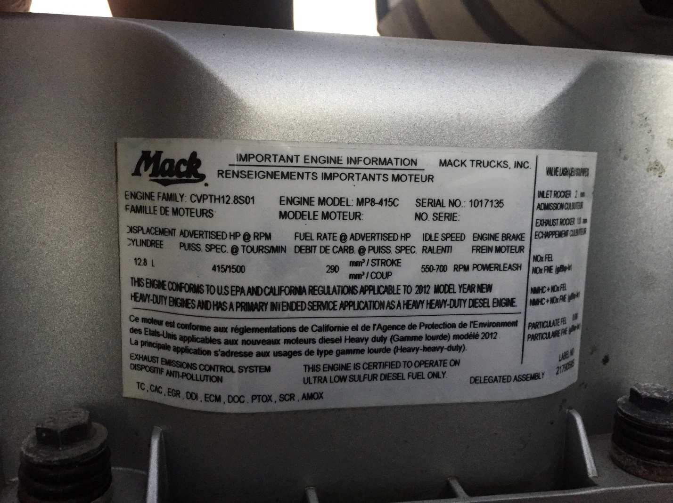
Detailed Photo Survey: Pictures

Slide 38
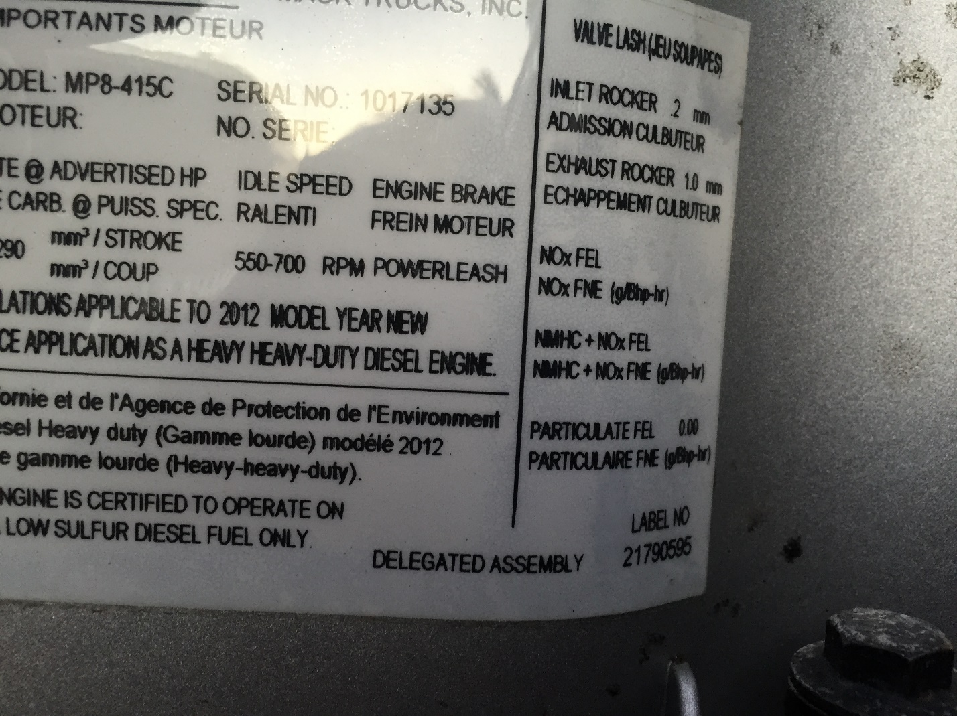
Detailed Photo Survey: Pictures

Slide 39
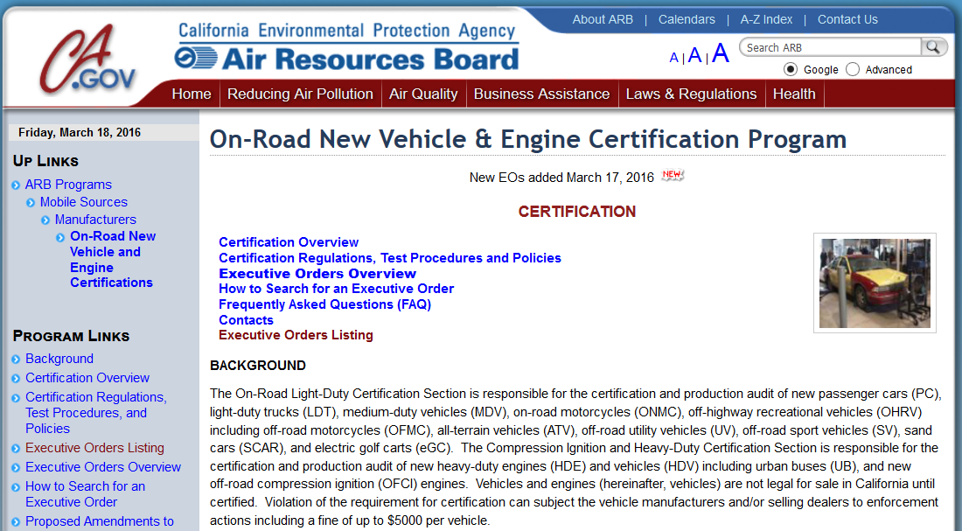
Detailed Photo Survey: Ex Orders
http://www.arb.ca.gov/msprog/onroad/cert/cert.php#6

Slide 40
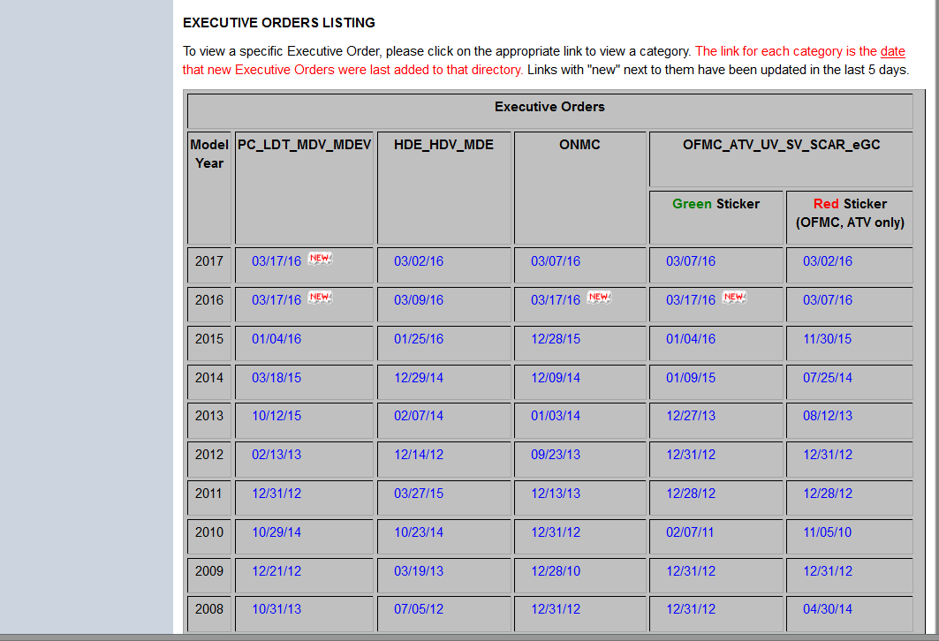
Detailed Photo Survey: Ex Orders
http://www.arb.ca.gov/msprog/onroad/cert/cert.php#6

Slide 41
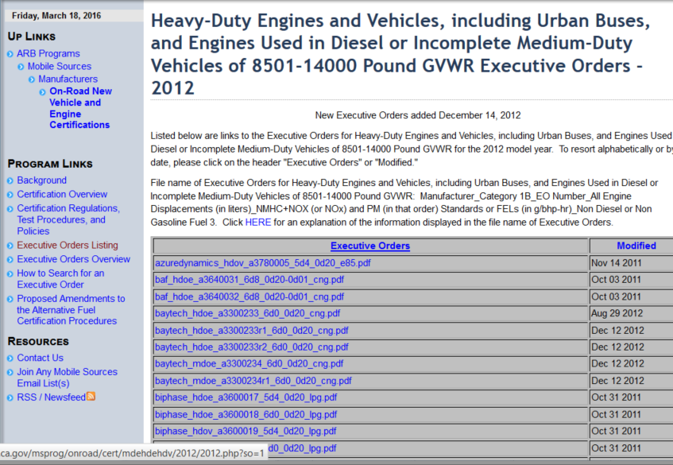
Detailed Photo Survey: Ex Orders
http://www.arb.ca.gov/msprog/onroad/cert/cert.php#6

Slide 42
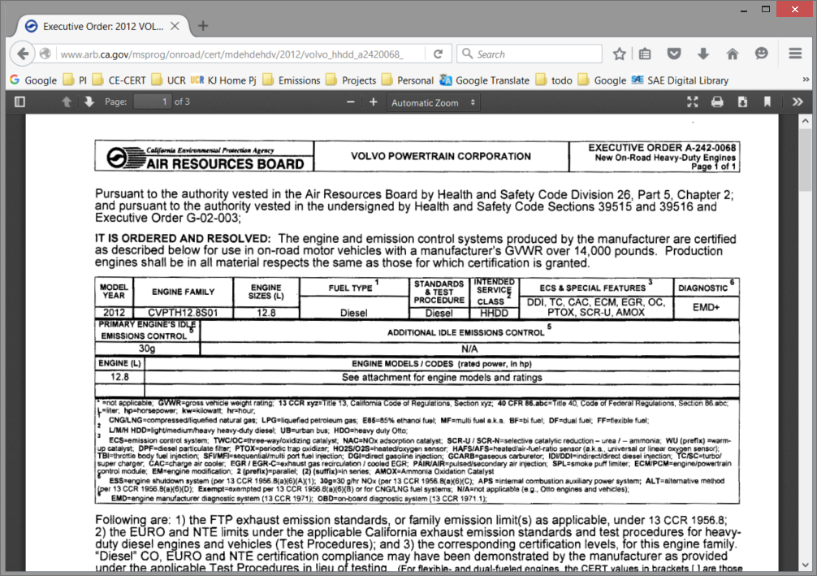
Detailed Photo Survey: Ex Orders
http://www.arb.ca.gov/msprog/onroad/cert/cert.php#6

Slide 43
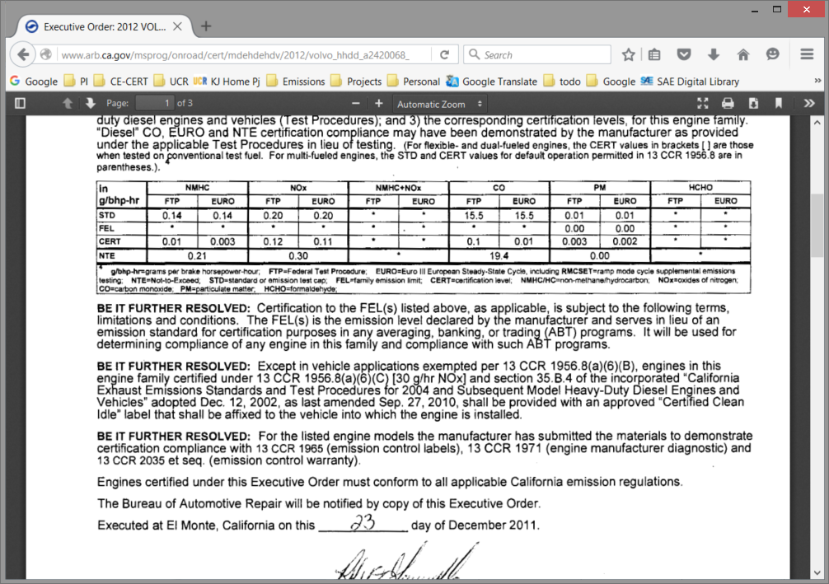
Detailed Photo Survey: Ex Orders

Slide 44
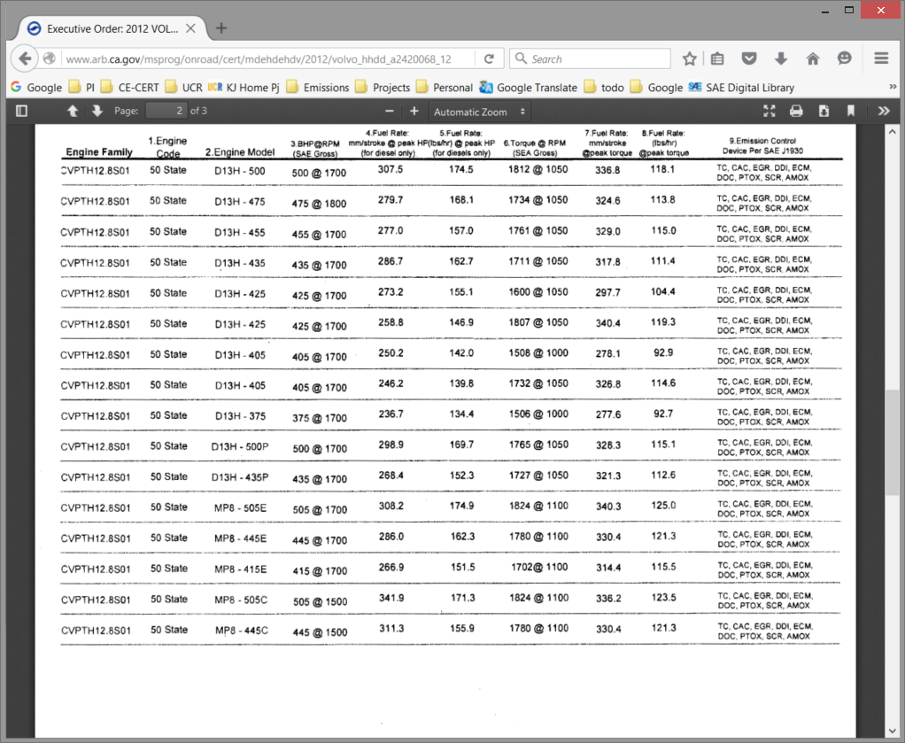
Detailed Photo Survey: Ex Orders
http://www.arb.ca.gov/msprog/onroad/cert/cert.php#6

Slide 45
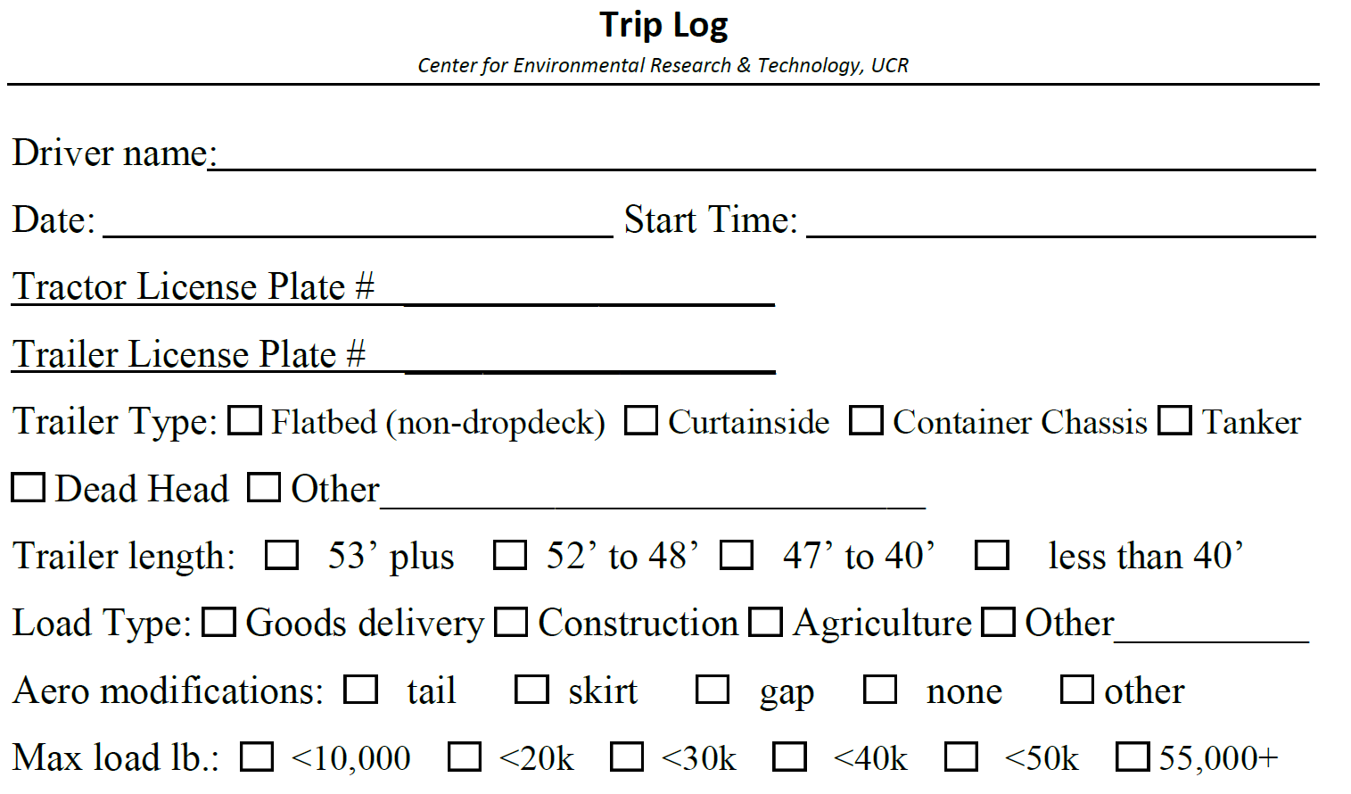
Daily Trip Log HDVs

Slide 46
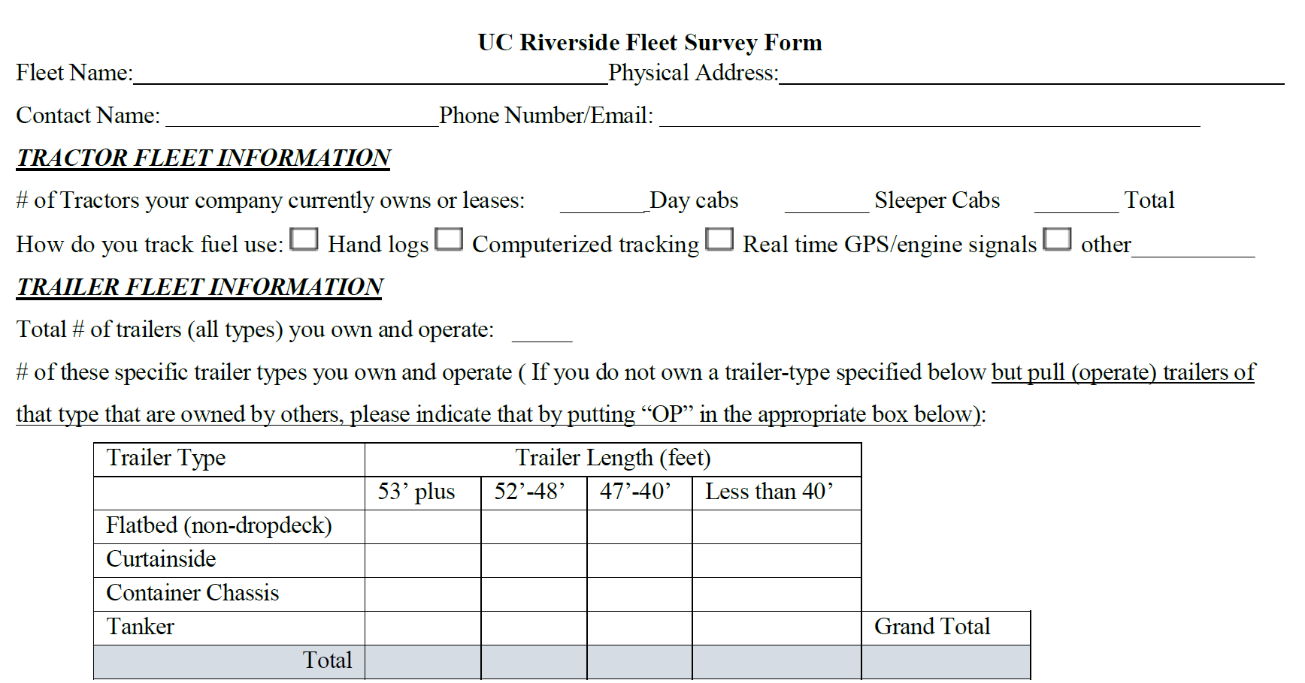
Trailer Survey Form: 1 of 2

Slide 47
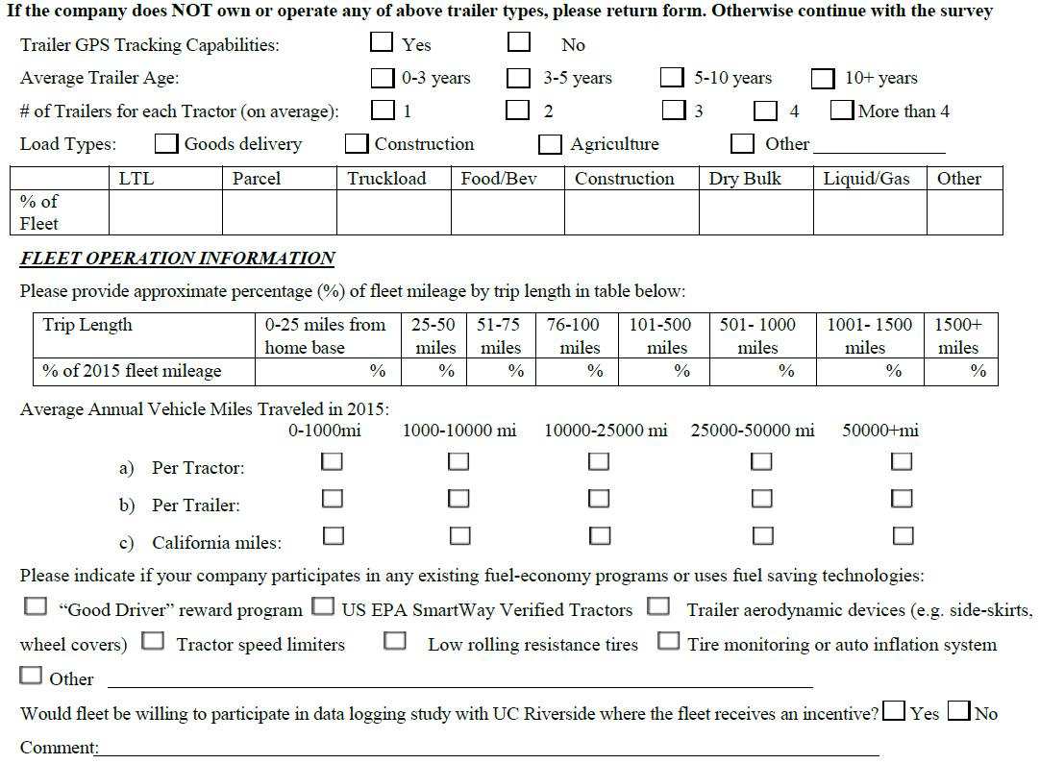
Trailer Survey Form: 2 of 2

