Slide 1


Real-World Black Carbon, Particle Number Concentration and Nitrogen Oxide Vehicle Emission Factors:
On-Road Chasing Campaign Results
I. Ježek¹, L. Drinovec^{1,2}, S. Oprešnik Rodman³, L. Ferrero⁴, M. Carriero⁵, D. Westerdahl⁶, T. Katrašnik³, G. Močnik^{1,2}
¹ Aerosol d.o.o., Ljubljana, Slovenia
² Jožef Stefan Institut, Ljubljana, Slovenia
³ University of Ljubljana, Faculty of Mechanical Engineering, Ljubljana, Slovenia
⁴ University of Milano Bicocca, Milano, Italy
⁵ Joint Research Centre, Ispra, Italy
⁶ Cornell University, Ithaca, NY 14853, USA
Contact:
irena.jezek@aerosol.eu

Slide 2
Outline
On-road chasing method tests:
Influence of dilution on EF calculation
Influence of vehicle performance on the EF distribution
On-road chasing measurement campaign
first on-road chasing measurements of cars
sampled vs. European fleet statistic
influence of vehicle age on EFs
contribution of super emitters to fleet emissions

Slide 3
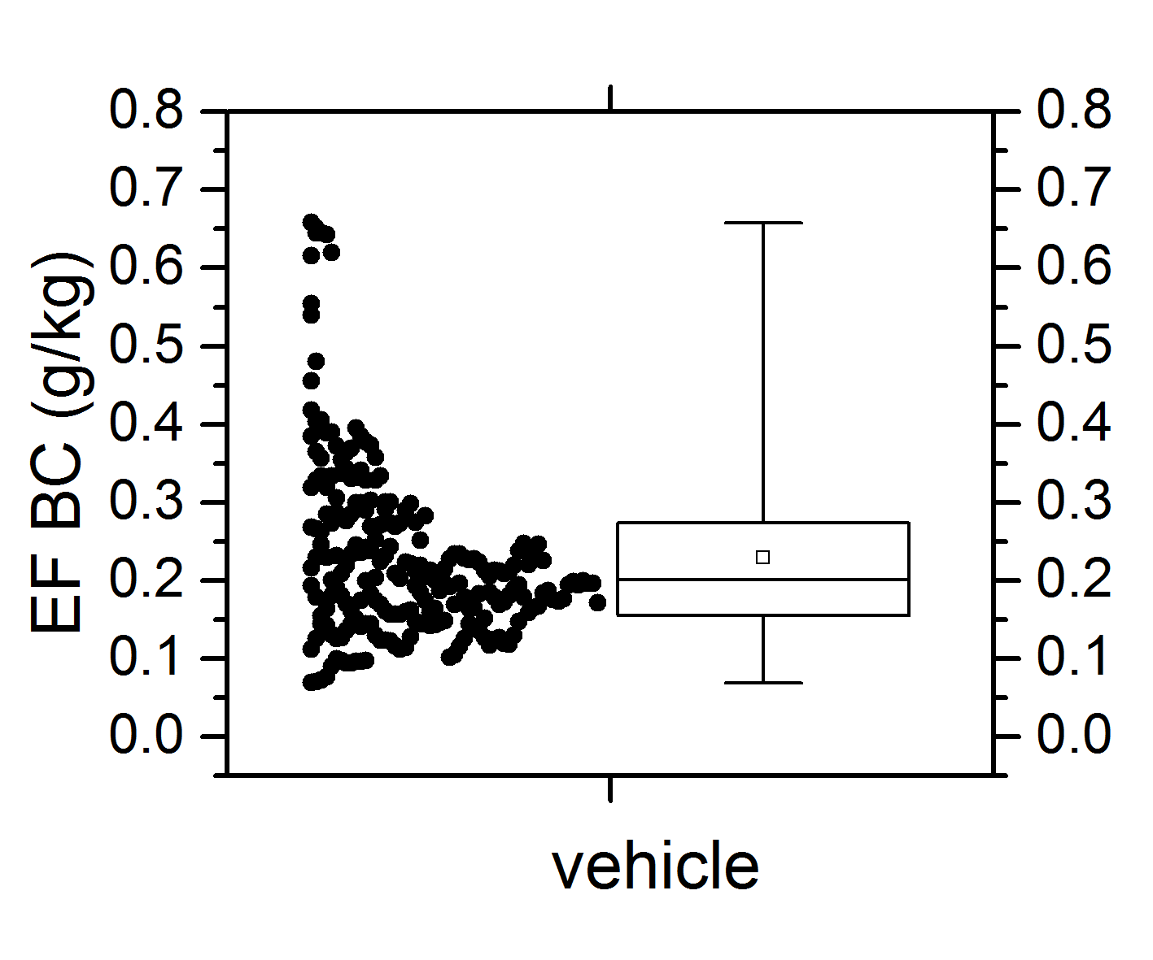
Emission factor (EF) determination
w_{c} – carbon fraction in fuel
EF distribution for a single chasing event
Ježek et al., AMT, 2015

Slide 4
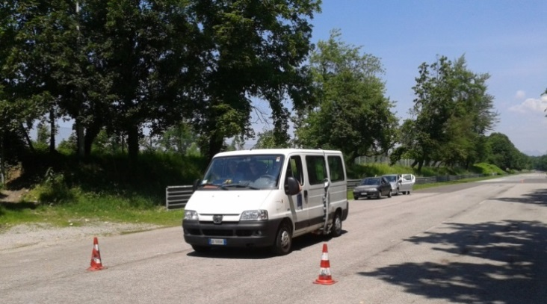
On-road emission factor measurement tests
    Chasing a vehicle equipped with Portable Emissions Measurement System (PEMS)
    Influence of dilution
    Relate vehicle performance to measured BC EF
Instruments:
Mobile platform:
Aethalometer AE33 (BC), Carbocap (CO₂)
Euro 3 van with PEMS:
  CO₂, exhaust mass flowrate, engine rotational frequency, vehicle speed and position, outside air temperature
The van equipped with PEMS on the old part of the Monza F1 race track (Italy)

Slide 5
    Results: Influence of dilution on EF
Ježek et al., AMT, 2015

Slide 6
  EF distribution and vehicle‘s performance
- max
- 99th
- 90th
- 75th
- 50th
- 25th
- 10th
- min
/Percentile\
Torque (M) - engine‘s ability to work (Heywood , 1988)
n – crankshaft rotational frequency
In p^{th} percentile p% of the sample values are less than the p^{th} percentile and (100 − p)% are greater

Slide 7
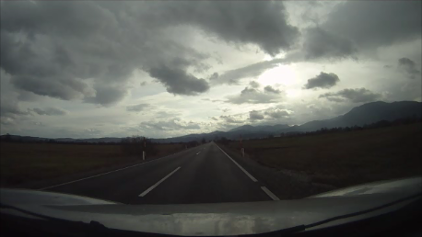
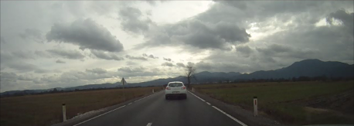
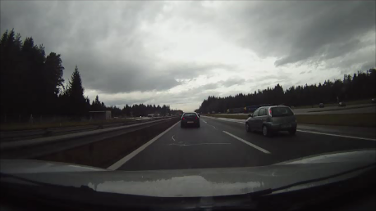
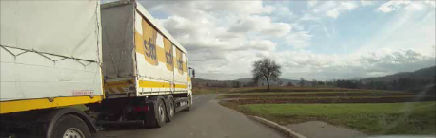
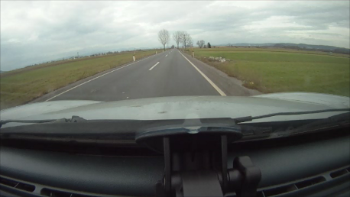
On-road EF measurement campaign
We measured CO₂, BC, PN and NO_{x} concentrations.
We obtained registry information on vehicles (fuel, age, category, weight, engine displacement …)
  Comparison of sampled fleet statistic to Eurostat data
The total of 139 vehicles measured
and distributed to three vehicle categories :
68 cars with compression ignition engine - diesel cars;
24 cars with spark ignition engine - gasoline cars;
47 goods vehicles (included light goods vehicles N2, busses M2 and M3, and heavy goods vehicles N3)

Slide 8
Representativeness of car fleet
 |  | 10 years or over | From 5 to 10 years | From 5 to 2 years | Less than 2 years
Europe | Total | 42% | 28% | 19% | 11%
Slovenia | Total | 39% | 34% | 18% | 9%
 | Gasoline | 50% | 25% | 15% | 9%
 | Diesel | 18% | 48% | 23% | 11%
This study | Total | 27% | 47% | 29% | 7%
 | Gasoline | 50% | 25% | 17% | 8%
 | Diesel | 16% | 49% | 29% | 6%
 | % of diesel cars
Europe | 34
Slovenia | 36
This study | 68
Ježek et al., ACP, 2015

Slide 9
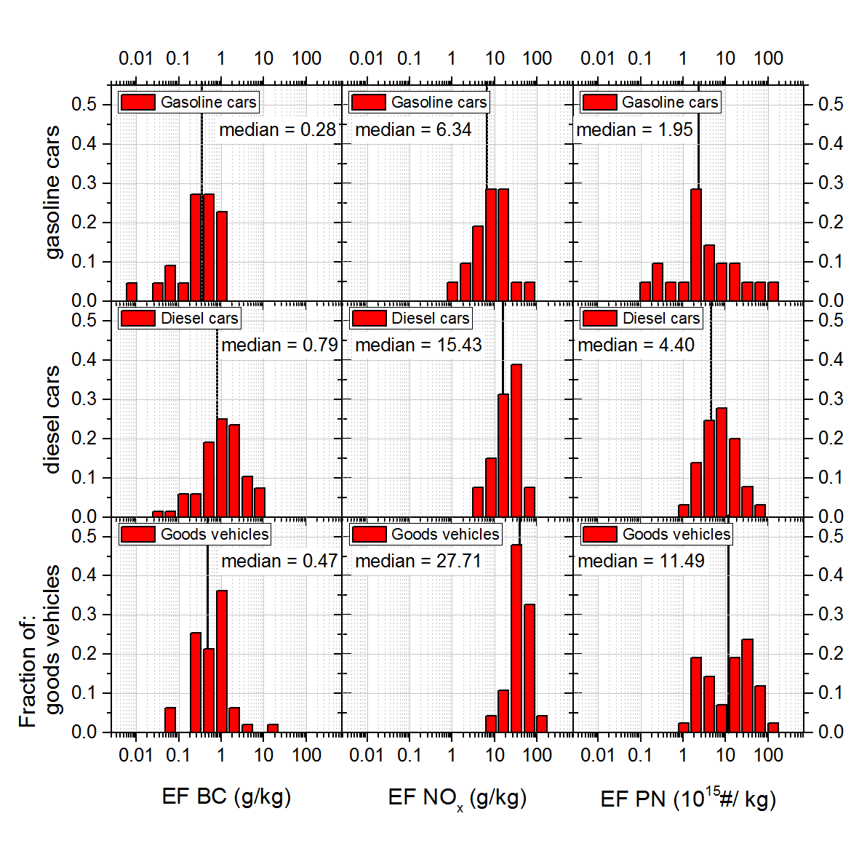
Results:
EURO3
EURO3
EURO4
EURO4
EURO5
EURO5
First on-road BC EFs for diesel cars
Ježek et al., ACP, 2015

Slide 10
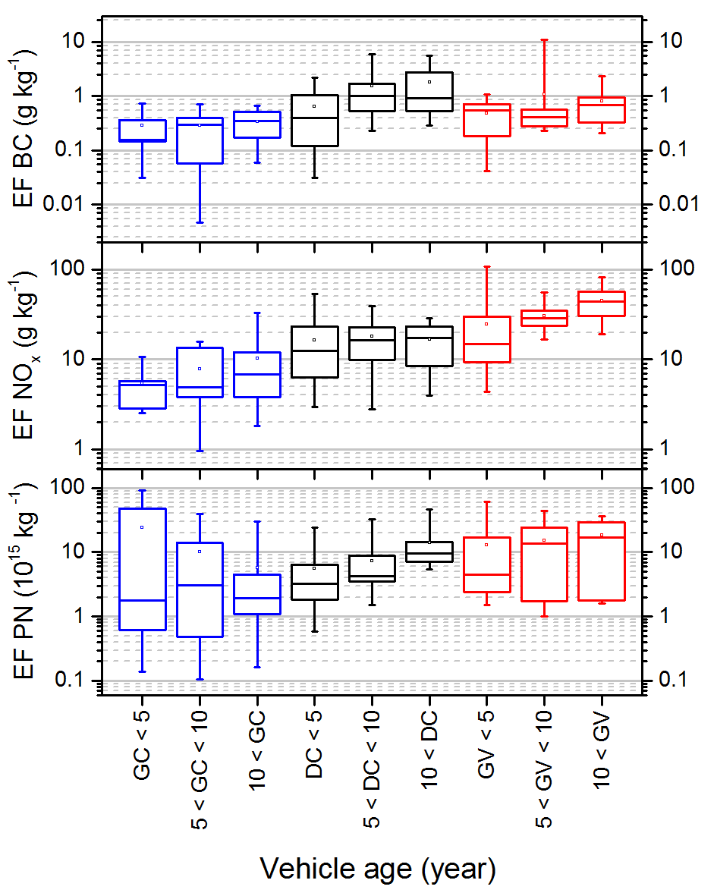
Effect of vehicle age
Less than 5 years ≈ Euro 4 and 5
Between 5 and 10 ≈ Euro 3
10 and more ≈ Euro 2 or less
The median BC EF of diesel cars that were in use for less than 5 years was reduced by a 60% compared to those in use for 5 – 10 years.
No decrease in median BC EF of the goods vehicles.
PN and NO_{x} EF of goods vehicles were reduced by 52% and 67%, respectively.
Ježek et al., ACP, 2015

Slide 11
Comparing our results to other on-road studies
Ježek et al., ACP, 2015
Study | Study type | Vehicle type | EF BC (g kg⁻¹) | EF NO_{X} (g kg⁻¹)
Shorter et al., 2005 | Chasing ª | Diesel buses |  | 34.5 (8.1 – 117.1)
 |  | CRT |  | 27.8 (±6.3)
Wang et al.,2012 | Chasing ^{b} | HGV Beijing | 0.4 (0.2-0.8) | 47.3 (38.1 - 62.5)
 |  | HGV Chongqing | 1.1 (0.7-1.6) | 40.0 (31.7-48.1)
Dallmann et al., 2011 | Remote s. ^{c} | HGV (2009) | 1.07 ± 0.18 | 25.9 ± 1.8
 |  | HGV (2010) | 0.49 ± 0.08 | 15.4 ± 0.9
Dallmann et al., 2013 | Remote s. ^{c} | HGV | 0.62 ± 0.17
Carslaw and Rhys-Tyler, 2013 | Remote s. ^{d} | Gasoline cars |  | 5.34 (1.15 - 26.83)
 |  | Diesel cars |  | 16.37 (14.82 – 20.65)
 |  | Van |  | 18.1 (16.87 – 23.59)
 |  | HGV (all) |  | 37.88 (35.13 – 48.37)
This study | Chasing ^{b} | Gasoline cars | 0.35 (0.005–1.52) | 6.74 (3.3 – 13.16)
 |  | Diesel cars | 0.92 (0.03–5.87) | 15.47 (9.15 – 23.28)
 |  | LGV | 0.56 (0.05–5.24) | 20.25 (11.84 – 28.22)
 |  | HGV | 0.45 (0.04–11.01) | 29.6 (23.18 – 48.67)
ª mean and range in parenthesis; ^{b} median (1st and 3rd quartile); ^{c} mean ± 95% confidence interval; ^{d} emission ratios from Carslaw and Rhys-Tyler paper were converted to EFs using the same molecular weights and carbon fraction as in formula 1; presented are average values for all Euro standards in a group, in parenthesis are the smallest and largest mean value of emission standards.

Slide 12
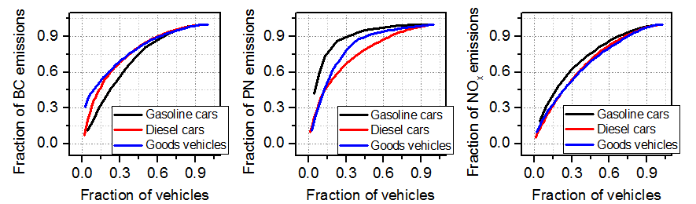
„Super emitters“ contributions to total fleet emissions
Contribution of super emitters: 25% of vehicles was found to disproportionately contribute to the total fleet emissions 47% to 87%.
25% of emitting diesel cars contributed:
63% of BC, 61% of PN and 47% of NO_{x} emissions
Ježek et al., ACP, 2015

Slide 13

Conclusions
The first tests of the on-road chasing method.
First reported BC EF for individual diesel cars measured in real driving conditions.
Good agreement with the results of previous studies.
The median BC EF of diesel cars that were in use for less than 5 years was reduced by a 60% compared to those in use for 5 – 10 years.
No decrease in median BC EF of the goods vehicles. PN and NO_{x} EF of goods vehicles were reduced by 52% and 67%, respectively.
Simple and efficient methodology for monitoring emissions of the in-use vehicle fleet
Identification of supper emitters
Thank you for your attention!
Contact:
irena.jezek@aerosol.eu
Notes:
The methodology used in this study is a relatively simple and efficient approach for monitoring emissions of the in-use vehicle fleet, and investigating the effectiveness of emission reduction measures. Real world measurements are important because individual vehicle emissions depend not only on the vehicle type approval at the time it is put on the market, but also on their maintenance and the driving conditions.

