Slide 1





Using Portable Emission Measurement System to Test Emissions of Light Duty Vehicle on Texas Highways with Different Pavement Roughness
PEMS Workshop in University of California at Riverside, March 17-18, 2016
Presenter: Fengxiang Qiao, Ph.D.
Associate Professor and Co-Director
Innovative Transportation Research Institute
Texas Southern University
Sponsored by US DOT Tier 1 UTC TranLIVE, NSF, and TxDOT

Slide 2
Table of Content
Motivation of Research
Measuring Vehicle Emissions Using PEMS
Classifying Pavement Roughness Indexes Based on Vehicle Emissions
Modeling Vehicle Emissions Considering Pavement Roughness in Work Zone

Slide 3
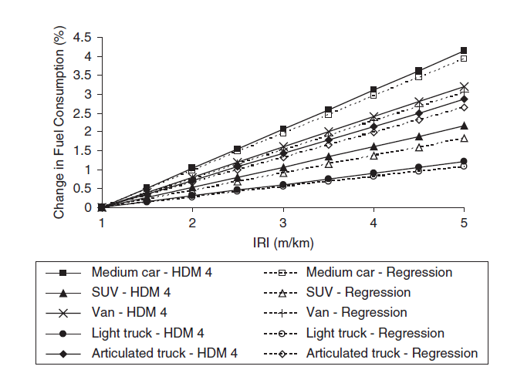
One Example: A Calibrated Model for Estimating Pavement Effect on Fuel Consumption
By Imen Zaabar and Karim Chatti

Slide 4
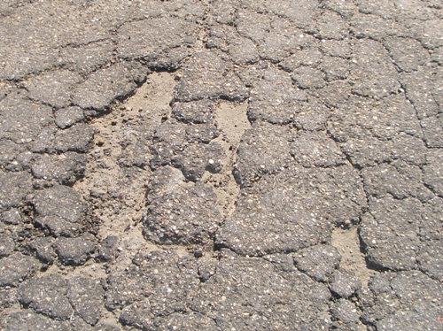
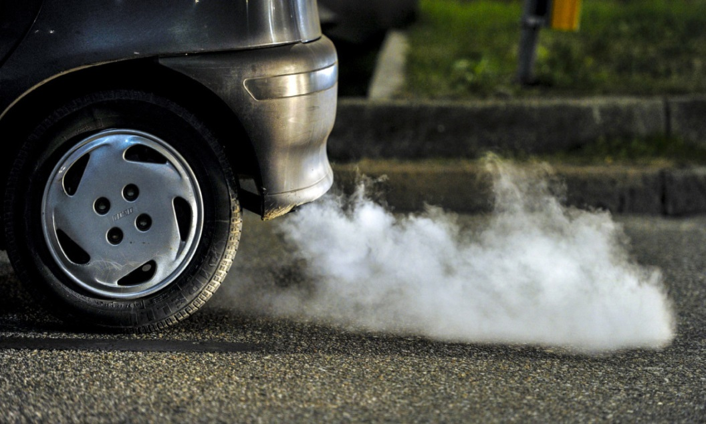
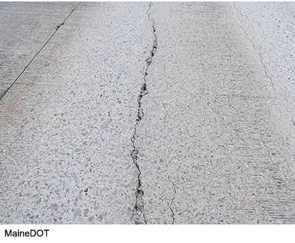
Research Questions
Will Roadway Roughness Really Affect Vehicle Emissions
What would be the Trend if such Impacts are True?

Slide 5
Methodology
Test Vehicle Emissions Using PEMS
Measure Pavement Roughness
  From a phone application, and/or
  From DOT measurement record
Cluster Roughness Based on Pavement Roughness
Model the Nonlinear Relationships between “Roughness + other Independent Variables” and Vehicle Emissions in Work Zone
  With serious changes of pavement roughness

Slide 6
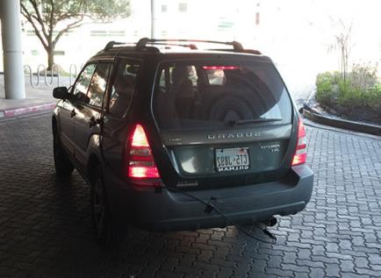
A Dedicated Test Vehicle
  A 2004 Passenger Vehicle
  Starting Mileage 16,496 km
Vehicle Information |  | Engine Information
Year | 2004 | Displacement (L) | 2.5
Make | Subaru | Cylinder Configuration | 4
Model | Forester | HP@RPM | 165 @ 5699
Vehicle Weight | 3100 lb | Torque@RPM | 225 Nm @ 4000
Test Weight | 3500 lb | Fuel Delivery | Gas

Slide 7
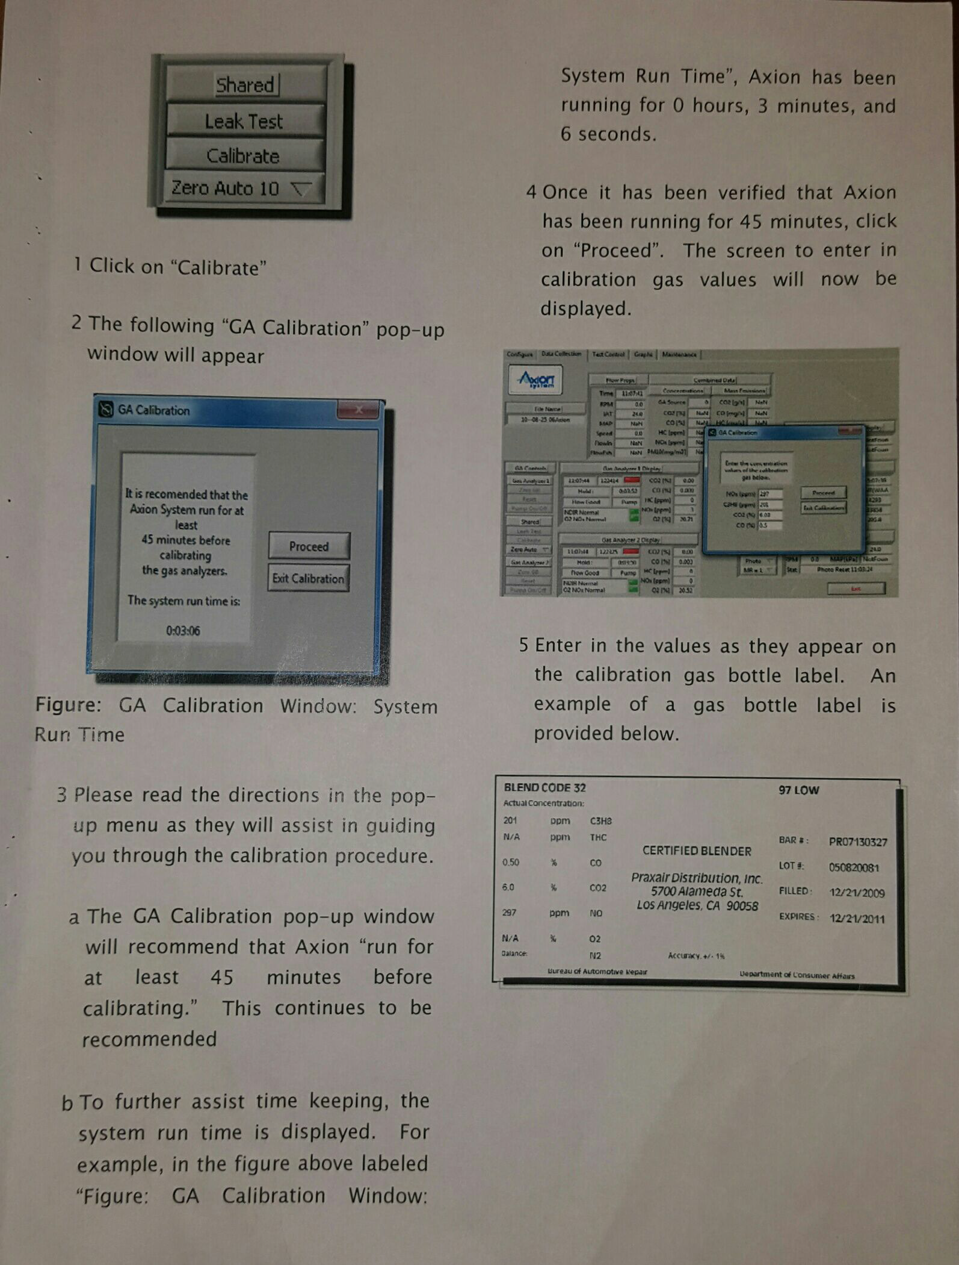
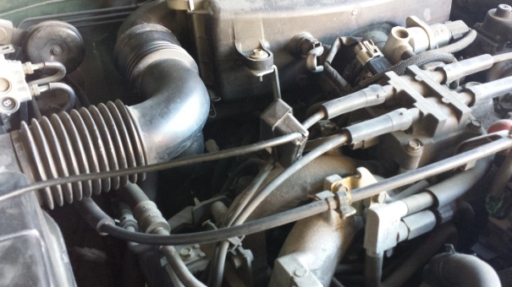
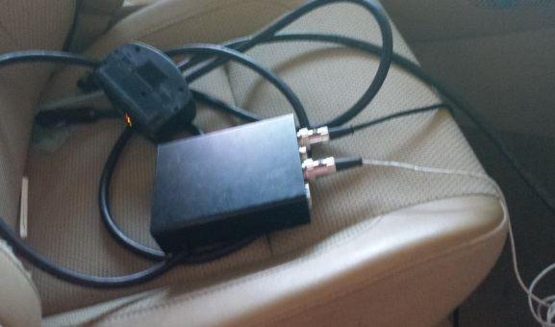
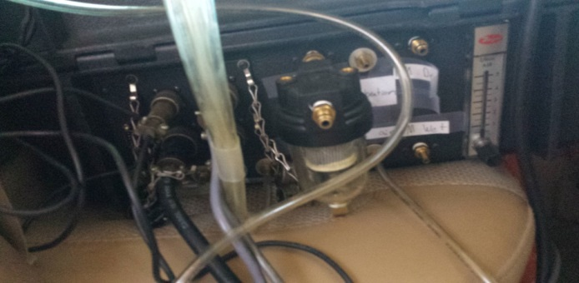
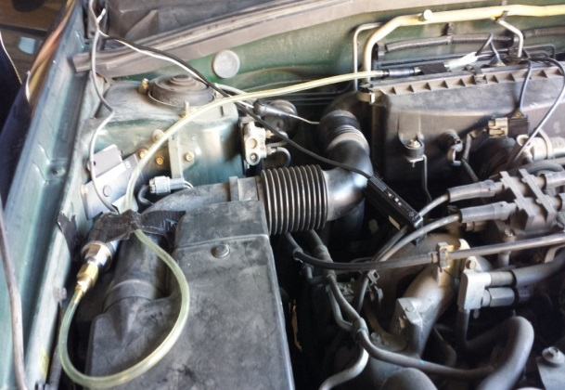
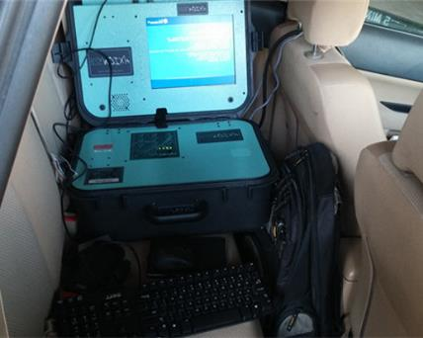
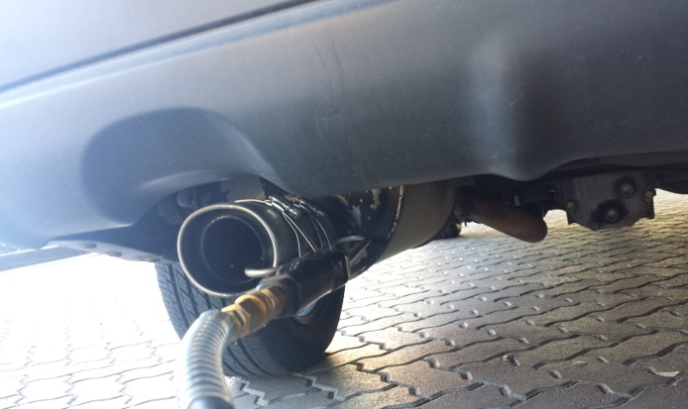
PEMS for Testing
Axion GlobalMRV
CO, CO₂, NO_{x}, HC, PM (for HDDV)

Slide 8
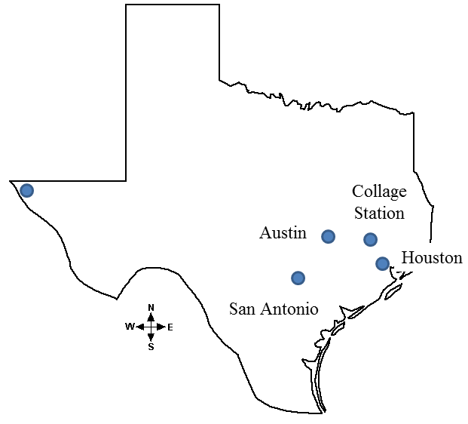
Emission Measurement
Test roads (2,000+ km/ 1,242 mile+) in Texas
Data Collection
  Vehicle activity, such as speed, MAP, rpm, Intake Air Temperature (IAT), Ambient Air Temperature (AAT), etc. from OBD II/sensors
  Vehicle emissions (CO₂, CO, HC, NO_{x}) and fuel consumption(FC) from Portable Emissions Measurement System (PEMS)
  Pavement roughness from a smartphone app for every 20 meters

Slide 9
Clustering Pavement Roughness Based on Vehicle Emission
Data pairs were prepared. Each includes International Roughness Index (IRI), geographic location, emission rates, speed, and engine information.
Normalization for four emission indexes (CO, CO₂, NO_{x}, and HC)
Identify a clustering model from three clustering models
  TwoStep, Kohonen, and K-means
Clustering Model | Clusters | Silhouette
TwoStep | 4 | 0.576
Kohonen | 12 | 0.552
K-means | 5 | 0.311

Slide 10
Clustering Results
The relationship between pavement roughness and emissions is nonlinear
Suggested for pavement roughness design for reduced emissions
Category | IRI |  | Average of Normalized Emission Factor (ANEF)
 | Range | Cluster Center | Ave. | Std | Evaluation
A | (0.00-1.99] | 1.36 | 0.051 | 0.055 | High
B | (1.99-3.21] | 2.54 | 0.032 | 0.017 | Low
C | (3.21-6.00] | 4.07 | 0.030 | 0.016 | Low
D | > 6.00 | 7.07 | 0.039 | 0.014 | High

Slide 11
Findings
Category | IRI |  |  |  | In-vehicle noise | Heart Rate | General Impression
 | Range | Ave. | Std. | Evaluate
A | (0.00-1.99] | 0.051 | 0.055 | High | 60-70 | Low | Poor
B | (1.99-3.21] | 0.032 | 0.017 | Low | 60-70 | Low | Optimal
C | (3.21-6.00] | 0.030 | 0.016 | Low | > 70 | High | Acceptable
D | > 6.00 | 0.039 | 0.014 | High | >70 | High | Poor
Category B is Recommended for Pavement Roughness Design
  Less vehicle emissions
  High fuel consumption efficiency
  Lower in-vehicle noise
  Better riding conform, and
  Lower possibility of adverse health effects
From our another research

Slide 12
Evaluation of the Impact of Work Zone on Vehicular Emissions Considering Roughness
Investigated the effects of work zone on vehicular emissions in consideration of roadway roughness profiles
Proposed an emission model based on the operating mode binning method and roughness data to quantify the impact of road roughness on vehicular emissions
Analyzed roadway construction related emissions

Slide 13
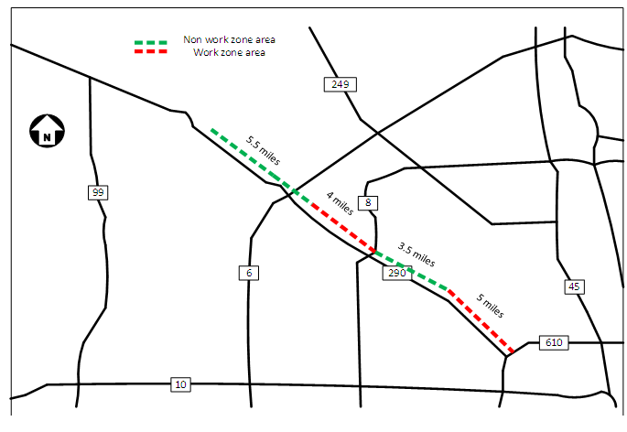
Data Collection
A Work Zone in US 290 Houston, TX Using PEMS
2:30 p.m. to 5 p.m. on March 19, 2015, Dry pavement condition

Slide 14
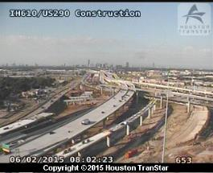


Test Site

Slide 15


Methodology
Emission Factor in work zone is a function of emission factor in non-work zone and the roughness under both situations
Emission factor data pairs in work zone and non-work zone area were compared within each operating mode ID bin, which is based on the values of speed and vehicle specific power (VSP)

Slide 16
Operating Mode Binning and Frequency
OMID | Operating Mode Description | Frequency (0) | Frequency (1)
0 | Braking: Acceleration<-2mph/s or<-1mph/s for 3 seconds | 360 | 285
1 | Idling: -1≤Speed<1 | 12 | 0
11 | Low Speed Coasting: VSP<0; 1≤Speed<25 | 287 | 267
12 | Cruise/Acceleration: 0≤VSP<3; 1≤Speed<25 | 369 | 296
13 | Cruise/Acceleration: 3≤VSP<6; 1≤Speed<25 | 228 | 122
14 | Cruise/Acceleration: 6≤VSP<9; 1≤Speed<25 | 329 | 245
15 | Cruise/Acceleration: 9≤VSP<12; 1≤Speed<25 | 415 | 386
16 | Cruise/Acceleration: 12≤VSP; 1≤Speed<25 | 6 | 24
21 | Moderate Speed Coasting: VSP<0; 25≤Speed<50 | 125 | 102
22 | Cruise/Acceleration: 0≤VSP<3; 25≤Speed<50 | 282 | 266
23 | Cruise/Acceleration: 3≤VSP<6; 25≤Speed<50 | 363 | 360
24 | Cruise/Acceleration: 6≤VSP<9; 25≤Speed<50 | 0 | 0
25 | Cruise/Acceleration: 9≤VSP<12; 25≤Speed<50 | 341 | 345
27 | Cruise/Acceleration: 12≤VSP<18;25≤Speed<50 | 317 | 433
28 | Cruise/Acceleration: 18≤VSP<24; 25≤Speed<50 | 27 | 12
29 | Cruise/Acceleration: 24≤VSP<30; 25≤Speed<50 | 2 | 0
30 | Cruise/Acceleration: 30≤VSP; 25≤Speed<50 | 0 | 0
33 | Cruise/Acceleration: VSP<6; 50≤Speed | 182 | 239
35 | Cruise/Acceleration: 6≤VSP<12; 50≤Speed | 326 | 373
37 | Cruise/Acceleration: 12≤VSP<18; 50≤Speed | 190 | 251
38 | Cruise/Acceleration: 18≤VSP<24; 50≤Speed | 78 | 116
39 | Cruise/Acceleration: 24≤VSP<30; 50≤Speed | 127 | 145
40 | Cruise/Acceleration: 30≤VSP; 50≤Speed | 6 | 1
Lower Speed
Medium Speed
Higher
Speed
0 stands for work zone, 1 for non-work zone

Slide 17
Emission Factors
Work Zone and Non Work Zone
 | EF_{w} | EF_{nw} | (EF_{w}-EF_{nw})/EF_{nw}
CO₂ (g/mi) | 0.392 | 0.340 | 15.2%
CO (mg/mi) | 1.392 | 1.966 | -29.2%
HC (mg/mi) | 0.140 | 0.183 | -23.5%
NO_{x} (mg/mi) | 0.158 | 0.091 | 73.6%
FC (g/mi) | 0.138 | 0.108 | 27.8%

Slide 18
Emission, Fuel Consumption and eIRI of Operating Mode Bins
OMID | CO₂ (0) | CO₂ (1) | CO (0) | CO (1) | NO_{x} (0) | NO_{x} (1) | HC (0) | HC (1) | FC (0) | FC (1) | eIRI (0) | eIRI (1)
0 | 0.087 | 0.073 | 0.364 | 0.531 | 0.028 | 0.021 | 0.018 | 0.012 | 0.028 | 0.023 | 2.172 | 1.940
11 | 0.295 | 0.220 | 1.364 | 1.252 | 0.073 | 0.045 | 0.067 | 0.019 | 0.094 | 0.070 | 1.704 | 1.584
12 | 0.527 | 0.345 | 4.324 | 6.111 | 0.127 | 0.108 | 0.090 | 0.029 | 0.169 | 0.112 | 1.753 | 1.607
13 | 0.885 | 0.552 | 5.446 | 8.867 | 0.221 | 0.125 | 0.153 | 0.093 | 0.282 | 0.179 | 1.928 | 1.513
14 | 1.088 | 0.801 | 5.502 | 8.771 | 0.277 | 0.188 | 0.175 | 0.203 | 0.347 | 0.258 | 1.767 | 1.641
15 | 1.264 | 0.980 | 2.286 | 3.551 | 0.322 | 0.239 | 0.180 | 0.482 | 0.399 | 0.311 | 1.623 | 1.618
21 | 0.133 | 0.128 | 0.826 | 0.765 | 0.034 | 0.028 | 0.020 | 0.016 | 0.042 | 0.041 | 1.794 | 1.754
22 | 0.218 | 0.210 | 1.122 | 1.798 | 0.057 | 0.046 | 0.036 | 0.021 | 0.069 | 0.067 | 1.885 | 1.760
23 | 0.303 | 0.286 | 1.071 | 1.803 | 0.077 | 0.060 | 0.043 | 0.059 | 0.097 | 0.091 | 2.317 | 1.671
25 | 0.430 | 0.447 | 0.752 | 1.193 | 0.105 | 0.096 | 0.070 | 0.064 | 0.137 | 0.142 | 1.995 | 1.634
27 | 0.596 | 0.597 | 0.815 | 0.923 | 0.138 | 0.129 | 0.123 | 0.105 | 0.182 | 0.190 | 1.860 | 1.808
28 | 0.760 | 0.750 | 0.761 | 0.461 | 0.172 | 0.172 | 0.127 | 0.334 | 0.240 | 0.237 | 2.032 | 2.070
33 | 0.171 | 0.189 | 0.432 | 1.076 | 0.045 | 0.048 | 0.021 | 0.035 | 0.054 | 0.060 | 2.072 | 2.144
35 | 0.310 | 0.299 | 0.592 | 1.524 | 0.079 | 0.076 | 0.050 | 0.075 | 0.098 | 0.095 | 2.168 | 2.021
37 | 0.415 | 0.377 | 0.683 | 1.426 | 0.102 | 0.100 | 0.068 | 0.124 | 0.132 | 0.120 | 2.174 | 1.961
38 | 0.495 | 0.423 | 0.874 | 1.263 | 0.119 | 0.110 | 0.107 | 0.135 | 0.157 | 0.134 | 2.231 | 1.946
39 | 0.455 | 0.452 | 0.907 | 1.413 | 0.116 | 0.123 | 0.066 | 0.082 | 0.144 | 0.144 | 1.872 | 1.566
0 stands for work zone, 1 for non-work zone
Units: CO₂ (g/mi), CO (mg/mi), NO_{x}(mg/mi), HC(mg/mi), FC(g/mi)

Slide 19
Calibrated Parameters for Emission Factor under different Operation Mode ID bin
OMID | Index | b1 | b2 | b3 | R² | RSME
0 | FC | 0.940 | -0.040 | 0.952 | 0.929 | 0.021
 | CO₂ | 0.954 | -0.045 | 1.168 | 0.890 | 0.064
 | CO | 0.634 | 0.095 | 0.981 | 0.917 | 0.201
 | NO_{x} | 0.879 | -0.009 | 0.903 | 0.930 | 0.141
 | HC | 0.262 | 0.680 | 1.298 | 0.801 | 0.162
11 | FC | 1.185 | -0.062 | 0.968 | 0.899 | 0.062
 | CO₂ | 1.152 | -0.054 | 1.168 | 0.916 | 0.073
 | CO | 0.621 | -0.091 | 0.982 | 0.927 | 0.182
 | NO_{x} | 0.887 | -0.020 | 0.901 | 0.931 | 0.170
 | HC | 0.261 | 0.694 | 1.296 | 0.792 | 0.119
12 | FC | 1.149 | -0.055 | 0.956 | 0.917 | 0.012
 | CO₂ | 1.174 | -0.064 | 1.164 | 0.918 | 0.022
 | CO | 0.652 | -0.071 | 1.014 | 0.949 | 0.151
 | NO_{x} | 0.896 | -0.021 | 0.865 | 0.919 | 0.103
 | HC | 0.245 | 0.675 | 1.315 | 0.822 | 0.093
13 | FC | 1.164 | -0.063 | 0.982 | 0.886 | 0.017
 | CO₂ | 1.171 | -0.079 | 1.151 | 0.891 | 0.033
 | CO | 0.616 | -0.068 | 0.990 | 0.905 | 0.173
 | NO_{x} | 0.886 | -0.025 | 0.909 | 0.936 | 0.069
 | HC | 0.243 | 0.712 | 1.284 | 0.802 | 0.095
14 | FC | 1.149 | -0.061 | 0.947 | 0.896 | 0.012
 | CO₂ | 1.147 | -0.054 | 1.161 | 0.892 | 0.080
 | CO | 0.649 | -0.092 | 1.014 | 0.913 | 0.157
 | NO_{x} | 0.879 | -0.036 | 0.894 | 0.902 | 0.032
 | HC | 0.272 | 0.684 | 1.275 | 0.778 | 0.029
15 | FC | 1.158 | -0.061 | 0.939 | 0.882 | 0.011
 | CO₂ | 1.181 | -0.059 | 1.141 | 0.932 | 0.066
 | CO | 0.632 | -0.091 | 0.999 | 0.951 | 0.186
 | NO_{x} | 0.863 | -0.006 | 0.909 | 0.893 | 0.014
 | HC | 0.261 | 0.689 | 1.278 | 0.775 | 0.020
21 | FC | 1.136 | -0.027 | 0.985 | 0.929 | 0.026
 | CO₂ | 1.158 | -0.075 | 1.143 | 0.914 | 0.054
 | CO | 0.653 | 0.053 | 1.010 | 0.908 | 0.198
 | NO_{x} | 0.889 | -0.017 | 0.892 | 0.909 | 0.013
 | HC | 0.274 | -0.712 | 1.276 | 0.802 | 0.001
22 | FC | 1.155 | -0.066 | 0.960 | 0.895 | 0.031
 | CO₂ | 1.148 | -0.049 | 1.162 | 0.917 | 0.086
 | CO | 0.638 | -0.049 | 0.999 | 0.914 | 0.170
 | NO_{x} | 0.900 | -0.024 | 0.889 | 0.892 | 0.011
 | HC | 0.279 | 0.671 | 1.286 | 0.808 | 0.027
23 | FC | 1.141 | -0.061 | 0.967 | 0.921 | 0.021
 | CO₂ | 1.166 | -0.067 | 1.133 | 0.911 | 0.061
 | CO | 0.634 | -0.074 | 0.999 | 0.923 | 0.194
 | NO_{x} | 0.903 | -0.017 | 0.878 | 0.923 | 0.021
 | HC | 0.274 | 0.688 | 1.283 | 0.797 | 0.083
25 | FC | 1.158 | -0.054 | 0.960 | 0.915 | 0.085
 | CO₂ | 1.184 | -0.057 | 1.136 | 0.898 | 0.072
 | CO | 0.637 | -0.082 | 1.006 | 0.942 | 0.120
 | NO_{x} | 0.876 | -0.016 | 0.880 | 0.936 | 0.014
 | HC | 0.261 | 0.674 | 1.304 | 0.788 | 0.020
27 | FC | 1.168 | -0.051 | 0.972 | 0.908 | 0.017
 | CO₂ | 1.172 | -0.055 | 1.160 | 0.958 | 0.057
 | CO | 0.618 | 0.080 | 1.003 | 0.927 | 0.166
 | NO_{x} | 0.872 | -0.013 | 0.891 | 0.908 | 0.077
 | HC | 0.268 | 0.711 | 1.304 | 0.810 | 0.091
33 | FC | 1.181 | -0.045 | 0.959 | 0.906 | 0.021
 | CO₂ | 1.153 | -0.040 | 1.148 | 0.889 | 0.077
 | CO | 0.622 | -0.057 | 1.022 | 0.943 | 0.181
 | NO_{x} | 0.901 | -0.009 | 0.891 | 0.896 | 0.021
 | HC | 0.261 | 0.678 | 1.300 | 0.791 | 0.024
35 | FC | 1.145 | -0.049 | 0.957 | 0.887 | 0.025
 | CO₂ | 1.177 | -0.043 | 1.129 | 0.908 | 0.081
 | CO | 0.623 | -0.066 | 1.023 | 0.911 | 0.174
 | NO_{x} | 0.886 | -0.025 | 0.864 | 0.919 | 0.039
 | HC | 0.249 | 0.664 | 1.280 | 0.829 | 0.011
37 | FC | 1.178 | -0.031 | 0.974 | 0.898 | 0.012
 | CO₂ | 1.156 | -0.049 | 1.144 | 0.911 | 0.053
 | CO | 0.637 | -0.067 | 1.020 | 0.929 | 0.196
 | NO_{x} | 0.874 | -0.014 | 0.880 | 0.966 | 0.019
 | HC | 0.274 | 0.685 | 1.318 | 0.788 | 0.020
38 | FC | 1.179 | -0.025 | 0.973 | 0.965 | 0.012
 | CO₂ | 1.178 | -0.037 | 1.139 | 0.933 | 0.051
 | CO | 0.614 | -0.053 | 1.006 | 0.913 | 0.197
 | NO_{x} | 0.873 | -0.040 | 0.887 | 0.911 | 0.081
 | HC | 0.263 | 0.710 | 1.278 | 0.802 | 0.026
39 | FC | 1.135 | -0.053 | 0.973 | 0.911 | 0.030
 | CO₂ | 1.140 | -0.046 | 1.175 | 0.898 | 0.081
 | CO | 0.621 | -0.054 | 1.011 | 0.920 | 0.191
 | NO_{x} | 0.869 | -0.001 | 0.887 | 0.898 | 0.015
 | HC | 0.259 | 0.681 | 1.271 | 0.824 | 0.031

Slide 20
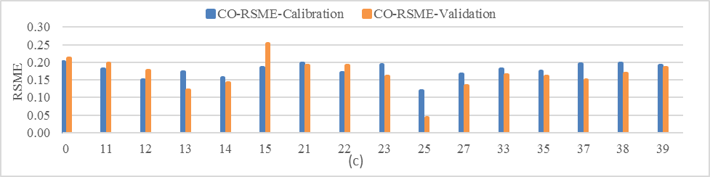
Comparing of RMSE on
Each Operating Mode Bin
For Work Zone and Non-Work Zone Area
70% Used for Modeling, 30% for Validation

Slide 21
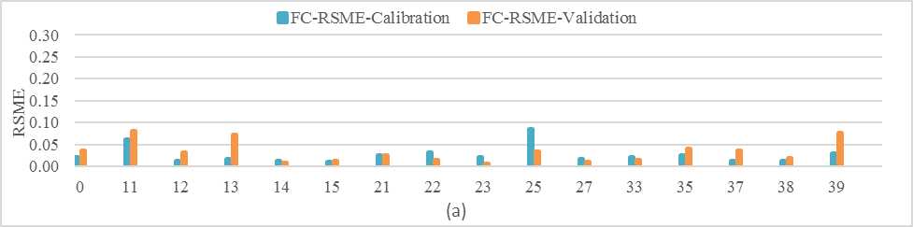
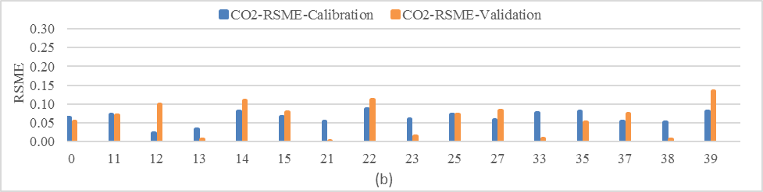
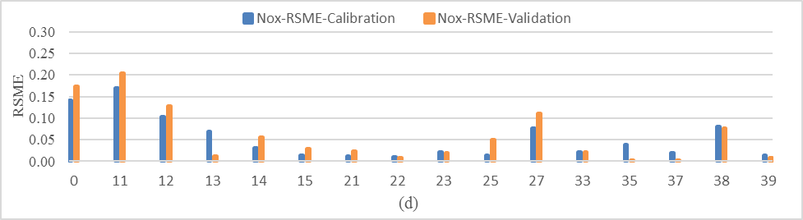
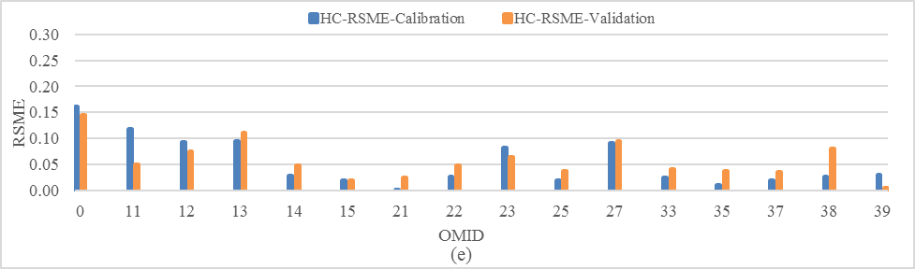

Slide 22
Results
The calibration and validation results of fuel consumption has the highest average accuracy compared with CO₂, CO, HC and NO_{x}
The proposed model has a good fit for NO_{x} and HC in the relatively higher speed range (above 25 mph) while in the low speed range (OMID between 0 and 13), the error may exceed 0.1 in some cases
The general trend of this model is that highest accuracy is achieved in the intermediate speed range (OMID between 21 and 27) and in the low speed range the model has highest error

Slide 23
Findings
Work zone can contribute to significantly increased emission factors of CO₂, NO_{x} and fuel consumption and reduced emission factor of CO and HC.
Increased roughness in work zone compared with the same non-work zone roughness leads to increased emission factor for CO₂, NO_{x} and fuel consumption and the opposite effect can be observed for CO and NO_{x}
The results are suggestive of the findings drawn, but more field work needs to be done in the future to see whether the findings are robust to support the conclusion

Slide 24



