Slide 1
The role of in-use PEMS testing to ensure regulatory compliance and policy effectiveness
… and to avoid another Volkswagen crisis.
Nick Molden
17 March 2016

Slide 2
Emissions Analytics’ credentials
  Founded in 2011
  Headquartered in UK, with operations in London, Los Angeles and Stuttgart
  Specialist in PEMS testing and data analysis
  1200+ vehicles tested
  Largest commercially available database of real-world emissions data
  Works with OEMs, Tier 1/2 suppliers, fuel and chemical companies, regulators, consultancies, consumer media

Slide 3

Equipment
SEMTECH-DS and -LDV
Portable Emissions Measurement System connects to tailpipe
    Captures emissions for CO₂, CO, NO, NO₂, total hydrocarbons
    At 1 Hertz
  Air temperature, pressure, humidity
  GPS for speed and altitude
  Engine data via CANBUS
  Fuel economy derived via carbon balance
  Weight addition 100-250 pounds

Slide 4
Objectives
  Rolling in-service surveillance programme of production vehicles
  Target to test 500+ vehicles per year
  To complement type approval
  And ensure efficacy of regulations
  Air quality, greenhouse gases, fuel economy
  Independent, making data available to all
  Top-level ratings for marketing
  Benchmark rankings
  Deep-dive analysis for manufacturers

Slide 5
TRACKING POLICY EFFECTIVENESS

Slide 6
NO_{x} latest trends (1)
Rolling 12-month average of exceedance factor in blue
Step-change technology launched Q2 to Q3 2014
No further reduction in Conformity Factor since then
Average CF dipped to 2.7 in 2014, but risen to 3.5 since then

Slide 7
NO_{x} latest trends (2)
German manufacturers leading introduction of Euro 6 vehicles
And offer the cleanest
US manufacturers slow to bring Euro 6 vehicles to market
Japanese very consistent around market average conformity factor

Slide 8
NO_{x} latest trends (3)
Earliest Euro 6 vehicles were LNT and EGR-only, but LNT quickly became dominant technology
More recent switch to SCR
Nevertheless, good performance achieved by many LNT systems
Similarly wide spread of performance between LNT and SCR

Slide 9
Will Real Driving Emissions help?
Conformity factor initially 2.1 – 168 mg/km
Further increased by exclusions due to boundary conditions – details TBD
PEMS test-to-test variability of 30%, so OEMs will need to target ~129 mg/km to avoid getting caught by in-service surveillance

Slide 10
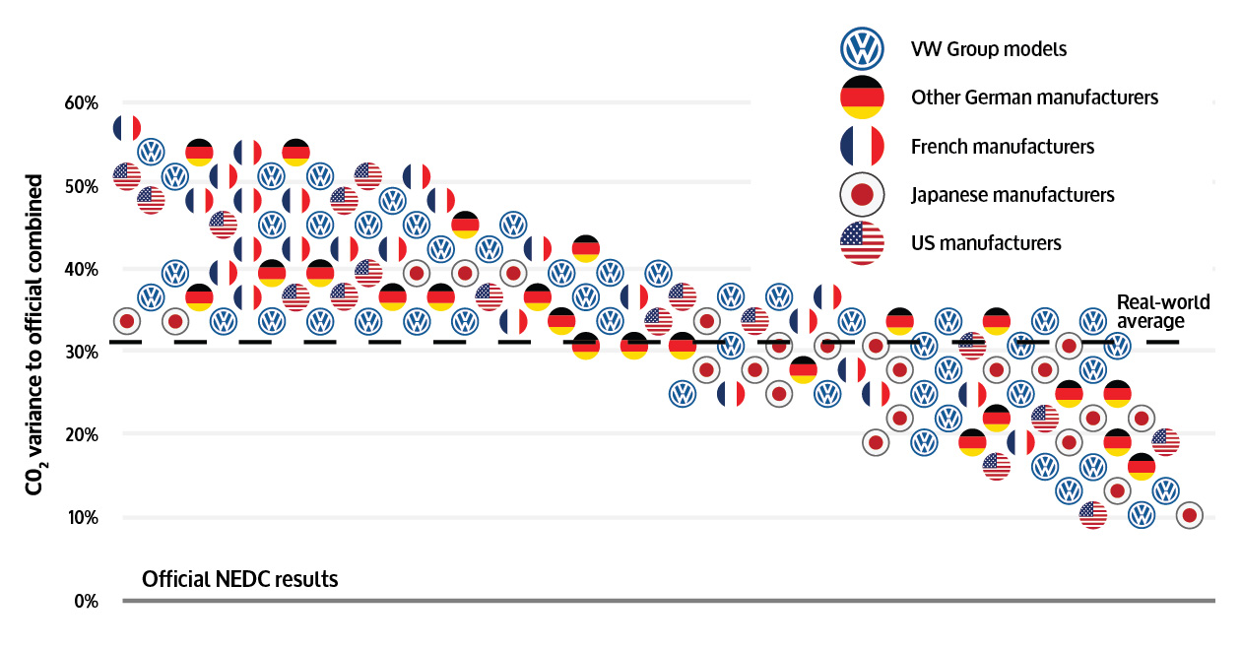
Fuel economy by country

Slide 11
TRACKING VEHICLE PERFORMANCE

Slide 12
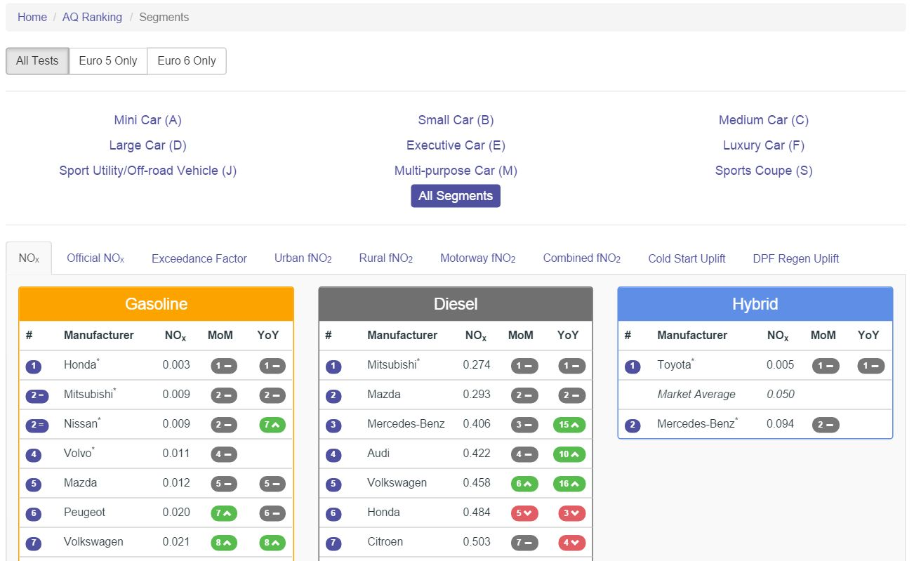
Segment/fuel ranking

Slide 13
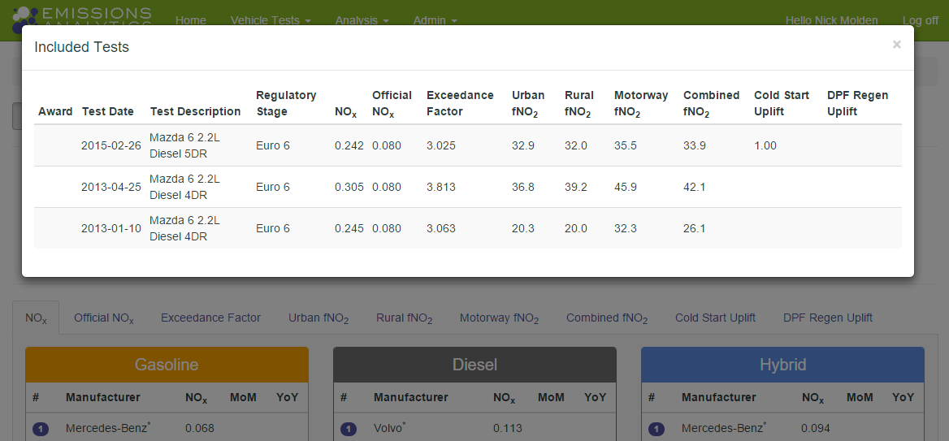
Drill-down to individual datasets

Slide 14
INDEPENDENT AIR QUALITY RATINGS

Slide 15
Vehicle rating scheme
  Vehicle rating scheme based on their real-world NO_{x} emissions, launching in April 2016
  Initially on cars, but shortly to extent to light commercial vehicles
  Non-statutory complement to new Real Driving Emissions regulations
  But will also
      Discriminate between high and low emitters, rather than just pass/fail
      Be updated for each model year to keep up with new calibrations
  Ratings will be published and put in the public domain
  Manufacturers and consumer media can adopt as independent, voluntary standard
  Similar to New Car Assessment Programme (Euro NCAP, Global NCAP)
  Robust, independent standard needed to measure and incentivise actions to bring about air quality improvements

Slide 16
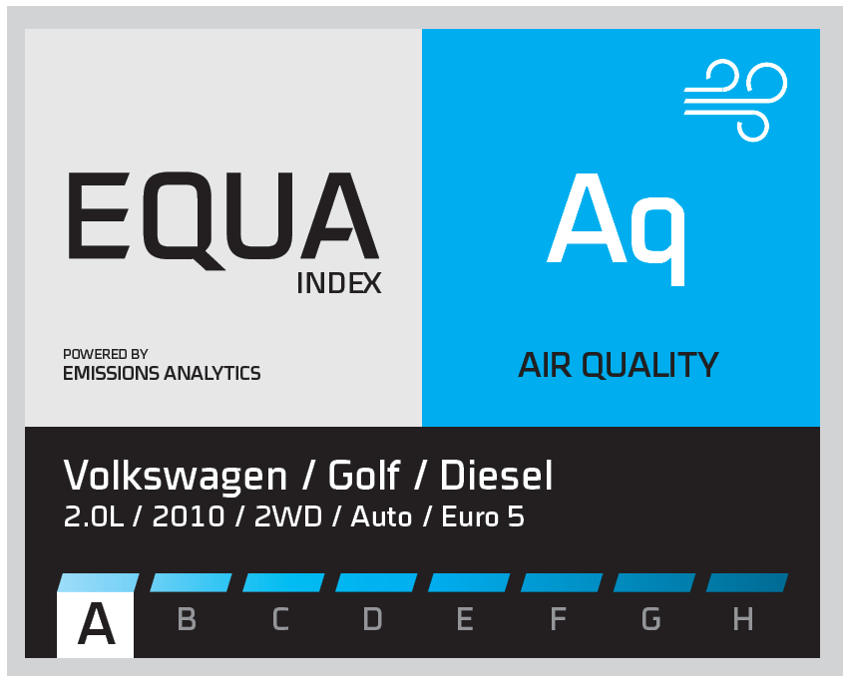

Slide 17
Nick Molden, Chief Executive Officer
nick@emissionsanalytics.com
+44 (0) 20 7193 0489
+44 (0) 7765 105902

