Slide 1
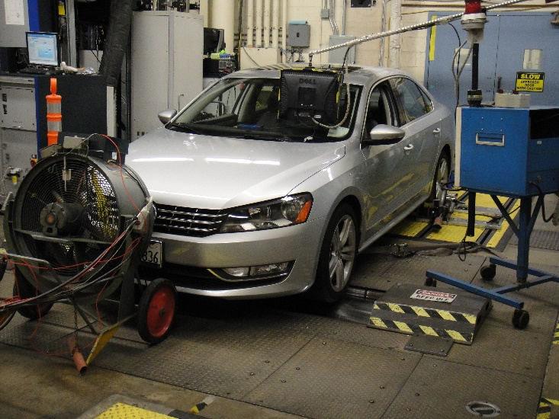
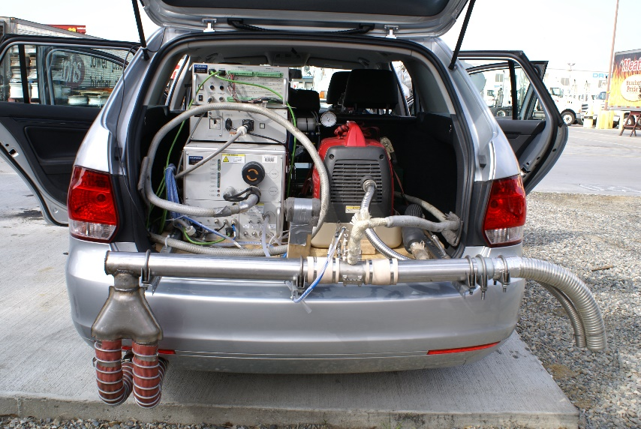
The VW Story and Its Impact on Future
In-use Emissions Compliance and Control Technologies
6th International PEMS Conference & Workshop
University of California, Riverside
College of Engineering - Center for Environmental Research and Technology (CE-CERT)
March 17 - 18, 2016
Dan Carder, Marc Besch, Arvind Thiruvengadam, Hemanth Kappanna, and Gregory Thompson
Center for Alternative Fuels, Engines, and Emissions
West Virginia University

Slide 2


ICCT Light-Duty Diesel Project
Initial Request by ICCT
  Initial Contact by Representatives from Horiba Ltd. on 11/15/2012
  Identify European-based Diesel Engines Sold in the United States Meeting at Least Tier 2 Bin 5, LEV II Emissions
  Propose a Plan to Evaluate the In-use Emissions from a Representative Selection of Suggested Vehicles – Request Specified Two SCR-Equipped and One Lean NOx Trapped-Equipped Vehicles
  Proposed Budget ~$193,662 with Multiple Options
  Project Award ~ $69,387

Slide 3
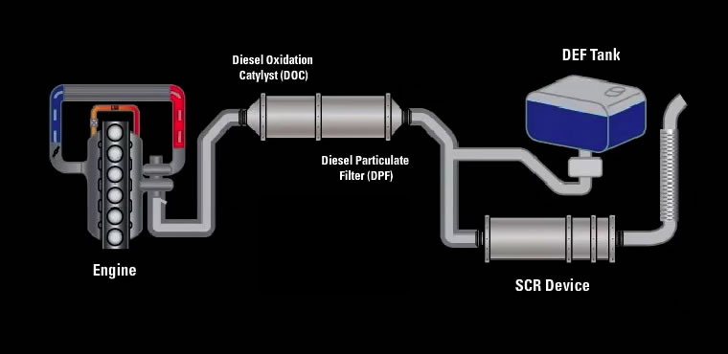
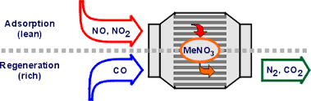
Emissions Control
  Typical Diesel OEM Solutions
    Exhaust Gas Recirculation (EGR)
    Diesel Oxidation Catalyst (DOC)
    Diesel Particulate Filter (DPF)
    And:
LNT
SCR
https://www.dieselnet.com/tech/cat_diesel.php
https://www.demanddetroit.com/performance/emissions.aspx
Notes:
Far more complex
More expensive
Somewhat binary in nature
Moreso an independent subsystem

Slide 4
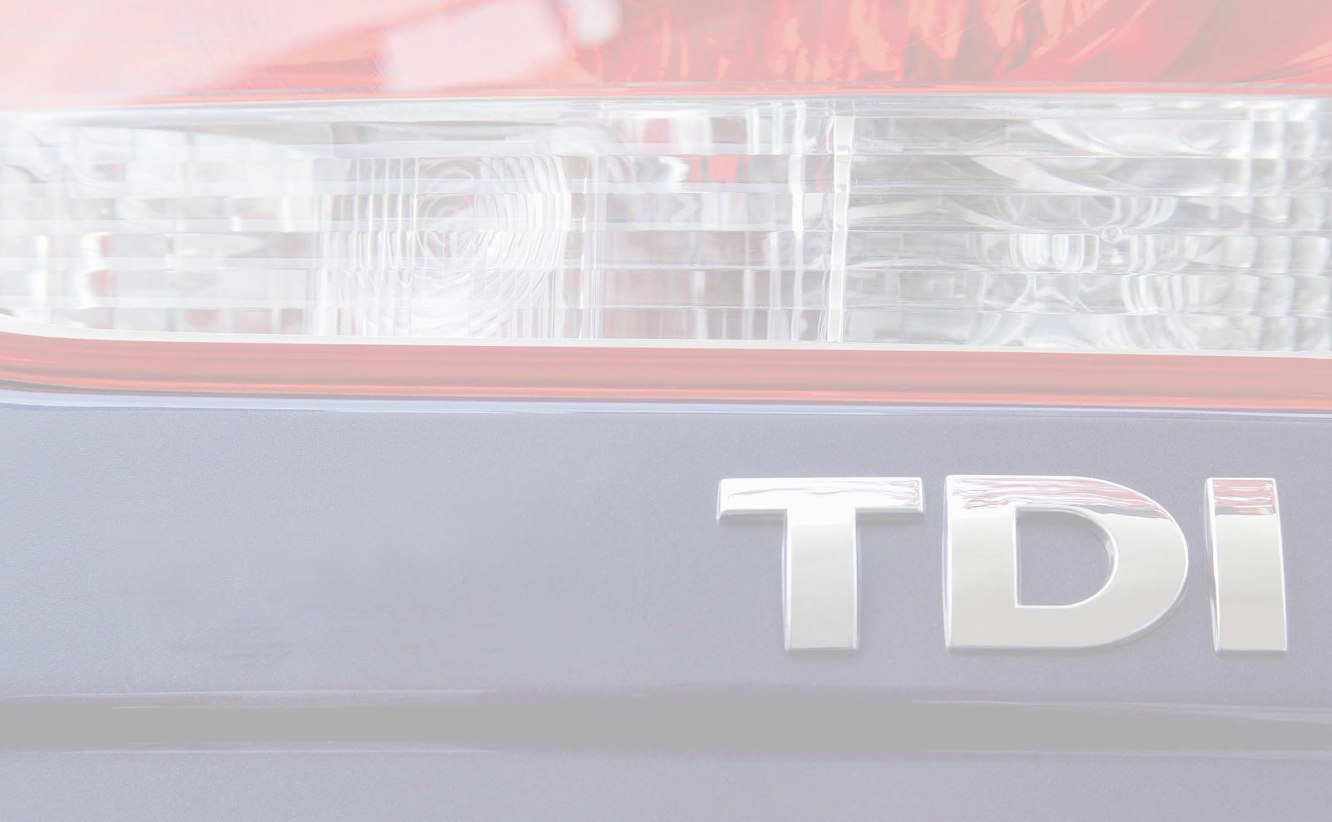



12th Diesel Engine-Efficiency and Emissions Research (DEER) Conference August 20-24, 2006, Detroit, Michigan
Richard Dorenkamp
LNT or Urea SCR Technology:
Which is the right technology for TIER 2 BIN 5 passenger vehicles?
Diesel Engine Development, Volkswagen AG, Wolfsburg

Slide 5
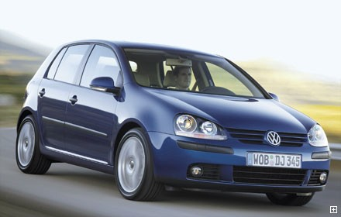
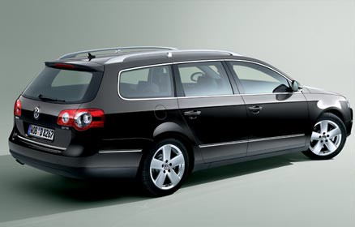
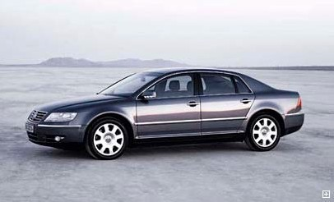
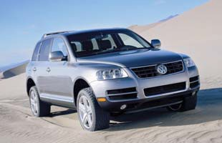

System Applicability
NO_{x} Emissions
Trap
Lean NO
x
Emission Limit
SCR
Vehicle weight
Notes:
Physics and Marketing at play here

Slide 6
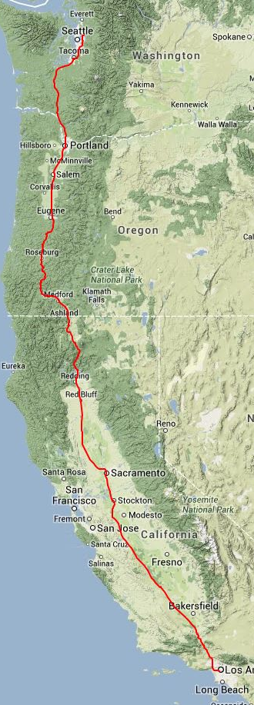
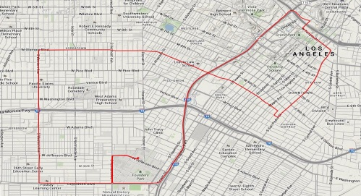
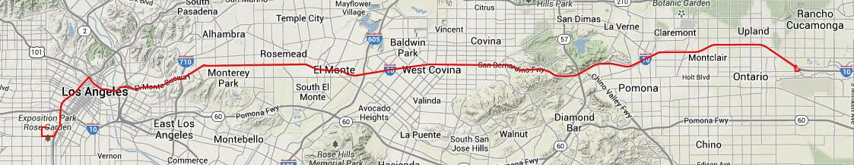
ICCT Light-Duty Diesel Project Protocol
Initial Proposal Planned Work Around Morgantown, WV, and North Florida
Vehicle Recruitment Resulted in Location Change to Southern California
Incorporated CARB Chassis Dynamometer Test Facility to Provide Baseline Data
Routes Selected to Provide Representative In-use Operation of City, Suburban, and Highway Driving
Part of the 1970’s Route in Los Angeles used to Generate the UDDS Included
Grade Included for Aftertreatment Effects
Extended Highway Driving to study PM Regeneration Events

Slide 7
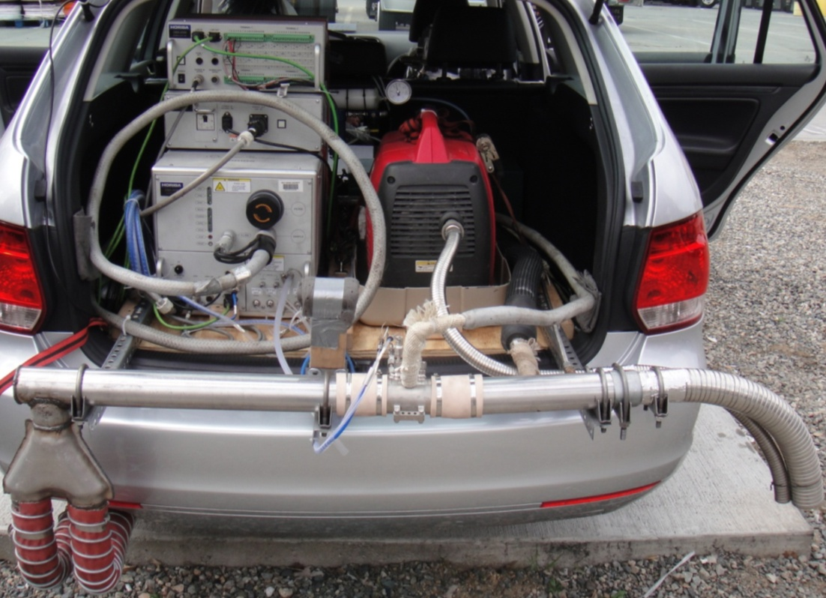
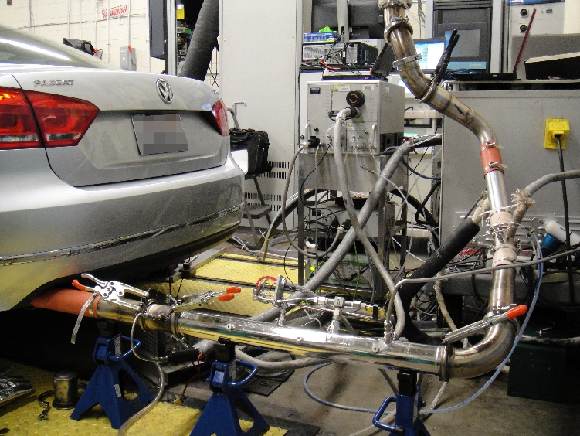
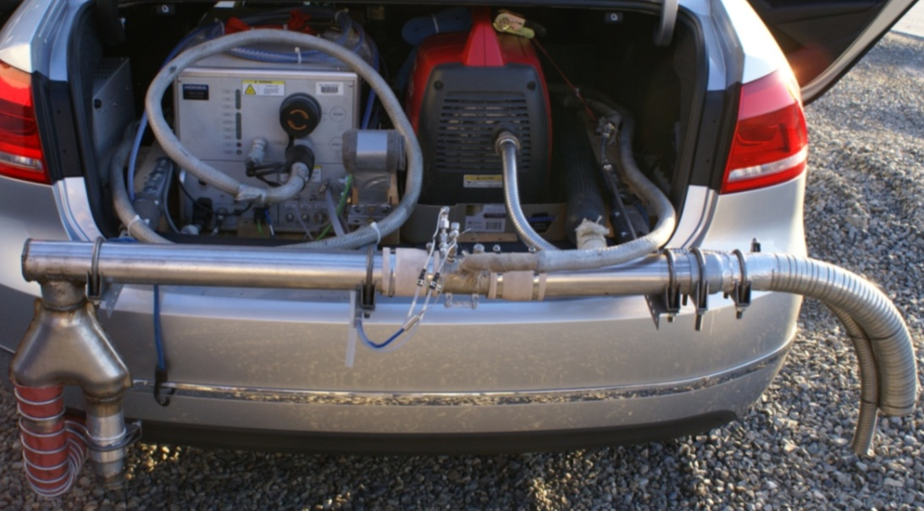
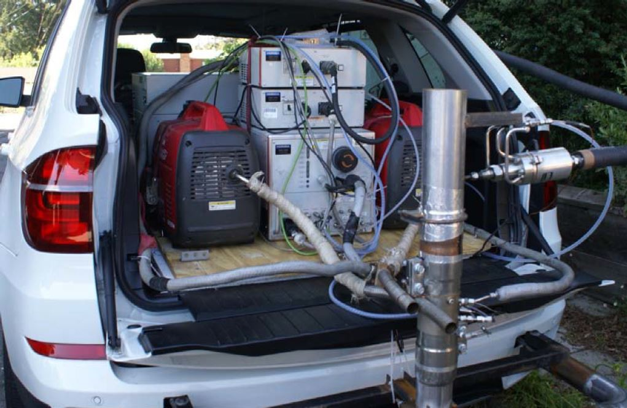
Methodology - Test Vehicles
Jetta
Passat
Passat
BMW
Notes:
Passive NOx adsorbers (or traps) are not a stand-alone NOx control technology—rather, they can be used with urea-SCR aftertreatment to improve the low temperature performance of the system.
Cummins 6.7 used LNOX (PTOX and NSC)
An early demonstration of PNA technology was conducted by Cummins on their 2.8 L US Tier 2 Bin 2 diesel engine developed under the US DOE ATLAS project

Slide 8
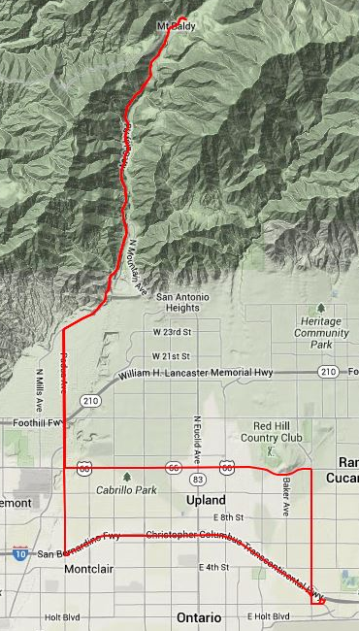
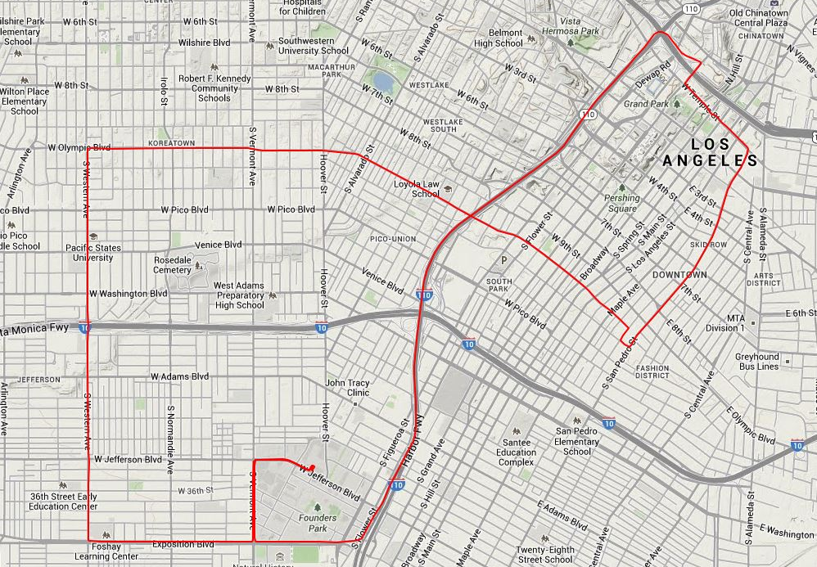
Methodology - Test Routes
Route 1: highway driving in Los Angeles
Route 2: urban driving in downtown Los Angeles
Route 3: rural and uphill/downhill driving in LA’s foothills
Route 4: urban driving in downtown San Diego
Route 5: urban driving in downtown San Francisco
Route 2: downtown LA,
“Los Angeles Route Four” (FTP)
Route 3: up/downhill, Ontario to Mt. Baldy

Slide 9
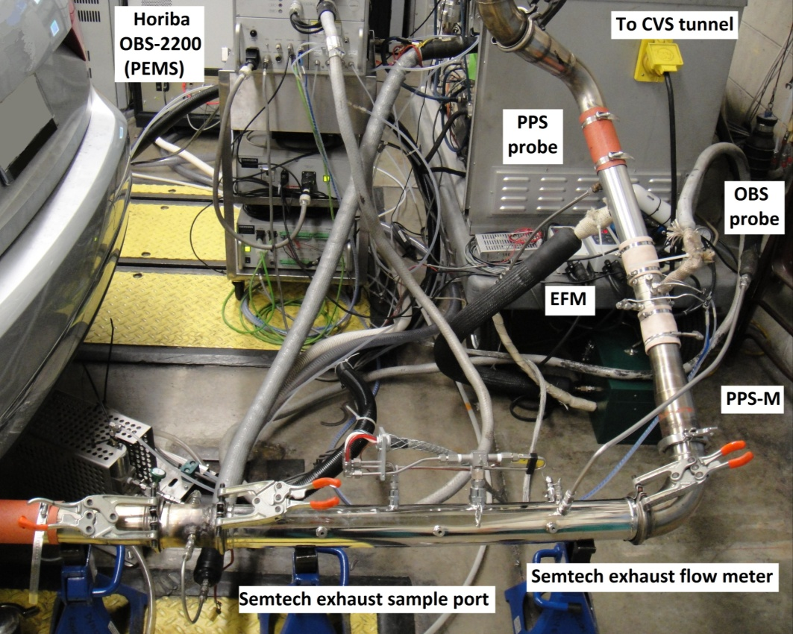
Chassis Dynamometer Testing at CARB
Volkswagen Jetta and Passat Tested in CARB’s El Monte Chassis Dynamometer Laboratory
Passat Used to Compare PEMS to Lab – Ensure Confidence in PEMS Data
Integrated (g/mile) and Continuous (g/s) Data Comparison
Three Different Test Cycles
  FTP75
  NEDC
  US06
Cold, Warm, and Hot Starts
Notes:
Emphasis WVU CAFEE did this testing.
Explain why.

Slide 10
PEMS vs. CARB Laboratory
Lab
PEMS
Lab
PEMS

Slide 11
On-Road Fuel Economy Results
Average fuel economy of Passat over cross-multi-state driving route portions expressed as mpg; repeat test variations are presented as ±1σ), ‘R’ designates segments including a DPF regeneration event, ‘nd’ - no data available.

Slide 12
Results - Routes NO_{X} Emissions
R - DPF regeneration event
Highest NO_{x} emissions during rural/up-downhill and lowest NO_{x} during highway driving
LNT shows deficiencies in NO_{x} reduction over urea-SCR system
Increase in NO_{x} emissions during tests with DPF regeneration event => especially pronounced for Vehicle A (LNT)
Route 1, Vehicle A contains rush-hour and non-rush-hour traffic conditions
FTP-75
FTP-75
R
R
R
R
R
(LNT)
(SCR)
(SCR)
Chassis dynamometer test results for NO_{x}
Vehicle | NO_{x} over FTP-75 [g/km] | Rel. to Tier2-Bin5 [%]
Vehicle A | 0.022 ±0.006 | 50.4
Vehicle B | 0.016 ±0.002 | 64.1
Vehicle C | (no data) | (no data)
FTP-75
FTP-75
NO_{x} standard EPA Tier2-Bin5, CARB LEV-II ULEV over FTP-75: 0.044 g/km

Slide 13
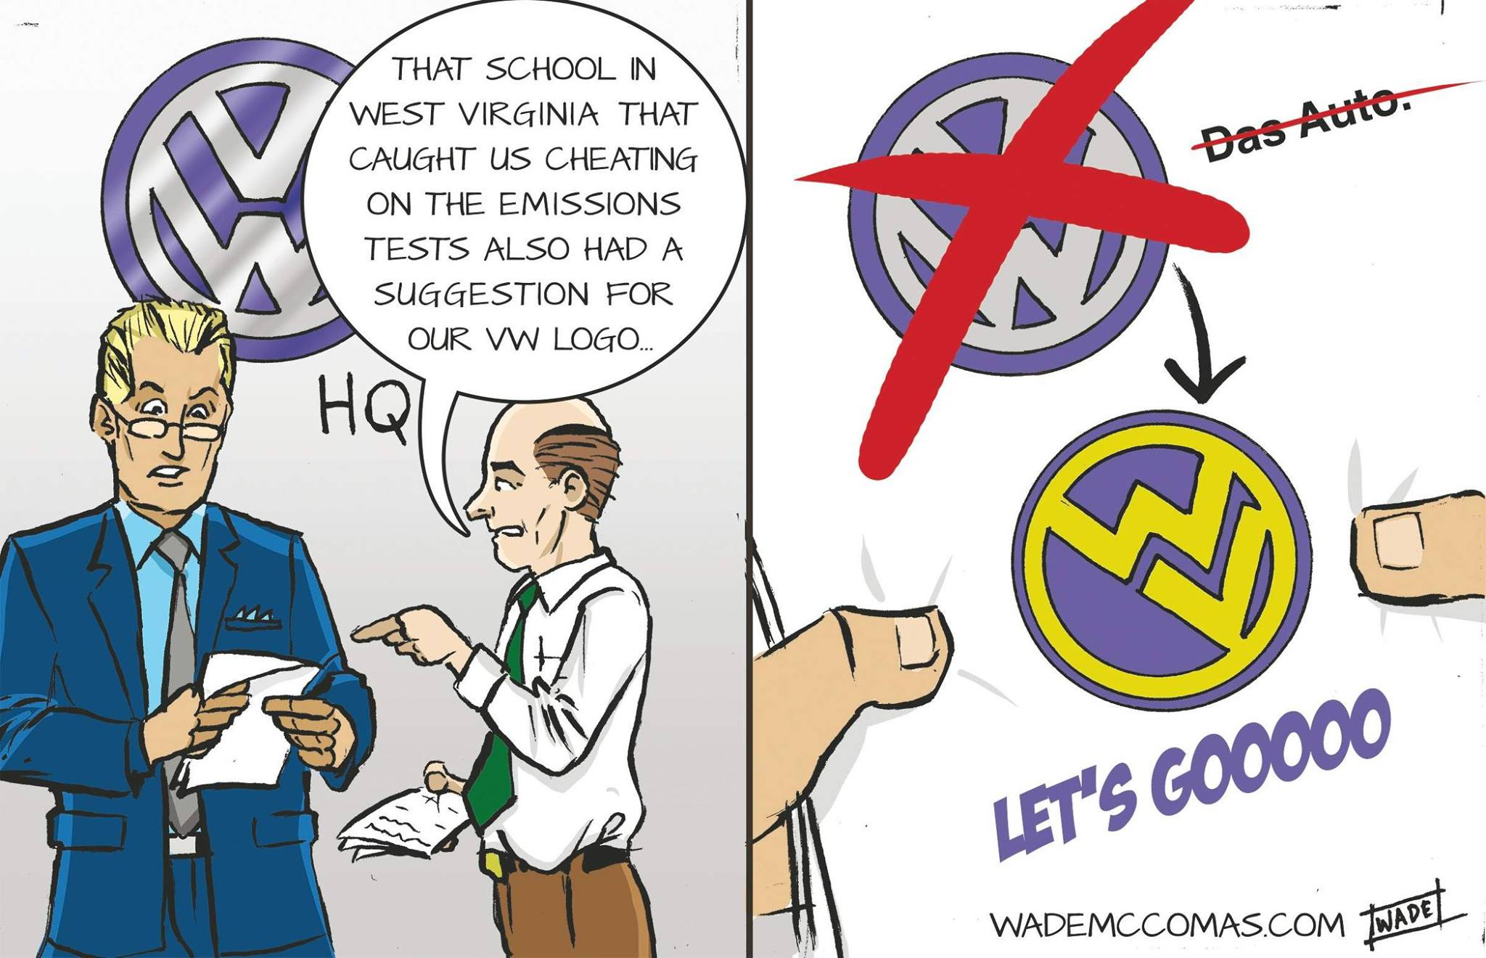


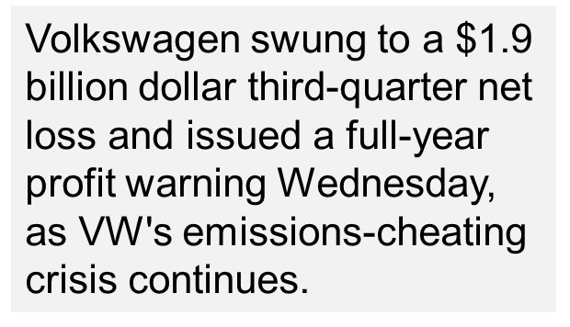


How A Little Lab In West Virginia Caught Volkswagen's Big Cheat
September 24, 2015 5:04 AM ET
EPA's notice of violation of the Clean Air Act to Volkswagen [press statement]
Investigation into "defeat device" allegedly used to circumvent emissions tests began with ICCT-sponsored research on in-use emissions from diesel passenger cars
Highlights the global need for vigilant enforcement of air pollution laws by regulatory agencies in all vehicle markets
How West Virginia engineer exposed Volkswagen's catastrophic environmental fraud and wiped BILLIONS off company's shares
By Reuters and Daily Mail Reporter
Published: 20:36 EST, 22 September 2015 | Updated: 18:50 EST, 23 September 2015
Volkswagen Shares Plunge On Emissions Scandal
VW CEO Issues Statement on EPA Emissions Violations, Apologizes for Wrongdoing

Slide 14

























Slide 15
Timeline
Increased on-road (i.e. off-cycle) NOx emissions measured in EU
March – May 2013
Testing of three vehicles (on-road and laboratory)
Sep. 25th 2015
CEO Winterkorn resigns, VW names Müller C.E.O.
Sept. 3rd 2015
VW Engineers admit to CARB of use of “defeat device”
May 15th 2014
Submission of final report to ICCT
Nov. 7th 2012
RFP by ICCT
ICCT wants to test Diesel LDVs sold in US to demonstrate EU legislator the feasibility of low NOx emissions
Nov. 22th 2012
Submission of proposal
March 30th 2014
Presentation of data at 24th CRC Real-World Emissions Workshop
Dec. 2014
Notification of voluntary recall by VW
Sept. 18th 2015
First Notice of Violation by U.S. EPA and CARB

Slide 16
Timeline….cont’d
Jan. 22nd 2016
Elizabeth Cabraser appointed sole lead class counsel in MDL against Volkswagen
Mar. 24th 2016
U.S. District Judge Charles Breyer requests definitive answer on the status of a fix
Jan. 4th 2016
DOJ files complaint on behalf of EPA against Volkswagen Group for alleged violations of the Clean Air Act. Fines estimated up to $46 Billion
Nov. 2nd 2015
Second Notice of Violation by U.S. EPA and CARB
History in the making
Dec. 10th 2015
Internal VW inquiry reports decision to cheat was made more than a decade ago
Jan. 12th 2016
EPA & CARB rejected WV’s proposed fix
Mar. 9th 2016
Horn steps down as president and CEO of Volkswagen Group of America. Woebcken named president and CEO on an interim basis.

Slide 17
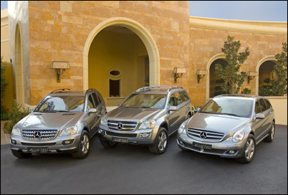
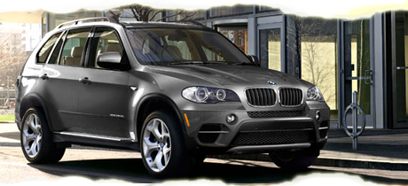
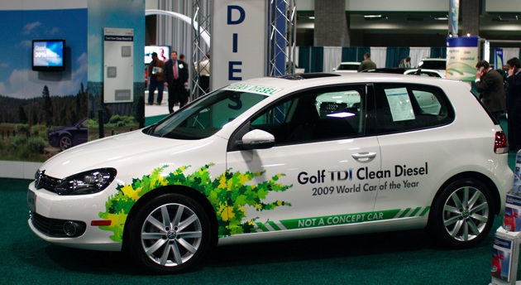
Can Diesels be “Clean”?
“Clean-diesel” Technology is REAL and AVAILABLE
Volkswagen is the problem, NOT the diesel engine
WVU has a long history – We are “diesel guys”
Some history…
  1974: Volkswagen was sued by US EPA for emissions defeat devices on four MY1973 vehicles. Settled for $120,000. Ref: http://brandilawblog.com/2015/10/01/history-repeats-itself-volkswagen-was-sued-by-the-epa-for-cheating-on-emissions-in-1974
  2005: Failure to promptly notify EPA and to correct a defective oxygen sensor At least 329,000 of 1999, 2000, 2001 Golfs, Jettas, and New Beetles. $1.1 Million fine.
                Ref: http://www.cnbc.com/2015/09/23/vw-had-previous-run-in-over-defeat-devices.html
http://www.roadandtravel.com/roadtests/buyersguides/2012-buyers-guide/green-suv-buyers-guide/bmw-x5--xdrive-35d-clean-diesel.html
http://auto.howstuffworks.com/fuel-efficiency/alternative-fuels/how-clean-diesel-fuel-works2.htm
http://clean-green-cars.blogspot.com/2010_01_01_archive.html
Notes:
Regulatory changes, technology accelerator

Slide 18

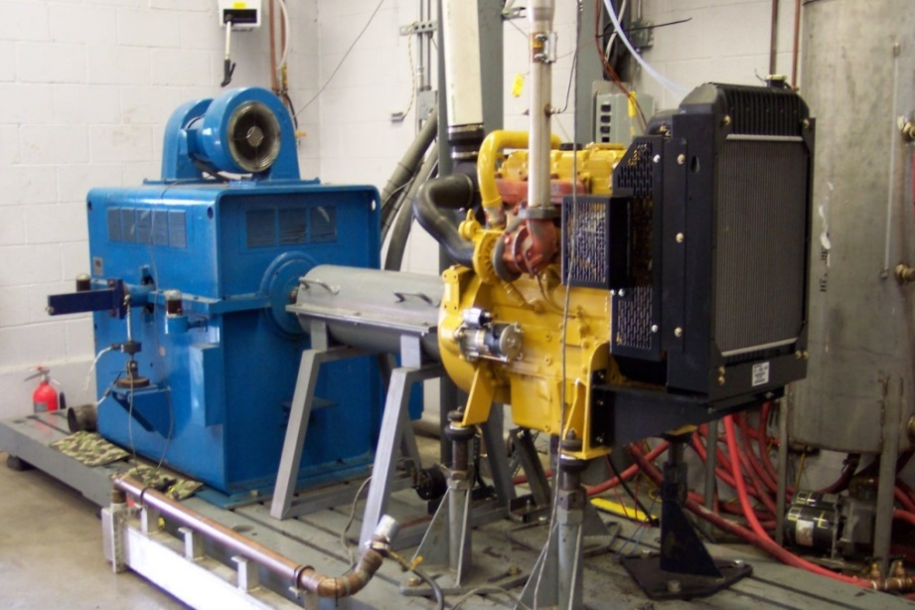
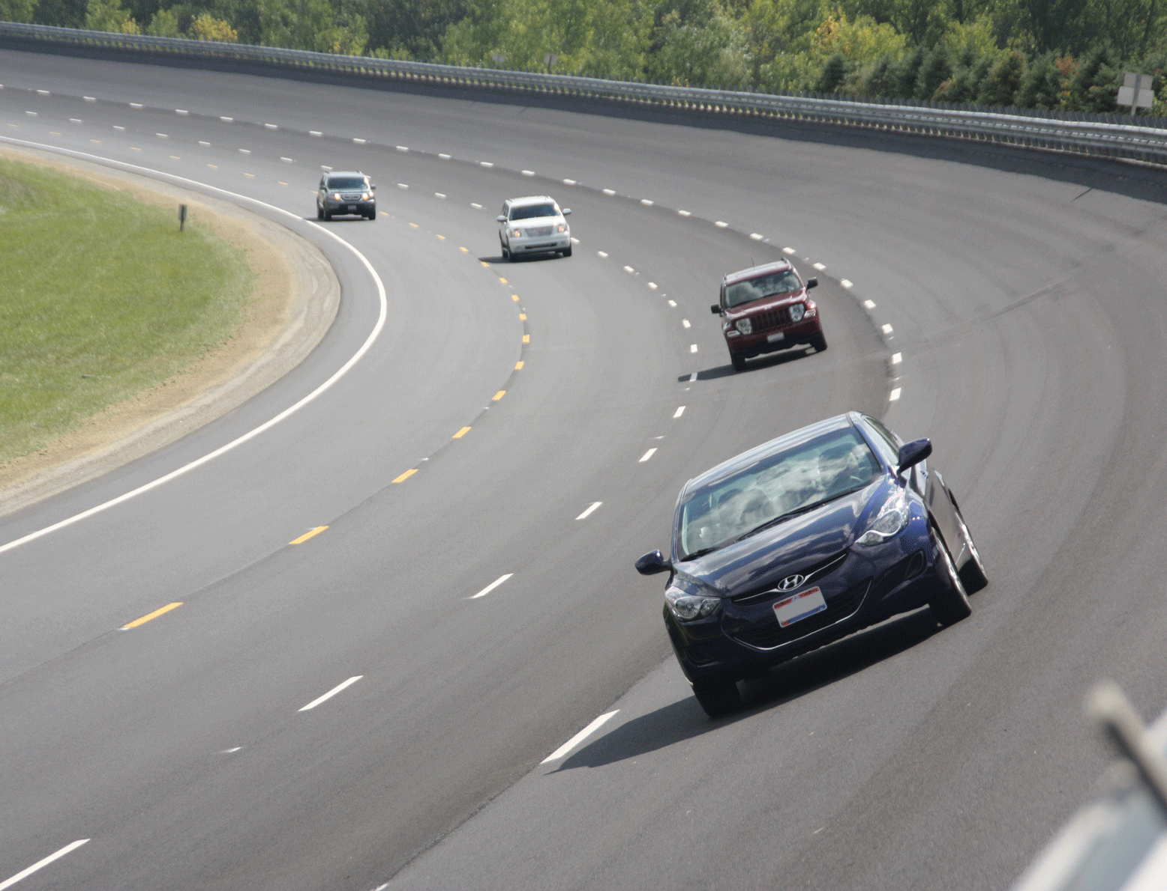
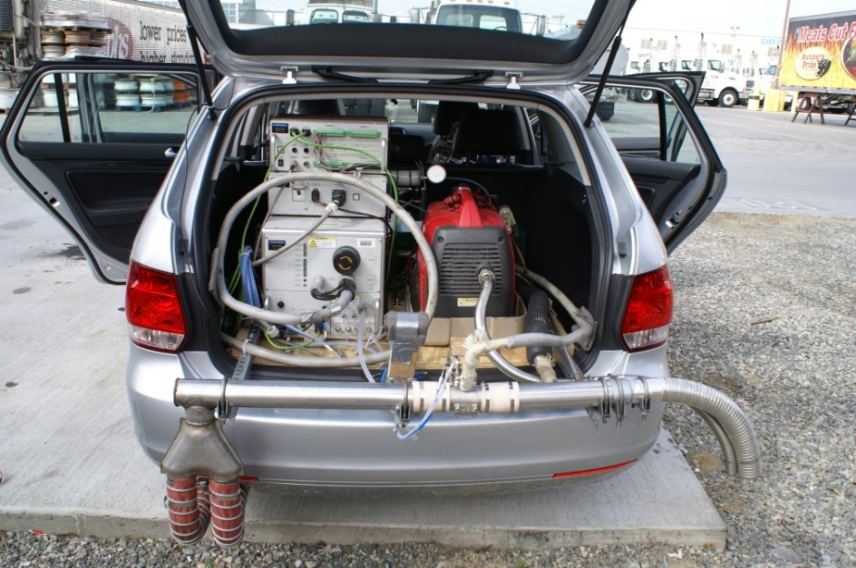
Development and Compliance
Certification
Fundamental
Drive Cal
?
Real World
?
http://www.trcpg.com/facility-tour/75-mile-test-track.aspx
Notes:
LDV is much different than HDV
Real-world (PEMS) is THE identifier for defeat devices
RDE in 2017

Slide 19



Regulatory Action?
  Increased Certification Procedures to Identify Off-Cycle Emissions
  On-Road Emissions Measurements
    Similar to HDD Requirements
  Expand Certification Test Ambient Conditions
    Low/High Temperature, Humidity, Elevation
  Real-world Certification/Compliance
    Geofencing
    Incentivize Future Reductions
  Drive Cycles
    More Representative of “Real-World” Driving
    “Surprise” Cycles or “Periodically Refreshed”
  NTE and ?-Based Windows
  OBD….I/M….??

Slide 20
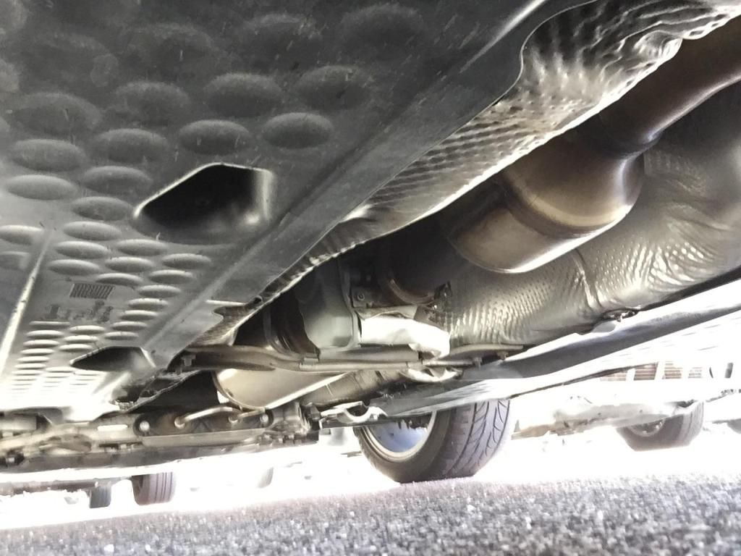
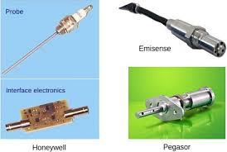
Technology Acceleration?
  Aftertreatment Development
  Sensor Development
  Advanced Combustion Techniques
  Advanced Driveline Strategies
  Fuel Alternatives
  Connected Vehicle
  Enhanced Integration
Ref: www.dieselnet.com

Slide 21

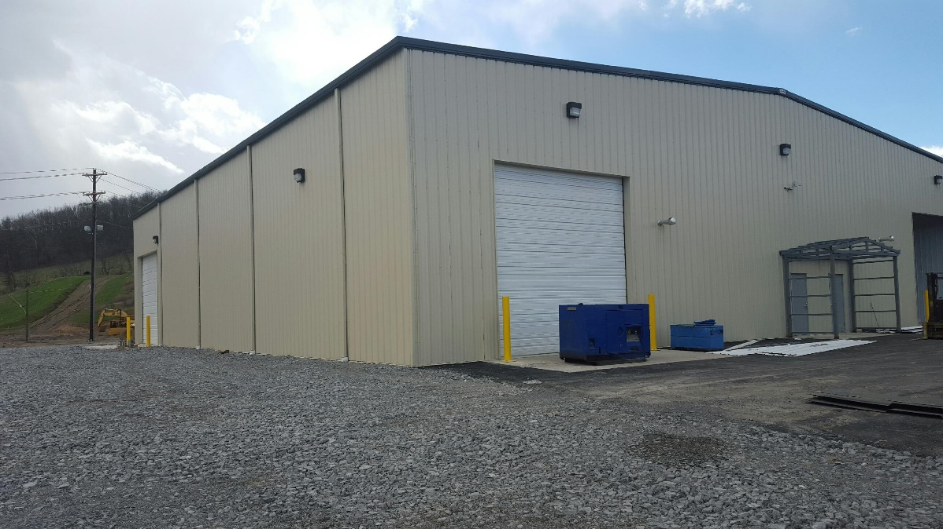
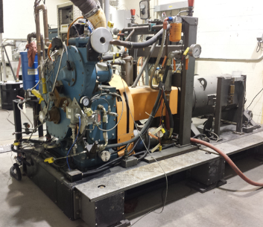
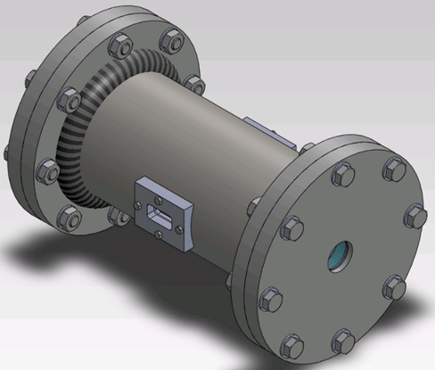
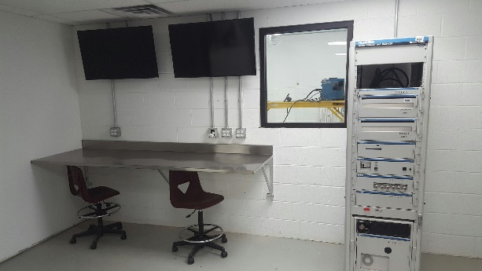
You Like Us…You Really Like Us
Advanced Combustion Laboratory
Engine and Emissions Research Laboratory
Vehicle and Engine Testing Laboratory

Slide 22
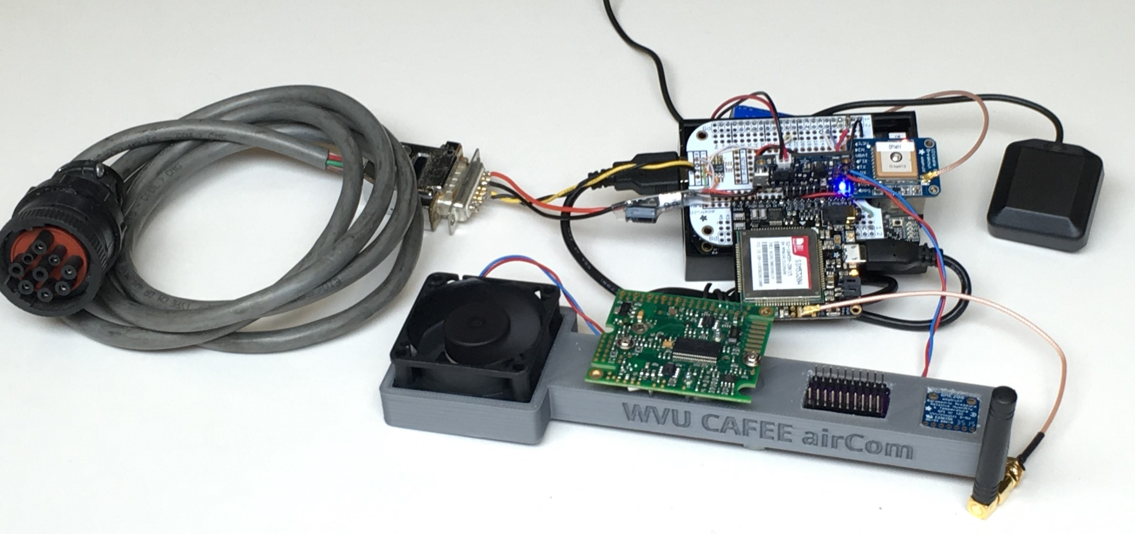
AirCom - Prototype
Barometric Pressure/Temperature Sensor
  Bosch BMP180
  Resolution: up to 0.03hPa / 0.25m (300-1100hPa)
  T accuracy: ± 2°C (Range: -40 to +85°C)
CO₂ Sensor
  NDIR K-30, 1% CO2 range
  Accuracy: ± 30ppm, ± 3% of measured value
Humidity Sensor
  Sensirion SHT21
  Resolution: 0.04 %RH, Accuracy: ± 2 %RH

Slide 23
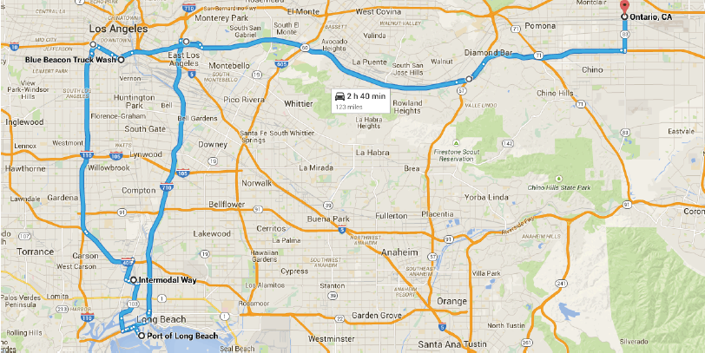
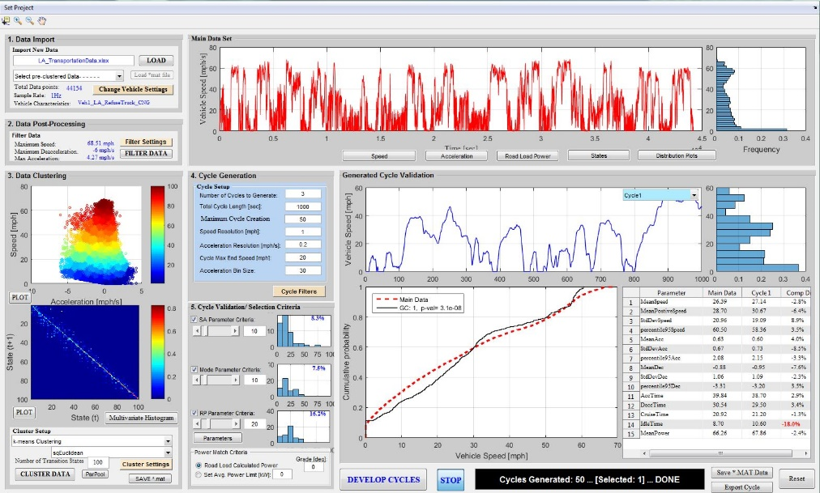
WVU Markov Drive Cycle
ADVANTAGES:
Interactive drive cycle generation tool for rapidly creating multiple unique cycles for any vehicle application that would statistically represent the real world driving Can generate both chassis dynamometer and engine dynamometer drive cycles Utilizes stochastic analysis using Markov Chain model opposed to traditional “micro-trip” based methods to create drive cycles Tool could be used by regulators to create drive cycles more representative of “real world” driving and surprise drive cycles to test engine and vehicles.
Real world on-road driving dataset
Drive Cycle Generating Tool
. . .
. . .

Slide 24

Thank You!
www.cafee.wvu.edu
Daniel.Carder@mail.wvu.edu
304-293-0650/304-288-7917
Acknowledgement

