Slide 1

“Low-Cost” Air Quality Sensor Evaluation Update
South Coast Air Quality Management District
Vasileios Papapostolou, Sc.D.
Air Quality Specialist
Portable Emissions Measurement Systems
International Conference & Workshop
University of California, Riverside
March 17th, 2016

Slide 2
Outline
      Background
      Field testing
      Laboratory testing
      Sensor testing results
      AQ-SPEC Website
      Upcoming activities
      Expected results & next steps

Slide 3
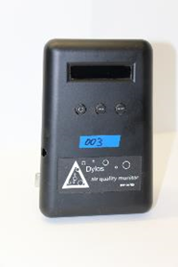
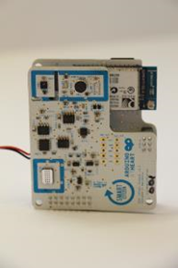
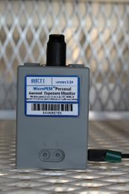
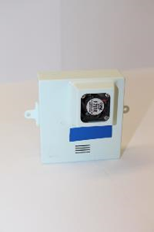
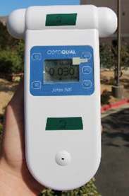
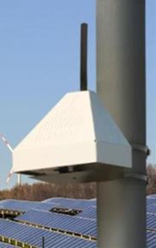
Background
      …air quality sensor technology…
      Rapidly proliferating
      Tremendous potential
        Low cost
        Ease of use
      Multiple potential applications
        Spatial/Temporal air quality info
        Fence-line applications
        Regulatory/Academic/Citizen scientist
      How reliable/accurate are they??
      Need to systematically evaluate their performance

Slide 4
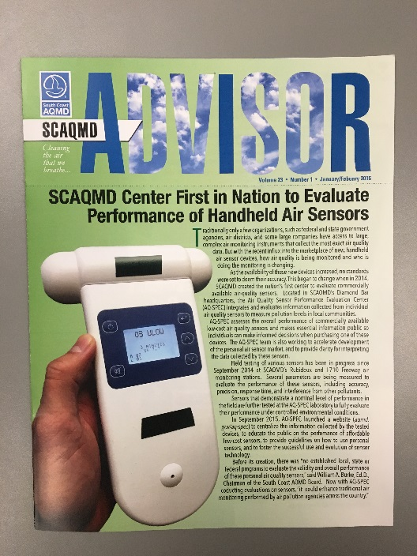
Background
AQ-SPEC was established in July 2014
An investment of $1,000,000 to date
Main Goals & Objectives
      Provide guidance and clarity for ever-evolving sensor technology & data interpretation
      Promote evolution/use of sensor technology
      Minimize confusion
Sensor Selection Criteria
  Commercially available
      Optical
      Electrochemical
      Metal-oxide
  Real- or near-real time
  Criteria pollutants & air toxics

Slide 5
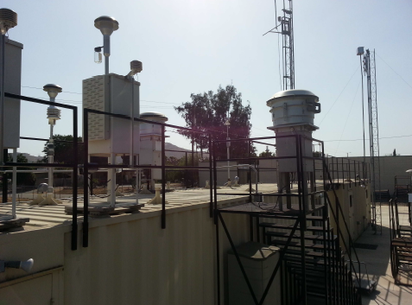
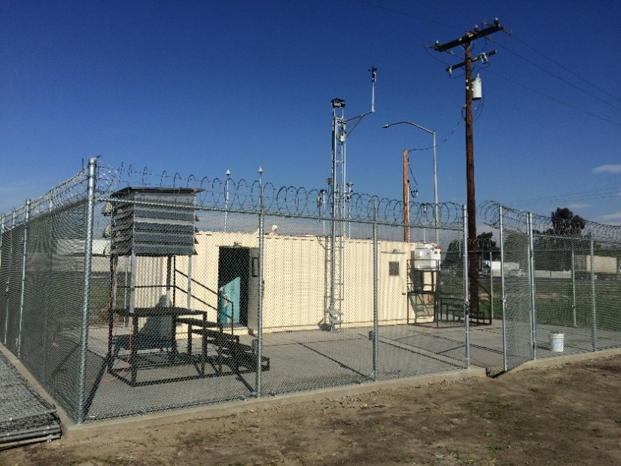
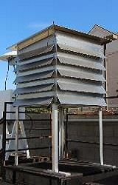
Field Testing
SCAQMD Riverside-Rubidoux inland stationary ambient monitoring site
SCAQMD I-710 near-roadway stationary ambient monitoring site
Field testing started in September 2014
Both sites are fully equipped with FEM/FRM instruments
Each type of sensor is deployed for two months

Slide 6
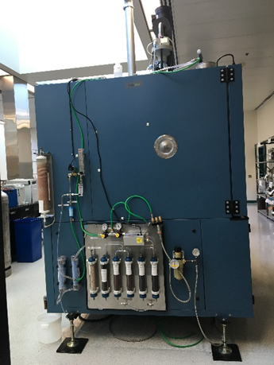
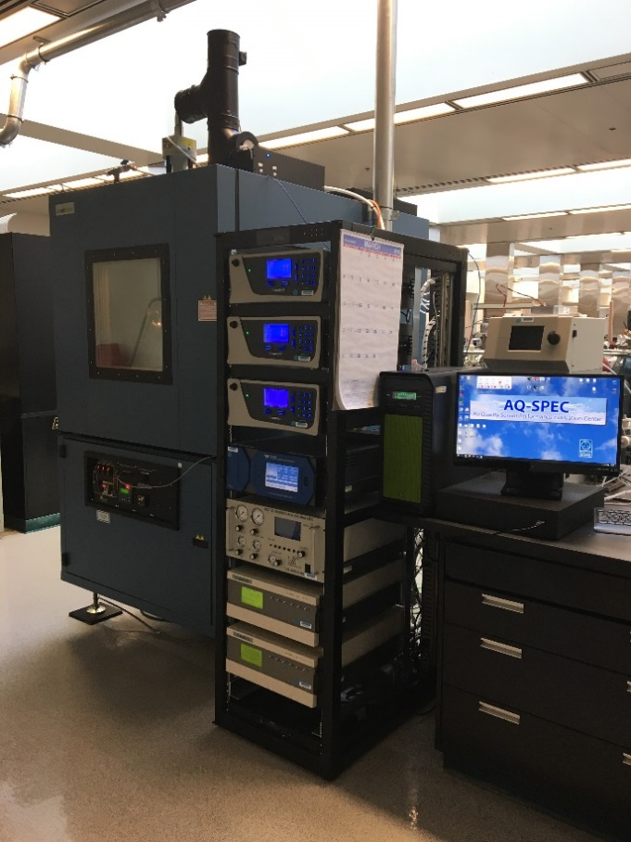
Laboratory Testing
The chamber system consists of:
Two professional-grade chambers
Dry, gas- and particle-free air system
Artificial aerosol generation system
Gas dilution calibrator and ozone generation system
Array of FRM/FEM (U.S. EPA approved) and BAT instruments
Computer software to control the experimental parameters such as gas/particle concentration, temperature and relative humidity

Slide 7
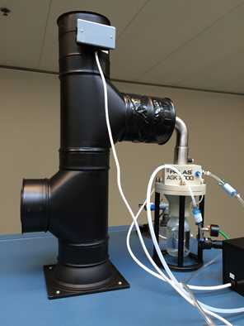
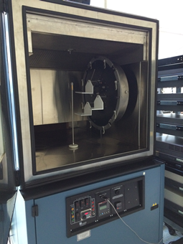
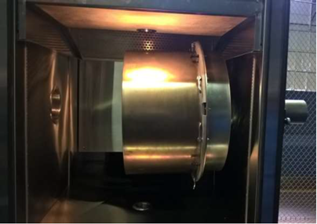
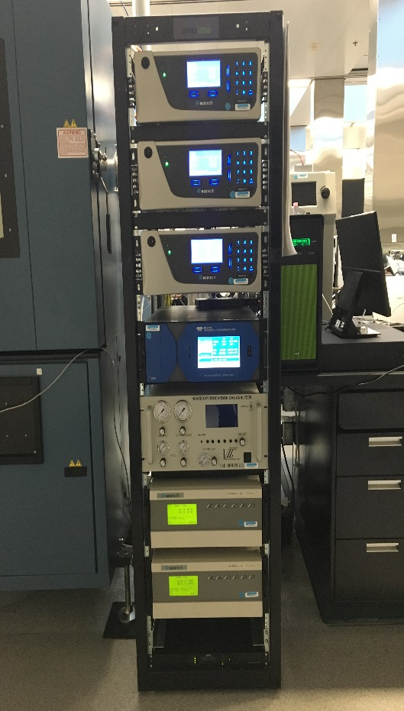
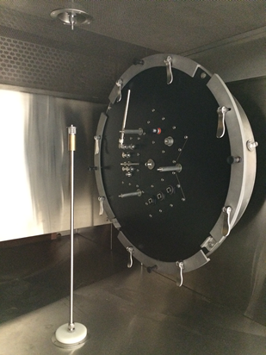
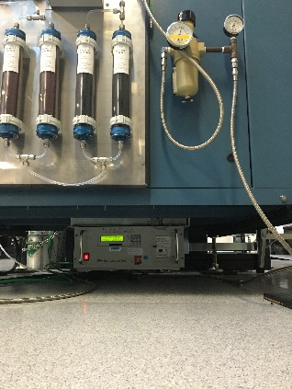
PM sensors testing
Outer chamber
Stainless Steel walls
Rectangular shaped
Volume: 1.1 m³
Particle instruments:
GRIMM EDM 180
TSI FMPS 3091
TSI APS 3321
Gas sensors testing
Inner chamber
Teflon-coated Stainless Steel
Cylindrical shaped
Volume: 0.11 m³
Gas instruments:
CO (EC 9830T)
NO_{x} (Serinus 40)
O₃ (Serinus 10)
SO₂ (EC 9850T)
H₂S (Serinus 55)
THC/NMHC (VIG 200T-S)

Slide 8
Laboratory Testing
Under controlled temperature and relative :
PM sensors are tested with known aerosol concentrations/size range
Gaseous sensors are tested with known concentrations of target and interferent gases
Evaluation parameters are:
Accuracy
Precision
Linearity of sensor response
Measurement range
Detection limit
Climate susceptibility
Bias
Measurement duration
Measurement frequency
Selectivity
Interferences
Sensor decay and expiration
Drift
Response to loss of power
Chamber Temperature range: -32 °C (-26 °F) to +177 °C (350 °F)
Chamber Relative Humidity range: 10% to 95%

Slide 9
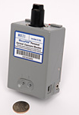
RTI MicroPEM PM_{2.5}
 | Field (ambient) | Laboratory (chamber)
Intra-model variability | 9.4% (13.4 µg/m³) | 15.1%
Data recovery (3 units) | 30%, 80%, 80% | 100% from each one
Correlation (R²) | 0.80 | 0.99
Field testing
Laboratory testing

Slide 10
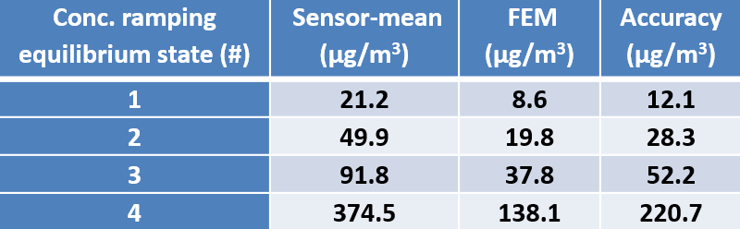
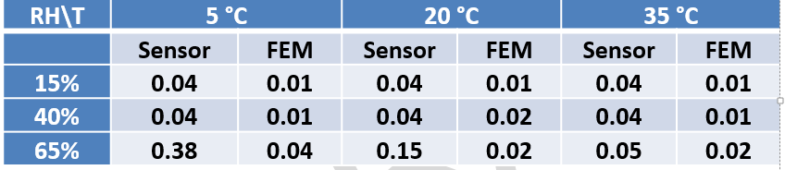
RTI MicroPEM PM_{2.5}
Susceptibility to weather changes
Accuracy
Precision
An example from medium concentration range (0-40 µg/m³)

Slide 11
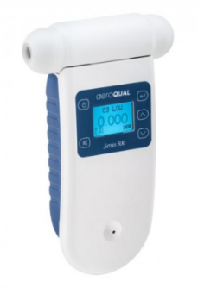
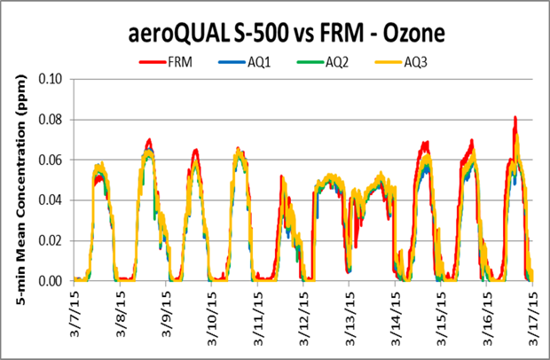
Aeroqual S-500 Ozone
 | Field (ambient) | Laboratory (chamber)
Intra-model variability | 4.5% (29 ppb) | 9.5%
Data recovery (3 units) | 100% from each one | 94%, 100%, 91%
Correlation (R²) | 0.85 | 0.91
Field testing
Laboratory testing

Slide 12
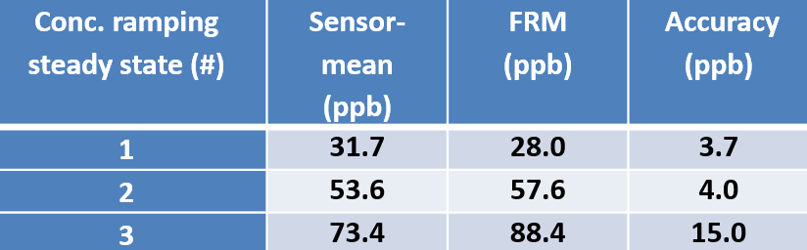
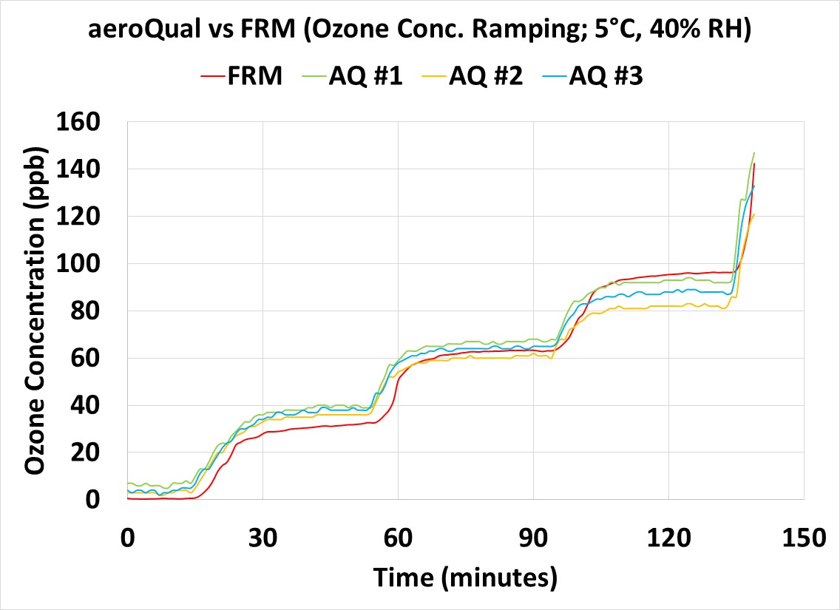
Aeroqual S-500 Ozone
Accuracy
Susceptibility to weather changes
Precision
Excellent precision across conditions

Slide 13
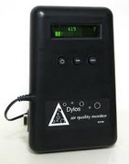
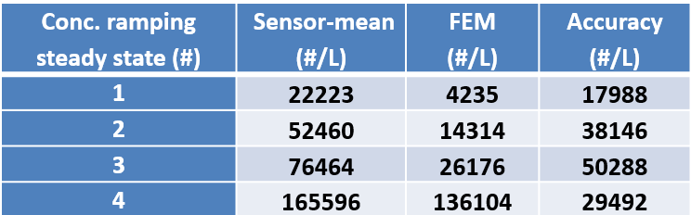
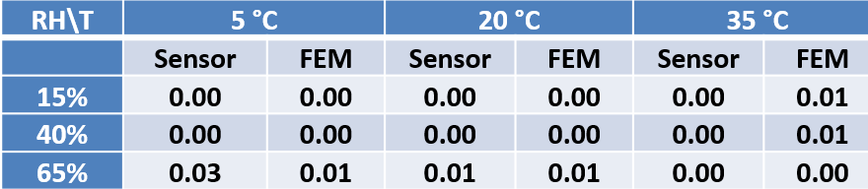
Dylos DC1700
 | Field (ambient) | Laboratory (chamber)
Intra-model variability | 14.2% (12,000 #/L) | 9.2% (150,000 #/L)
Data recovery (3 units) | 100% from each one | 100%, 97%, 100%
Correlation (R²) | 0.81 | 0.89
Accuracy
Susceptibility to weather changes
Precision
An example from medium concentration range (0-1.0*10⁵ #/L)

Slide 14
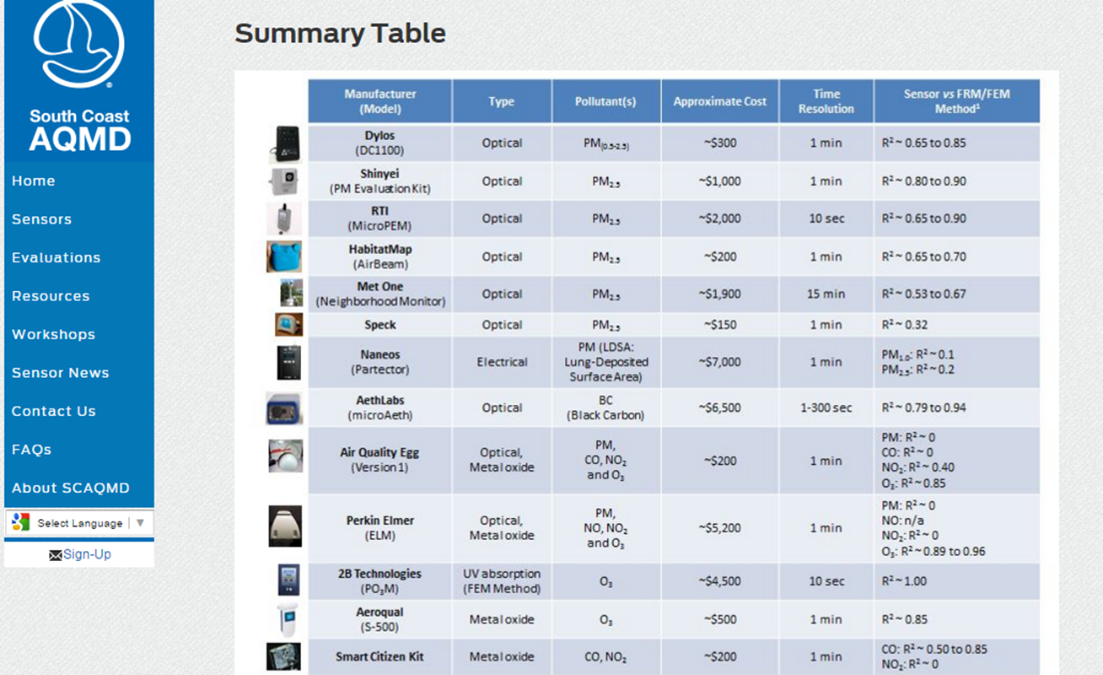
www.aqmd.gov/aq-spec

Slide 15
www.aqmd.gov/aq-spec

Slide 16
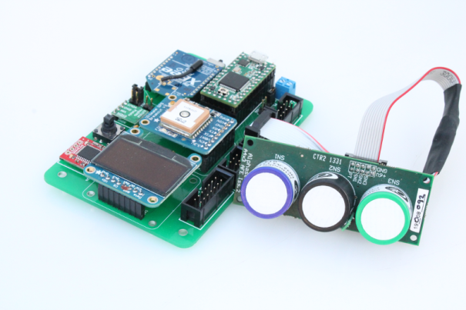
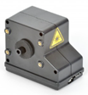
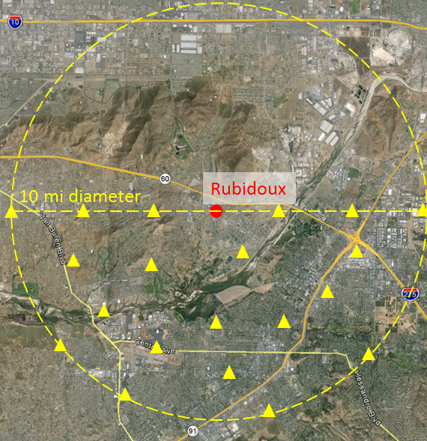
Upcoming AQ-SPEC related Activities
  Pilot Study #1:
Create a small sensor network
  20-25 sensors deployed at:
    Existing monitoring stations
    Near road sites
    Public and private locations
  Target PM, O₃, NO₂, CO
  Test sensor durability
  Show ability to scale up in future
Test connectivity options
    Cellular
    LoRa WAN
    Digi mesh
Explore various data ingestion,
storage, and analytics solutions

Slide 17
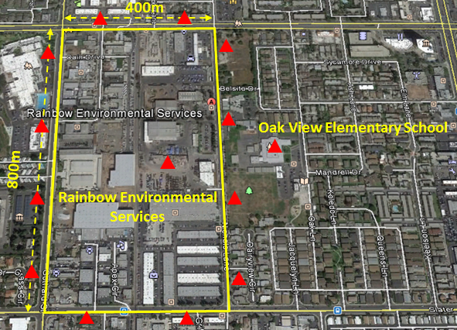
Upcoming AQ-SPEC related Activities
  Pilot Study #2:
  Monitor PM emissions from a waste disposal facility
  15-20 sensors deployed
    Around the facility
    Inside the facility
    Downwind of facility
  Test sensor durability
Use wireless mesh network
Explore various data ingestion, storage, analytics and mapping solutions
Provide real-time feedback and alerts
Elementary School
Waste Disposal Facility

Slide 18
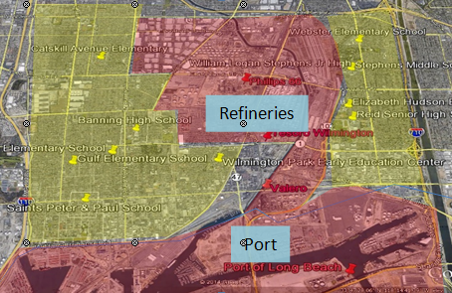
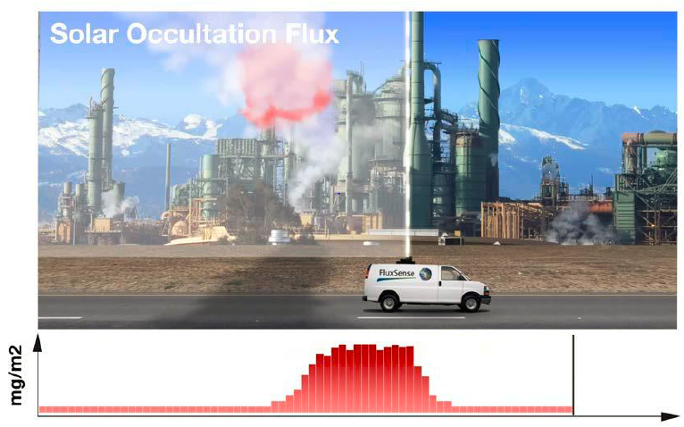
Upcoming AQ-SPEC related Activities
U.S. EPA STAR grant “Community-scale Air Toxics Ambient Monitoring”:
“Application of Next Generation Air Monitoring Methods to Characterize Hazardous Air Pollutant Emissions from Refineries and Assess Potential Impacts to Surrounding Communities”
June 1, 2015 – May 31, 2018
Use “low-cost” sensors and optical remote sensing methods to assess the impact of industrial Hazardous Air Pollutant (HAP) emissions on surrounding communities

Slide 19
Expected Results and Next Steps
Provide necessary information to appropriately select, use, and maintain sensor devices and correctly interpret sensor data
Promote better and more responsible use of sensors
Discover new and more efficient ways to interact with local communities
Provide manufacturers with valuable feedback for improving current and next generation sensor technology
Create a “sensor library” to make “low-cost” sensors available to communities, schools, and individuals across California

Slide 20
Thank you – Questions?

Slide 21
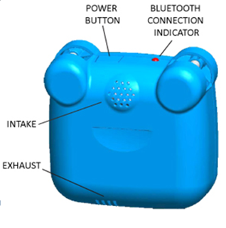
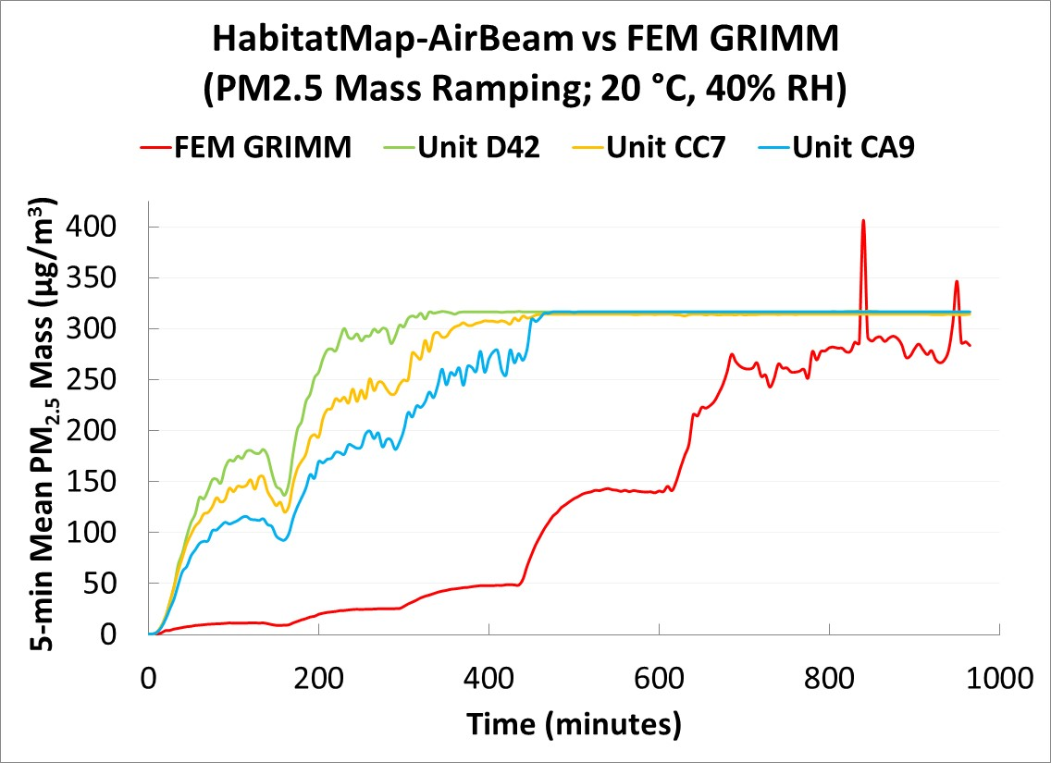
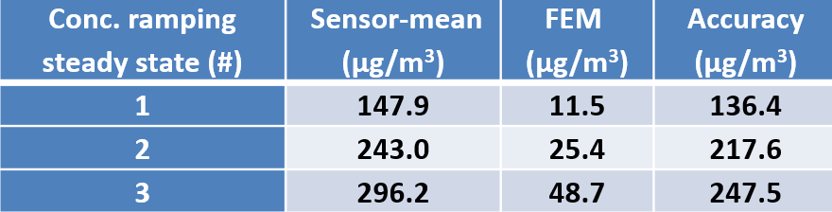
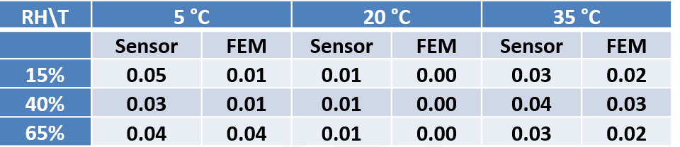
AirBeam PM_{2.5}
 | Field (ambient) | Laboratory (chamber)
Intra-model variability | 49.6% (35 µg/m³) | 58.8% (150 µg/m³)
Data recovery (3 units) | 99% from each one | 100% from each one
Correlation (R²) | 0.65 | 0.87
Accuracy
Susceptibility to weather changes
Precision
An example from medium concentration range (0-40 µg/m³)

