Slide 1
Spark-Plug Sized Exhaust Particle Sensors for OBD and Emissions Monitoring
Imad A. Khalek & Vinay Premnath, Southwest Research Institute
6th International PEMS Conference & Workshop
March 17&18, 2016, CE-CERT, Riverside, CA

Slide 2
Background
PSPD-I was completed in May, 2015
  Year 1 focus was on Sensor Performance
  Year 2 focus was on Sensor performance as a function of durability
PSPD-II on going
  Year 1 focus on sensor variability, sensor cross sensitivity and charge/conductivity of exhaust particles from different engine technologies

Slide 3
Particle Sensor Applications
Onboard vehicles downstream of exhaust particle filters for:
  OBD Requirement (highway vehicles, potentially nonroad)
    CARB Heavy-Duty & Light-Duty On-Highway: 2016 Enforcement
    Light-Duty Gasoline: 2019 Enforcement
  Leak detection and durability
    QA/QC
    In-use screening
  Onboard vehicles engine out
    Active particle emissions control
    Engine mapping (real world)
    EGR cooler diagnostics through particle dynamics
Retrofit applications
In-use testing (simple systems)
Smoke meter replacement (laboratory use)
Onboard for continuous in-use emissions monitoring

Slide 4
Sensor Technology in the Market Place

Slide 5
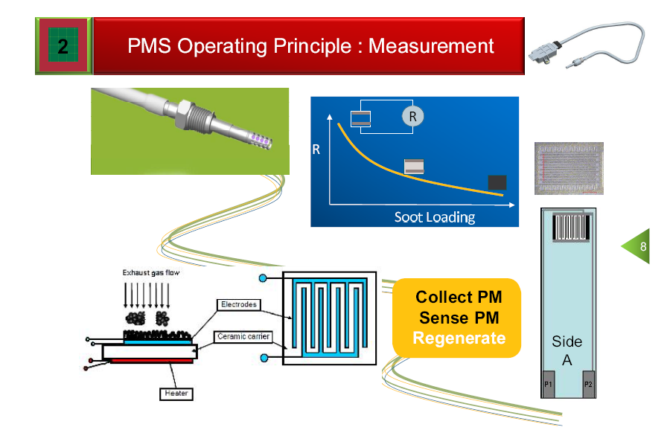
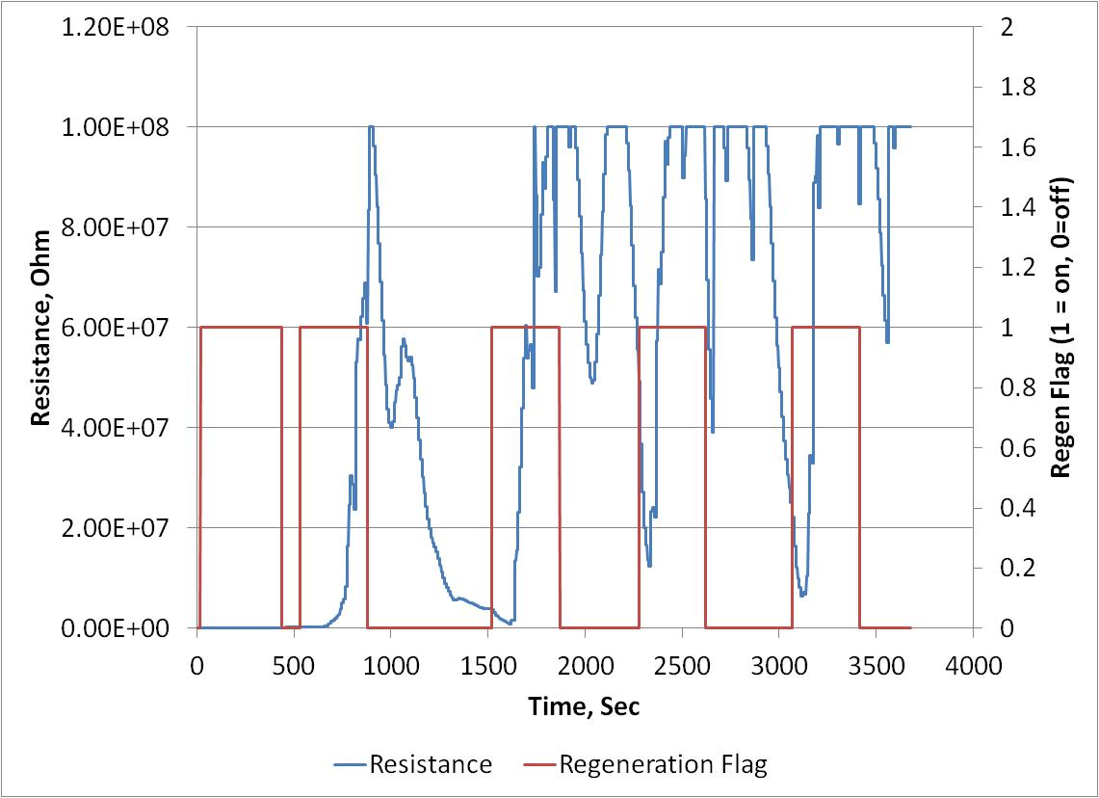
Electric Resistance Cumulative Sensor-Electricfil
Particles collect on an electrode with high electric resistor
Electric resistance decrease with soot loading
As resistance reaches a threshold, sensor is regenerated, and the process starts again
Change in resistance over time is determined between:
  End of Regeneration and Beginning of Regeneration
This sensor provides integrated soot accumulation on the sensor surface over a period of time:
  Time will be short if the concentration is high
  Time will be long if the concentration is low
  For an engine producing ~0.03 g/hp-hr, four regeneration events took place in 20 minutes
Even if the sensor is very accurate, particle deposition will have to be proportional to engine exhaust to get a proper weighting to exhaust emissions, especially under transient operation (a very challenging fluid dynamic problem)

Slide 6
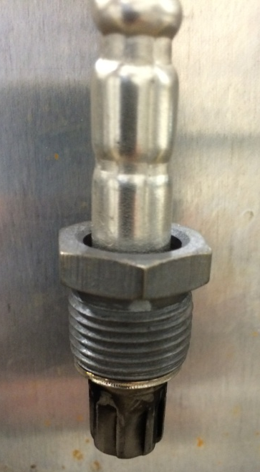
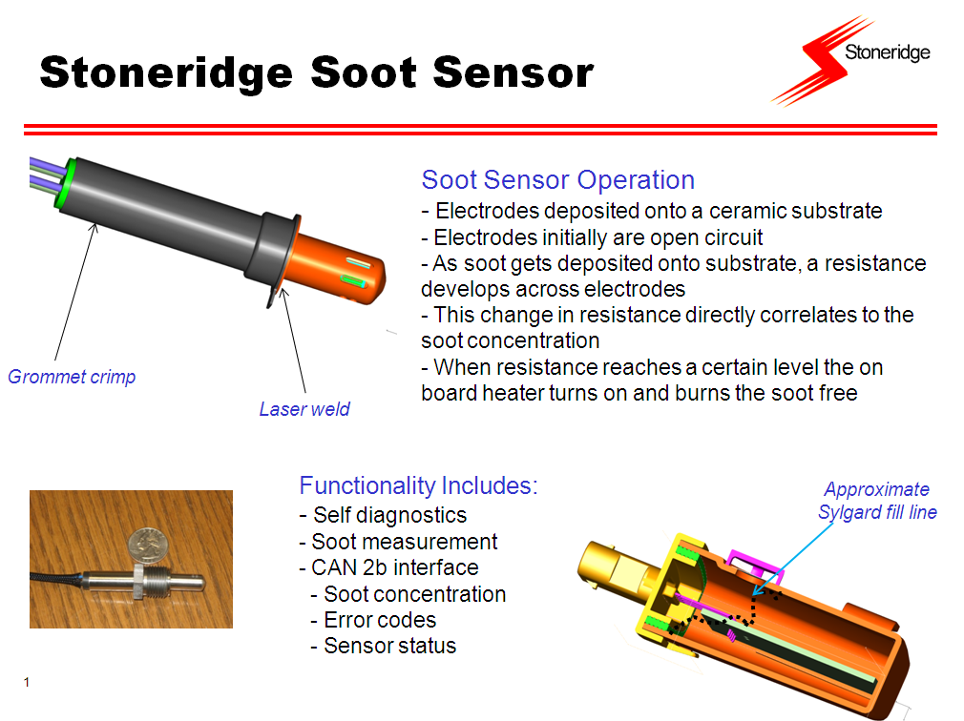
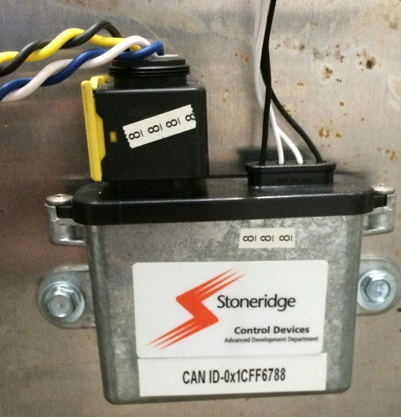
Electric Resistance Cumulative Sensor- Stoneridge

Slide 7
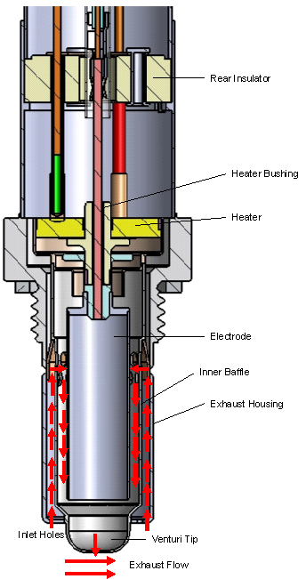
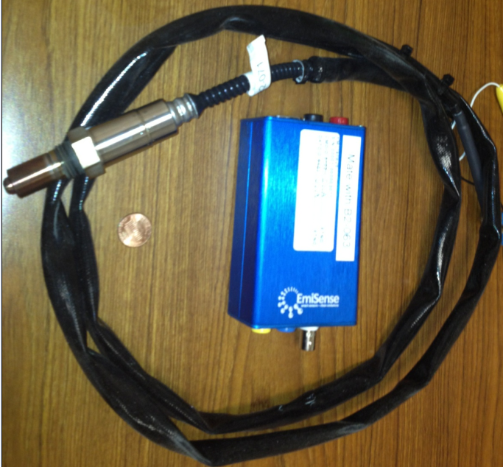
Real Time Sensor- Emisense
A sample of exhaust is extracted into the sensor electrode region by a venturi using exhaust velocity
Naturally charged particles are captured between two electrodes in a electric field
Captured particles break away from the surface of the electrode due to high charge buildup
Electrometer current is an output associated with particle release from the electrode surface.
  Better understanding of sensor fundamental performance is currently being developed by the sensor manufacturer

Slide 8
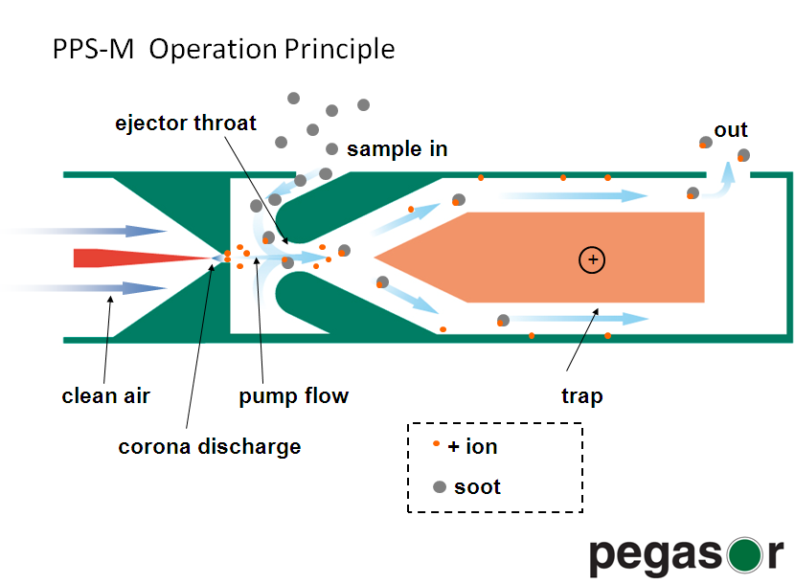
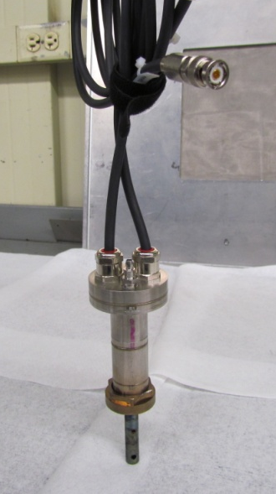
Real Time Sensor- NGK-NTK
Air driven by an external pump is ionized via a positive corona needle to charge the particles
The high velocity ionized air creates a low pressure region where exhaust enters and mixes with it.
The excess ions are trapped
  Newest design does not include an ion trap
The positively charged particles enter and escape a Faraday cup creating a net total charge that is proportional to particle concentration
No trapping of particles is required for this method to work

Slide 9
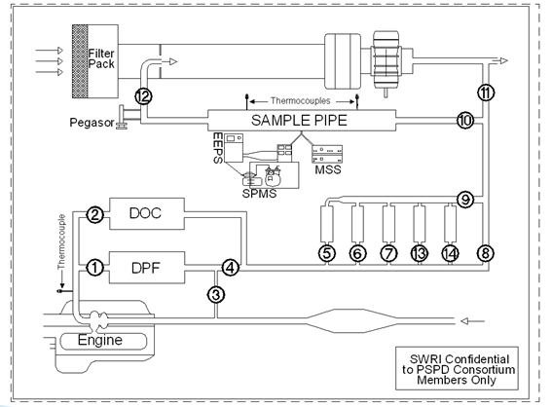
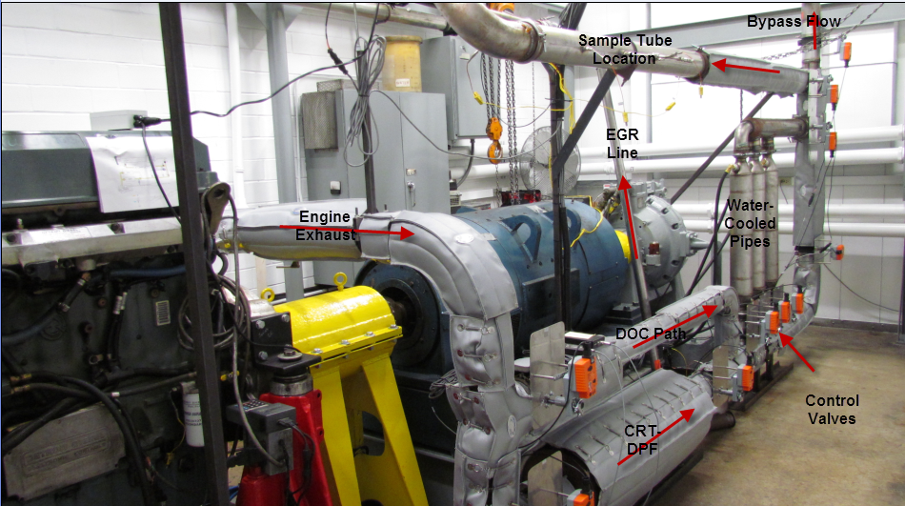
Engine Test Cell Setup - Year 1
1998 Heavy-Duty Diesel Engine

Slide 10
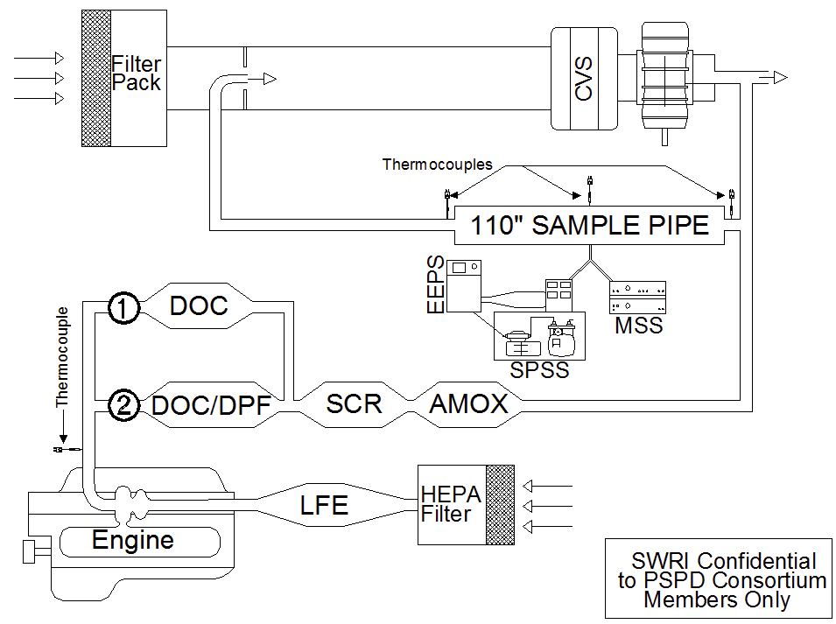
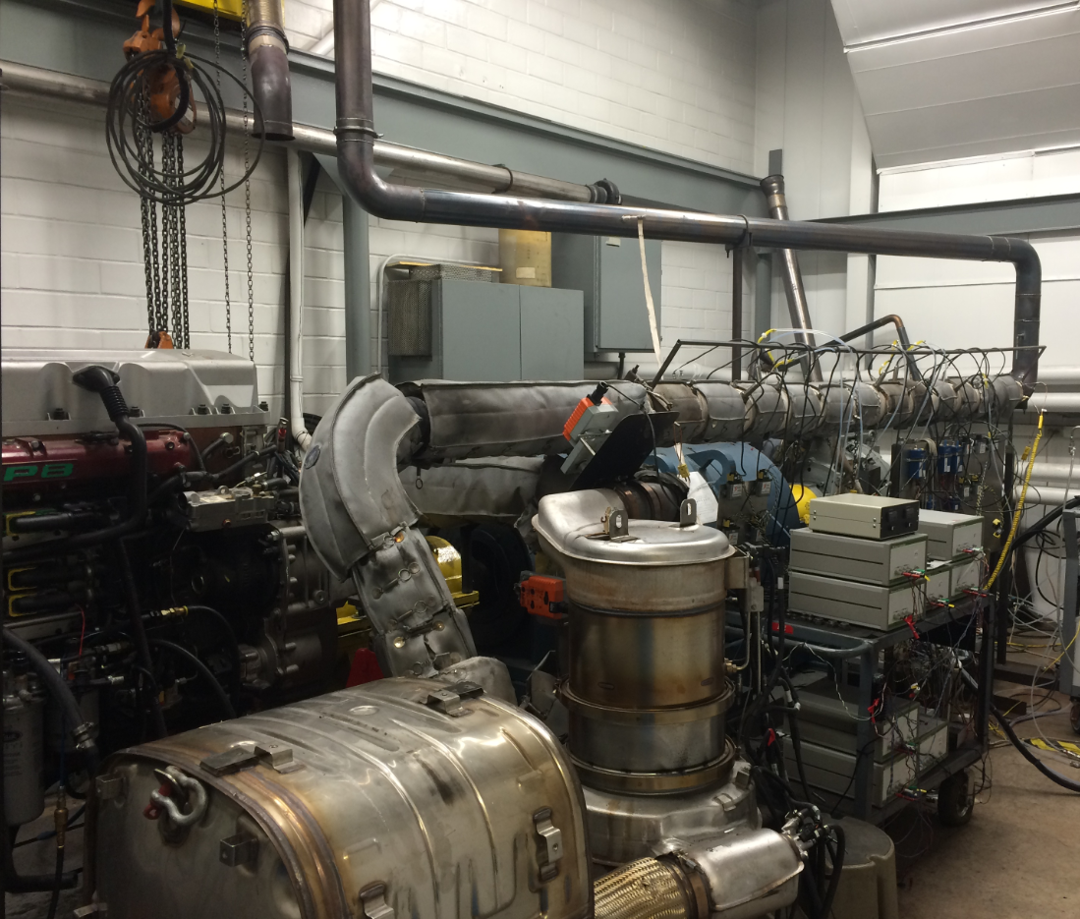
Engine Test Cell Setup - Year 2
2011 Heavy-Duty Diesel Engine

Slide 11
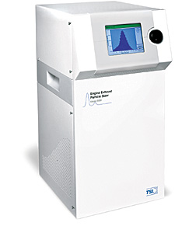
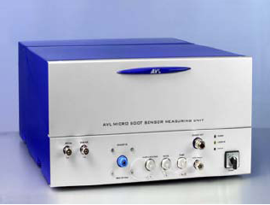
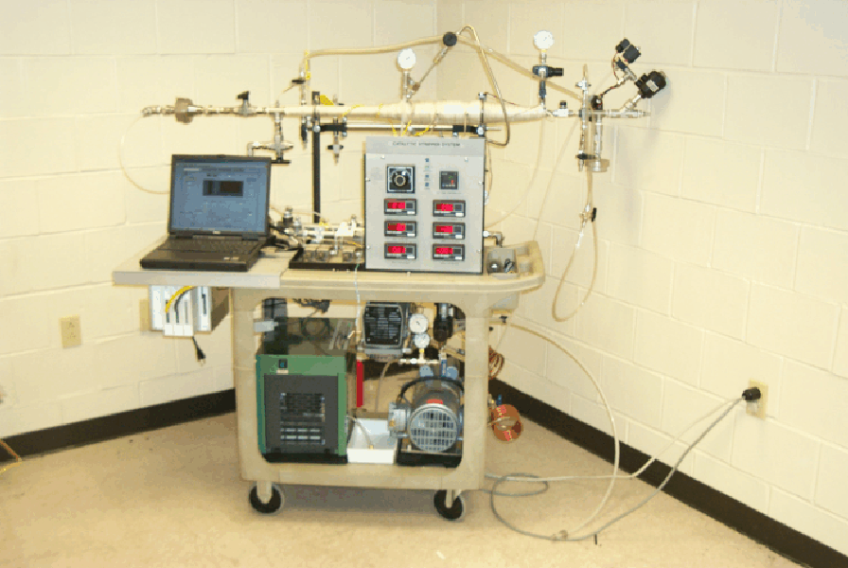
Reference Particle Instruments
TSI EEPS (Size, Number)
AVL MSS (Soot Mass)
SwRI SPSS, Facilitate Solid Particle Measurement
(Used Upstream of EEPS)
Full Flow CVS and Part 1065 Filter measurement were also included for transient testing

Slide 12
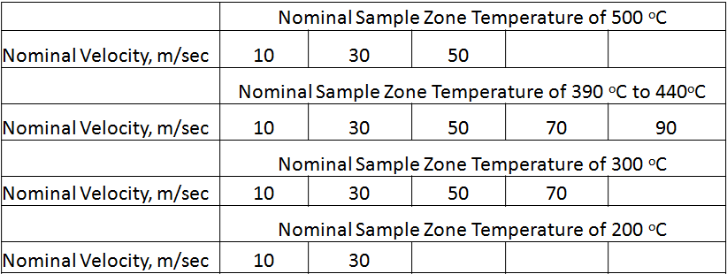
PSPD-I Year 1 Test Matrix
Performance Evaluation
Each condition repeated at 1, 3, 7, 10, 15 mg/m³
Entire matrix repeated for geo. number mean diameter (GNMD) of size distribution at ~55 nm and ~80 nm
Total of over 336 data points
Short-term survivability
Ammonia exposure
  Same engine with urea injection
  8 hours of exposure at ~500 ppm concentration
  FTIR used to measure ammonia concentration
High temperature exposure
  8 hours of exposure at 700 ˚C using High gas temperature burner
Pressure exposure (offline)
  1 hour of sub-atmospheric (0.75 atm) and positive pressure (1.25 atm)

Slide 13
Sensor Experiments Test Matrix – Year 2
Sample sensors were subjected to 50,000 miles of durability with accelerated soot exposure
  0-20,000 miles: DPF out with PM level of 0.001 g/hp-hr
  20,000-30,000 miles: PM level of 0.01 g/hp-hr
  30,000-50,000 miles: PM level of 0.02 g/hp-hr
  Equivalent to 520,000 miles of particle exposure assuming a fully functional DPF at 0.001 g/hp-hr
  Performance checks conducted at 0 mile, 1000 miles, 20,000 miles, 30,000 miles and 50,000 miles
Performance check involved
  One steady-state condition (~5 mg/m³, ~390°C, mean of particle size distribution ~ 50 nm)
  FTP (three repeats), NRTC (three repeats), WHTC (three repeats)
  Included sample and reference sensors totaling 27 sensors in parallel
  For performance checks, emission level was tuned to target 0.03 g/hp-hr (~90 mg/mile) for FTP cycle (OBD Threshold for HD on-highway)

Slide 14
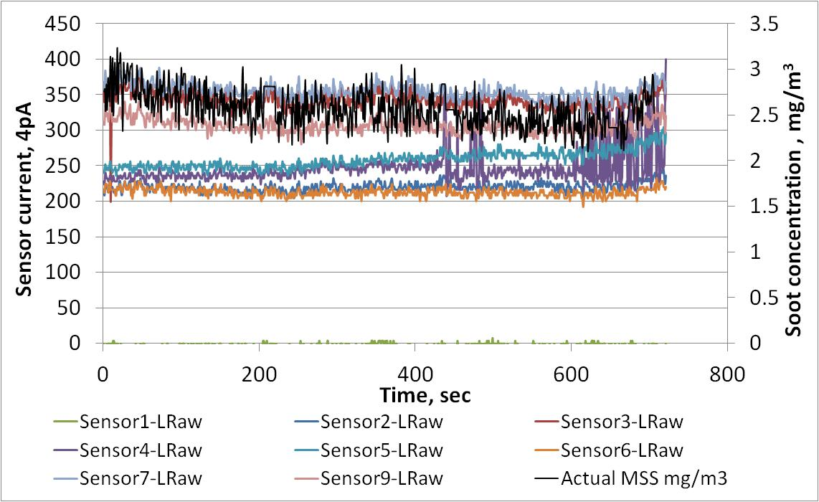
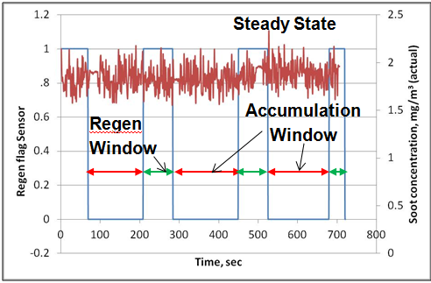
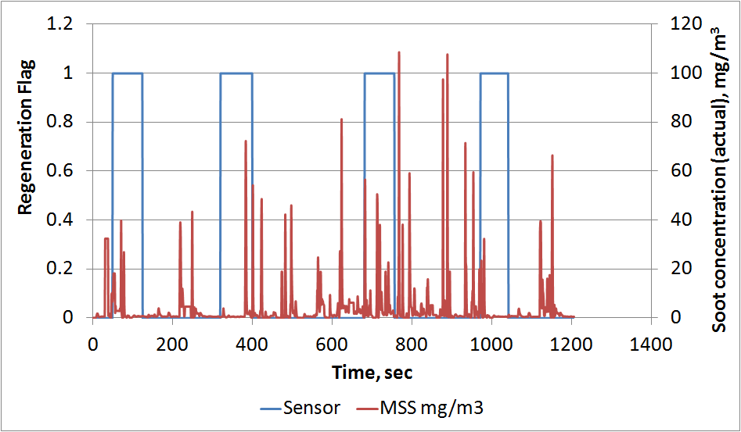
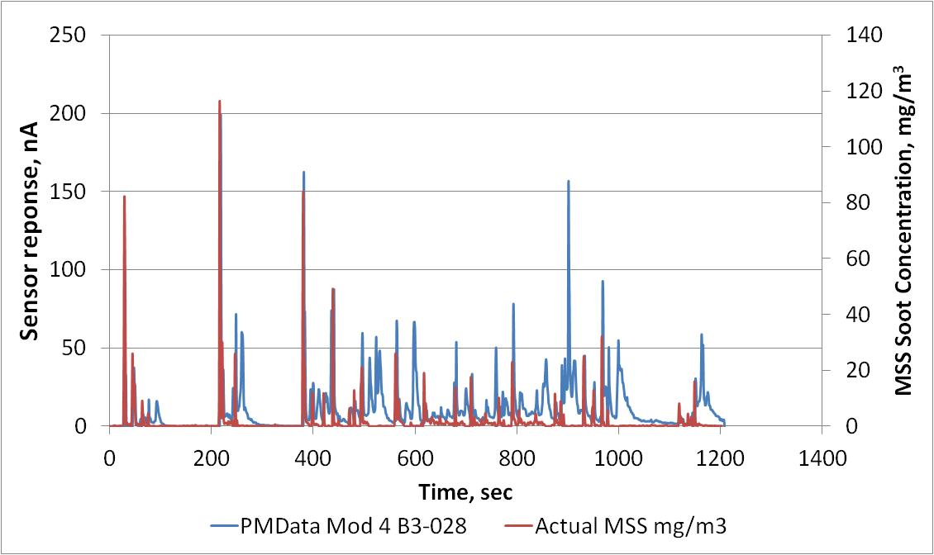
Results – Example of Steady-State (SS) & Transient Sensor Response
Real time Sensor
Cumulative-type Sensor
Real time sensors track Micro-soot sensor reasonably well
For Cumulative sensors, Rate of change of resistance can be correlated with rate of change of soot mass seen by the sensor
Sensor

Slide 15
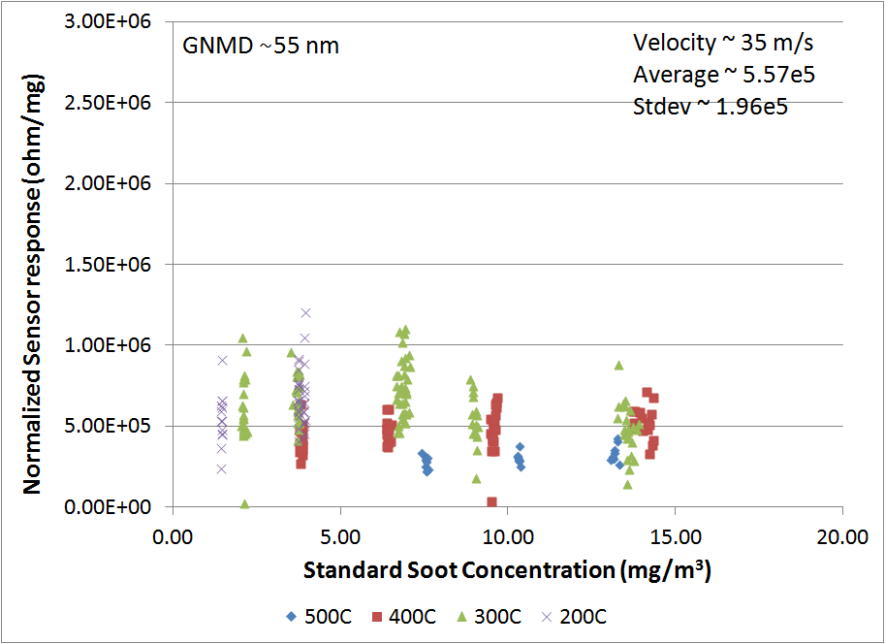
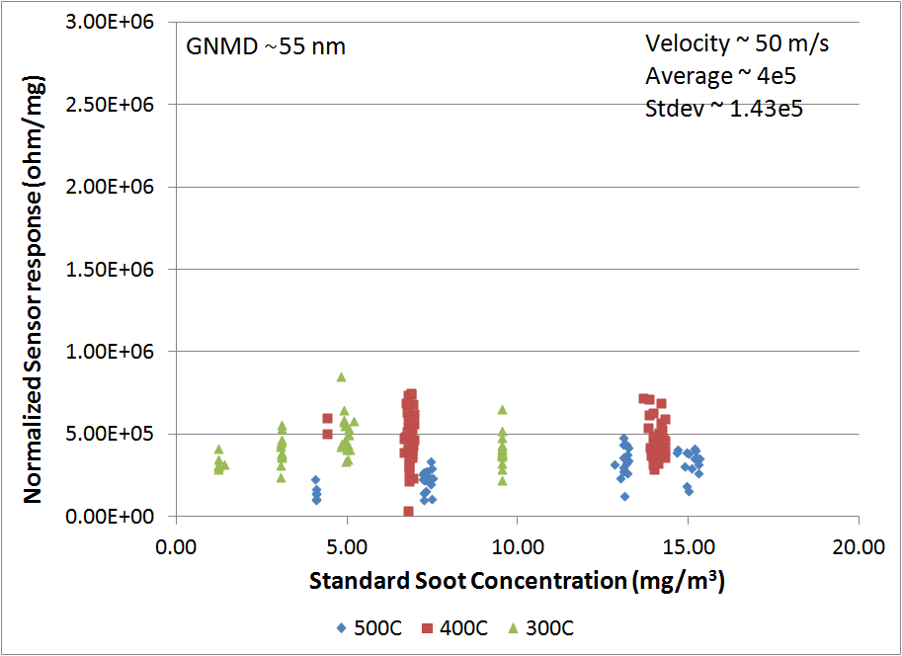
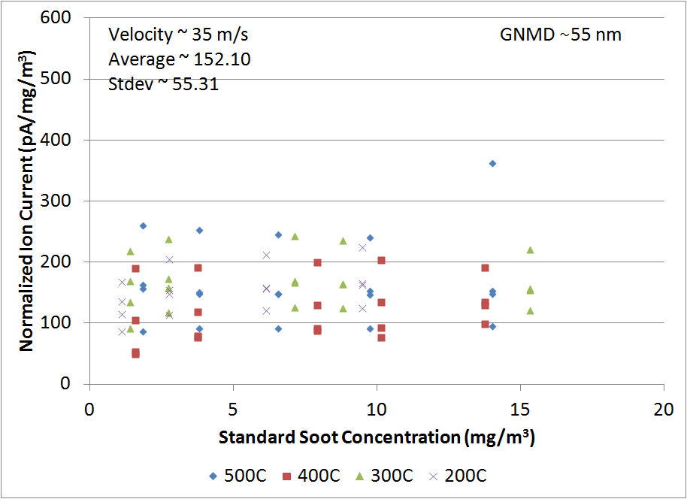
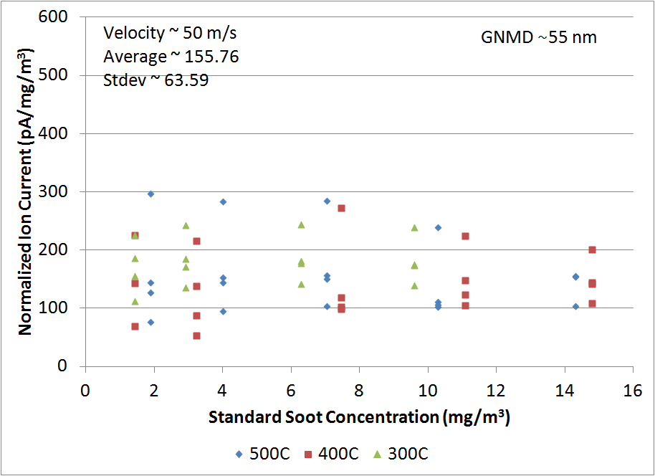
Results – Examples of Sensor Sensitivity Response with Soot Concentration (GNMD ~ 55 nm, SS)
Average sensitivity for all data was 4.85e5 ohms/mg, with a COV of 36%
Average sensitivity for all data was 150.09 pA, with a COV of 37%
Cumulative-type Sensor
35 m/s
Cumulative-type Sensor
50 m/s
Real time Sensor
35 m/s
Real time Sensor
50 m/s

Slide 16
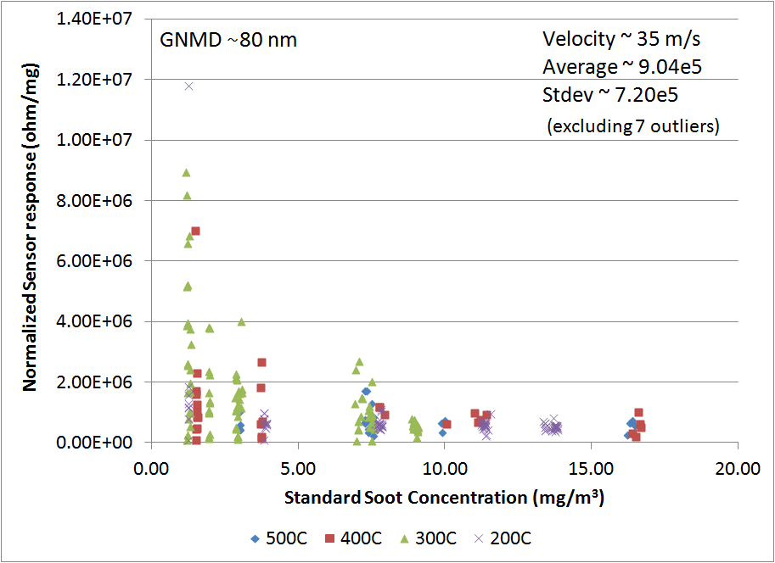
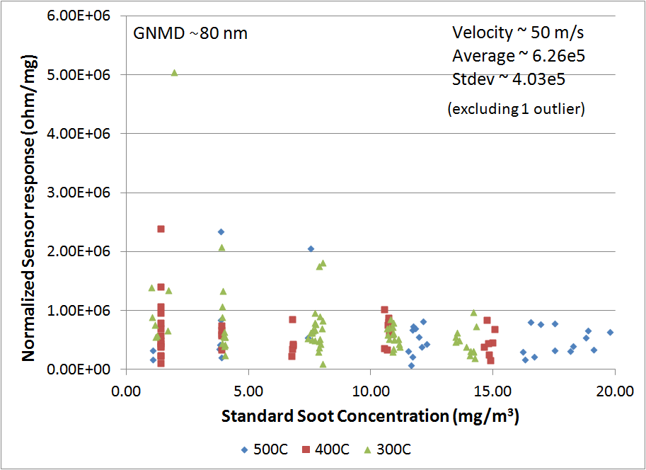
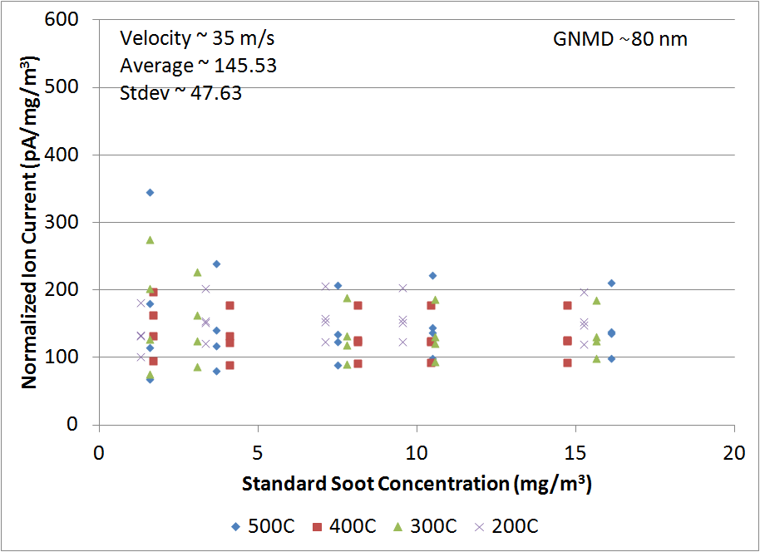
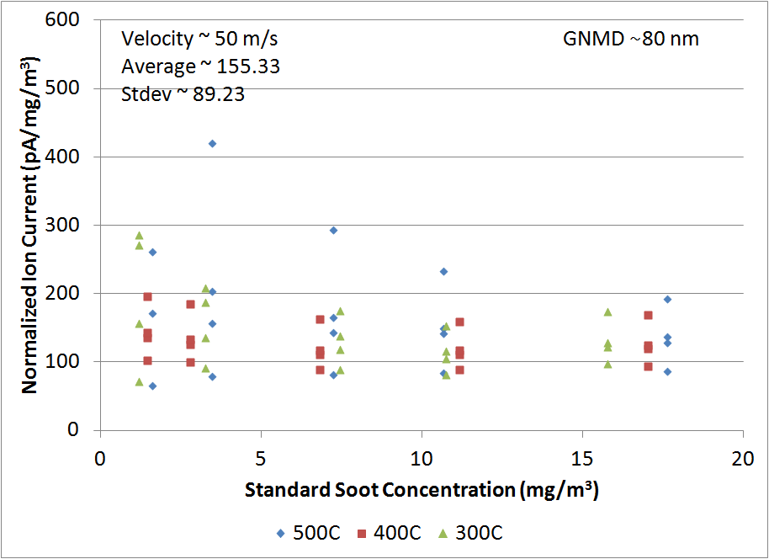
Results – Examples of Sensor Sensitivity Response with Soot Concentration (GNMD ~ 80nm, SS)
Average sensitivity for all data was 8.35e5 ohm/mg, with a COV of 73%
Average sensitivity for all data was 139.76 pA, with a COV of 45%
Cumulative-type Sensor
35 m/s
Cumulative-type Sensor
50 m/s
Real time Sensor
35 m/s
Real time Sensor
50 m/s

Slide 17
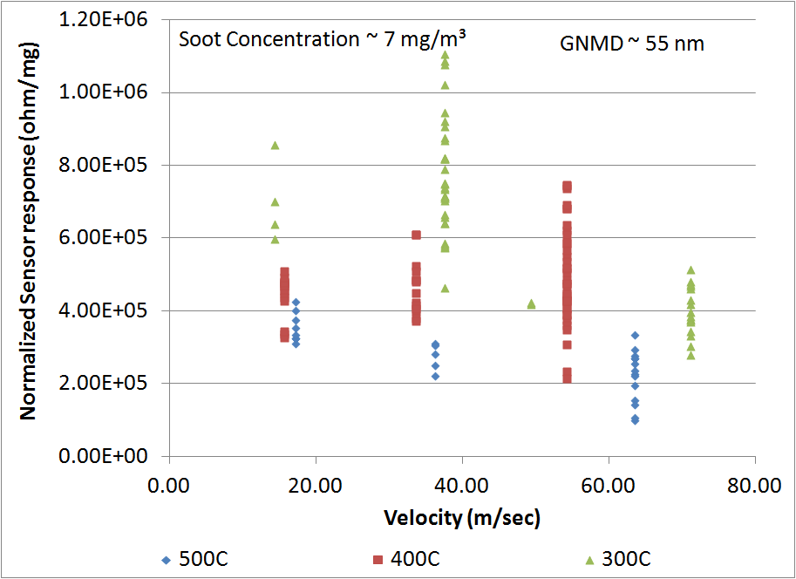
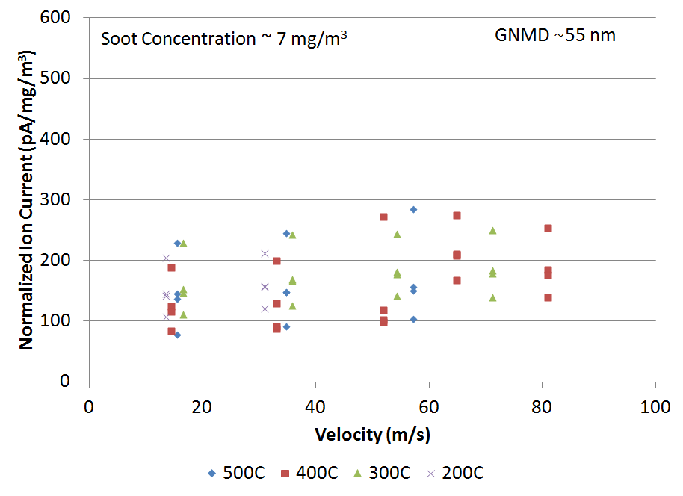
Results – Examples of Sensor Sensitivity Response with Velocity (GNMD ~ 55 nm,SS)
Cumulative-type Sensor
Real time Sensor
Slight decrease in sensitivity was observed with increasing velocity
Slight increase in sensitivity was observed with increasing velocity

Slide 18
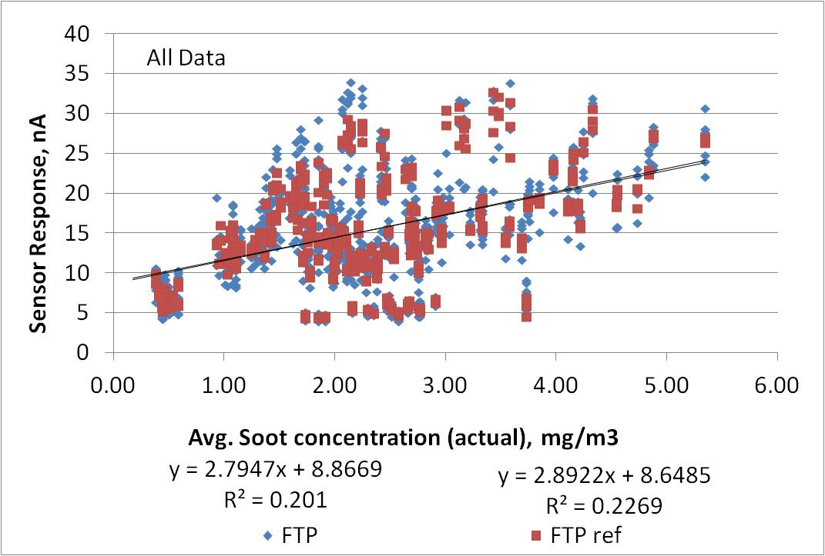
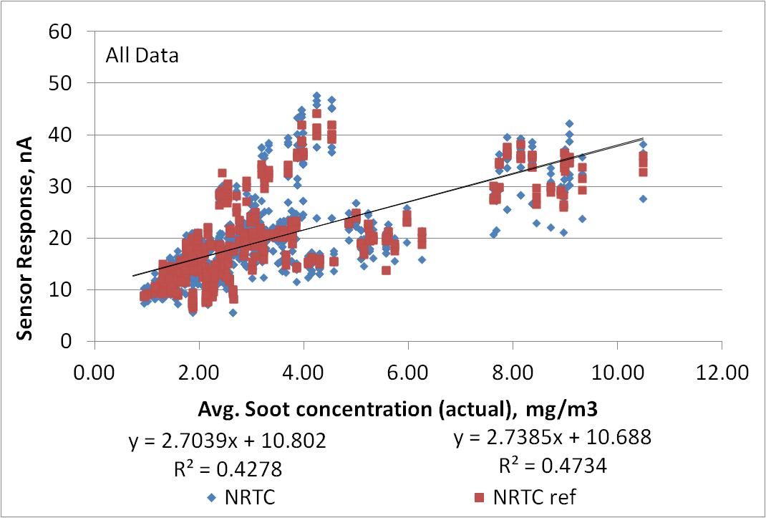
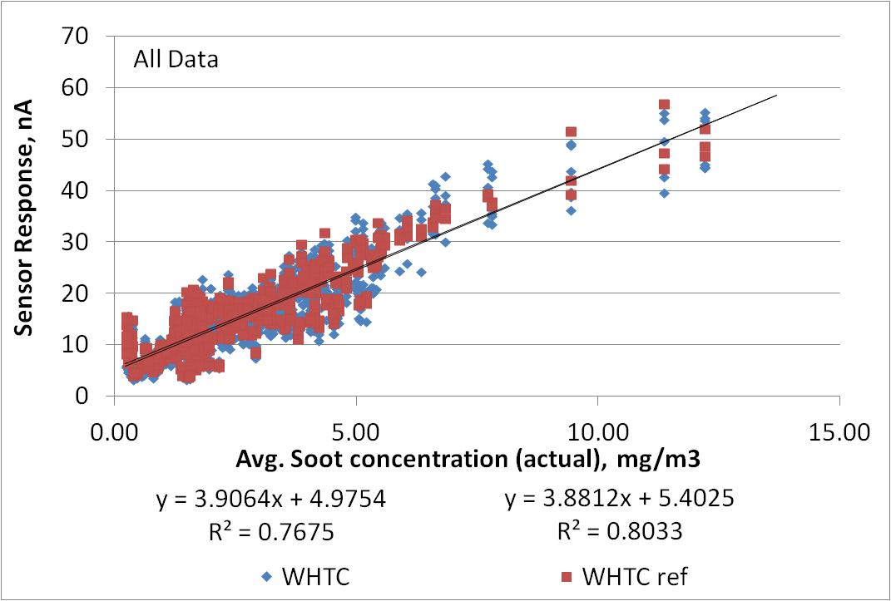
Transient Response (Cycle Basis)
Real time Sensor Example
FTP
NRTC
WHTC
  Correlation and slope seemed to be cycle dependent
  Similar observations made with Cumulative-type Sensors
  R² and slope lowest for FTP and highest for WHTC
  Includes all sensor data from 0-mile, 1000-mile, 20,000-mile-post, 30,000-mile and 50,000-mile Performance Checks

Slide 19
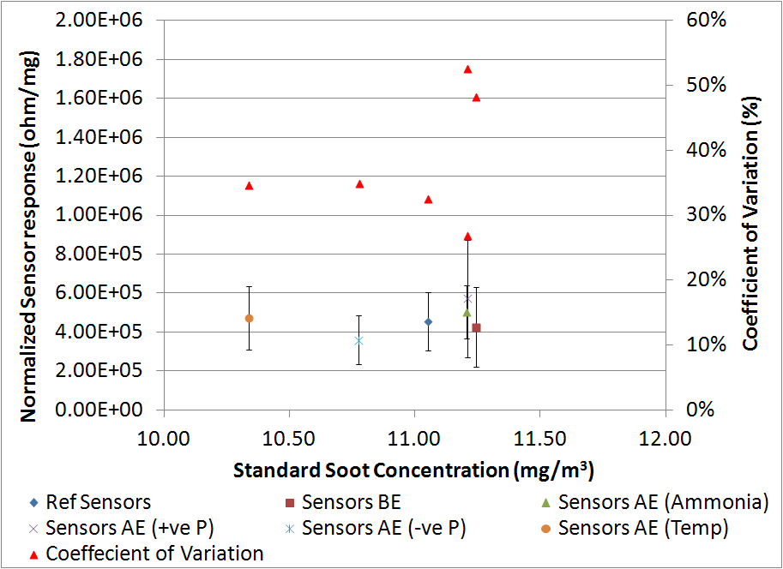
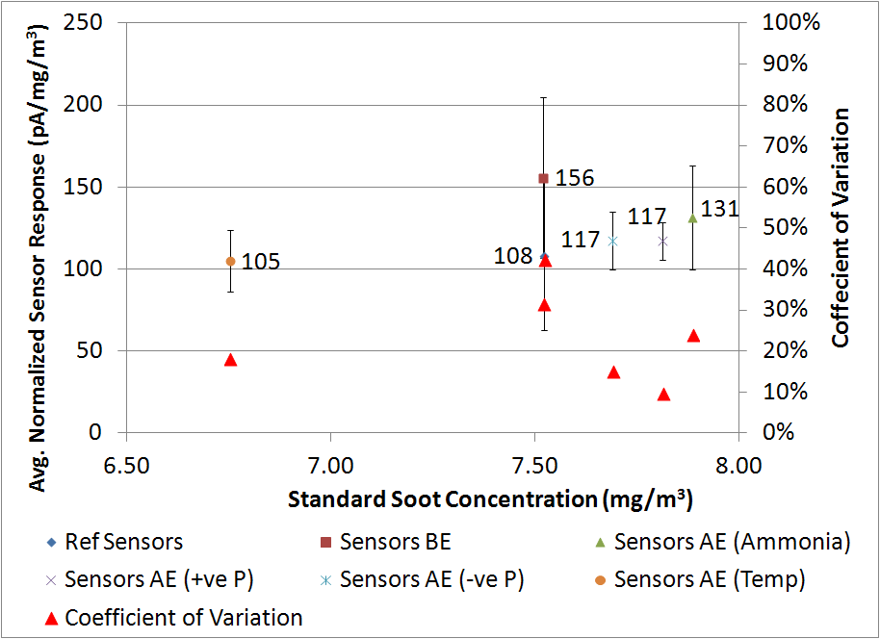
Results – Examples of Sensor Sensitivity Response After Multiple Exposures (SS)
Cumulative-type Sensor
Real time Sensor
COV ranged from 27% to 53%
Normalized response ranged from 3.59e5 to 5.72e5 ohm/mg
The average normalized output for all sensors after all exposures was 4.42e5 with a COV of 42%
COV ranged from 10% to 40%
Normalized sensor response ranged from 108 to 155 (pAx40)/(mg/m³)
The average normalized current for all sensors after all exposures was 135.4 pA/mg/m³ with a COV of 36%

Slide 20

Summary
Significant progress has been made in spark-plug sized technology for sensing particle in engine exhaust
Sensors show some promising results for moving forward with their applications
It is critical to continue the development of this process with the help of engine and sensor manufactures and other interested stakeholders

Slide 21











Acknowledgments
This work was funded by PSPD consortium members:

Slide 22
PSPD-II Consortium Activities
Year 1 Kickoff Meeting held in January 2016
Focus on
  Particle Sensor Variability & Accuracy Near Threshold
    Sensor to sensor variability
    Inherent variability of a sensor
  Particle Sensor Cross Sensitivity
    To gases such as NO, NO₂, CO, NH₃
    To ash loading
  Particle Natural Charge and Conductivity Using Different Technology Engines
    Fundamental knowledge needed by different sensing technologies

Slide 23
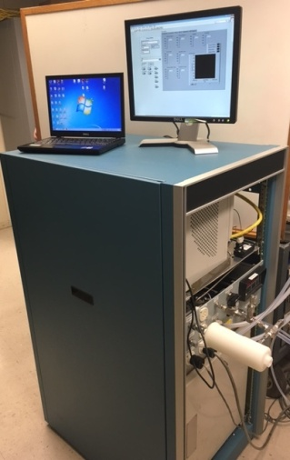
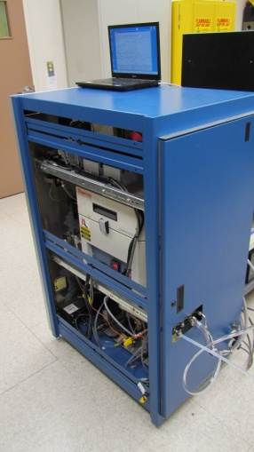
Reference Particle Instruments
PSPD-I
AVL MSS (Soot Mass)
TSI EEPS (Size, Number)
SwRI SPSS, Facilitate Solid Particle Measurement
(Used Upstream of EEPS)
Full Flow CVS and Part 1065 Filter measurement were also included for transient testing
Addition for PSPD-II
Eu PMP compliant Solid Particle Number System
RT-Ash
Full Flow CVS and Part 1065 Filter measurement

Slide 24



PSPD-II Members

Slide 25

Southwest Research Institute®
For questions or any other matters please contact:
Imad A. Khalek, Ph.D.
Ikhalek@swri.org
office: 210-522-2536
mobile: 210-305-2642

