Slide 1
Investigating the operating principle of the Emisense PMTrac sensor
David Bilby, David Kubinski, Matti Maricq
Research and Advanced Engineering, Ford Motor Company
2016 PEMS Workshop, CE-CERT

Slide 2
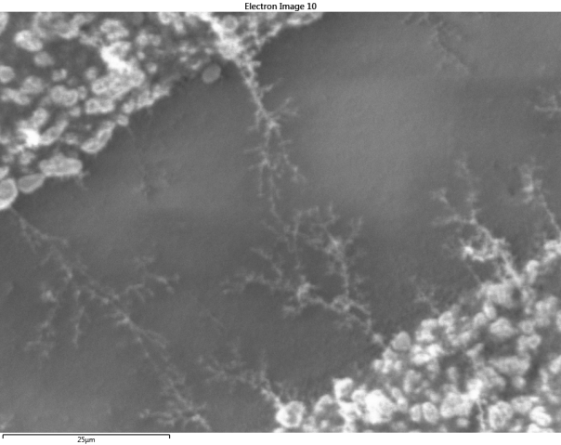
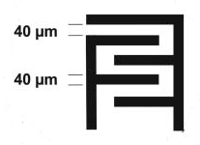
Introduction
On-board diagnostics (OBD) is required to monitor health of diesel particulate filters (DPF)
Current method is the resistive sensor
Many problems
  deposition efficiency unknown
  insufficient sensitivity
  takes too long
Electrode structure

Slide 3
Emisense PMTrac sensor – electrostatic trap
soot is naturally charged in flame
bipolar with approx 30% + and 30% - charges

Slide 4
Electrostatic traps
Top view
Side view
Segmented
PMTrac

Slide 5
Experimental setup

Slide 6
Trap current & exiting soot mass
Characteristic Behavior
Delay period of minutes where trap current is pA
And exit soot mass is ~1/3 of entrance value
After ~ 1 minute current rises to nA
And exit soot mass increases

Slide 7
SMPS – APS size distribution of soot at trap exit
Trap on
Particle number at ~100 nm reduced with trap turned on
Particle number at ~1000 nm increases with trap on

Slide 8
Tandem DMA measurement of dendrite fragment charge
Some fragments exiting the trap have very large numbers of charges: tens to hundreds

Slide 9
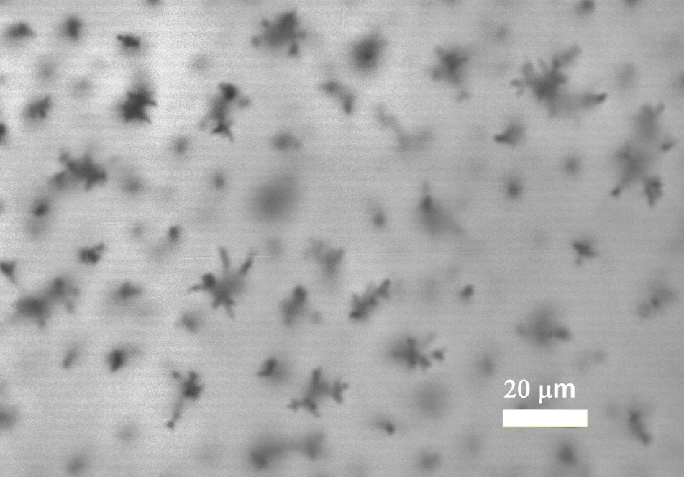
In situ images of soot dendrites
Top view
Electric field induces growth of high aspect dendritic structures.
Side view

Slide 10
SEM images of soot on electrodes
Sample unipolar soot into electrostatic trap
Soot dendrite structures found on both electrodes!
Implies that soot is moving from one electrode to the other

Slide 11
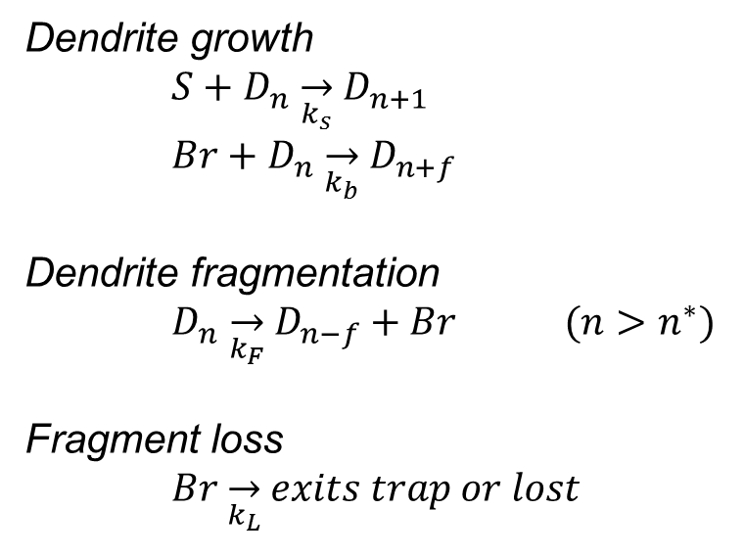
Trap model
Kinetic model for soot dendrite growth and fragmentation
Current carried by dendrite fragments
S = entering soot flux
D_{n} = dendrite with n segments
Br = “break-off” fragment
Dendrite growth
$S+D_{n} \overset{→}{k_{s}} D_{n+1}$
$Br+D_{n} \overset{→}{k_{b}} D_{n+f}$
Dendrite fragmentation
$D_{n} \overset{→}{k_{F}} D_{n−f}+Br (n>n^{∗})$
Fragment loss
$Br \overset{→}{k_{L}} exits trap or lost$

Slide 12
Comparison of model to experiment:
1). Voltage modulation
small modulations of HV, 0.25 – 4%, have a large impact on trap current, 20 - >100%

Slide 13
2) Flow dependence
Steps up (down) in flow through trap cause transient under (over) shoots in trap current
This behavior is not seen for step changes in soot concentration

Slide 14
Summary
PMTrac operates on electrostatic trap principle
Electric field causes the growth of high aspect ratio dendrites from the electrode surfaces
As these grow, they reach a threshold height at which the dendrite fragments
The fragment carries away a charge equivalent to or greater than the surface charge of the electrode
The resulting “chain reaction” of growth, fragmentation, charge transport amplifies the incoming pA current carried by soot particles to nA levels.

