Slide 1
On-Board Vehicle Emissions Measurements for hybrid buses and light duty vehicles in Hong Kong
Dr. Carol Wong
Senior Environmental Protection Officer
Environmental Protection Department
Hong Kong
March 2016

Slide 2
Outline
Test Set Up and Protocols
Real-world Emission Measurements from Hybrid Buses and Results
Real-world Emission Measurements from VW Light Duty Trucks and Results
Conclusion & Way Forward

Slide 3
Test Protocol
Follow most stringent testing requirements:
  PEMS requirements in Euro VI for gaseous pollutants/ISO16183 for PM
  CFR 1065 Subpart J
Zero every hour, audit every three hours & calibrate/ span check the gas analyzers twice a day
Analyze 2-3 fuel samples from the fuel tank of each test vehicle
  Use professional drivers
  Drive on a fix route or follow a vehicle of the same class
  Capture traffic by video camera mounted in front of the test vehicle

Slide 4
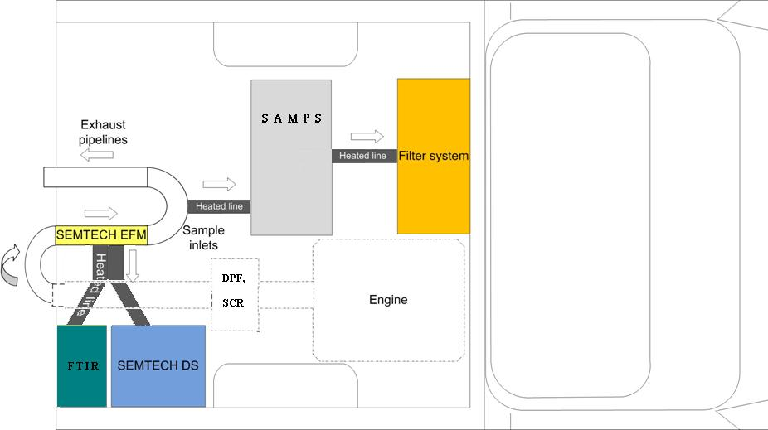
Test Schematics
PEMS used | Pollutants
Gaseous analyzer a) SEMTECH-DS for bus b) AVL GAS PEMS for LDV | CO, CO2, NO, NO2, THC
A&D FTIR (not for LDV) | CO, CO2, NO, NO2, N2O, NH3, HC species
AVL PM PEMS 494 | PM
AVL PM PEMS 494
Gaseous analyzer

Slide 5
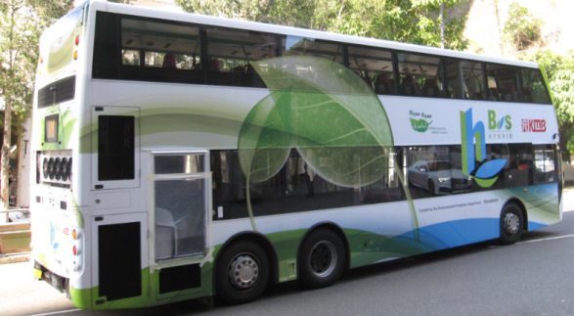
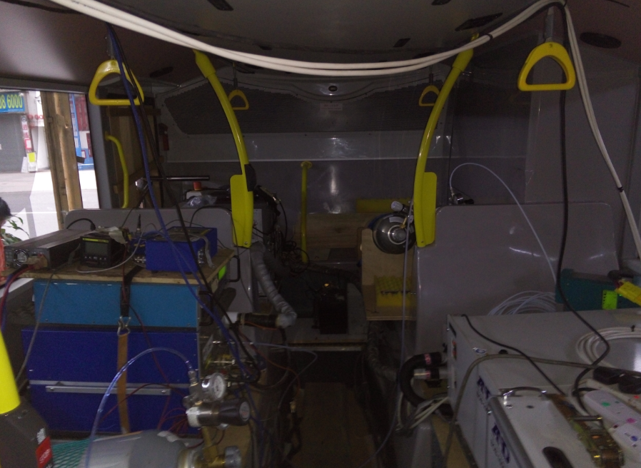
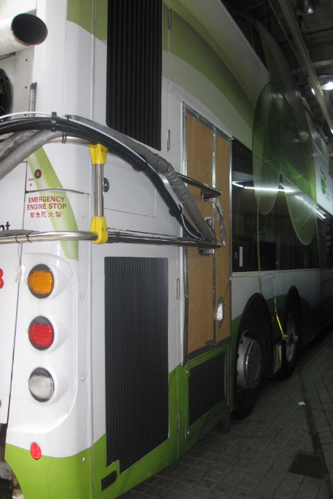
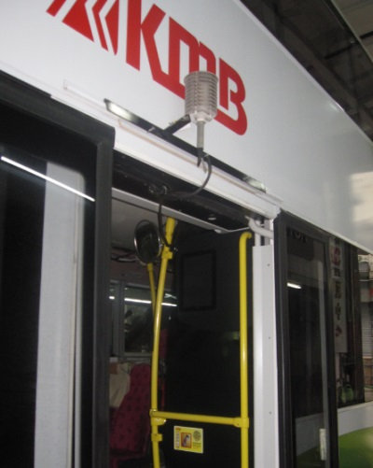
Vehicle Installation
Weather probe
Speedometer
SEMTECH DS
FTIR
AVL PM

Slide 6
Vehicle information
Description | Control double deck bus | Hybrid double deck bus | Heavy heavy duty truck
Make | Alexander Dennis |  | Scania
Eng Model | Enviro 500 Turbo | Enviro 500H Hybrid | DC1306360 XPI
Eng Capacity | 8.9 litre | 6.7 litre | 9.3 litre
Emis Std | Euro V | Euro VI
Engine rated power | 326bhp@ 2100RPM | 274bhp@ 2100RPM | 355bhp@ 1900RPM
Engine rated torque | 1500Nm@ 1200-1400RPM | 1100Nm@ 1200-1600RPM | 1850Nm@ 1000-1300RPM
Gross vehicle weight | 26.4 ton
After treat. device | SCR | EGR, DPF, SCR | DOC,DPF, SCR
Special feature | Nil | Hybrid | Nil

Slide 7
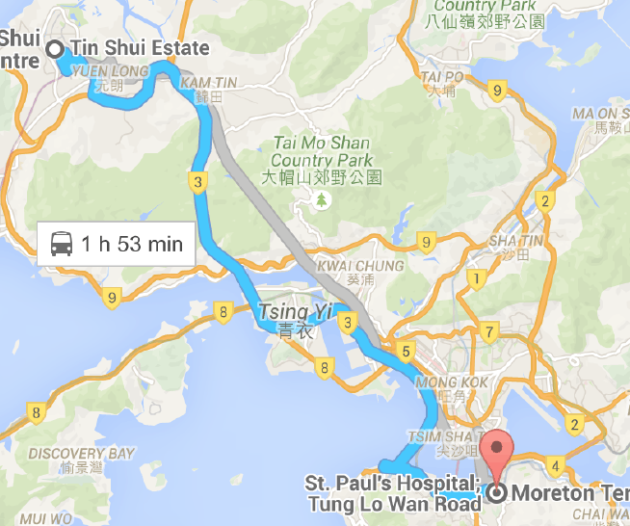
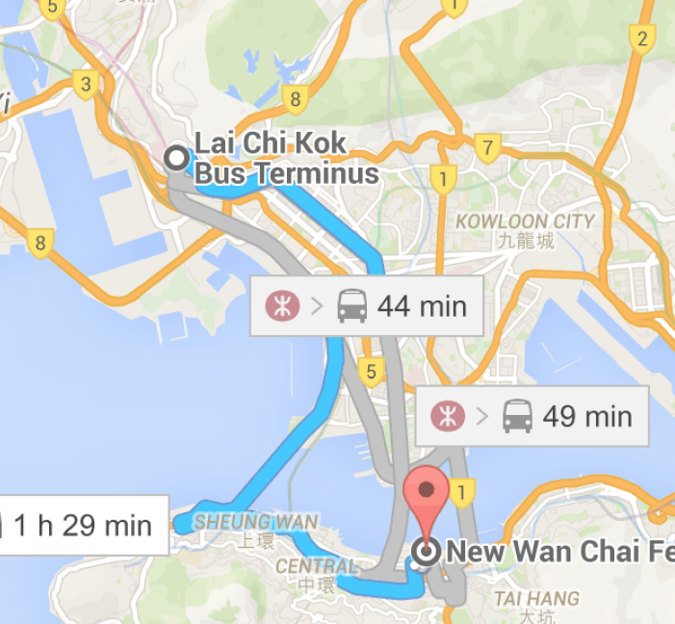
Route
969 (mainly highway)
905 (Mainly urban)
Route No. | Area | Control | Hybrid
969 | Mainly highway | Apr-15 | Apr-15
619 | Mainly urban | Jan-15 | Feb-15
905 | Mainly urban | Feb-15 | Mar-15
8 | Mainly urban | May-15 | May-15
1A | Urban | Jan-15 | Jan-15
5B | Urban | Mar-15 | May-15

Slide 8
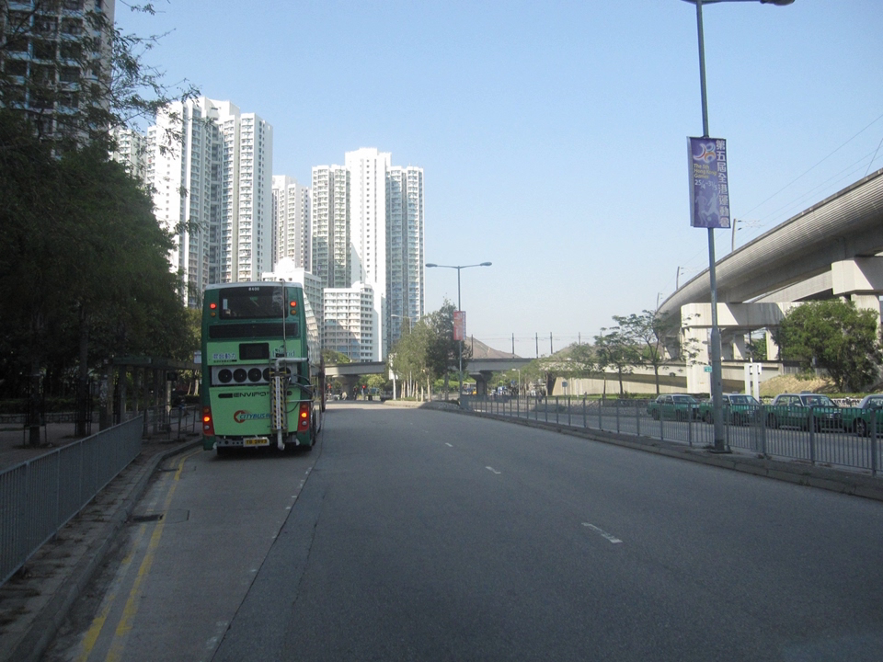
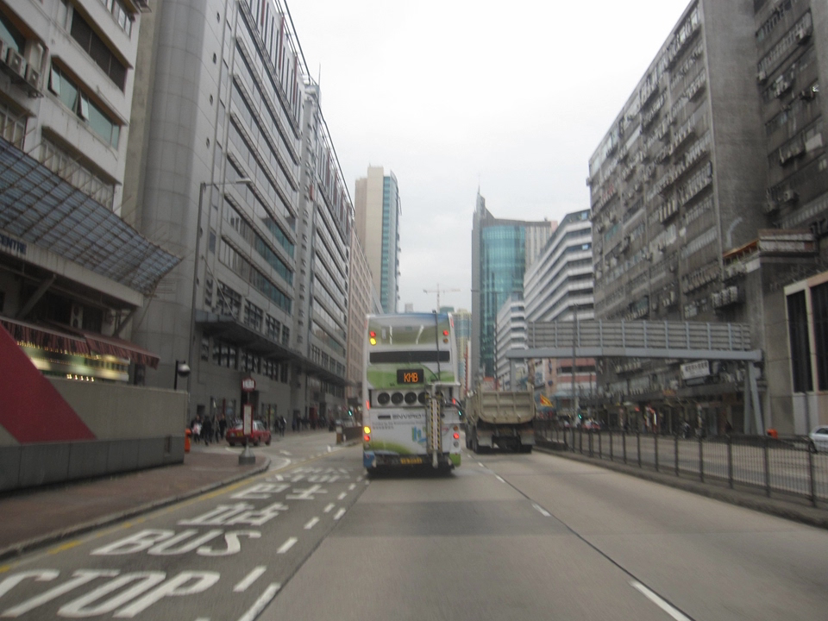
Slide show of PEMS testing for hybrid double deck (dd) buses
905 (mainly urban)
969 (mainly highways)

Slide 9
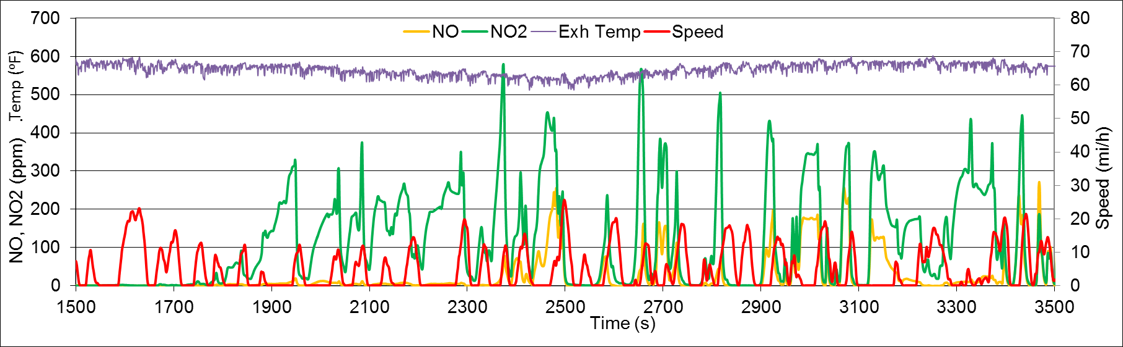
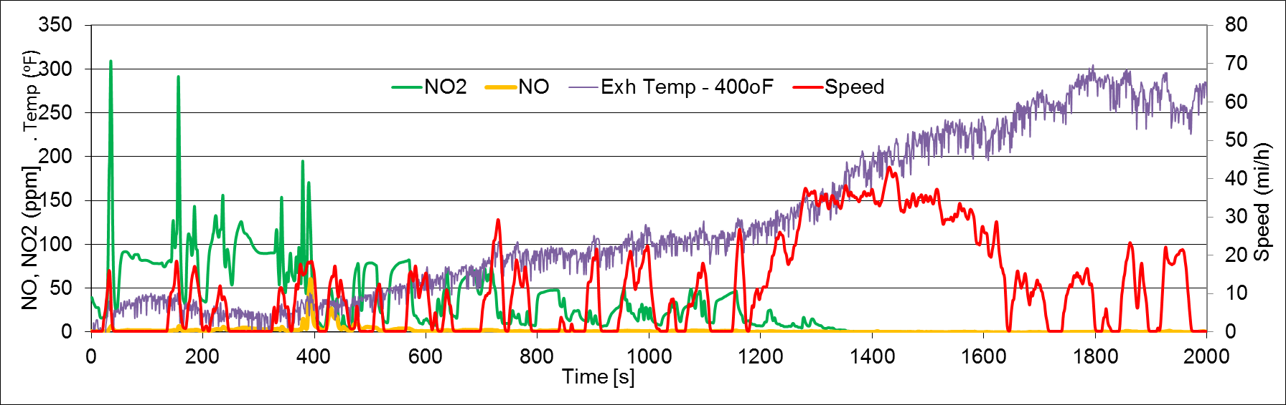
Real-time emission: NO, NO2
The hybrid (5B): Abnormally high NO2 conc. observed
A typical hybrid
Notes:
The hybrid (5B) has
extraordinary high NO2 emissions (its emission factor 3 g/km vs. ~ 0 g/km for other hybrids)
Lower NO2 emissions than the control bus
~ 0 NO emissions comparable with other hybrids

Slide 10
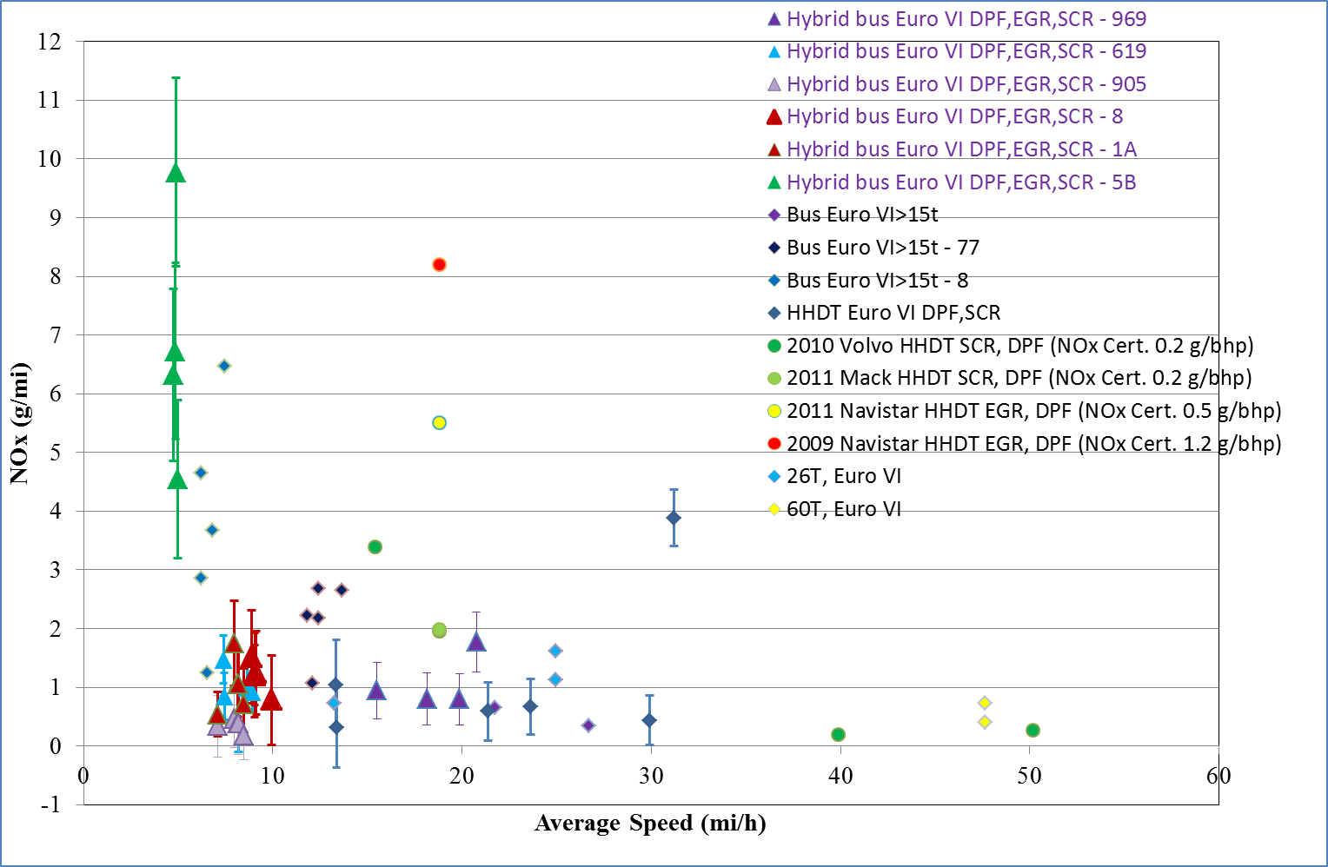
Comparison of NOx emissions from hybrid DD buses with the other Euro VI vehicles

Slide 11
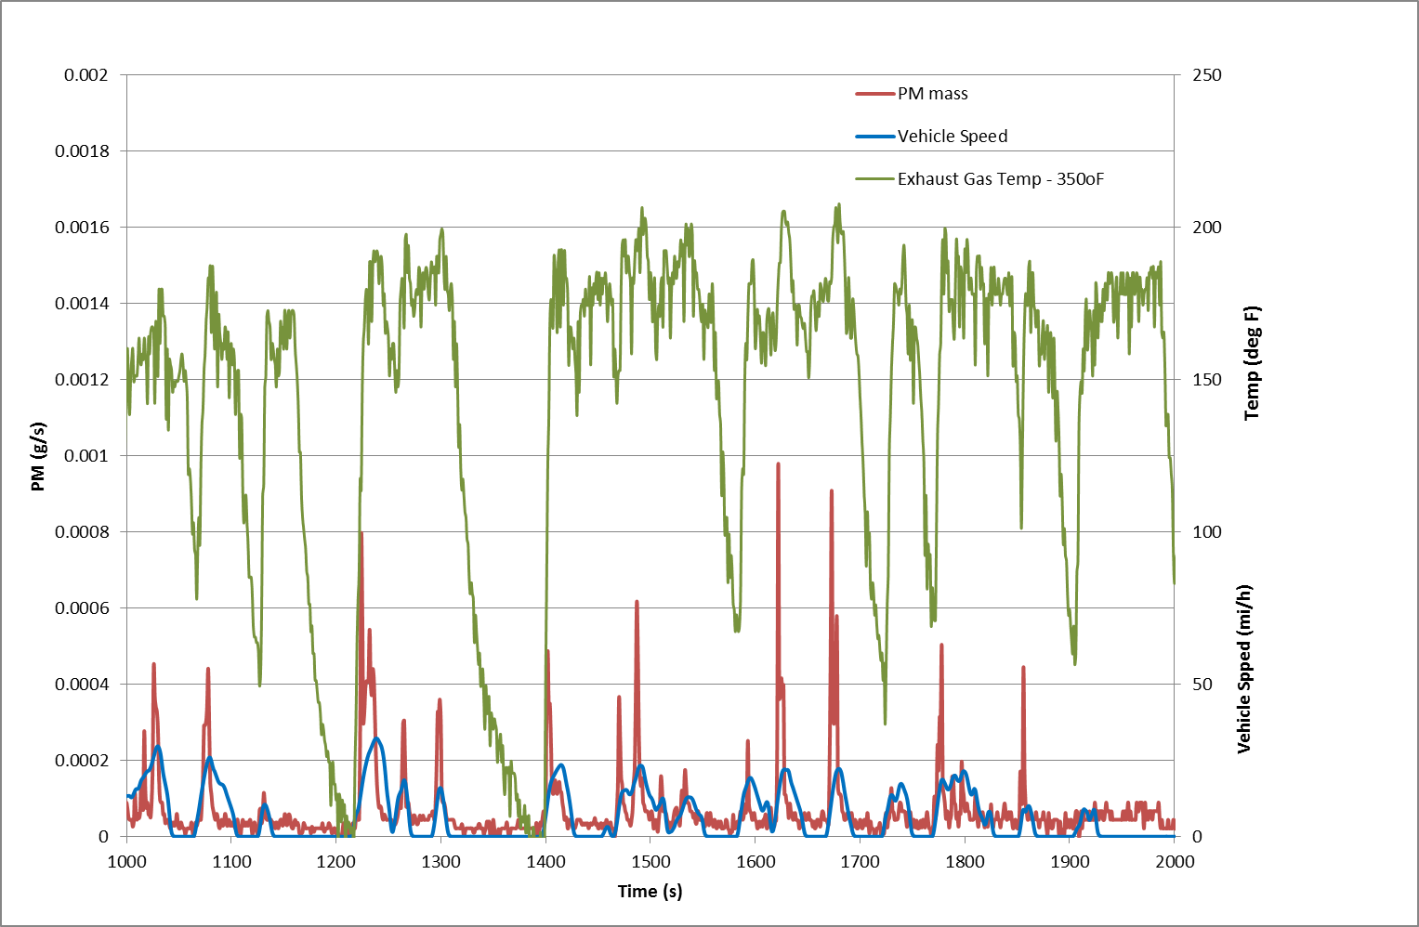
Real-time emission: PM
Notes:
The hybrid (5B) has
extraordinary high NO2 emissions (its emission factor 3 g/km vs. ~ 0 g/km for other hybrids)
Lower NO2 emissions than the control bus
~ 0 NO emissions comparable with other hybrids

Slide 12
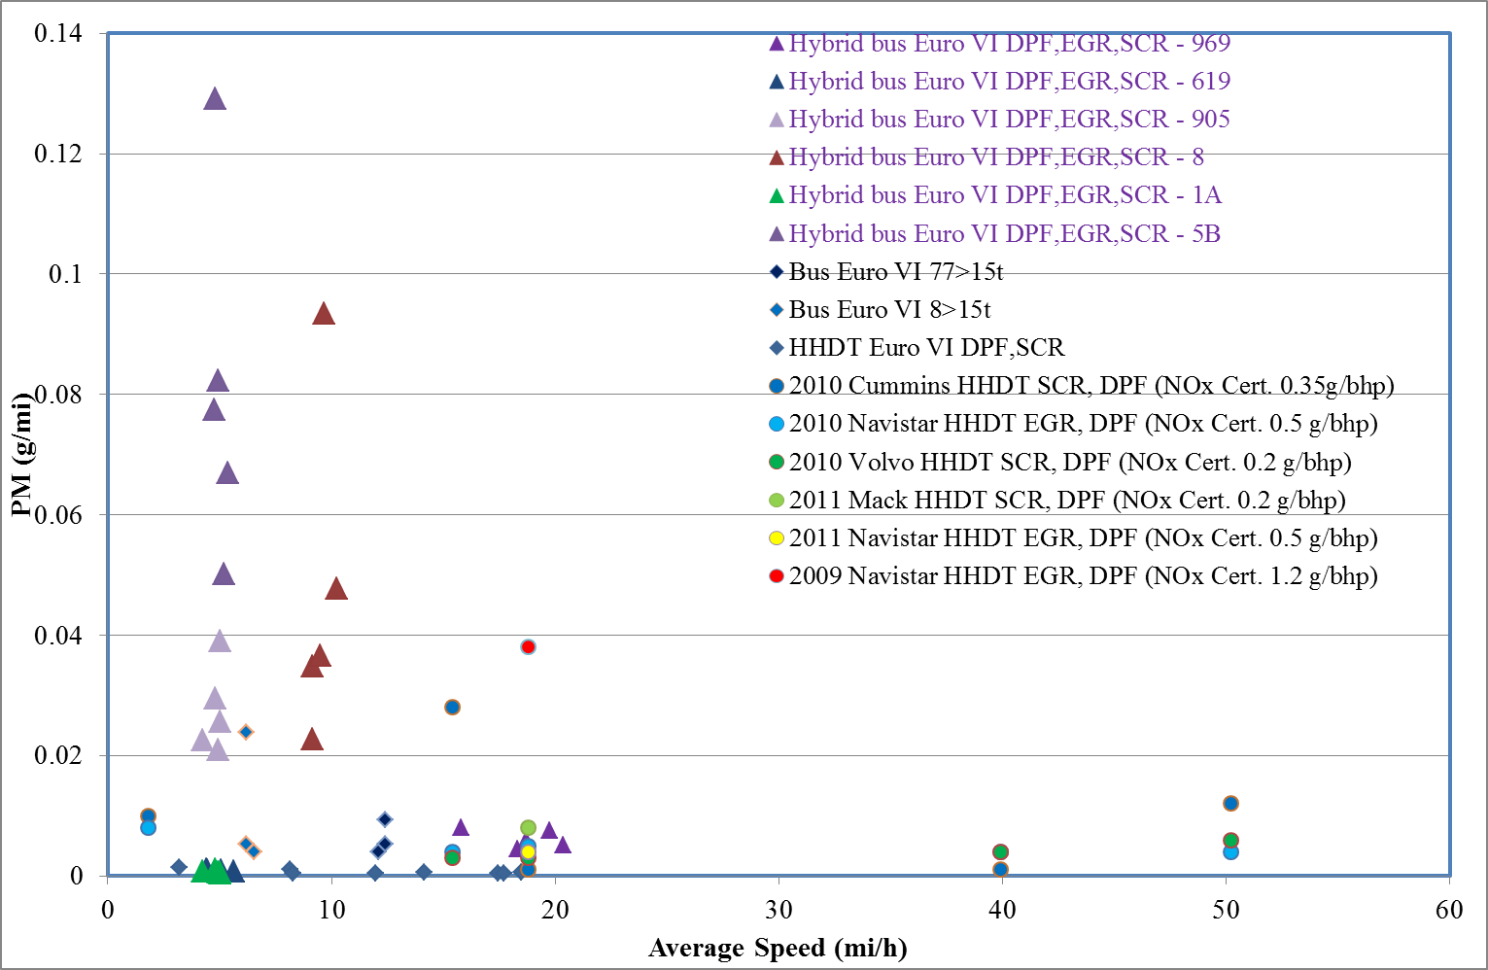
Comparison of PM emissions from hybrid DD buses with the others

Slide 13
CO2 emission: Effect of a/c
Reduction % | Average Ambient Temp (ºF) |  | % diff of CO₂ of hybrid bus over control bus
 | (Euro VI Hybrid) | (Euro V Control)
969 – mainly highways | 80 | 83 | -7%
619 – mainly urban | 65 | 67 | -12%
905 – mainly urban | 66 | 71 | -21%
8 - mainly urban | 90 | 90 | 26%
1A - urban | 69 | 63 | -12%
5B - urban | 89 | 80 | 20%
Emission Tests conducted in summer

Slide 14
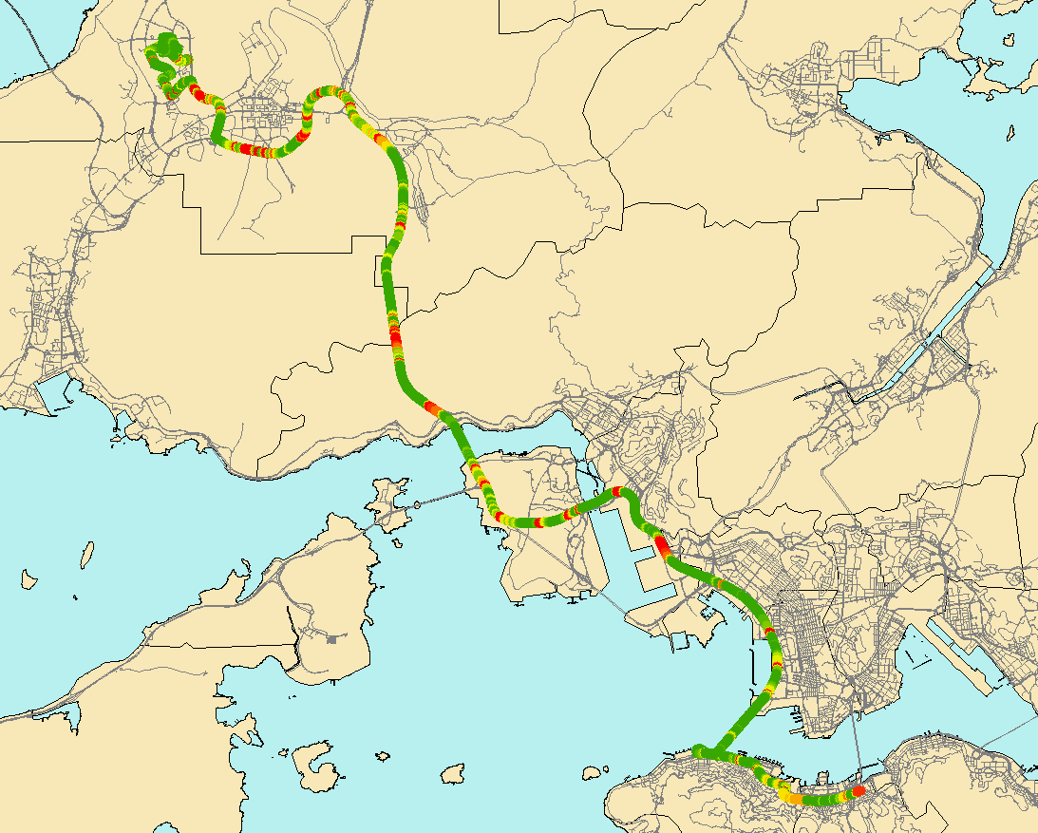
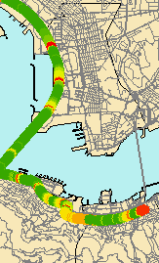
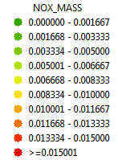
NOx emission in urban and highway
Urban-Highway

Slide 15
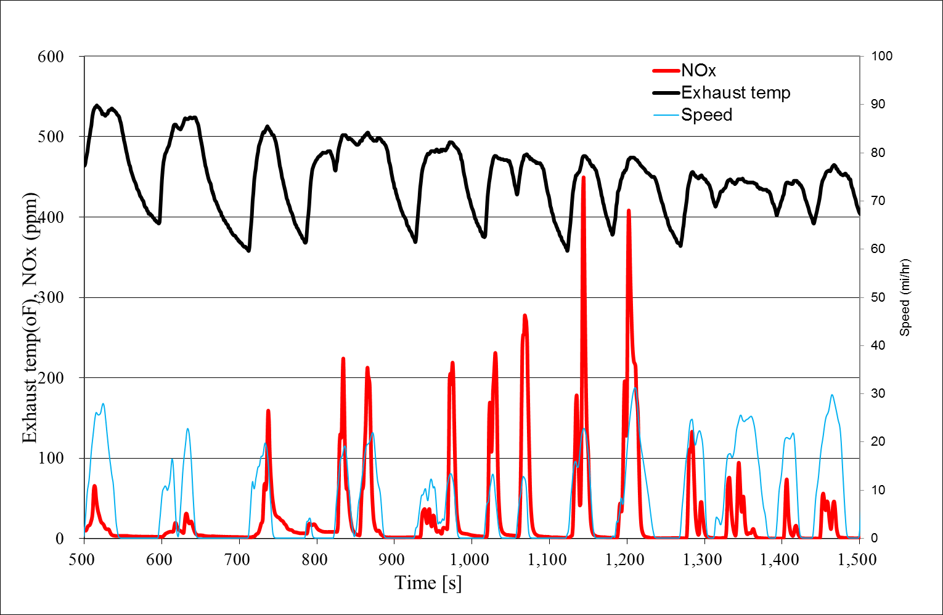
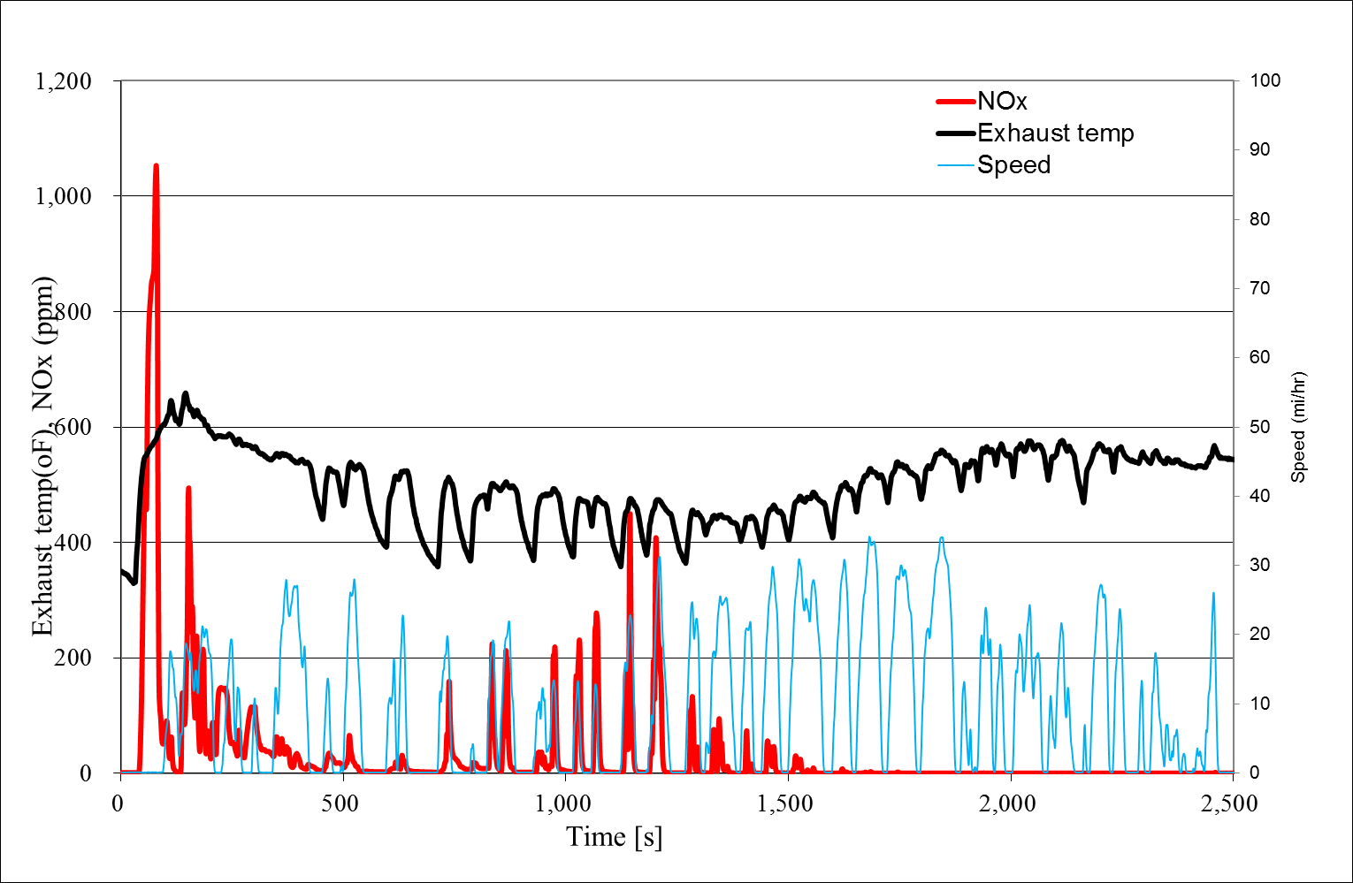
NOx emission: Effect of urban driving
Emission spikes during engine switch off

Slide 16
NH3 & N2O emissions (Euro VI hybrid vs. Euro V control)
TITLE | Bus | NH3 |  | N2O
 |  | Median (ppm) | 95th per. (ppm) | Median (ppm) | 95th per. (ppm)
1A - urban | Control | 0.5 | 2 | 0.8 | 14.2
 | Hybrid | 0 | 0.2 | 17.5 | 59.7
619 – mainly urban | Control | 0.2 | 0.5 | 0.9 | 25
 | Hybrid | 0.2 | 0.7 | 13.9 | 43.7
905 – mainly urban | Control | 0 | 0.4 | 1 | 19.6
 | Hybrid | 0 | 1.1 | 9.2 | 29.8
969 – mainly highways | Control | 0 | 0.1 | 0.8 | 8
 | Hybrid | 0.1 | 0.4 | 10.9 | 63.6
5B - mainly urban | Control | 0 | 0.1 | 0.7 | 3
 | Hybrid | 0 | 0 | 20.2 | 58
8 - mainly urban | Control | 0 | 0.3 | 0.6 | 12.5
 | Hybrid | 0 | 0.2 | 12.3 | 65.6

Slide 17
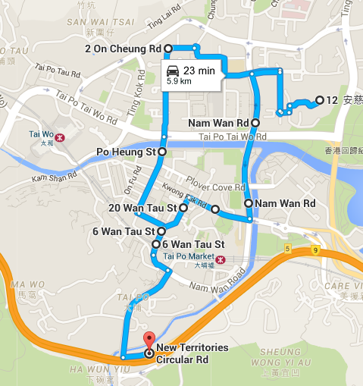
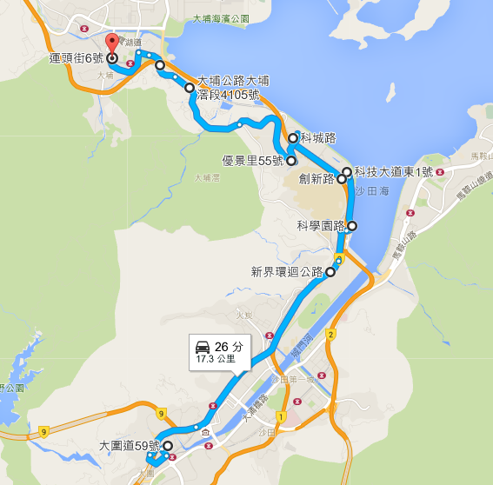
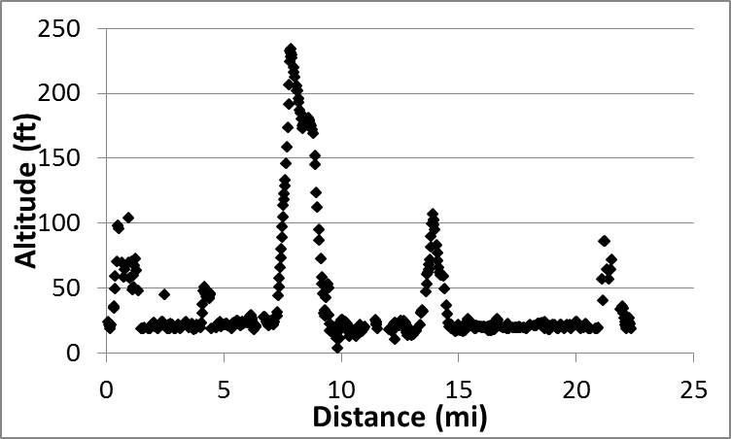
VW Diesel Light Duty Trucks
Fix route test
Chase car
Dyno
Travelled around suburban area
Parameter | NEDC | Fix route
Duration (sec) | 1180 | 3494
Distance (mi) | 7 | 19
Average speed (mi/h) | 21 | 19
Max speed (mi/h) | 75 | 63
Ave. RPA (m/s^2) | 0.145 | 0.267
Share %
idling (<1.2 mi/h) | 25 | 23
low speed (1.2-31 mi/h) | 54 | 48
medium speed (31-56 mi/h) | 14 | 23
high speed (> 56 mi/h) | 7 | 6
Started at suburban area

Slide 18
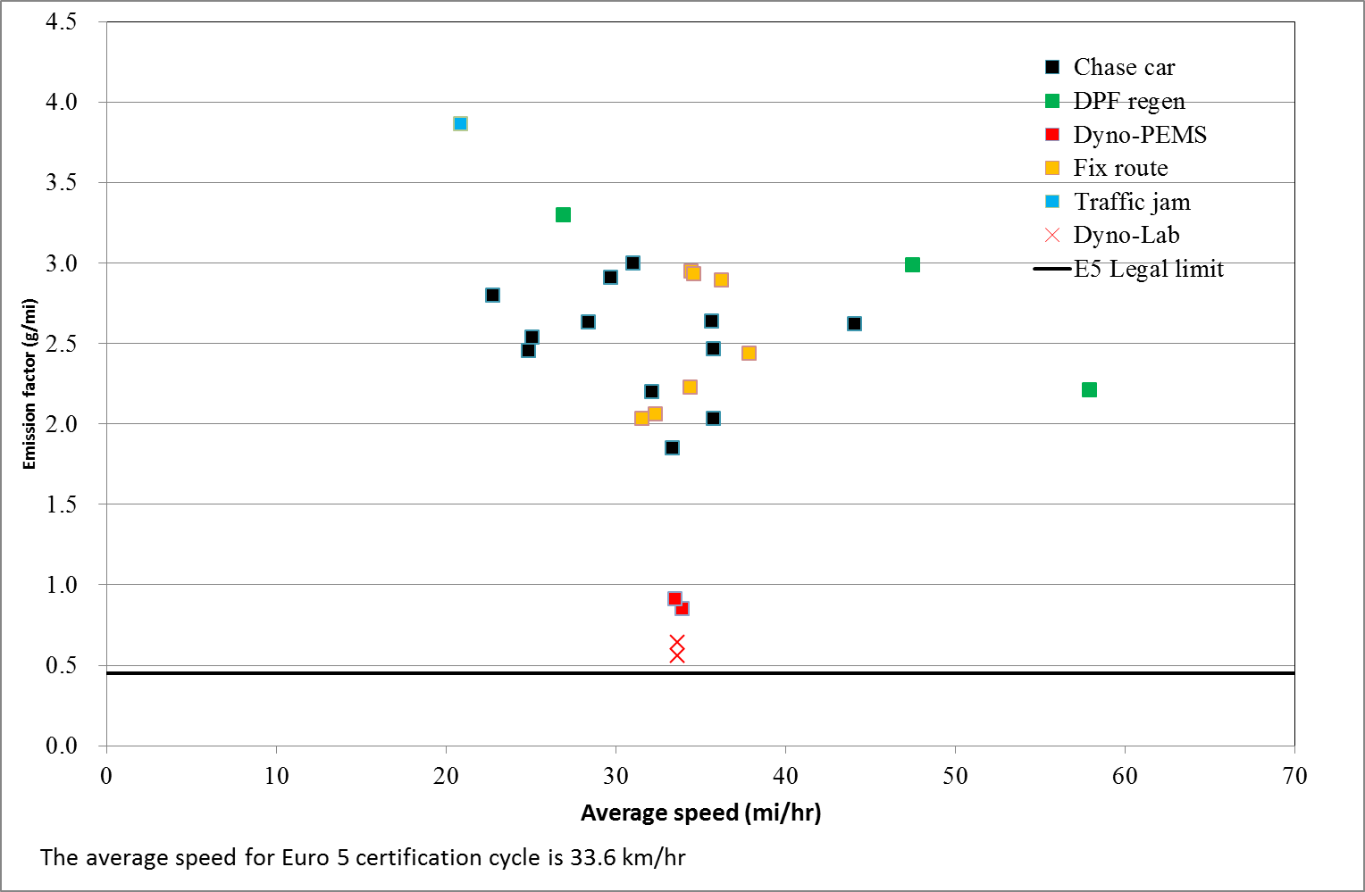
VW Transporter 5: NOx
Fuel Type | Diesel
Euro Std | Euro 5
Control devices | DPF,EGR
Model year | 2015
Test age | 1
Vehicle model | Transporter
GVW | 3.1 ton
Engine displacement | 2 litre
Engine rated power | 138bhp@ 3500rpm
Engine peak torque | 340Nm@1750-2500rpm
Odometer reading | 52 miles
Wt. before install. | 2.3 ton
Wt. After Install. | 2.8 ton
21 mi/h
Dyno testing: Vehicle weight including PEMS but no cold start.
All PEMS testing are hot running.

Slide 19
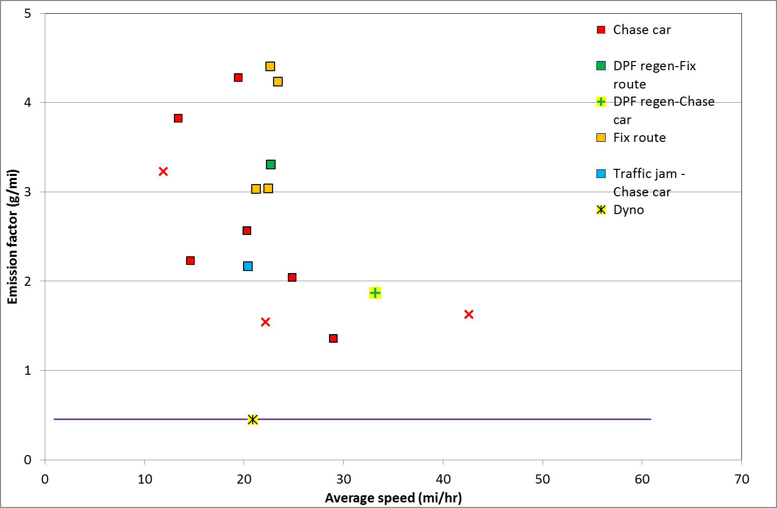
VW Amarok: NOx
Fuel Type | Diesel
Euro Std | Euro 5
Control devices | DPF,EGR
Model year | 2014
Test age | 1
Vehicle model | Amarok 2.0 TDI
GVW | 3.1 ton
Engine displacement | 2 litre
Engine rated power | 177 bhp @ 4000 RPM
Engine peak torque | 420 Nm @ 1750 RPM
Odometer reading | 537 miles
Wt. before install. | 2.4 ton
Wt. After Install. | 3.1 ton
Invalid result: Drift correction > 4% for NO2
(based on CFR1065.650)
Dyno testing complies with Euro 5 certification
requirements and with cold start.
All PEMS testing are hot running.

Slide 20
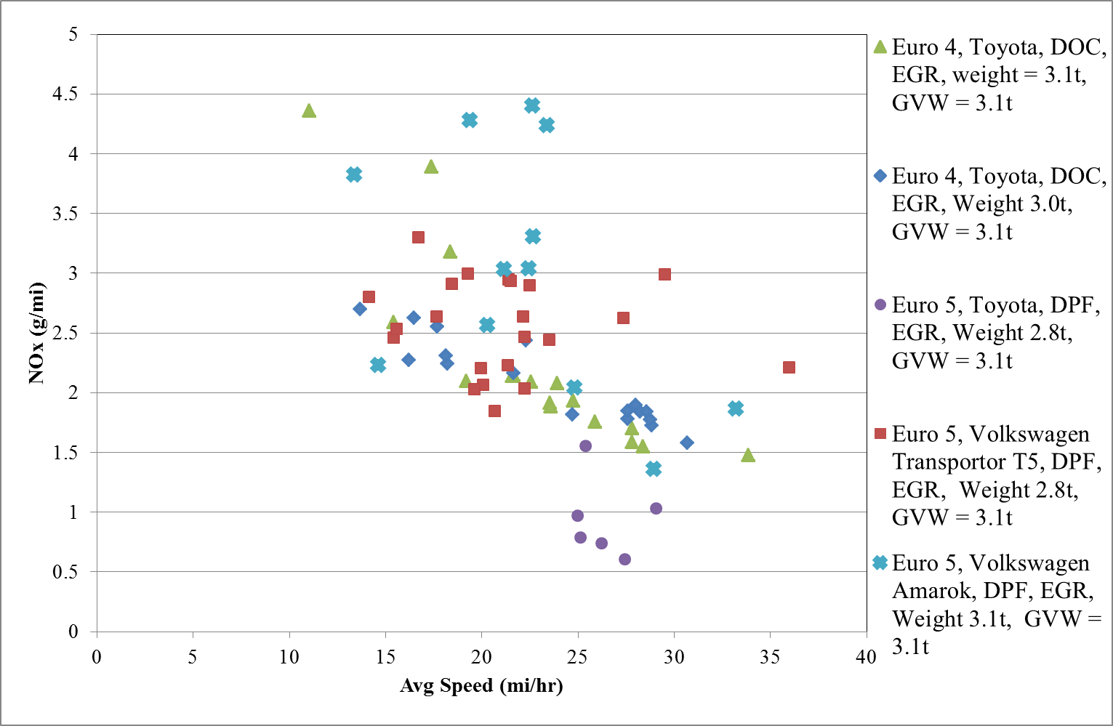
Comparison of VW Trucks with Other Light Duty Diesel Trucks

Slide 21
Conclusion & Way Forward
The NOx and PM emissions from the Euro VI hybrid double deck buses are similar to the Euro VI HHDT
The CO2 emissions of hybrid Euro VI double deck buses are similar to diesel Euro V buses, but higher than the Euro VI HHDT
For high loading of air conditioning occurred often in HK summer, the CO2 emissions of hybrid double deck buses are higher than diesel Euro V buses
Spikes appear in NOx emissions from hybrid double deck buses in urban area because the engines will switch off often. Hence, exhaust temp. will be dropped rapidly and SCR may not fully function

Slide 22
Conclusion & Way Forward
Tested two Euro 5 VW light duty diesel trucks. The emissions are comparable to Euro 4 vehicles of the same class. The emissions are higher in PEMS testing than on dyno.
Will conduct on-board testing using PEMS on diesel Euro VI double deck buses for comparison this summer.
Will conduct PEMS and dyno testing on Euro 6 VW Caddy

Slide 23
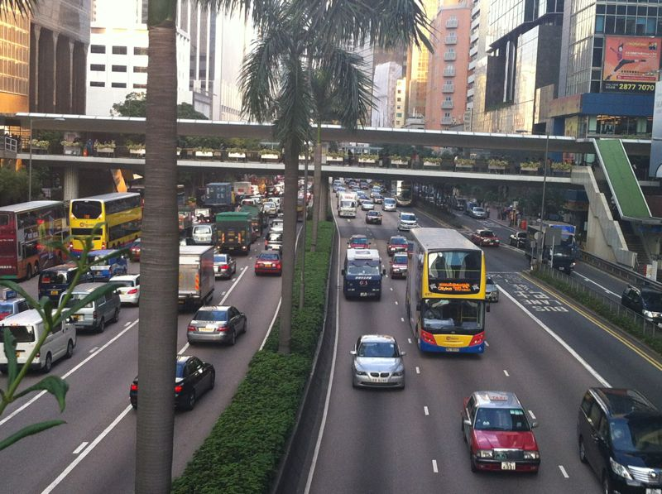
Thank you.
23
Notes:
23

