Slide 1
European union development of in use evaluation method for Non Road Mobile Machinery
Jonas Holmberg

Slide 2
Agenda
Volvo Penta and Volvo Group Organization
Background to EU Non-Road PEMS
Likely future PEMS requirements for Non-Road in EU
Non-Road In Use Evaluation Development

Slide 3
Volvo Penta within the Volvo Group Organization
Group Trucks
Group Trucks Sales
Group Trucks Operations
Group Trucks Technology
Business Areas
Construction Equipment
Buses
Volvo Penta
Governmental Sales
Volvo Financial Services
50% Industrial
50% Marine
Notes:
Needs to be replaced. New ones on Volvo Group Violin.

Slide 4
Background
For Heavy-Duty On-Road in EU PEMS testing is mandatory.
Non-Road gaseous PEMS pilot program goal:
The result (pass/fail) of the test shall give sufficient confidence that the engines - if extracted from the machine - would comply with the applicable emissions limits on the type approval transient cycle (NRTC).
Existing evaluation methods were:
US Not-To-Exceed (NTE)
EU Heavy Duty On-Road, Work-Based-Window (WBW)

Slide 5
Background US Not To Exceed method
US NTE sets a limit for emissions during ≥30 seconds with:
High enough torque
High enough engine speed
High enough engine power
…
For many non road applications there would be few or no NTE events. NTE does not reflect the overall emissions from the engine and it does not indicate whether the engine would pass a certification transient test cycle.
EU conclusion: NTE is not a suitable evaluation method for
Non Road Mobile Machinery.

Slide 6
Background EU Heavy Duty On Road WBW (Work-Based-Window)
Emissions in use averaged over the same work as in the transient certification test cycle used in test cell, called work window.
In Use cycle defined by composition of:
city driving
rural driving
motorway driving

Slide 7
Likely future PEMS requirements for Non-Road in EU
Next emission step for Non-Road in EU is Stage V starting 2019.
Variable engine speed Non-Road engines with power from 56 to 560kW in first scope.
To be measured (per manufacturer) before end of 2024:
9 engines with running hours <30% of full useful life
9 engines with running hours >70% of full useful life
Currently PM/PN is not in the scope.
Reporting requirement but no emission limits that have to be met.

Slide 8
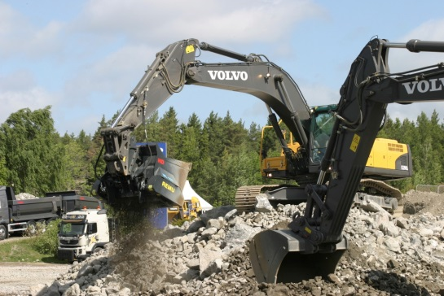
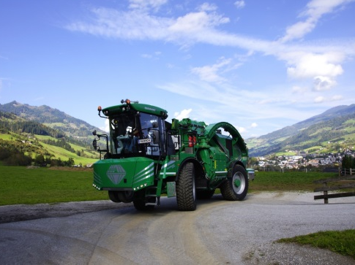
EU Non-Road In Use Evaluation Development
Based on Heavy Duty On Road WBW but without predefined engine use composition. There is no equivalent to “city, rural and motorway driving” for Non Road.
Engine use not represented in the transient certification test cycle (NRTC) to be excluded.

Slide 9
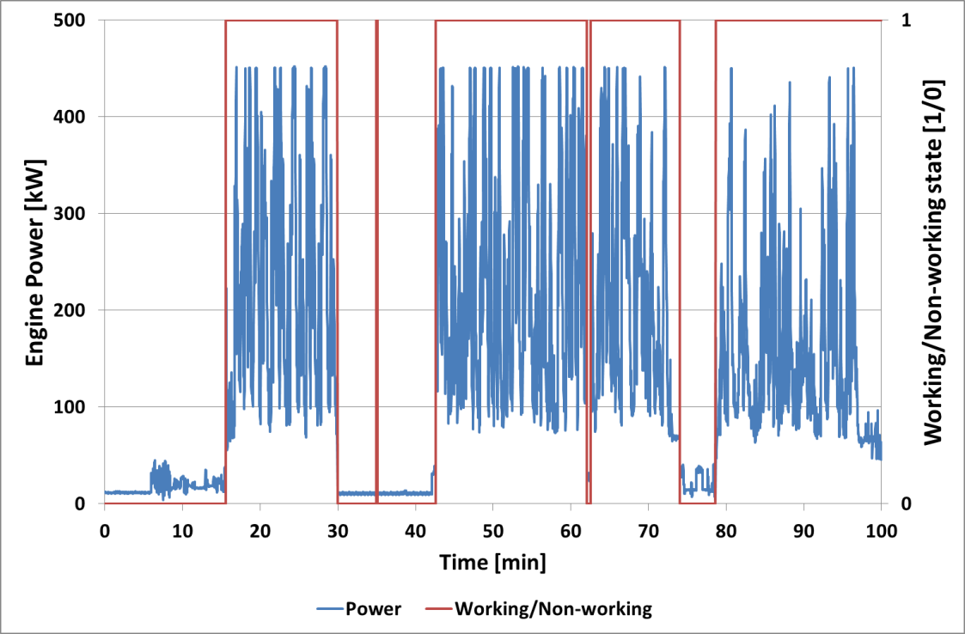
EU Non-Road In Use Evaluation Development
“Working event” and “Non working event” defined as:
Working event: power≥10% of engine maximum power
Non working event: power <10% of engine maximum power

Slide 10
EU Non-Road In Use Evaluation Development
Working events shorter than 2 minutes are merged with surrounding non-working events longer than 2 minutes

Slide 11
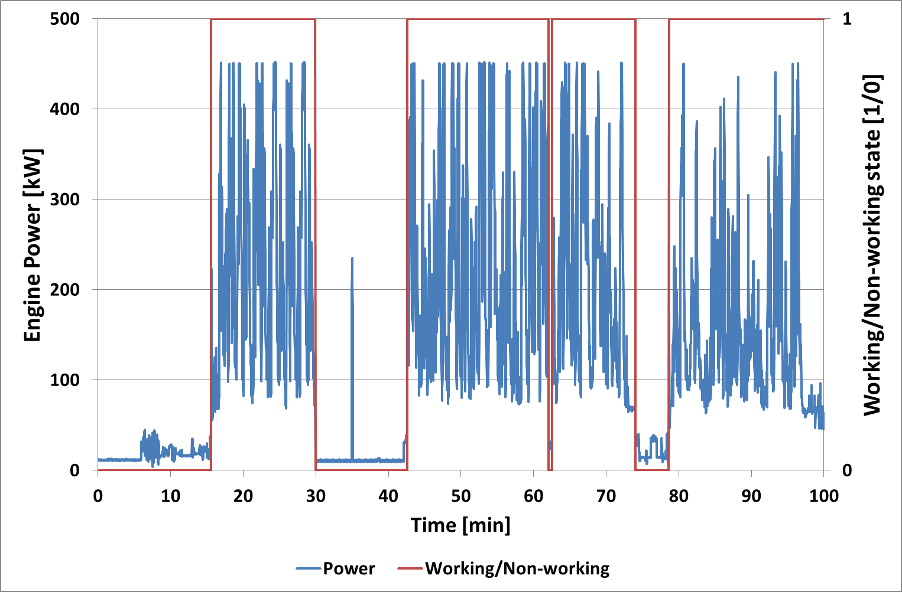
EU Non-Road In Use Evaluation Development
For all non-working events, the first 2 minutes of the events are valid (i.e. defined as working).

Slide 12
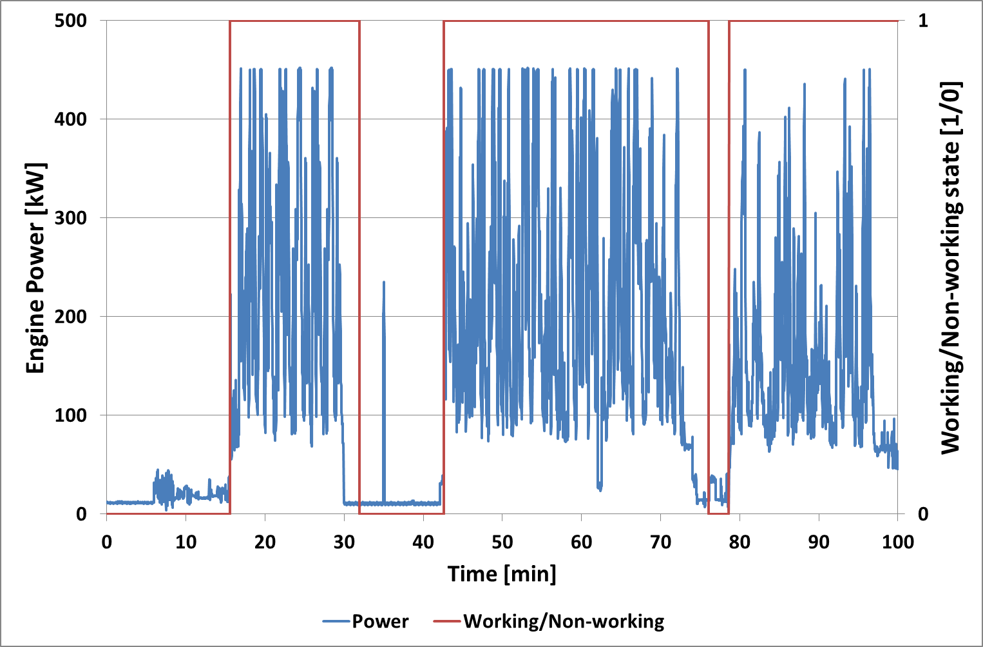
EU Non-Road In Use Evaluation Development
Exclude data following long non working events (>10 min) until the exhaust temperature reaches 250ºC or 4 min has passed, whatever occurs first.

Slide 13
EU Non-Road In Use Evaluation Development
Summary:
<10% power: Non working, ≥10% power: Working
Working events shorter than 2 minutes are merged with surrounding non-working events that are longer than 2 minutes.
For all non-working events, the first 2 minutes of the events are valid.
After long non working events, >10 min, exclusion until the exhaust gas temperature downstream of exhaust aftertreatment system reaches 250ºC or maximum 4 minutes.

Slide 14
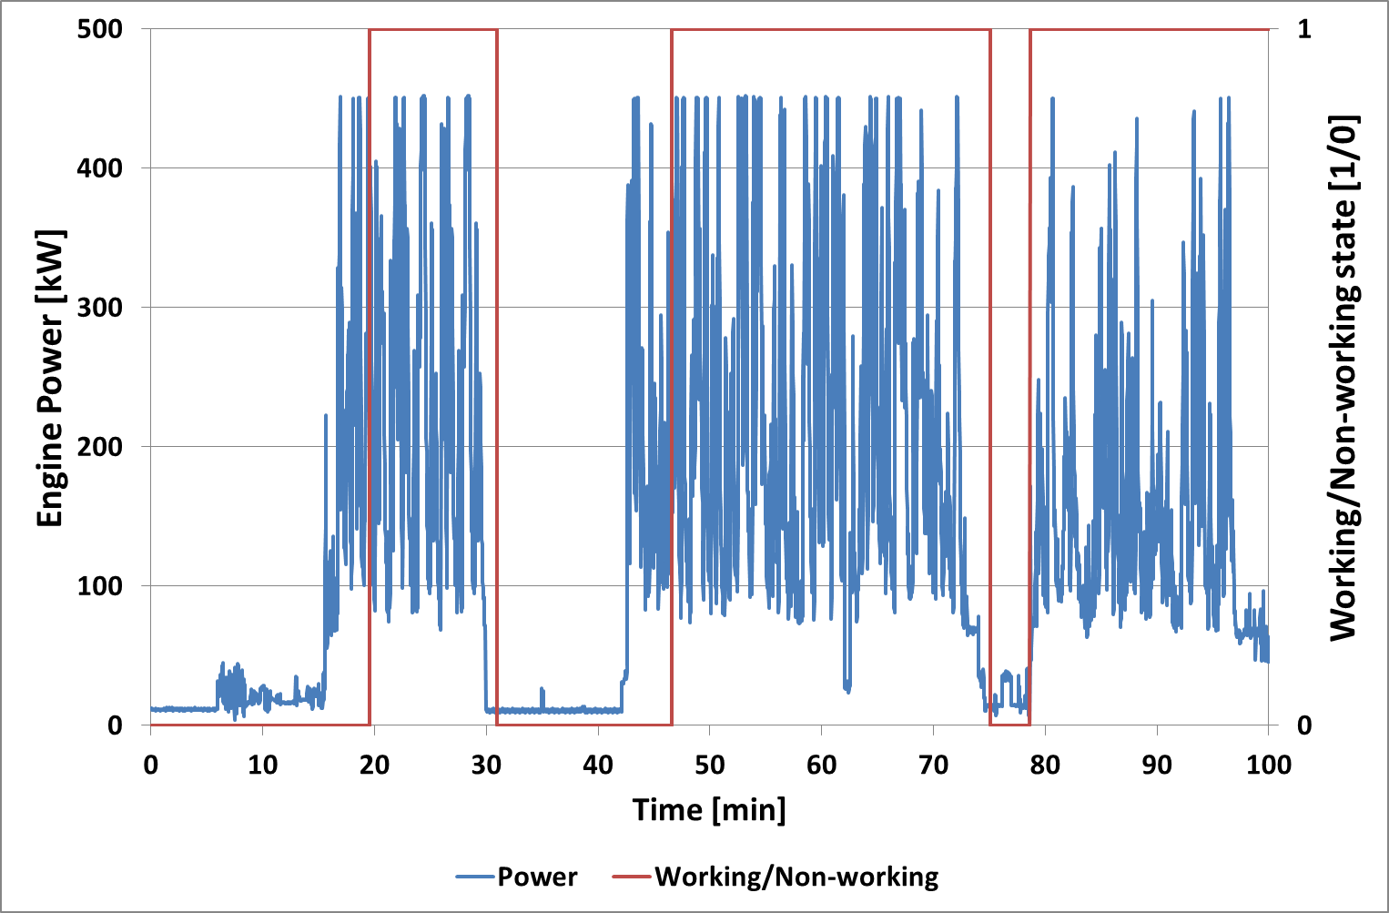
EU Non-Road In Use Evaluation Development
Work-Based-Window is calculated for the remaining working events.

Slide 15
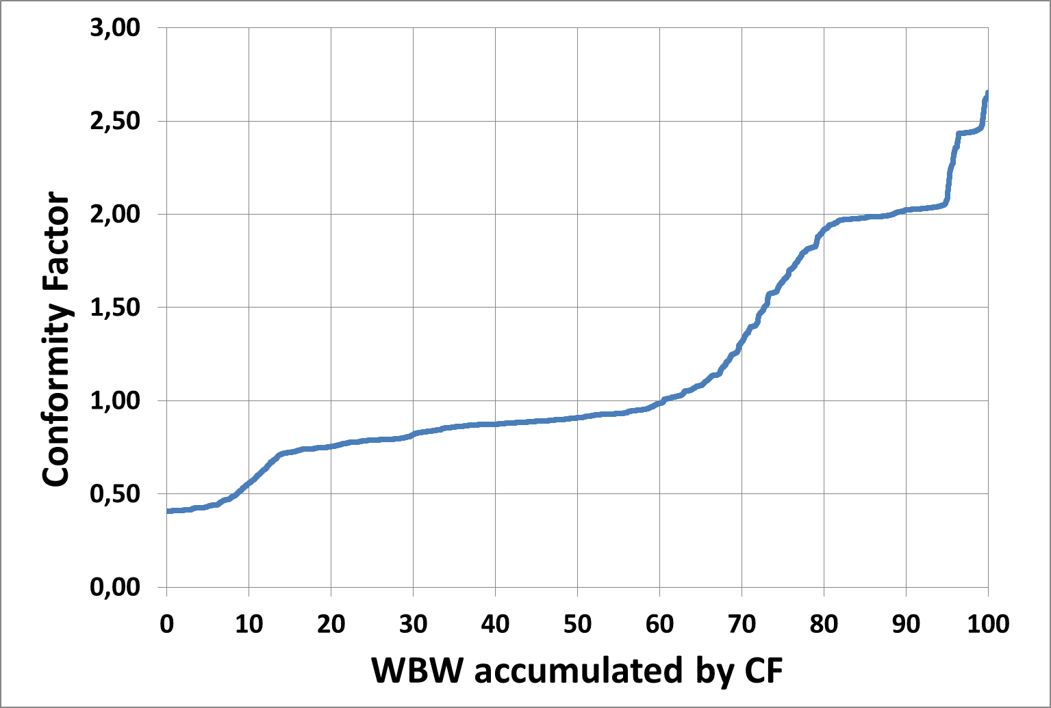
EU Non-Road In Use Evaluation Development
Only work-based-windows produced with average engine power >20% of maximum power used.
Calculation of Conformity Factor (CF):
The 10% windows with highest brake specific emissions are excluded.
The emission value for the 90% percentile divided by the limit for the transient certification cycle -> Conformity Factor (CF)
CF at 90% percentile

Slide 16
EU Non-Road In Use Evaluation Development
Summary:
The evaluation tool for PEMS-testing of Non-Road engines in EU is available.

Slide 17
Back-up slides, more detailed information

Slide 18
Ambient test conditions
The Non Road PEMS tests shall be conducted under ambient conditions meeting the following conditions:
Coolant temperature, start evaluation when one of the following is fulfilled:
Coolant temp >70ºC or (~158F)
Coolant temp ±2ºC (~±4F) within 5 min or
Latest after 20min regardless of coolant temperature
Ambient temperature >-7ºC (~19F)
Ambient temperature <~29-37ºC (~84-99F) (altitude dependent)
Ambient pressure >82,5 kPa ambient pressure (~5570ft)

Slide 19
References
For JRC (Joint Research Center) report on the EU NRMM evaluation method please see: http://publications.jrc.ec.europa.eu/repository/handle/JRC86958

