Slide 1
NEW METHODOLOGIES AND IMPROVED DATA GATHERING DEVELOPED FOR CARB’S HEAVY-DUTY VEHICLE (HDV) SELECTIVE CATALYTIC REDUCTION (SCR) TEST PROGRAM
Carl Fulper, Kent Johnson¹, Sandeep Kishan², and Michael Sabisch²
United States Environmental Protection Agency, OTAQ
¹ CE-CERT, Riverside, CA; ²Eastern Research Group
PEMS Conference
UC-CERT
March 17-18, 2016

Slide 2
Outline
Introduction of Sampling Methodology
Overview of CARB’s HDV SCR Test program
Enhanced Support for CARB’s HDV SCR Test Program
Sampling Methodology
Standardize Fleet Information
Standardize Vehicle Information
Data Gathering
Data Analysis

Slide 3
Integrated “Real-World” Testing Design
CARB/CE-CERT HDV SCR Activity Study - Ongoing

Slide 4
Working Together to Gather Data
Governments,
Universities, Regulated Community, International Regulators, & others
Partnerships
Testing
Laboratory
Chassis Dynos
Engine Dynos
Evap SHEDs
“Real World”
PEMS
PAMS
Remote Sensing

Slide 5
Partnerships
Partnerships allow for synergies:
Combining different experiences and knowledge between partners
Better use of facilities and equipment
Potential to expand test programs through cost sharing
Increase in understanding across the entire emissions community
Gain support from local entities

Slide 6
CARB’s HDV SCR Test Program Features
Objective: to develop activity profiles for different types of heavy-duty vehicles
CARB contracted with CE-CERT to gather activity data on 100 HD trucks with SCR (MY2010+)
Three months of activity data per vehicle
Different sizes of vehicles (MDV, HDVs, HHDVs)
Different geographic locations within California (North/Central/South)
Different truck vocations

Slide 7
Enhanced Support from EPA
EPA and CE-CERT signed a Cooperative Research And Development Agreement (CRADA) to work together to gather HDV and non-road data
EPA and CE-CERT partnered to help support CARB’s HDV SCR data gathering effort
Technical support
Equipment support
Sampling Methodology support
Data Analysis support

Slide 8
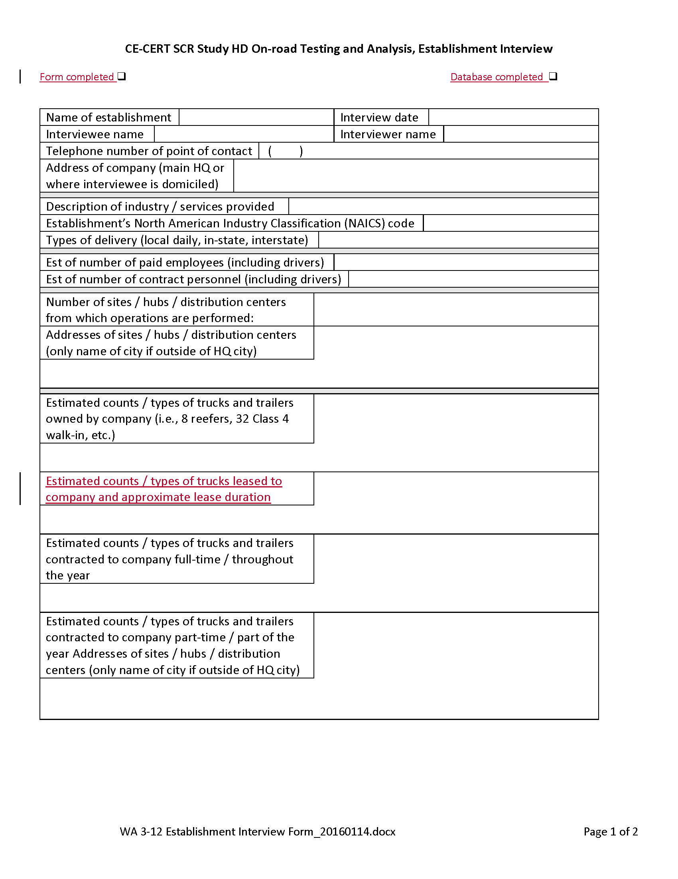
Improvements to Sampling Methodology
Sampling full fleet instead of just the vehicle being tested with PAMS and/or PEMS
Provides a better understanding of how that tested vehicle fits into the rest of the fleet and to the overall vehicle population
Developed a new standardized fleet survey form to capture fleet data (details in a later presentation)

Slide 9
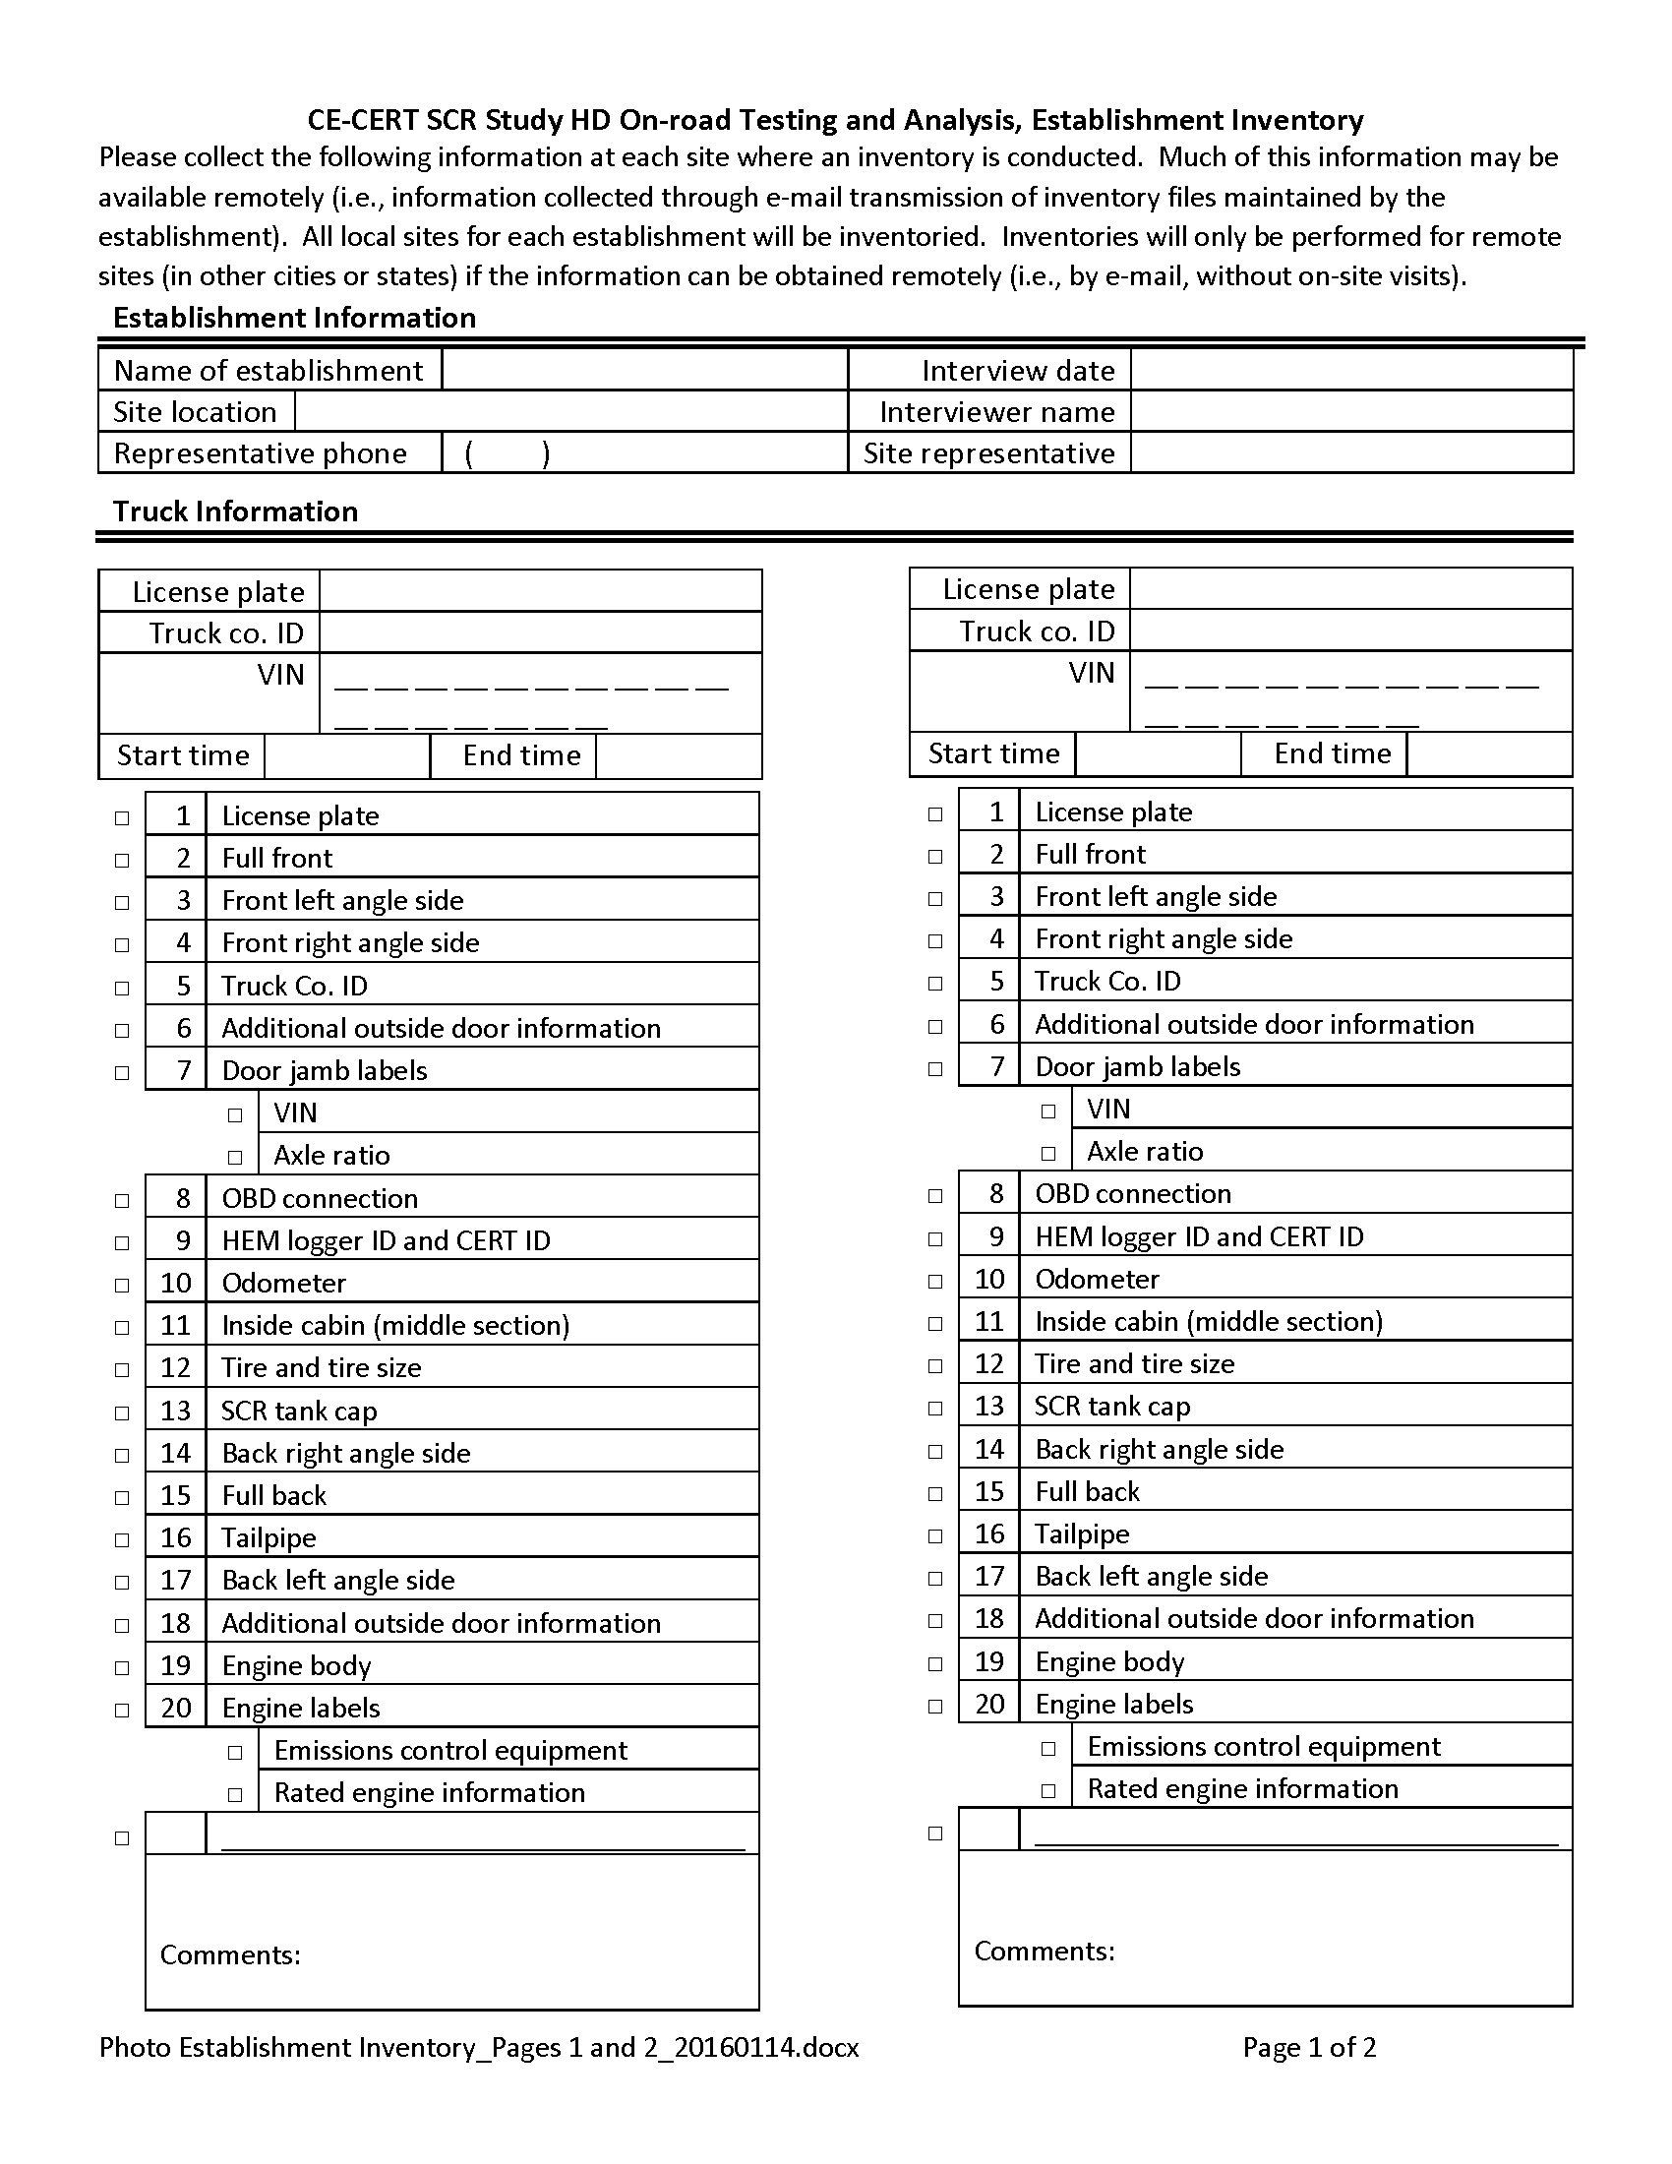
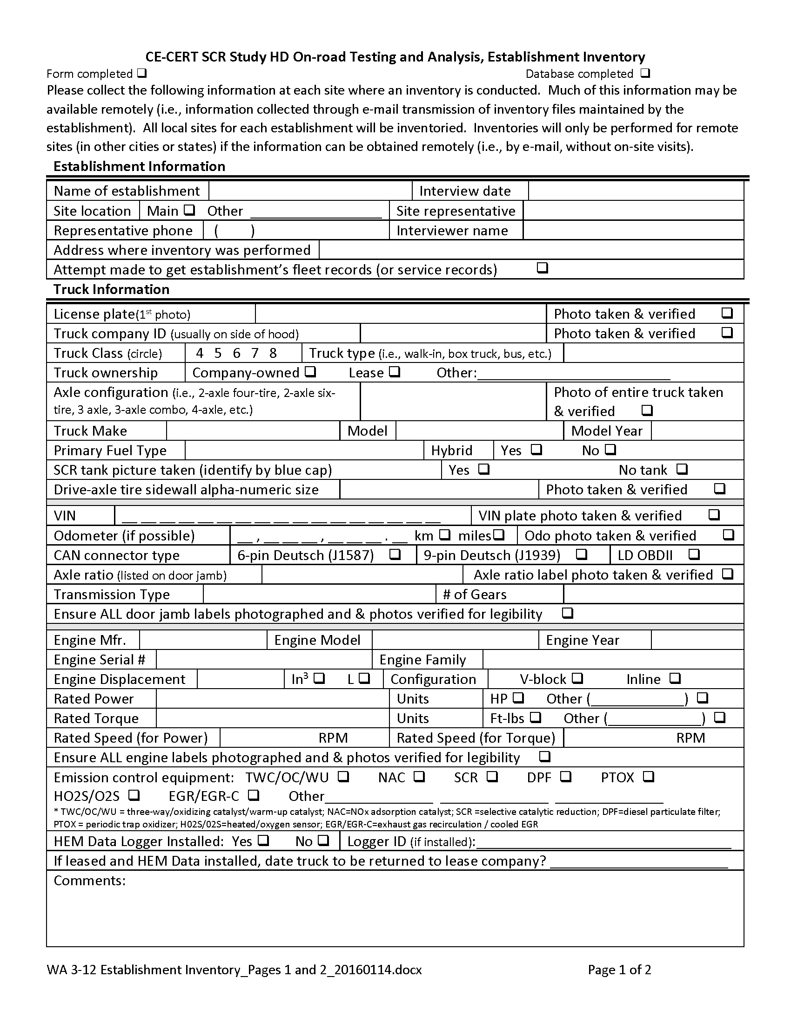
Improvements to Sampling Methodology
Developed new standardized vehicle profile documentation forms (details in a later presentation)
Saves “field” time by taking pictures of vehicle
Data fields can be completed later

Slide 10
Improvements to Data Gathering
Standardizing HDV J1939 Data Files for Loggers (details in a later presentation)
Known database structure for quick data analysis
Gathering “key” vehicle parameter fields for present and future data analysis

Slide 11
Improvements to Data Gathering
Standardizing Data Loggers (Non-cellular)
Quicker installation and setup
Problem: Did not know if worked for 3 months
Cellular Data Loggers (details in a later presentation)
Create “Dashboard” to monitor data logger and vehicle
“Real-time” notification of issues on data logger and/or vehicle and resolve them (better data)
Allow “Real-time” data analysis

Slide 12
Improvements to Data Analysis
Currently developing and implementing an open database and open data analysis structure with partners
Standard database structure: MySQL
Standard data analysis and QC/QA techniques: modular designed Scripts in Python and MySQL
Standard graphics: R
Communicate through “Bit-Bucket” to share data analysis methods
Quicker QA/QC of data
Quicker data analysis Quicker Results!

Slide 13
Conclusions
Partnering together is allowing for:
Sharing the experience, knowledge and expertise of staffs;
Sharing equipment and costs to gather data; and
Better and consistent data to be gathered to address present and future research questions.

Slide 14
Thank You and Questions

