Slide 1
The Increasing Importance
of Vehicle Real-World Data
Matthew Thornton
National Renewable Energy Laboratory
March 17, 2016

Slide 2
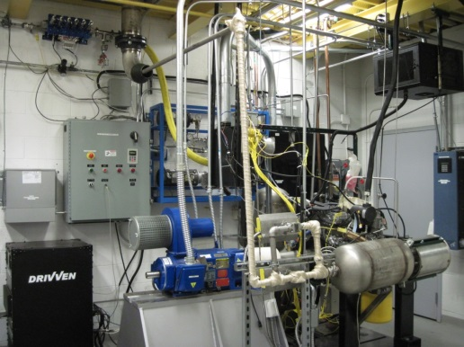
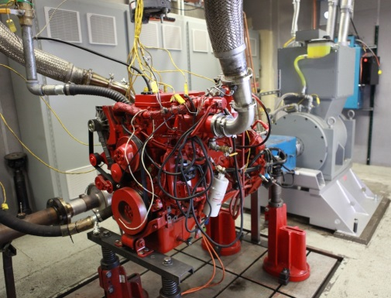
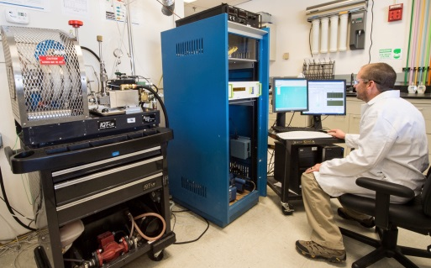
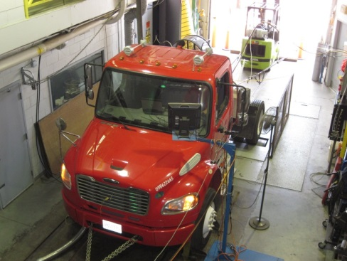
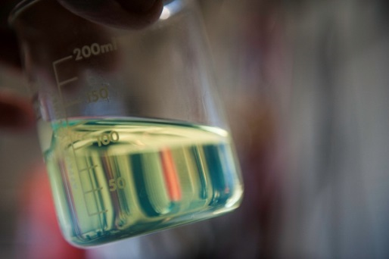
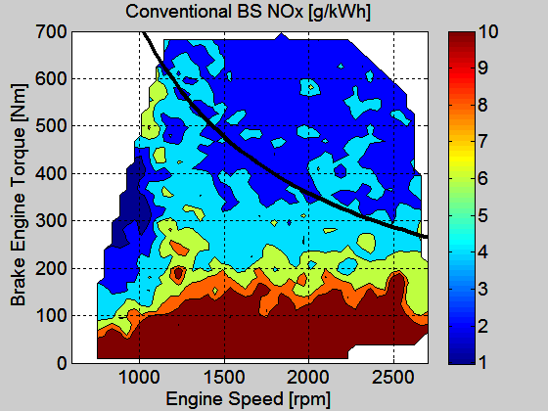
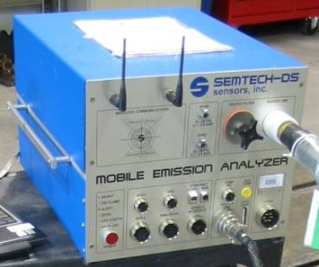
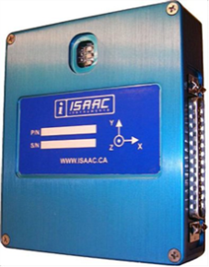
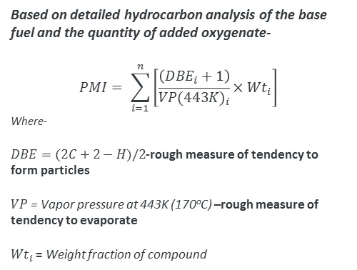
The Emissions Testing Continuum--Repeatability Versus Reality
The Role of PEMS and Real-World Data
Single cylinder Engine
Multi-cylinder Engine
Combustions Device
Chassis Dyno
Based on detailed hydrocarbon analysis of the base fuel and the quantity of added oxygenate-
$$PMI= \sum_{i=1}^{n}{\left[\frac{\left({DBE}_{i}+1\right)}{VP{(443K)}_{i}}×{Wt}_{i}\right]}$$
Where-
$DBE=(2C+2−H)/2$-rough measure of tendency to form particles
$VP$ = Vapor pressure at 443K (170ºC) –rough measure of tendency to evaporate
${Wt}_{i}$ = Weight fraction of compound
Fuel Analysis
On-Road

Slide 3
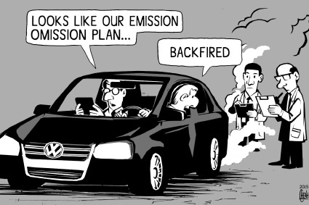

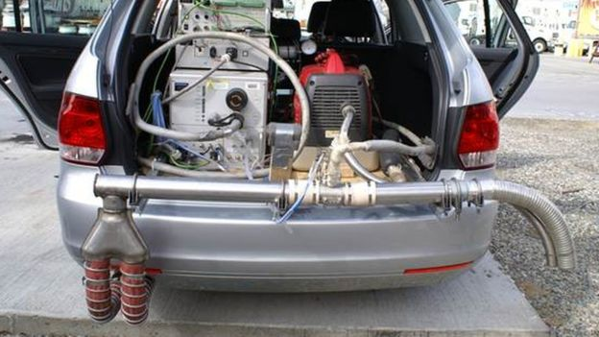
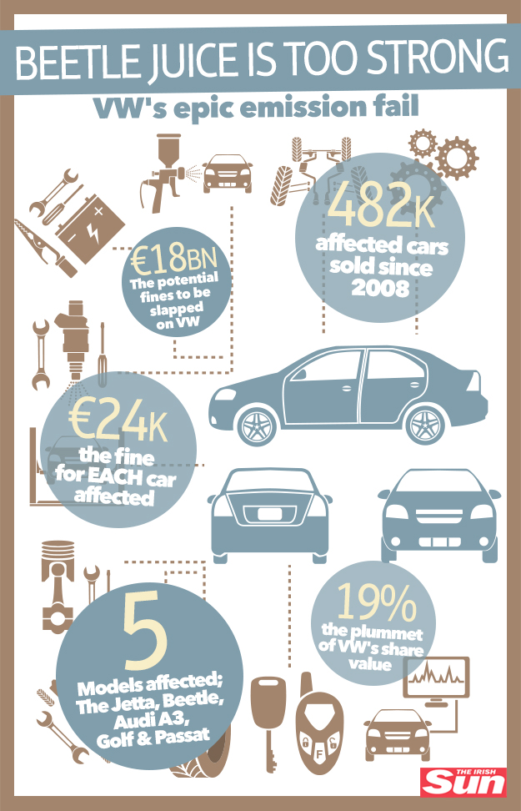
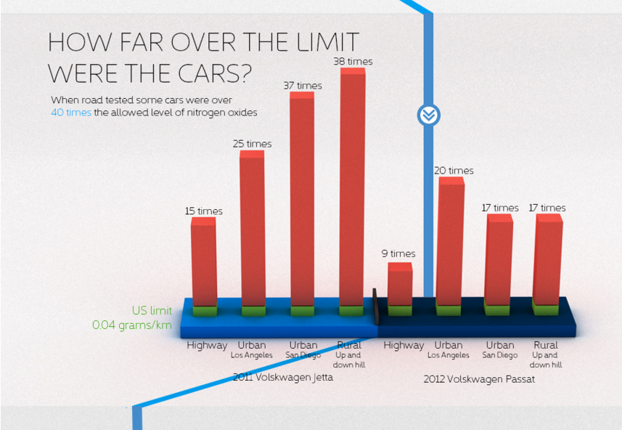
Why is PEMS Important: VW Controversy
Source: Arvind Thiruvengadam, Center for Alternative Fuels, Engines and Emissions at West Virginia University

Slide 4
It’s More than Just Defeat Devices
Many other Studies Have also Shown In-use Emissions Increases
Study | Emissions Increase
More than half of the 14 Euro 6 diesel cars tested with SCR, LNT, or EGR systems…(1). | NOx emissions >6X higher than certified
Two cars, each with LNT or SCR systems...(1) | 25X higher than certified
In a study of three vehicles the best performing SCR (2) | 3-4X higher
In the same study the highest (EGR; and LNT+urea-SCR). (2) | 5-7X the certified level in PEMS testing
Study of US Tier 3 light-duty diesel showed high in-use emissions--two cars with either an LNT or SCR (3) | 4-20X the Bin 5 allowable NOx, depending on route. Most SCR emissions were in the range of 10X.
A Euro 6 gasoline direct injection (GDI) car (4). | 2X higher PN emissions on the autobahn versus on the NEDC
In another study of two Euro 6 GDI cars (5) | 10X higher PN emissions at 130 kph (km/hr) versus the NEDC.
GDI and MPI gasoline engines relative to LD diesels with DPFs. (6) | 1.5 to 2.5 orders of magnitude higher hot-start solid PN emissions (10-15 second duration)
Johnson, T., "Vehicular Emissions in Review," SAE Int. J. Engines 7(3):2014, doi:10.4271/2014-01-1491.
REFERENCES:
1. Mock, P.; Franco, V. "Developments in Automotive Emissions in the EU and Globally", presentation at BOSMAL 4th International Exhaust Emissions Symposium, Bielsko-Biala (Poland), May 22nd, 2014. See also www.TheICCT.org
2. May, J.; Bosteels, D.; Favre, C., "A Comparison of Light-Duty Vehicle Emissions over Different Test Cycles and in Real Driving Conditions", Paper F2014-CET-058, 2014 FISITA Conference, Maastricht, June 2014.
3. Thompson, Gregory J.; Carder, Daniel K.; Besch, Marc C.; Thiruvengadam, Arvind, Kappanna, Hemanth K., "In-Use Emissions Testing of Light-Duty Diesel Vehicles in the United States", study for International Council on Clean Transportation, website: www.TheICCT.org
4. Deutsche Umwelthilfe (DUH) press release, October 29, 2013. http://www.duh.de/pressemitteilung.html?&no_cache=1&tx_ttnews%5btt_news%5d=3200&cHash=58b125fbc6c5b932d5bbe17221354dd2
5. Kolke, R., "Die Grossen Herauseforderungen fuer Diesel-Pkw", 11th FAD Conference "Challenge - Exhaust Aftertreatment for Diesel Engines", Dresden, November 6-7,2013.
6. Khalek, I. A.; Badshah, H., "Particle Emissions from Vehicle Exhaust During Engine Start-Up", presentation at 18th ETH Conference on Combustion Generated Nanoparticles, June 23-25, 2014, Zurich.

Slide 5
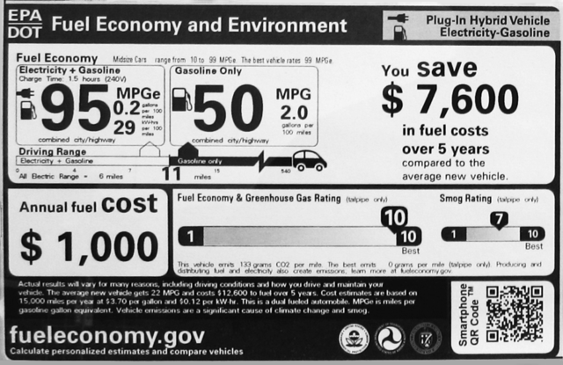
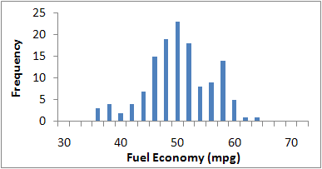
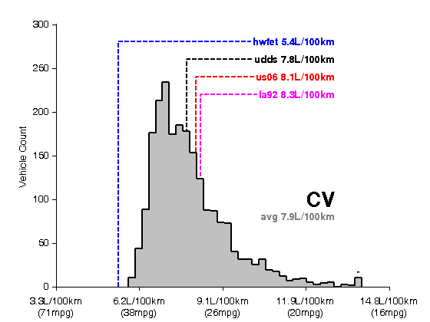
Real-World Effects Emissions and Fuel Economy (CO₂)
“Your mileage will vary” based on driving style
2010 Prius Fuel Economy Histogram for 133 Drivers*
Window sticker rating
Cert vs. Real-World Variance
  Off-cycle impacts—drive cycle
  Auxiliaries, weather, elevation, driver behavior, traffic…
* Data accessed from www.fueleconomy.gov

Slide 6
A/C Fuel Use is Important for all Vehicles
The Impact of Climate and Auxiliary Loads on Fuel Economy (CO₂)
2.5
1.275
1.063
2.0
0.850
1.5
A/C fuel Use (liters/100 km)
A/C fuel Use (gallons/100 miles)
0.638
1.0
MPG -16%
MPG -18%
MPG -22%
0.425
0.5
0.213
0.0
0.000
SI
Diesel
Hybrid - 7 Vehicle Average
Conventional - 5 Vehicle
7 billion gallons of fuel used annually for vehicle A/C in the U.S.
Average
NREL, analysis, FTP
U.S. Dept. of Energy, Test, SAE J1634
http://avt.inl.gov/hev.shtml
U.S. EPA, Test, SC03, EPA420-D-06-002
http://www.epa.gov/fueleconomy/420d06002.pdf

Slide 7
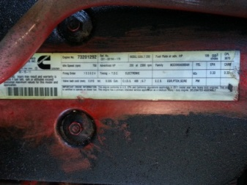
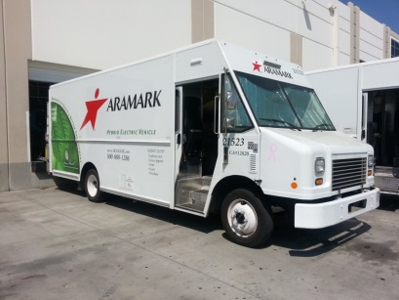
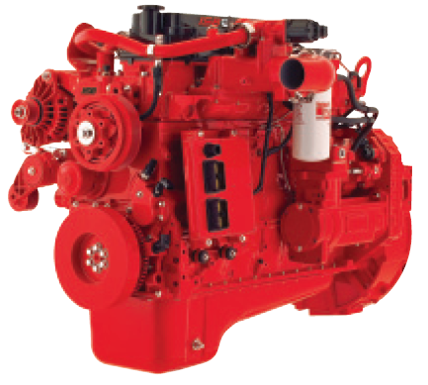
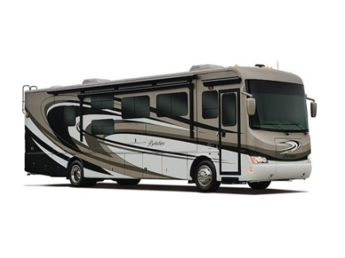
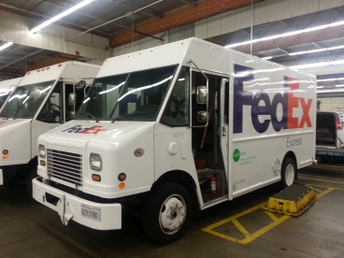

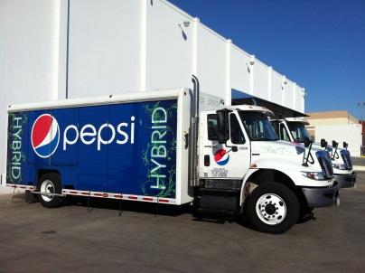
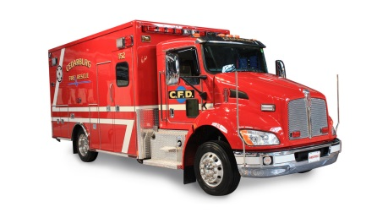
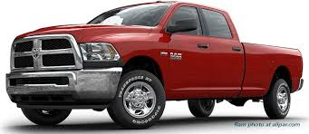
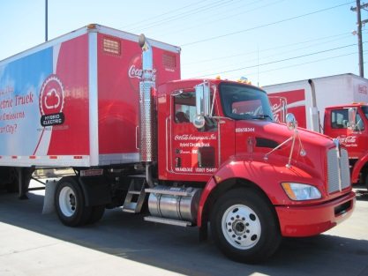
Heavy-Duty: Even a More Complex Issue than LD?
Cummins ISB (Certified for use over 14,000 lbs. GVWR)
Vehicle class range: 2b-7

Slide 8
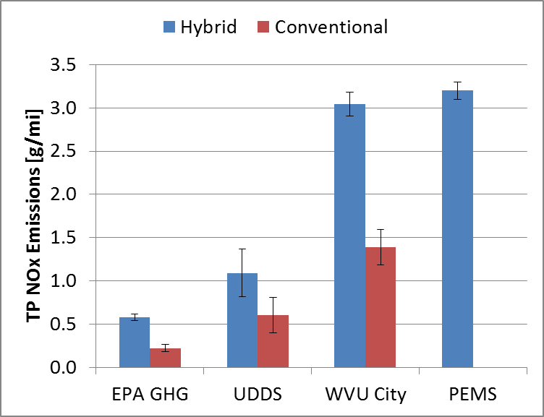
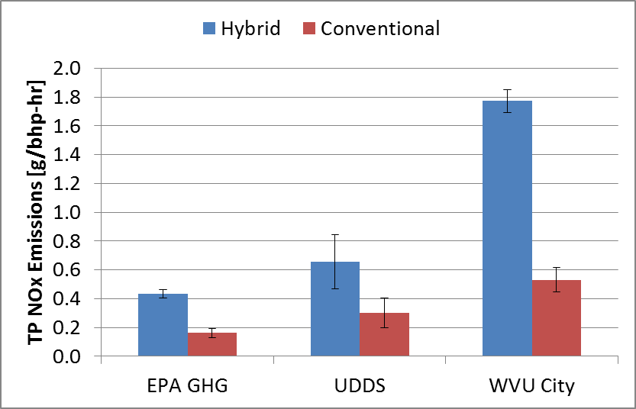
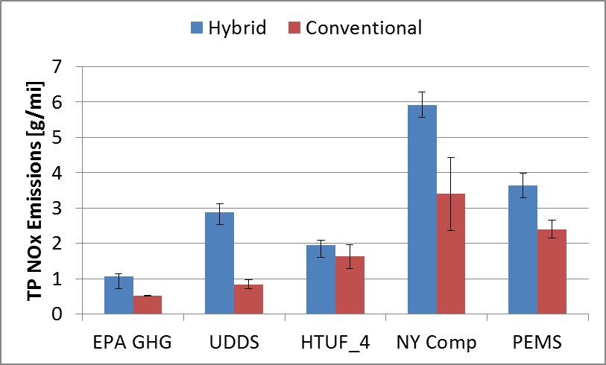
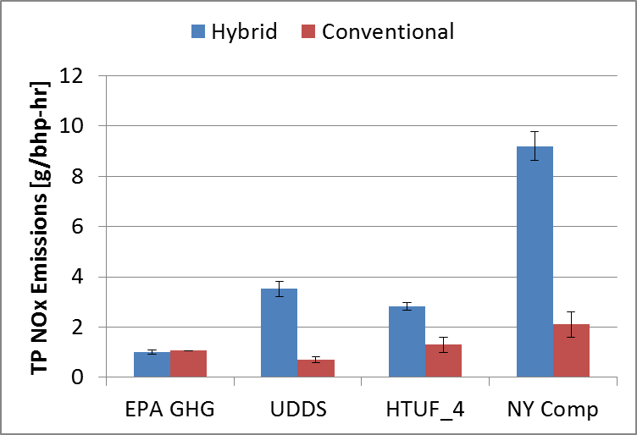
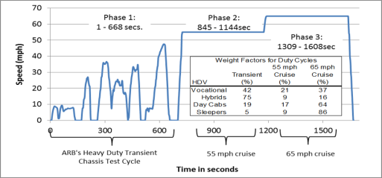
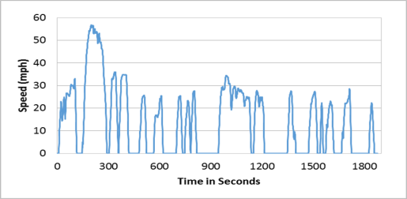
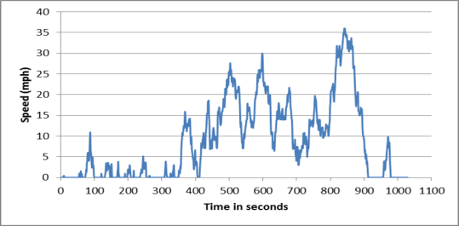
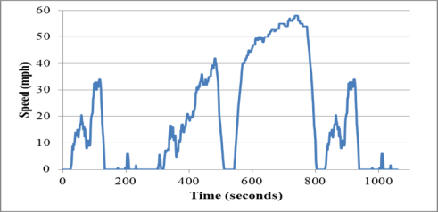
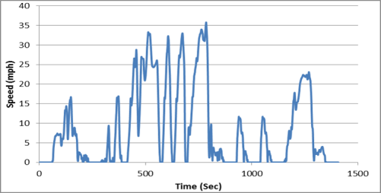
Emissions Impact Example-Hybrid Trucks
Straight Truck with ISB-Beverage Delivery
Step Van with ISB -Parcel Delivery
Urban Dynamometer Driving Schedule (UDDS)
West Virginia University City Cycle (WVU City)
Environmental Protection Agency Greenhouse Gas Cycle (EPA GHG) or HHDDT
Hybrid Users Truck Forum Class 4 Driving Schedule (HTUF 4)
New York City Composite Cycle (NYCC)

Slide 9
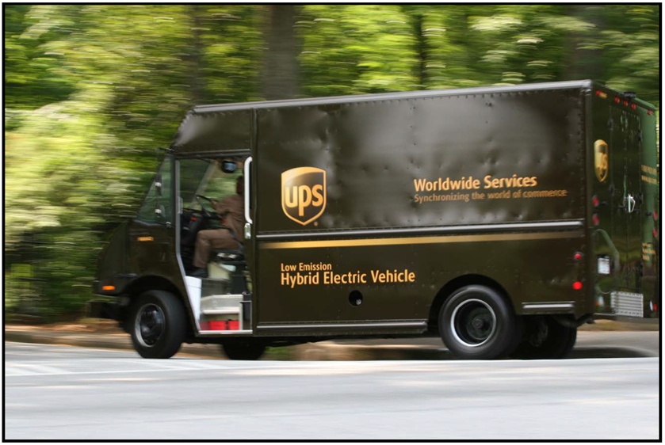
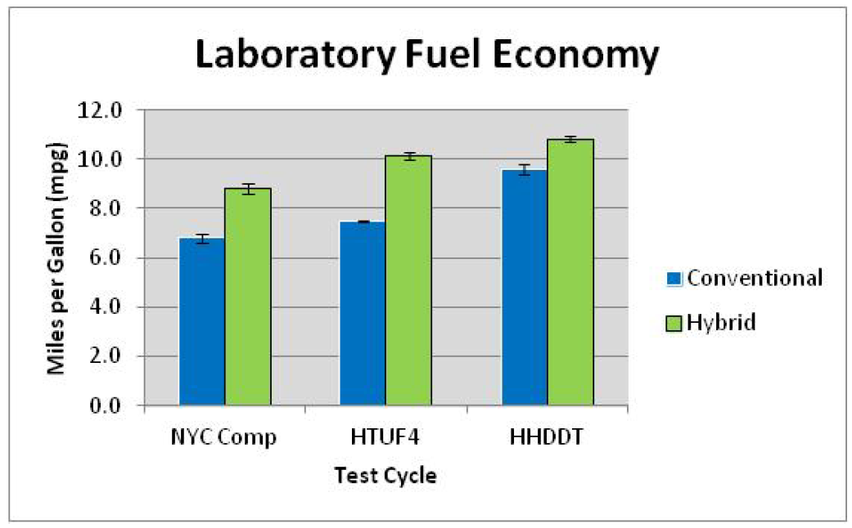
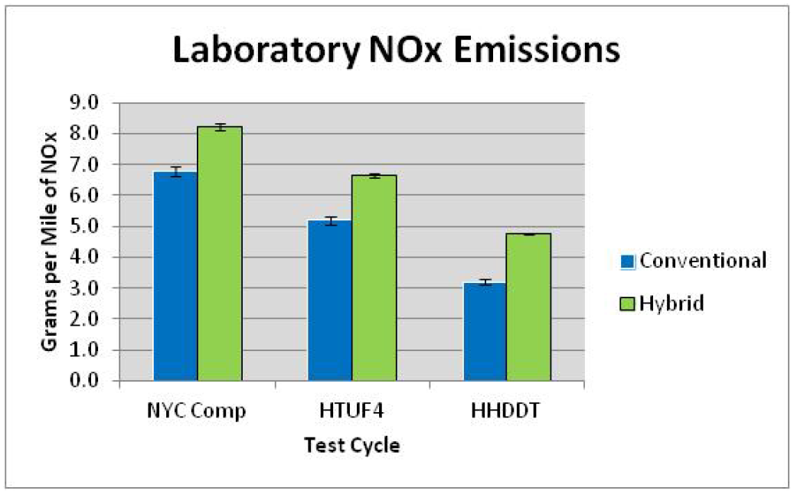
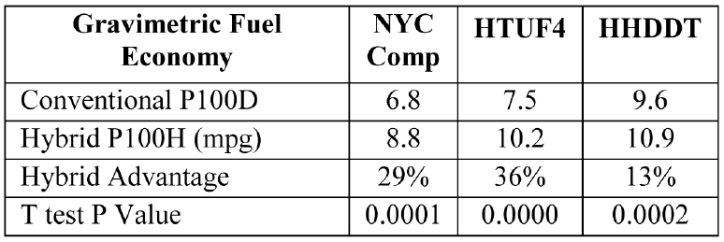
UPS Diesel HEV Class-6 Walk-In Step Vans

Slide 10
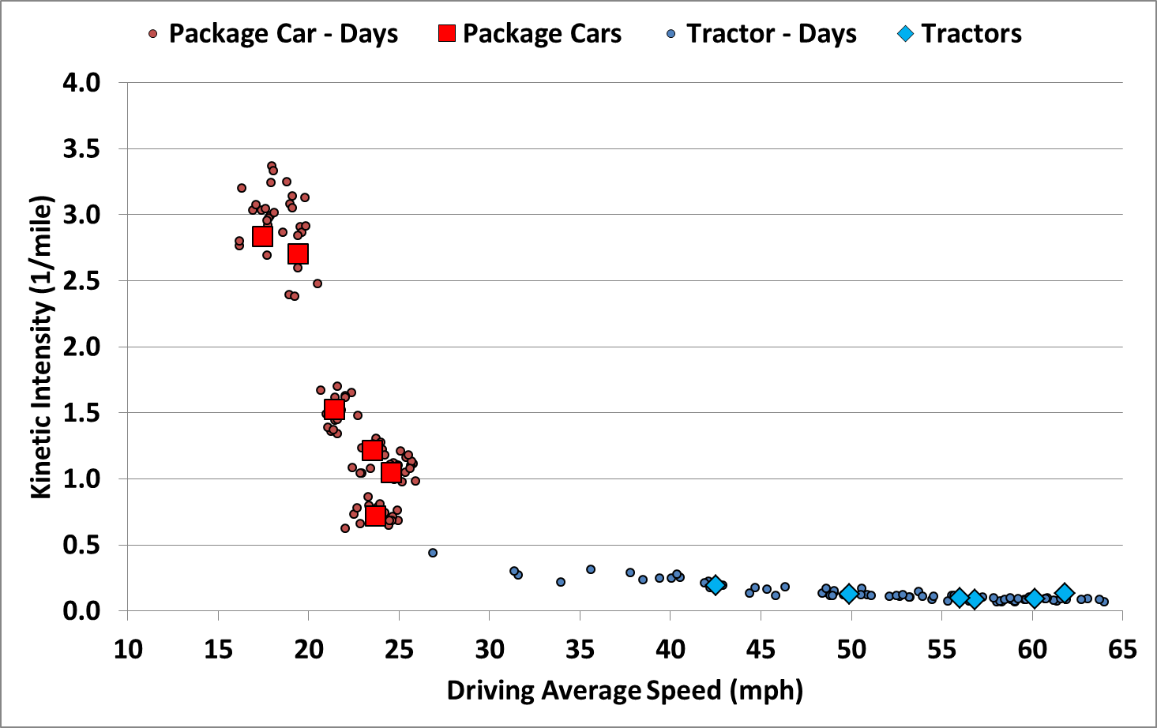
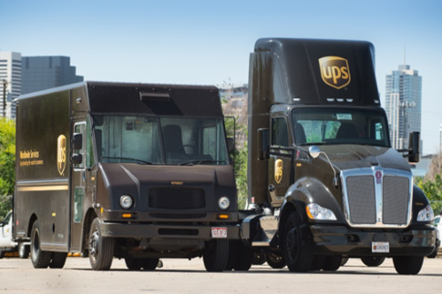
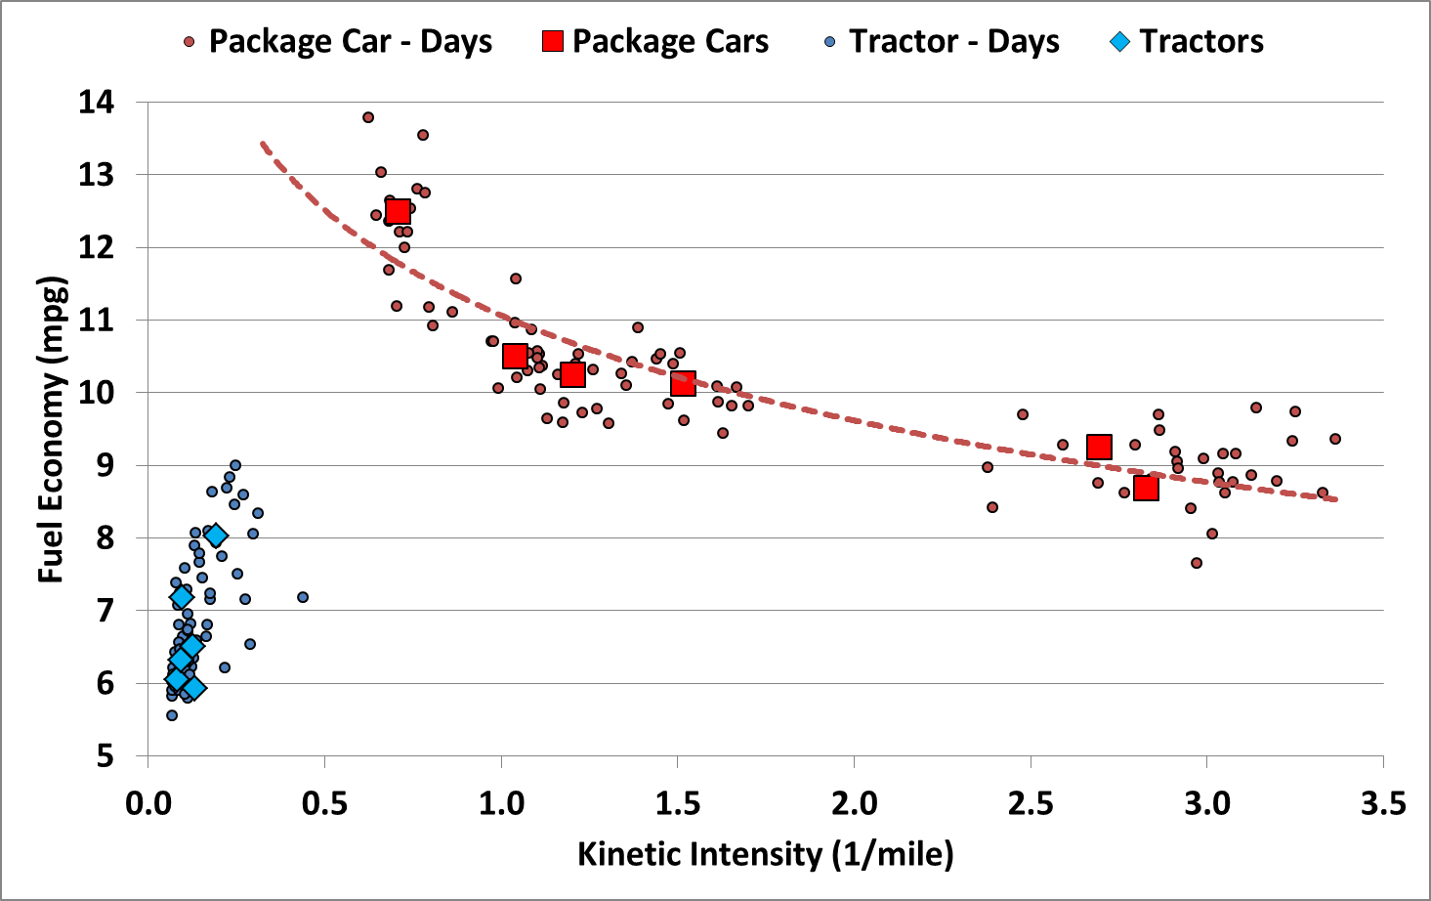
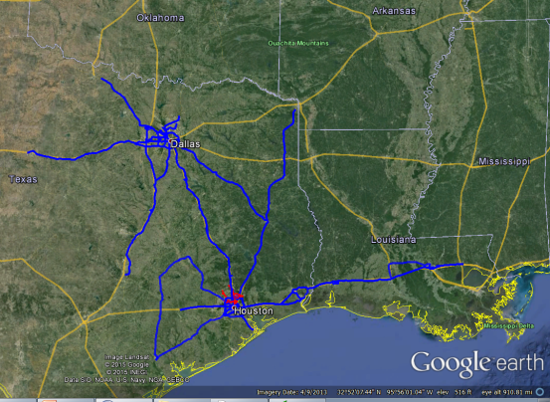
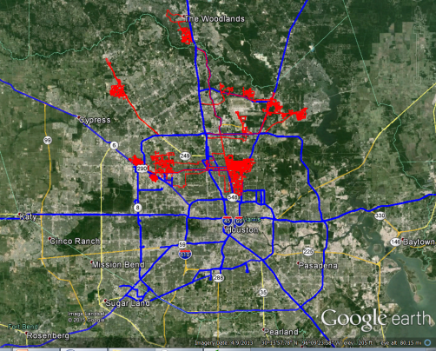
UPS Step Van and Tractor Fuel Economy
Field Data showing range of duty cycles for a sample of UPS tractors and package delivery vehicles
3-weeks on-road data collection
Six class 4 package vans
Six class 8 tractors
Kinetic intensity clusters indicative of low-speed urban delivery vs. high-speed regional haul duty cycles – note range of operation
CAN-based fuel efficiency correlated to duty cycle parameters – showing influence of duty cycle on fuel efficiency

Slide 11
It’s All About the Duty Cycle
Example: hybrid technology benefit on different cycles
Avg. speed: 8.4 mph
Avg. speed: 34 mph

Slide 12
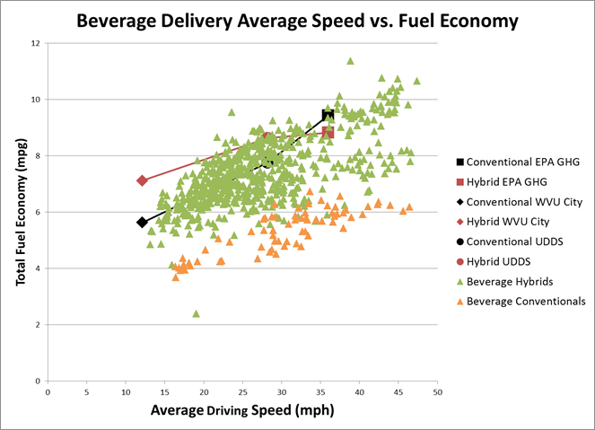
Activity Data is Key for Understanding Real-World Impacts
Evaluate real-world emissions and fuel-saving opportunities for technologies difficult to assess with standard certification cycles
  DOE and regulatory bodies want to maximize real-world fuel savings
  Manufacturers want to get credit for actual emissions and fuel savings achieved
  Example technologies:
    Engine Cold Start
    Hybridization-Start-stop
    High-efficiency alternators
    Catalyst Insulation
    Glazing technology
    Connected vehicle applications
  DOE labs such as NREL can provide objective inputs
  Relevant existing capabilities
    Evaluation of energy efficiency technologies
    On-road driving data
    Fusion of large datasets capturing range of real-world operating conditions
Notes:
CAFE requires 54.5 mpg by 2025: 4-5% annual improvement
Mechanism exists to apply for off-cycle credits; NREL and other labs can give objective insights
Operating considerations: Drive cycles, road grade, ambient temperature, solar loads, national VMT (vehicle miles traveled)

Slide 13
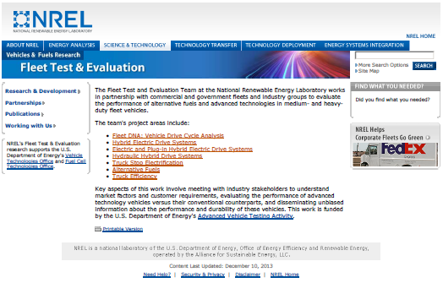
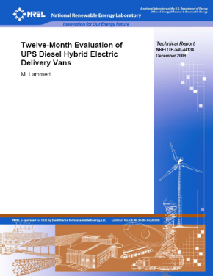
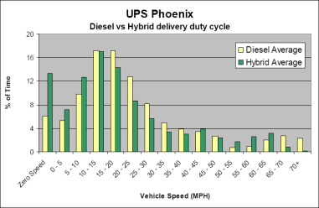
Medium- and Heavy- Vehicle Field Testing Approach
Evaluate the performance of alternative fuels and advanced technologies in medium- and heavy-duty fleet vehicles - in partnership with commercial and government fleets and industry groups vehicles.
Collect, analyze and publicly report data:
    Drive cycle and system duty cycle analysis
    Operating cost/mile
    In-use fuel economy
    Chassis Dynamometer emissions and fuel economy
    Scheduled and unscheduled maintenance
    Warranty issues
    Reliability (% availability, MBRC)
    Implementation issues/barriers
    Subsystem performance data & metrics (ESS, engine, after-treatment, hybrid/EV drive focus)
  Data stored in FleetDNA for security and limited public accessibility
  Frequent interactions and briefings with stakeholders – fleets, technology providers, researchers, and government agencies
Fleets
Vehicle & Equip Mfg’s
Useful Data, Analysis and Published Reports
UPS, FedEx, Coke,
Frito-Lay, Foothill Transit, PG&E, Miami-Dade, Verizon, Walmart, Waste Management
Proterra, Navistar, Smith EV, Eaton, Allison, BAE, EDI, Altec, International, PACCAR, Oshkosh, Odyne, Parker-Hannifin, Cummins

Slide 14

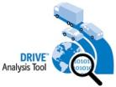
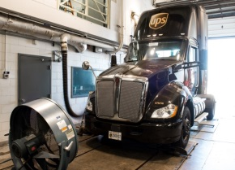



NREL Field Data, Testing, & Analysis Tools
Data from Field Evaluations helps populate FleetDNA
database
DOE Fleet Tools (DRIVE, FASTSim, AFleet, etc.) used to analyze and investigate impacts – data used to validate and improve tools
Published information and data used by fleets, industry, DOE and other research programs, and other agencies
Collect Lab and Field Data
Capture, Store and Analyze
Explore & Optimize
Communicate & Inform
Identify Barriers, New R&D Opportunities, Validate Efforts
Laboratory Testing
Partnership with Fleets and Technology Providers = Relevant Results & Optimized Solutions for Real World Applications

Slide 15
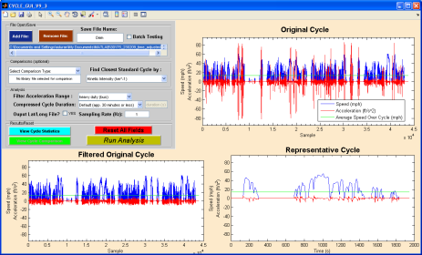





Applying Fleet DNA – NREL’s DRIVE Tool
Drive-cycle Rapid Investigation, Visualization and Evaluation Tool (DRIVETM)
Created to help fleets and OEMs analyze vehicle usage data for proper vehicle placement, design and testing
Combines large amounts of user data then filters, creates new cycles & identifies best fitting existing cycle
Quickly processes and analyzes data :
  Over 250 metrics
  Histograms
  Scatter plots
  Creates custom cycle
  Recommends standard cycles

Slide 16
Transportation Data Centers at NREL
Real-World Data and Analysis to Support Decision Making
Alternative Fuels Data Center (AFDC)
Public clearinghouse of information on the full range of advanced vehicles and fuels
National Fuel Cell Technology Evaluation Center (NFCTEC)
Industry data and reports on hydrogen fuel cell technology status, progress, and challenges
Transportation Secure Data Center (TSDC): Detailed individual travel data, including GPS profiles
Fleet DNA Data Collection
Medium- and heavy-duty drive-cycle and powertrain data from advanced commercial fleets
FleetDASH: Business intelligence to manage Federal fleet petroleum/alternative fuel consumption
Features | AFDC | NFCTEC | TSDC | Fleet DNA | Fleet DASH
Securely Archived Sensitive Data |  | Y | Y | Y | Y
Publicly Available Cleansed Composite Data | Y | Y | Y | Y
Quality Control Processing | Y | Y | Y | Y | Y
Spatial Mapping/GIS Analysis | Y | Y | Y | Y | Y
Custom Reports |  | Y |  | Y | Y
Controlled Access via Application Process |  |  | Y
Detailed GPS Drive-Cycle Analysis |  |  | Y | Y

Slide 17


Additional Information
Available through Fleet DNA
www.nrel.gov/fleetdna
    Objectives:
    Capture and quantify drive cycle and technology variation for the multitude of medium- and heavy-duty vocations
    Provide a common data storage warehouse for medium- and heavy-duty vehicle data across DOE activities and labs – www.nrel.gov/fleetdna
    Integrate existing DOE tools, models, and analyses to provide data driven decision making capabilities
    For Government : Provide in-use data for standard drive cycle development, R&D, tech targets, and rule making
    For OEMs: Real-world usage datasets provide concrete examples of customer use profiles
    For Fleets: Vocational datasets help illustrate how to maximize return on technology investments
    For Funding Agencies: Reveal ways to optimize impact of financial incentive offers
    For Researchers: Provides a data source for modeling and simulation

Slide 18


Conclusion
PEMS has important role in collecting real-world data and it’s importance is growing
Off-cycle and environmental impacts can impact emissions and fuel economy greatly
Advanced technology and alternative fuel can accentuate impacts and are becoming bigger players
Activity data is key to properly quantifying impacts
Opportunity for benefits--not just negative impacts

Slide 19
Questions?
Thank You!
Additional Information:
matthew.thornton@nrel.gov
720-232-4285

