Slide 1




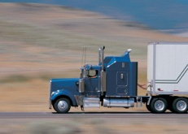
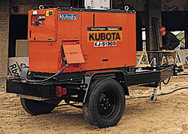



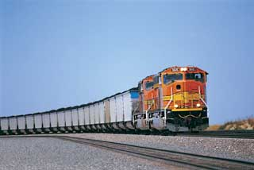


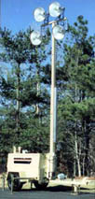


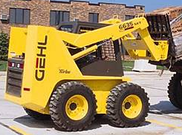
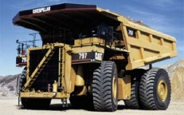

Real-World Emissions From Mobile Sources
Edward Nam
USEPA Office of Transportation and Air Quality
PEMS Conference & Workshop
UC Riverside CE-CERT
March 17, 2016

Slide 2
Introduction
Characterizing Real-world emissions is critical for EPA
  Essential for program oversight and assessment
  Results inform program direction
Access to real-world data enables EPA to pinpoint excess emissions and respond
  Research and emissions inventories
  Robust and effective regulations
  Targeted compliance oversight to ensure level playing field, maximize emissions reductions, and deliver public health benefits promised by regulations

Slide 3
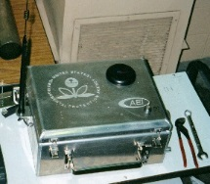
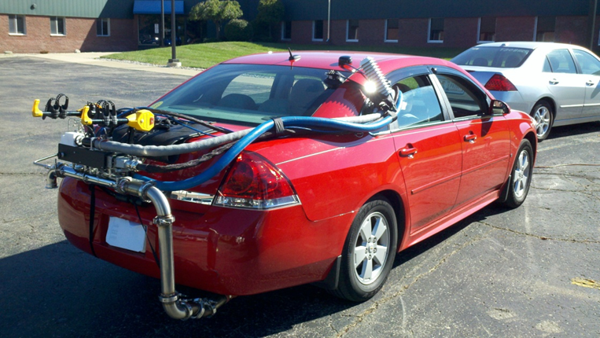
PEMS History
EPA issued regulations covering PEMS testing
EPA’s ROVER
Development
EPA’s PEMS Patent
EPA’s PEMS SPOT (Nonroad) Development
1970
1980
1990
2000
2010
2015
Future
EPA Chase Car Testing
EPA PEMS Testing
EPA’s HD In-use PEMS Program

Slide 4
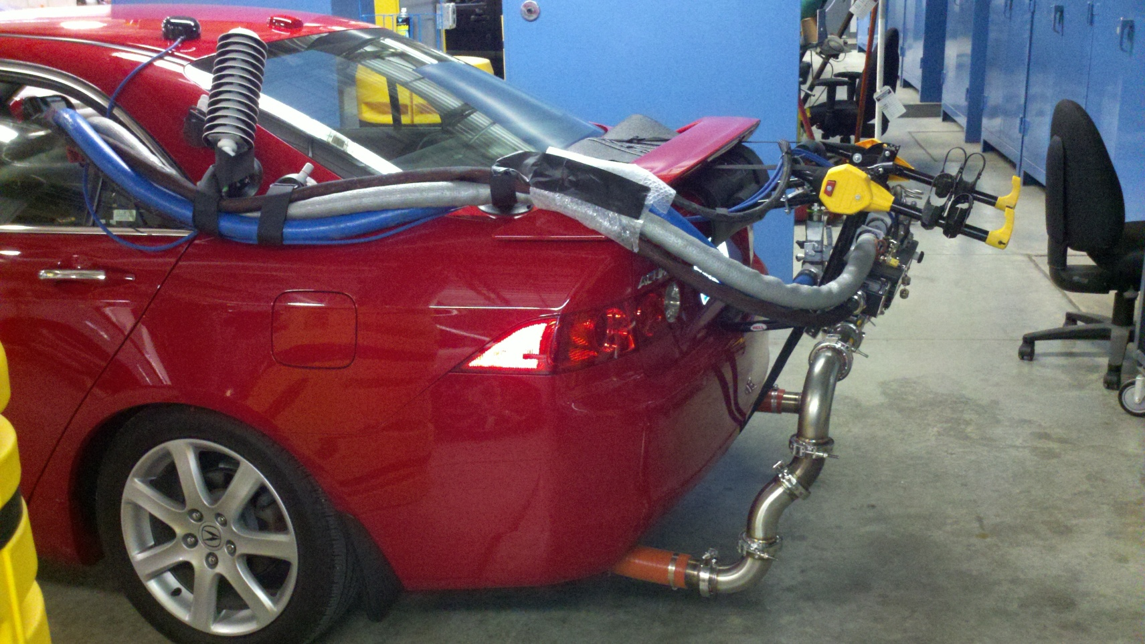
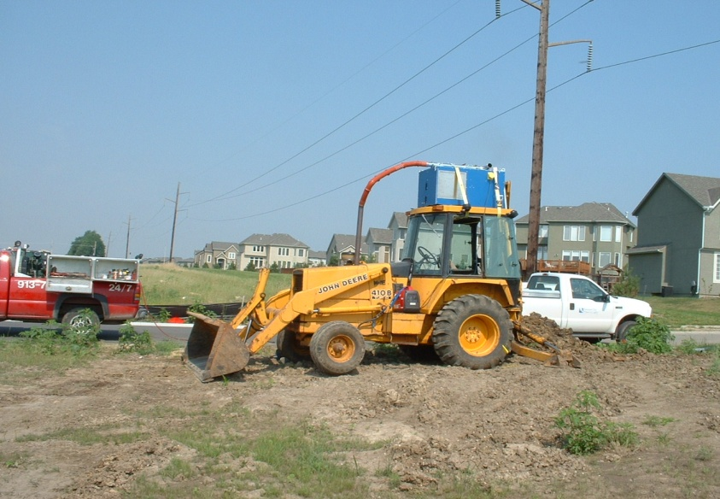
PEMS/PAMS Research Programs Underway
Heavy Duty Vehicles
Non-Road Diesel Equipment
Light Duty Vehicles
We are pursuing partnerships to support these efforts

Slide 5
Research and Emission Inventories
Forms the genesis for subsequent EPA actions
EPA emissions inventories are primarily built from the “bottom up” using data
  from vehicle and equipment usage
  From real-world as well as laboratory measurements
Much of our vehicle data is from dynamometers – how do we translate that to the real-world activity?
Testing in the real-world is inherently variable and non-repeatable – how can we scientifically compare with standards and dyno testing?

Slide 6
Drive Cycle Comparisons
MOVES is at its core a physics-based modal model
Variability from real world tests can be reduced when the road load impacts and acceleration rates considered
By splitting up emissions by VSP modes, can convert any driving to any other cycle for an apples to apples comparison*
  Can also describe any driving as function of other cycles
  Can help reduce uncertainty related to conformity factors
  *As long as you have covered sufficient operating window

Slide 7
PEMS/PAMS Used in Regulations/Compliance Efforts
Heavy Duty
  In-Use testing requirements, including Not To Exceed provisions
LDV: Fuel Economy Labeling Rule
  Measured in-use fuel economy from Kansas City vehicles, including Hybrid Electric Vehicles
  Important for any future labeling rule
Ocean Going Vessel and Locomotive/Marine Rules
Off-cycle emissions

Slide 8
Off-Cycle Emissions
The Light-Duty GHG Rules made allowances for CO₂ credits from technologies not measured on the fuel economy test procedures
Manufacturers not using the pre-determined table values or 5-cycle testing must conduct a scientific study to quantify the CO₂ impact
  This includes consumer behavior
  Driving patterns
  Real-world emissions
Our stakeholders will need your help

Slide 9
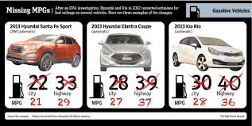

EPA Compliance Oversight
Some fundamentals:
  Regulations alone don’t achieve emissions control. Vehicles and engines must comply if environmental benefits are to be realized
  Strong EPA presence and oversight is needed to maximize compliance
Recent events have reinforced these realities

Slide 10
Compliance Actions - Additional Examples
In 2012/13 manufacturers recalled ~3.7 million cars and 340,000 heavy-duty engines with potential or actual emission problems
  Consumers received free repairs, extended warranties or other remedies
In 2013, EPA voided 153 certificates of conformity for engine families covering 170,000+ on- and off-highway motorcycles and all-terrain vehicles (model years 2005-12)

Slide 11
Importance of Compliance – Some Examples
Clean Air Benefits
1990 Clean Air Act Amendments
  From 1990-2020, 4.2 million lives saved, benefit outweighs costs ~30:1
  In 2030 alone, eliminate > 38,000 premature deaths; > $380 billion in health and welfare benefits
Light duty vehicle greenhouse gas program is projected to result in:
  $1.7 trillion dollars of fuel savings over the lifetime of vehicles produced between 2011 and 2025
  12 billion fewer barrels of oil consumed
Level Playing Field
Vehicle, engine, and fuels industries are highly competitive, especially in today’s global environment
  Regulated industries expect and rely on EPA to protect their investment in emissions compliance

Slide 12
Our Compliance Approach
Our approach to compliance oversight is multi-dimensional and flexible
We apply a flexible mix of testing, audits, manufacturer tracking/reporting review, and partnerships to collect and respond to compliance information
We monitor emissions compliance throughout product lifecycle
  Pre-production
  Products coming off production lines
  Vehicles and engines already in customer service
PEMS and other real-world emissions monitoring technologies are important elements in our toolkit

Slide 13
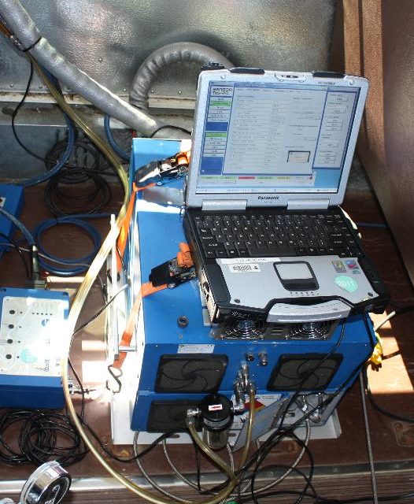
EPA Has Been PEMS Compliance Testing for 15+ Years
HD In-Use Compliance PEMS Testing evaluates emissions in real world operation, including:
  Actual urban and highway routes, including road grade
  Ambient conditions
  Payloads
PEMS measurements
  CO₂, CO, HC, NO_{x}, & PM (g/hr basis)
  Torque from engine controller
  Combine to estimate g/bhp-hr emissions

Slide 14
Conclusions
EPA-led research has led to significant advances in measurement as well as modeling techniques to capture real-world emissions
Real-world monitoring technologies are increasingly important for EPA’s vehicle emissions programs
Regulatory programs help ensure cleaner air and health and welfare improvements
Compliance programs
  Maximize air quality benefits
  Ensure that manufacturers compete on a level playing field
  Protect consumers
  Include “unpredictable” elements
Partnerships are critical for advancement

Slide 15
We’re In This Together
You are on the leading edge of measurement technology
  Smaller, lighter, lower power
  NMOG Speciation
While laboratories will always be needed, PEMS democratizes emissions testing
  Lower cost, flexibility, portability
  Opportunity for this to become “big data”
There is an explosion of new vehicle technologies and fuels introduced into the fleet…
  We need to understand the real world impact of these technologies
  Continue working with policy makers to collect data

Slide 16
Appendix
Will delete most of these slides.

Slide 17
Example: Light-Duty Vehicle Compliance Program
EPA Action
Durability Review and Approval Process
Manufacturer Action
EPA Follow-Up (Defect and Recall Reports, Mfr. In-Use Testing, EPA Testing)
EPA Test Data Review/Analysis
CARB Coordination (Warranty Reporting)
OECA Coordination (Enforcement)
EPA Issues Certificate of Conformity
EPA Review of Manufacturer Application
EPA Confirmatory Testing (Random and Targeted)
EPA In-Use Surveillance Testing
EPA Certification Preview and Pre-model Year Reports
0 Miles
10,000 Miles
20,000 Miles
50,000 Miles
90,000 Miles
120,000 Miles
(End of Useful Life)
Vehicle Design and Build
Low-mileage In-Use Verification Testing Performed by Manufacturer
High-Mileage In-Use Verification Testing Performed by Manufacturer
Vehicle May Enter Commerce
End of Useful Life (per CAA)
Manufacturer Emissions Vehicle Prototype and Durability Testing
Warranty Tracking and Emission Warranty Reports (EWIRs) to CARB
Emission Defect Information and Voluntary Emission Recall Reports (EDIRs/VERRs) to EPA
(introduction into commerce – useful life miles)

