Slide 1
The Role of OSAR in moving Towards a Sustainable Transportation Future
Keynote - OSAR Conference
April 2025
Presented By:
Thomas Durbin, Kent Johnson, Georgios Karavalakis, Zisimos Toumasatos, Grace Johnson, and Troy Hurren
University of California, Riverside
Bourns College of Engineering
Center for Environmental Research and Technology

Slide 2
Environmental Impacts of Transportation Emissions
Mitigating the environmental impacts of transportation emissions is one of the biggest challenges of ours and future generations
Transportation accounts for approximately 24% of worldwide and 33% of U.S. CO₂ emissions, with about 75% of this from on-road sources.¹
World Health Organization (WHO) estimates of air quality impacts include²
  In 2019, 99% of the world’s population was living in places where the WHO air quality guidelines levels were not met.
  Ambient (outdoor) air pollution was estimated to have caused 4.2 million premature deaths worldwide in 2019.
  The combined effects of ambient air pollution and household air pollution are associated with 6.7 million premature deaths annually.
1 https://ourworldindata.org/co2-emissions-from-transport; https://www.epa.gov/ghgemissions/global-greenhouse-gas-overview
2 https://www.who.int/news-room/fact-sheets/detail/ambient-(outdoor)-air-quality-and-health
Notes:
Where premature deaths can be attributed to the impacts of disease from stroke, heart disease, lung cancer, and both chronic and acute respiratory diseases, including asthma

Slide 3
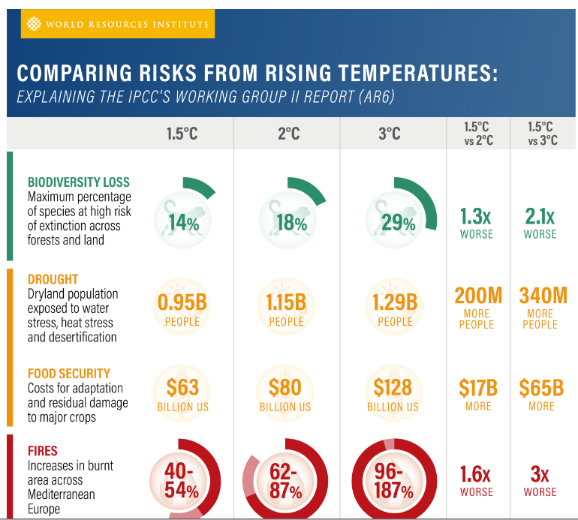
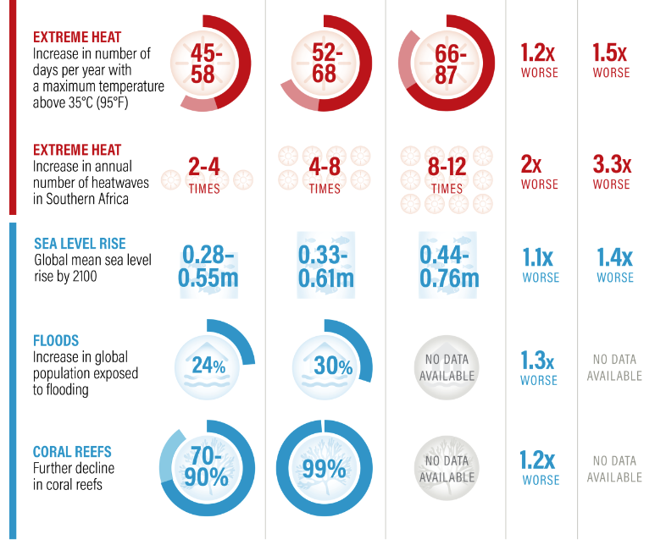
Global Warming – Potential Impacts
Source: World Resources Institute. https://www.wri.org/insights/2023-ipcc-ar6-synthesis-report-climate-change-findings
Notes:
Now we can look at projected impacts of global warming. This chart shows the impact of global warming from temperature increases from 1.5 to 3C, and a comparison of the relative impact of 1.5 to 2 and 3C for a variety of impact categories. This chart shows how significant the contribution of global warming might be on biodiversity loss, drought and food security, heat and fires, and sea level rising, floods, and coral reef damage, and how these impacts multiple with higher temperature increases.

Slide 4
Costs of Global Warming
Costs of US$ 143 billion per year attributable to extreme events due to climatic change.¹
In U.S., 400 weather /climate disasters since 1980 where overall damages/costs reached or exceeded $1 billion (including CPI adjustment to 2024). The total cost of these 400 events >$2.785 trillion.²
From 2000 to 2019, extreme weather events globally, like hurricanes, floods and heat waves, have cost an estimated $2.8 trillion. This is around $143 billion/year or $16.3 million/hour.³
The global cost of climate change damage is estimated to be between $1.7 trillion and $3.1 trillion per year by 2050. ³
1. Newman, R., Noy, I. The global costs of extreme weather that are attributable to climate change. Nat Commun 14, 6103 (2023). https://doi.org/10.1038/s41467-023-41888-1.
2. National Centers for Environmental Information (NCEI) http://www.ncei.noaa.gov/access/billions
3. World Economic Forum. https://www.weforum.org/stories/2023/10/climate-loss-and-damage-cost-16-million-per-hour/
Notes:
1. Edison International, 2023, Countdown to 2045: Realizing California’s Pathway to Net Zero, September.
2. Ramboll US Consulting, Inc., 2021, Transportation Electrification Infrastructure Costs in California: A Meta-Study of Published Literature, Final report for Western States Petroleum Association, August.
3. Davis, Adam, Tiffany Hoang, Thanh Lopez, Jeffrey Lu, Taylor Nguyen, Bob Nolty, Larry Rillera, Dustin Schell, Micah Wofford. 2023. Assembly Bill 2127 Second Electric Vehicle Charging Infrastructure Assessment: Assessing Charging Needs to Support Zero-Emission Vehicles in 2030 and 2035. California Energy Commission. Publication Number: CEC-600-2024-003-CMR
4. U.S. DOE, Office of Policy. 2022. Queued Up… But in Need of Transmission, April.
5. https://source.benchmarkminerals.com/article/more-than-300-new-mines-required-to-meet-battery-demand-by-2035

Slide 5
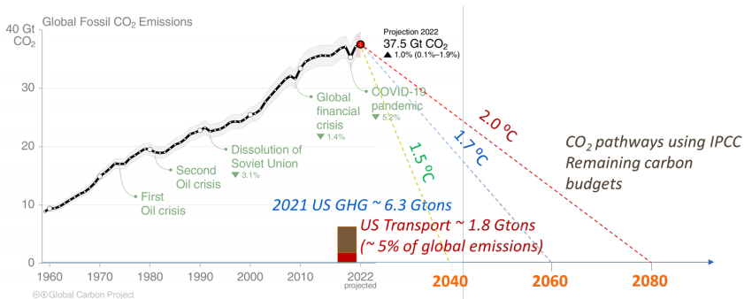
Global Warming – Mitigation Goals
Source: Global Carbon Project 2022 - chrome-extension://efaidnbmnnnibpcajpcglclefindmkaj/https://www.globalcarbonproject.org/carbonbudget/22/files/GCP_CarbonBudget_2022.pdf
But some studies suggest global costs of net zero goal on order of $200 (BloomburgNEF)¹ to $275 (McKinsey Global Institute)² trillion.
  Global assets: stock market $115T³ residential real estate $300-500T⁴
Notes:
We are now going to transition to looking at the levels of mitigation that are going to be needed to limit the temperature rise to 1.5 to 2C. This graph shows the rise in global fossil fuel based CO2 emissions from 1960 to 2022. And then estimates of the impacts of global warming temperature rise for moving to zero net CO2 emissions in the years 2040, 2060, and 2080. This chart shows why there is so much emphasis globally on trying to move to zero net carbon emissions in the 2040-2060 timeframe, in trying to limit the temperature to the 1.5 to 1.7C range, and to not reach above that.
1. https://about.bnef.com/blog/the-7-trillion-a-year-needed-to-hit-net-zero-goal/
2. https://www.mckinsey.com/mgi/overview/in-the-news/what-it-will-cost-to-get-to-net-zero
3. https://www.sifma.org/resources/research/fact-book/#:~:text=Global%20equity%20market%20capitalization%20increased,%2B3.3%25%20Y%2FY.
4. https://www.savills.com/impacts/market-trends/the-total-value-of-global-real-estate-property-remains-the-worlds-biggest-store-of-wealth.html
https://www.statista.com/outlook/fmo/real-estate/residential-real-estate/worldwide

Slide 6
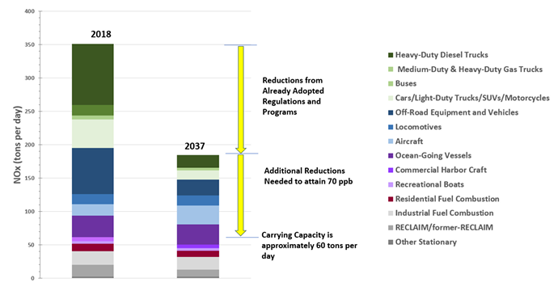
Need for Further Emission Reductions in LA
Source: South Coast Air Quality Management District, 2022 Air Quality Management Plan, Adopted December, 2022.
Notes:
The importance of achieving reductions in NOx emissions in order to meet future ozone NAAQS standards is illustrated in this slide. The results show that dramatic NOx reductions are needed in order to meet the 2037 NAAQS ozone standards. This suggests that most of the mobile source NOx emissions would need to be eliminated. This is due in part of needing to reduce ambient NOx emissions levels to the point where the atmospheric chemistry is in the NOx limited regime.

Slide 7
Economic Challenges going into 2030s - I
Government debt is increasingly becoming a problem
  CFOs, bankers (Jamie Diamond), the Fed and others see government debt as looming crisis¹
  Overall debt $36.7 trillion² 1/10/25, U.S. stock market $52.0 T,³ U.S. residential real estate - $49.7T⁴
Federal Government Spending is very high and continuing to grow
  $6.75 Trillion for 2024⁵ ($52,656 per household), 51.8% higher than pre-COVID levels
  Social Security/Medicare/Medicaid + Interest $2.51 Tril. ($19,640/house) in 2019 to $3.89 Tril. ($30,307/house) in 2024
  ~ All private real estate in 12 mid-west states (IL, IM, IA, KS, NE, MN, MI, MO, OH, WS, ND,SD)⁶
  ~ Market cap Autos, Oil, Telecom/TV, Retail (Major+specialty), + many Food Companies combined⁷
  ~ U.S. Retail sales revenue minus motor vehicles, auto parts & gas stations⁸
Federal government deficit is growing at historic levels
  $1.83 Tril. in 2024⁵ ($14,275/house) (~$3,000/house Aug 2024⁹), 86% higher than pre-COVID levels
  Equivalent to the value of all residential real estate in Colorado and Oregon combined
  All profits of the 220 most profitable U.S. companies in 2022¹⁰
Notes:
² https://www.usdebtclock.org/ (4/9/2025)
³ https://siblisresearch.com/data/us-stock-market-value/ (April 1 2025)
⁴ https://investors.redfin.com/news-events/press-releases/detail/1274/u-s-housing-market-gained-2-5-trillion-in-value-in-2024#:~:text=Still%2C%20the%20total%20value%20of,climbed%2011%25%20to%20$107.8%20billion.
⁵ chrome-extension://efaidnbmnnnibpcajpcglclefindmkaj/https://www.cbo.gov/system/files/2024-11/60843-MBR.pdf
Spending up 51.8% ($17,981 per household) since pre-pandemic levels (2019) of $4.45 trillion
Yearly deficit up 86% ($6,623 per household) since pre-pandemic levels (2019) of $0.984 trillion
⁶ https://www.redfin.com/news/housing-market-loses-value-2023/
⁷ https://companiesmarketcap.com/
https://disfold.com/industry/specialty-retail/companies/#google_vignette
⁸ https://www.statista.com/statistics/289776/us-retail-annual-sales-store-type/#:~:text=In%202023%2C%20food%20and%20beverage,of%20884%20billion%20U.S.%20dollars.
⁹ https://bipartisanpolicy.org/report/deficit-tracker/#:~:text=Tracking%20the%20Federal%20Deficit%3A%20August,(YOY)%20by%20%24470%20billion.
¹⁰ https://fueled.com/blog/2022-fortune-1000-companies-spreadsheet-download/
1 CFO conference - https://www.cfodive.com/news/ceos-see-increasing-federal-debt-biggest-business-threat-inflation-recession/704689/
Jamie Diamond (JP Morgan), Ray Daimio (Bridgewater Associates) https://www.cnn.com/2024/05/16/business/jamie-dimon-ray-dalio-us-government-debt/index.html
Jamie Diamond (JP Morgan) – Most predictable crisis in history- https://fortune.com/2024/02/11/american-national-debt-concerns-housing-market-portfolio-impact/
Jerome Powell (Federal Reserve Chair) https://www.pgpf.org/blog/2024/02/fed-chair-powell-its-past-time-to-address-our-national-debt
Elon Musk, https://fortune.com/2024/02/13/national-debt-elon-musk-government-spending-interest/
Fred Smith, Fed Ex founder, https://www.vcpost.com/articles/124588/20240215/fedex-founder-fred-smith-joins-business-leaders-sounding-alarm-over.htm
Brian Moynihan, Bank of America, https://fortune.com/2024/02/06/bank-of-america-ceo-brian-moynihan-national-debt-problem/
Ken Griffin Citadel https://finance.yahoo.com/news/hedge-fund-tycoon-ken-griffin-114600243.html?guccounter=1&guce_referrer=aHR0cHM6Ly93d3cuZ29vZ2xlLmNvbS8&guce_referrer_sig=AQAAAAn1ziKrx1yMJ5RA3O4a7KomEivvpc43NS2TxbTBKp_AuslO7nBG0Ka8m2gCcVDO70IGAoQXZ40VgO4-emXKEtf9yUmbKOUFqLLeTYRfyxNTsd0m8dYFEua1pG8lSYdWqtdVuhGPc_YoNFtOuggnI-oiKojblQh8_qRHsY6YNmPP
Food producers and restaurants – Coca Cola, Pepsi, Kraft, breakfast cereals, McDonalds, starbucks, + nearly restaurants
Retail major (Walmart, Home Depot, Costco, Alibaba, Lowes, CVS, Target)
Specialty retail (Autozone, Best Buy, Ulta, Willaims Sonoma, Dicks sporting goods
Telecoms (T-Mobile, Verizon, AT&T) + TV (Comcast [NBC], Disney [ABC, ESPN] …..Paramount [CBS], Fox)
Retails sales revenue (e-commerce, food & beverages, general merchandise, clothing, building materials, health/personal care, etc.)

Slide 8
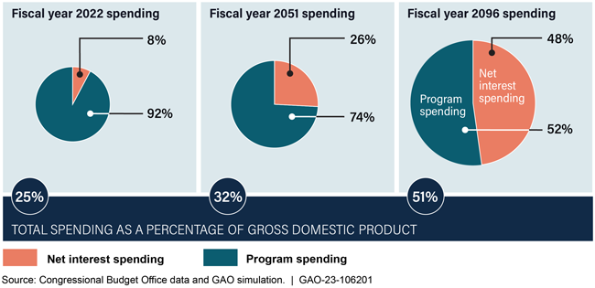
Economic Challenges going into 2030s - II
Solutions will be problematic - higher taxes / slower economy, increase money supply /inflation, probably in combination with less services
  Interest payments
    $892 B in 2024 - $6,958 per household¹
    2051 - 8% of GDP - $16,486/household²
Economic constraints / cost effectiveness will continue to play an important role in environmental policy for the foreseeable future
1 /https://www.cbo.gov/system/files/2024-11/60843-MBR.pdf
2. U.S. Government Accountability Office, 2023, https://www.gao.gov/assets/gao-23-106201.pdf

Slide 9
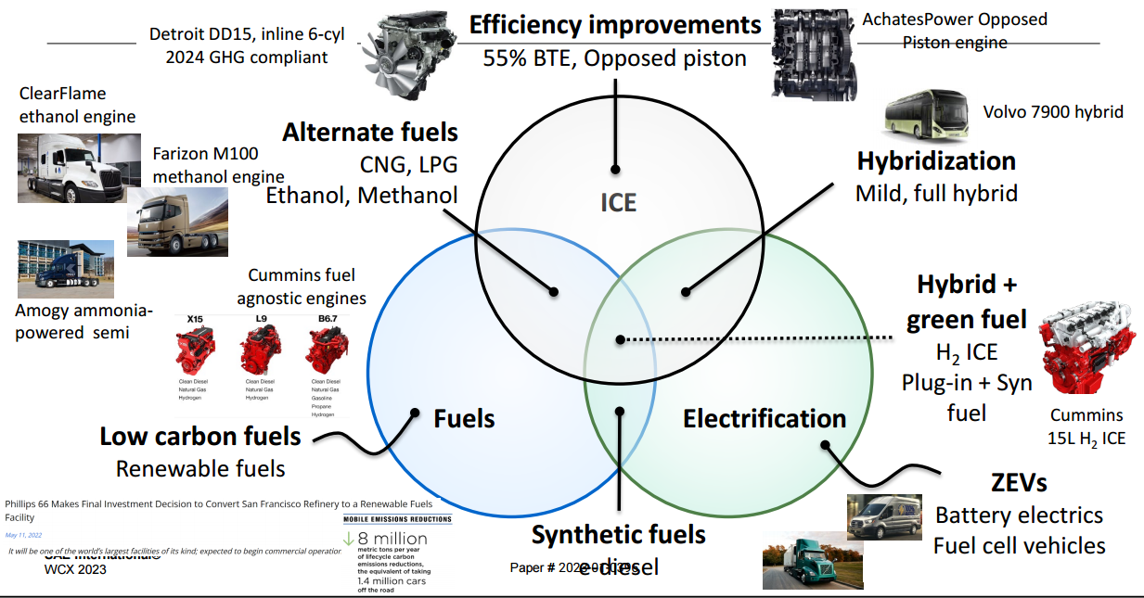
In a challenging environment, various pathways will likely needed to be pursued for transport decarbonization
Source: Joshi, A., 2023, “Year in review – Progress towards decarbonizing transportation and zero emissions,” presentation at Society of Automotive Engineers, WCX conference, Detroit, MI, April.
Notes:
This slide has a lot of information on it. It is designed to provide a synopsis of some of the key findings of a DOE program called “Super Truck II” from about 2017 to 2021. One of the main goals of this program was to develop truck platforms that were capable of achieving a brake thermal efficiency, or BTE, of 55%, which was about a 125% improvement over 2009 levels. This program included essentially all the highest-volume engine manufacturers as shown across the top on the center to the right.
On the left, you can see some of the engine improvements included improved combustion, improved air handling, improved aftertreatment, and waste heat recovery. In the upper right side, the improvements for the vehicles included weight reduction, reducing aerodynamic drag, tires, transmissions, and hybridization and electrification.

Slide 10
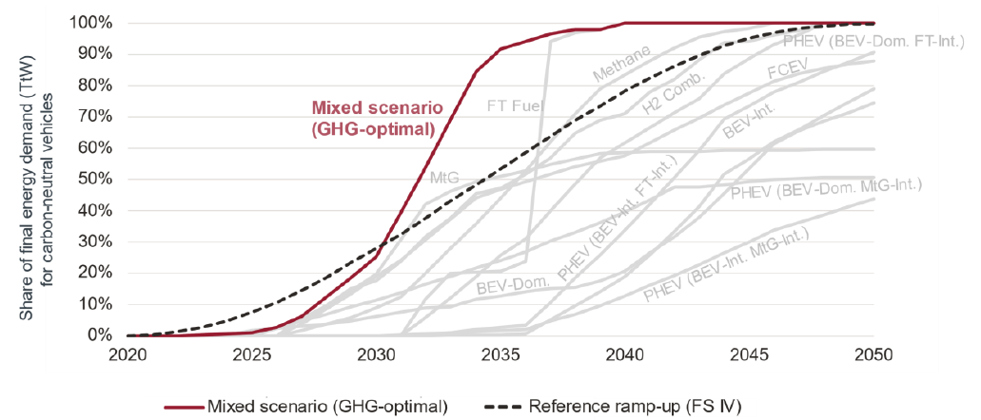
Various pathways will need to be pursued for transport decarbonization
Source: Krammer, U. Bothe, D., Gatzen, C, et al., 2022, FVV eV // Science for a moving society (FVV), Future Fuels: FVV Fuel Study IVb Follow-up study: Transformation of Mobility to the GHG-neutral Post-fossil Age, Project. No. 1452.
Notes:
The importance of utilizing a broad range of fuels in our transportation system is illustrated in the following slide. This slide shows how rapidly we can decarbonize the fleet in there of penetration rates or percentages on the y-axis as a function of calendar year on the y-axis. This slide is based on modeling different scenarios for different technology options that might be pursued towards the goal of reaching a carbon neutral transportation future. This includes electrification options, such as fuel battery electric vehicles, hybrids, or fuel cells, as well as options such as natural gas or methane or hydrogen. The results show that to the extent that we as a society pursue any given decarbonization route single-mindedly that it will take longer and be less effective than the baseline scenario based on a “status quo” technology profile, which is based on regulations that were in place in the early 2020s. In particular, when we look at single-source strategies, all have limitations on how rapidly they can penetrate the in-use fleet. Electrification, for example, this might be the need to have a extended infrastructure of chargers and a expanded electrical grid. For fuels such as methane or hydrogen, they will have some limitations as to the availability of the fuels. But as you can see with the red line, you can actually decarbonize the fleet much more quickly when you use a mixture of all of the strategies to decarbonize the fleet.

Slide 11
Renewable Fuels
Renewable Fuels
In California, nearly 80% of diesel fuel is comprised of renewable fuels [Q1 2025]¹, with diesel fuel for off-road equipment required to be renewable
Renewable Diesel (RD) has ~85% (92%?) carbon intensive benefit of electricity (basis CA current grid)
Biofuels provide carbon intensity benefits equivalent to electrifying
  68%-74% of the Heavy-duty vehicles (HDVs) + off-road engines (OREs) in CA
  85%-92% of off-road equipment (since RD required for off-road in CA)
Diesel 102
Base Electricity 80.55
32.2
2.5x
3x
⁻⁻⁻ 1 https://ww2.arb.ca.gov/sites/default/files/2025-07/quarterlysummary_Q12025_2.xlsx
https://ww2.arb.ca.gov/news/first-time-50-california-diesel-fuel-replaced-clean-fuels
--- Diesel fuel = 102 gCO2e/MJ
--- Electricity value from electrical grid value of 80.55 gCO2e/MJ w/ BEVs being 3x more efficient. Probably overstated as diesel engines are getting towards 40%-50% efficient now
--- Note negative carbon intensity for RNG is due to avoided methane emissions into the atmosphere

Slide 12

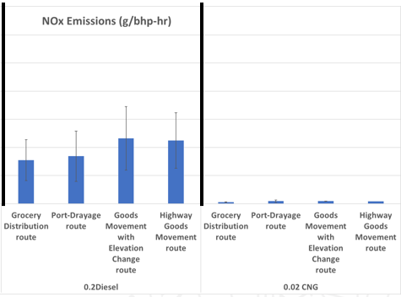
Biofuels + Ultraclean engines
When biofuels are combined with ultralow NOx HDVs there is a potential for significant near and intermediate term benefits in both GHGs and exhaust pollutants, as the market transitions towards BEVs
This could include both 2027+ diesel vehicles and current technology 0.02 g NOx CNG vehicles
2010 SCR-equipped Diesels
2027+ Diesels + 0.02 CNG

Slide 13
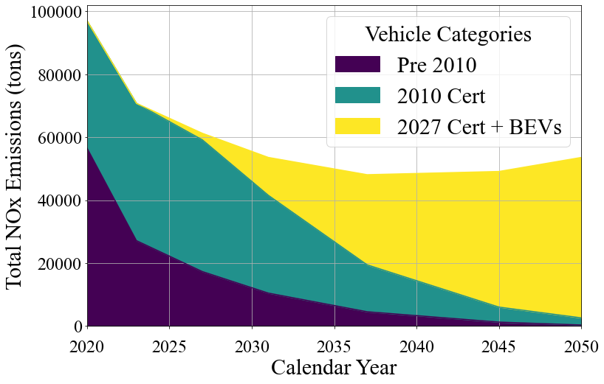
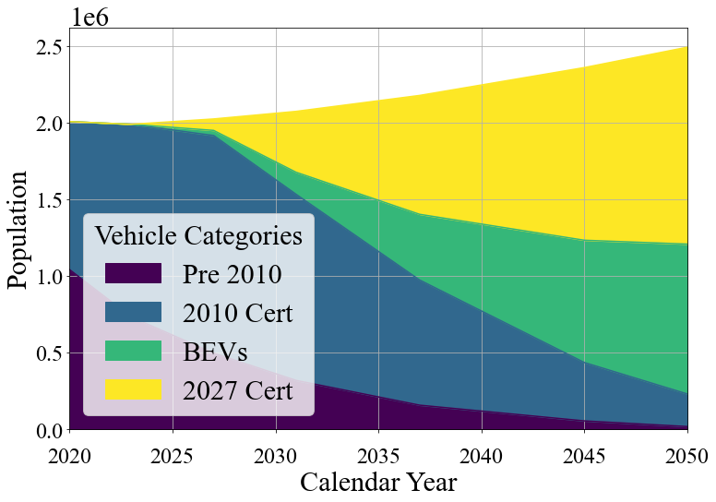
Understanding In Use Emissions and Emissions Inventories
Base case EMFAC emissions inventory modeling (without ultralow NOx diesel engines) shows increases in vehicle population could be an important contributing factor to emissions inventories

Slide 14
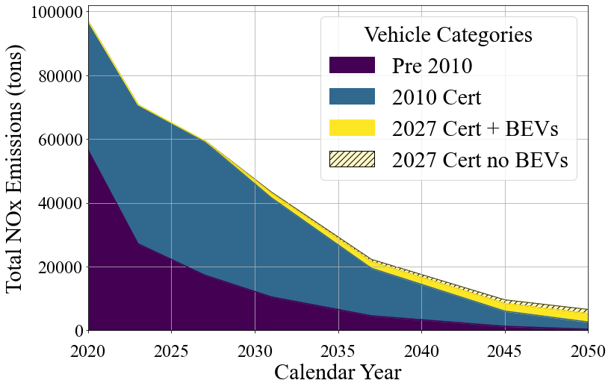
Potential Importance of Ultralow NOx Engines
Incorporating ultralow NOx diesel engines could have a dramatic impact on emissions inventories.
90% of the NOx emissions reductions between 2025 and 2050 for heavy-duty vehicles could come from fleet turn over with ultralow NOx diesel vehicles……
If we can keep the vehicles clean
Source: Troy Hurren; Thomas D. Durbin; Kent C. Johnson, Georgios Karavalakis, 2025, The Impacts of improving heavy-duty internal combustion engine technology on reducing NOx emissions inventories going into the future, Science of the Total Environment., 986, 179781

Slide 15
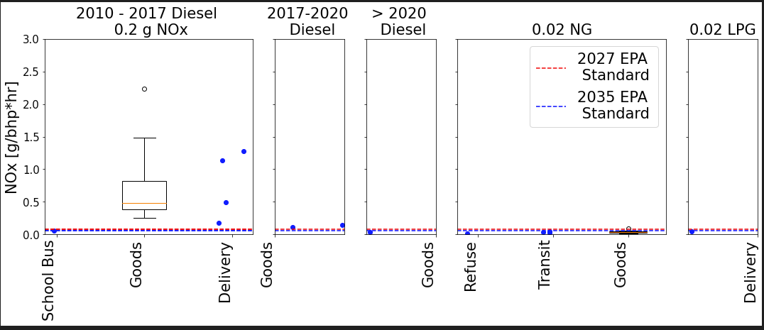
Trends CE-CERT is examining in heavy-duty vehicle emissions
Available Now
Regulations
Source: Troy Hurren; Thomas D. Durbin; Kent C. Johnson, Georgios Karavalakis, 2025, The Impacts of improving heavy-duty internal combustion engine technology on reducing NOx emissions inventories going into the future , Science of the Total Environment., 986, 179781

Slide 16
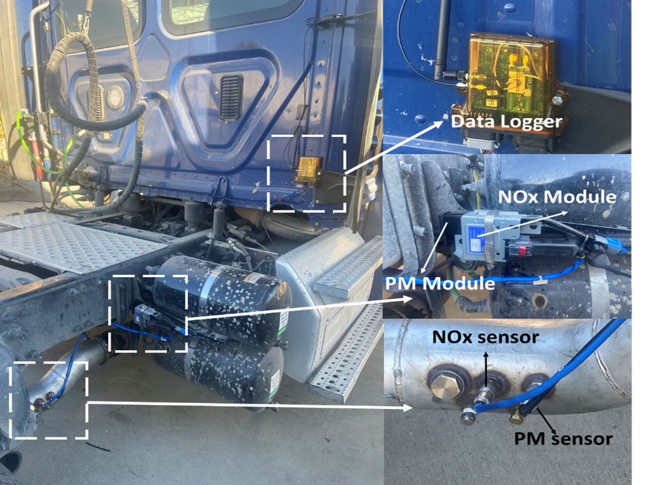
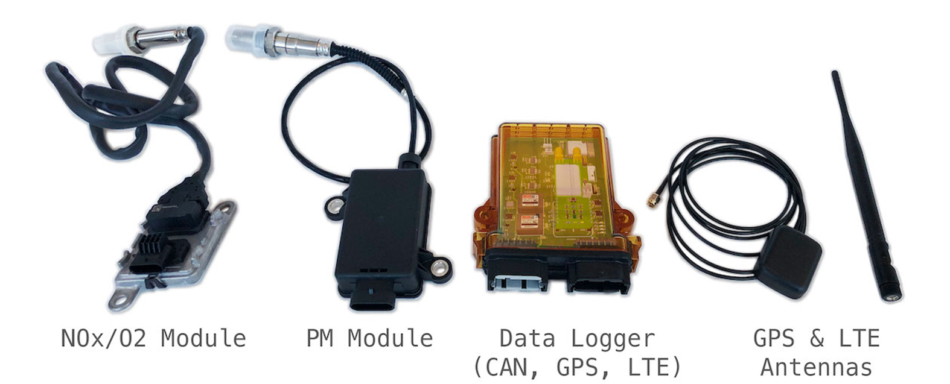
CE-CERT Methodology is
On Board Sensing and Reporting (OSAR)
Onboard Sensing Analysis and Reporting (OSAR) was developed for continuous monitoring of diesel technologies annually
OSAR started out as a consortium lead research initiative, but has now grown to over nine funded programs
OSAR includes
  NOx, PM, GPS, CAN, and other sensors
  Auto starting and shutdown to capture cold starts and all truck operation

Slide 17
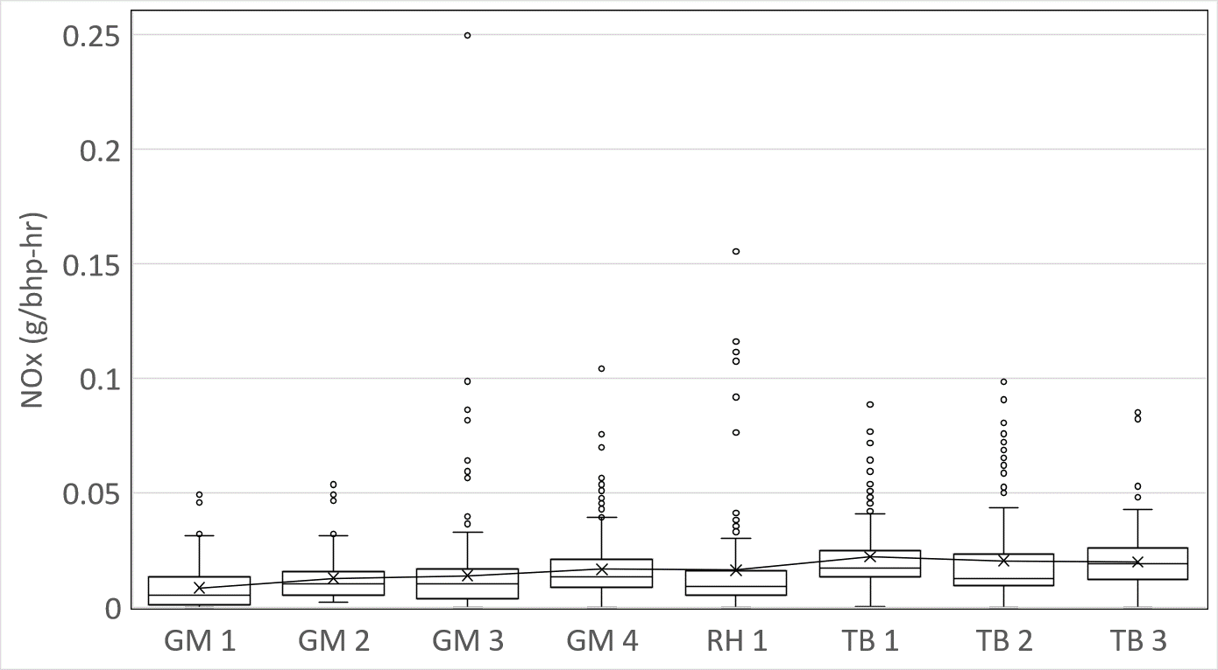
OSAR Monitoring of CNG Vehicles - I
The average trip emissions for most fleets are on the order of the 0.02 g/bhp-hr level
But there are outliers that have higher emissions

Slide 18
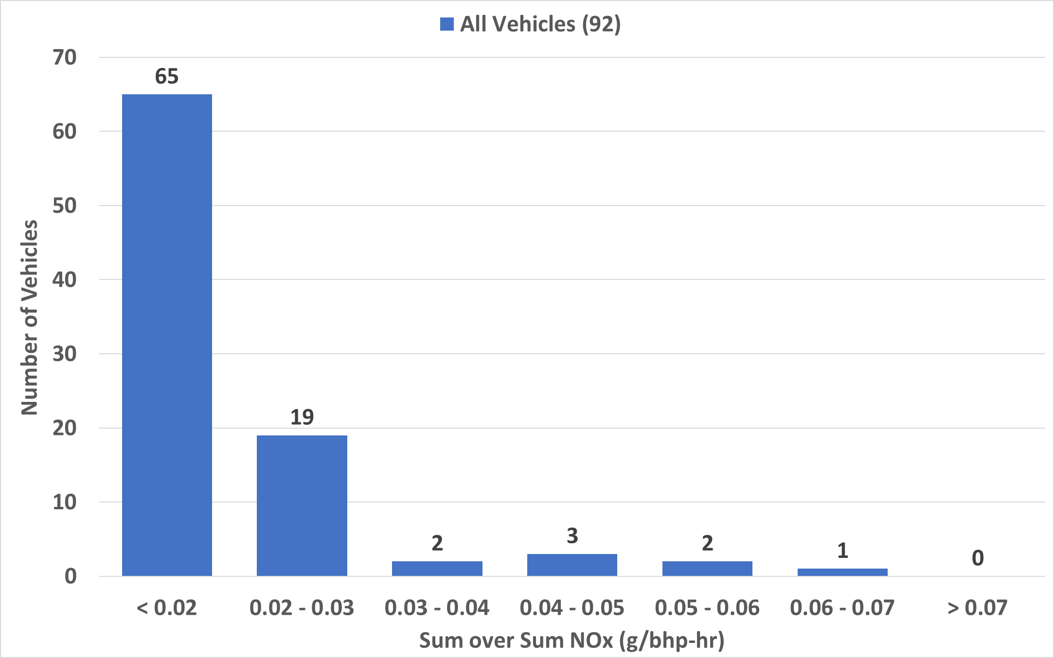
OSAR Monitoring of CNG Vehicles - II
Based on sum of all NOx emissions over all work for each vehicle
Most vehicles are operating within 2x of the 0.02 g/bh-hr limit

Slide 19
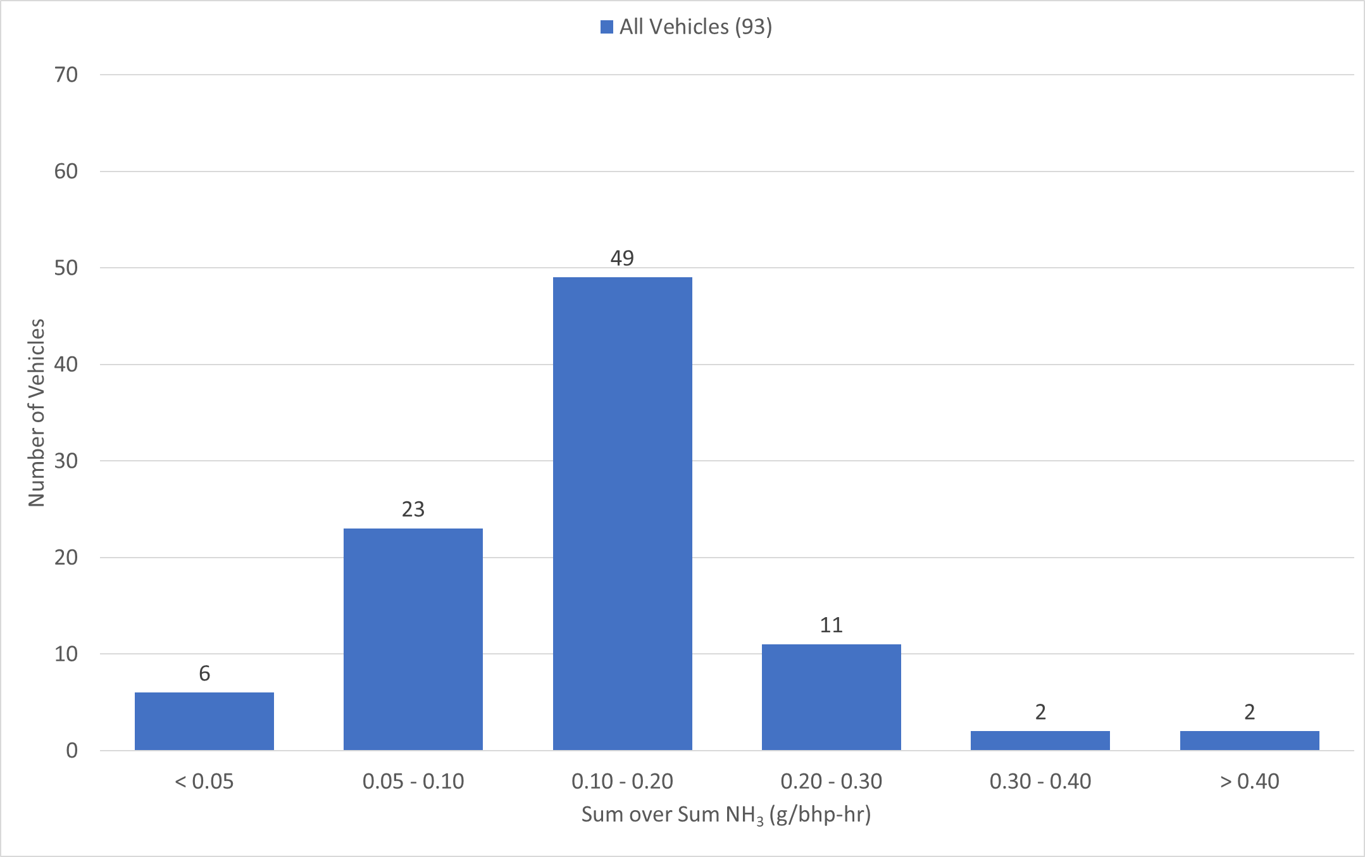
CNG Vehicle Histogram
NH₃ Emissions
To the extent that ultralow NOx CNG vehicles expand into the fleet, control of NH₃ emissions would likely need to be addressed more aggressively
Average NH₃ (g/bhp-hr)

Slide 20
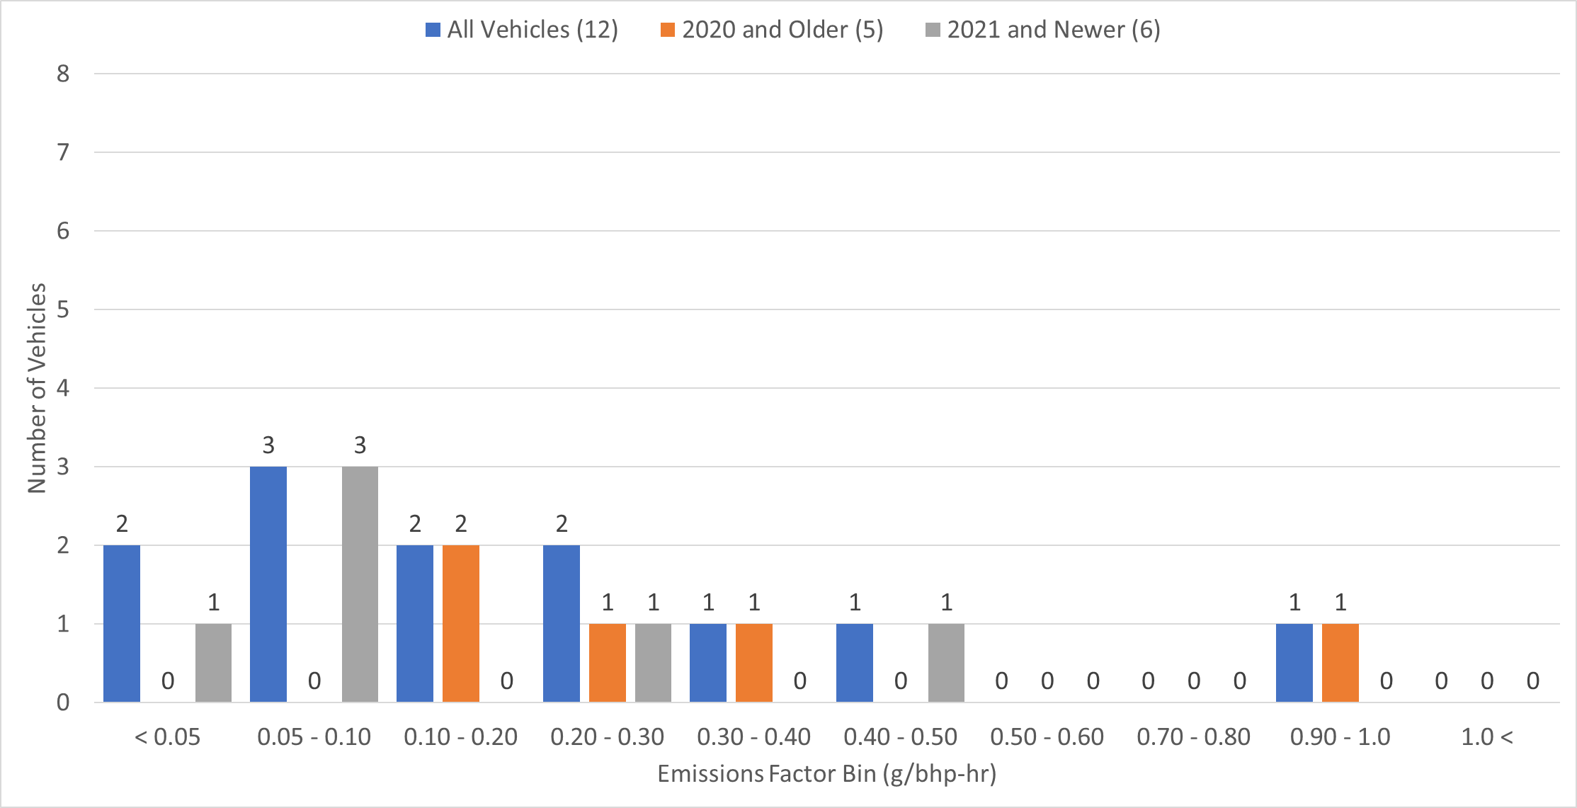
Preliminary Diesel Vehicle Emissions Histogram
Initial data is suggesting lower emission rates than found in “200 vehicle study, with some vehicles showing higher emissions than others.
Sum NOx g all trips
Sum Work all trips
*
*The vehicle missing from this section is from the OEM fleet. We have not been given this information

Slide 21
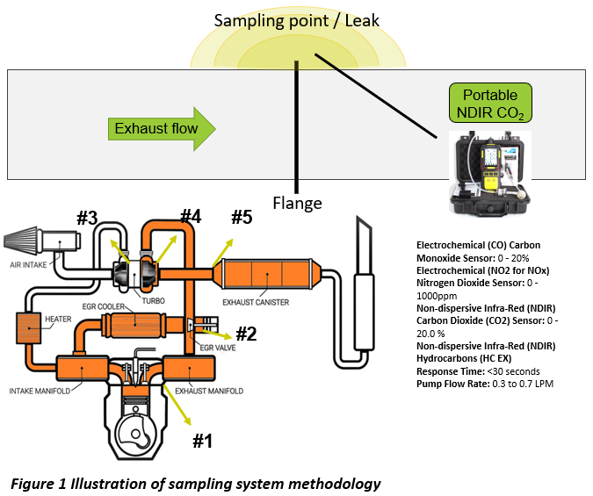
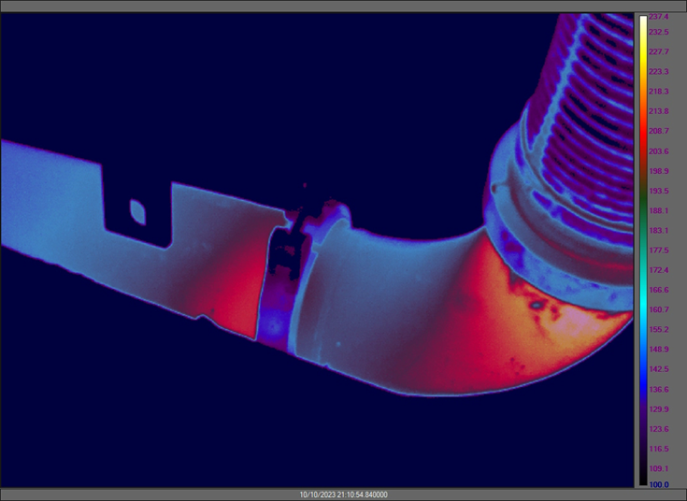
Monitoring for Leaks
The potential for exhaust leaks prior to the aftertreatment system could add significantly to in-use emission rates
CE-CERT is currently working on a CARB-funded project to evaluate the potential extent on more than 300 heavy-duty vehicles

Slide 22
Inspection and Maintenance Programs can play a big role in keeping emissions low
High emitters in-use will remain a key consideration for ICEs
The CARB Clean Truck Check program is expected to be one of the most impactful programs approved in decades.
Projected emissions reductions include:
  Reductions of 8.6 tons per day (tpd) NO_{x} and 0.09 tpd PM emissions in San Joaquin Valley (SJV) in 2024.
  Reductions of statewide NO_{x} emissions by 81.3 tpd and PM emissions by 0.7 tpd in 2037.
Benefits of these PM and NO_{x} emissions reductions include
  Roughly 7,500 avoided premature deaths
  6,000 avoided hospitalizations statewide
  Equivalent monetized health benefits of $75.8 billion for 2023-2050 period.
Clean Truck Check would reduce NOx from HDVs >14,000 lbs.
  Reductions of 50% in 2031, increasing to a 56% reduction by 2037 compared to baseline.

Slide 23
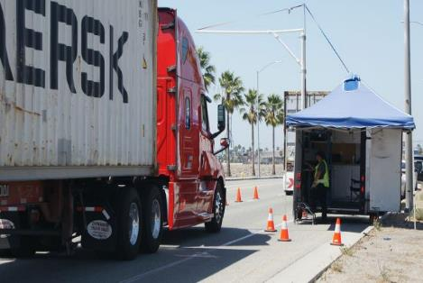
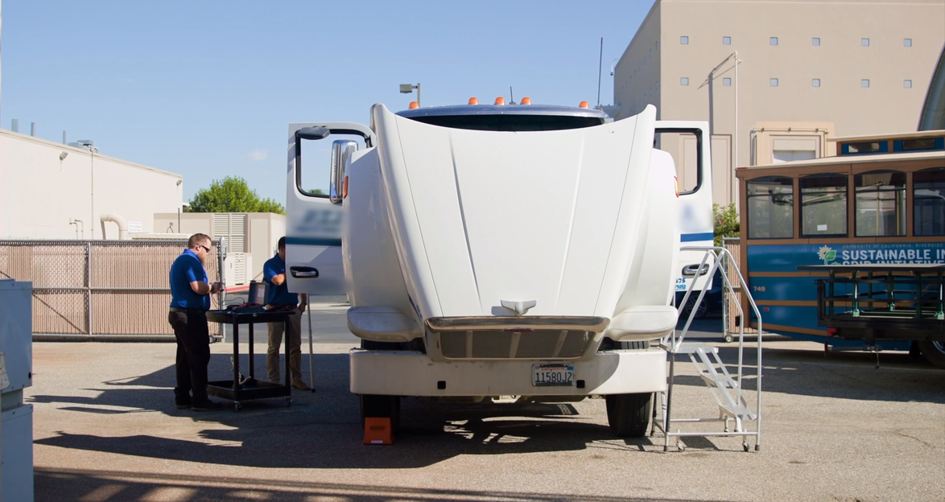
Inspection and Maintenance Programs can play a big role in keeping emissions low
Trucks “caught” having high emissions will have to be brought to inspection locations to be evaluated
UC Riverside CE-CERT involved in the CARBTest “referee” part of this of the program to CE-CERT in part because of our reputation as being an honest broker
Extensive network of stations with involvement of CSU Fresno and Community Colleges

Slide 24
Takeaways
Climate change will likely remain one of the most significant challenges facing the world for the foreseeable future.
An “All hands on deck” will be needed in the drive to a sustainable transportation future.
Conventionally-fueled technology vehicles will play a important part in the intermediate term in achieving environmental metrics.
  Some early data show trends towards lower in-use emissions with later generation vehicles, with some vehicles still having higher emissions.
  If the vehicles can maintain ultralow emissions during operation, fleet turnover could provide 90% of emissions reductions from 2025 to 2050.
  This could be coupled with greater renewable fuels use for reducing GHGs.
Ensuring conventionally fueled vehicles can maintain low or ultralow emissions levels will likely be the key to ensuring continued progress towards achieving future air quality goals.
Emissions monitoring and inspection will continue to play an important role as we continue our journey to a fully sustainable transportation sector.

