Slide 1
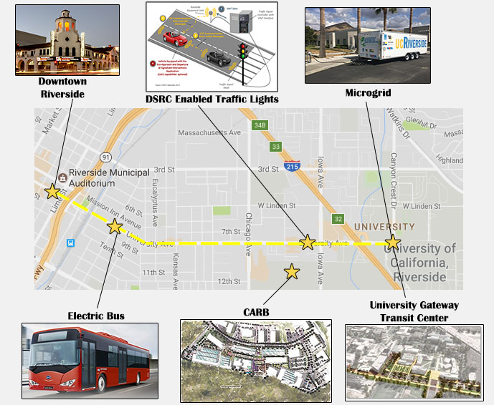
Riverside Innovation Corridor
10-km section of University Avenue between the main UCR campus and downtown Riverside
Arterial corridor has been outfitted with traffic signal controllers that broadcast signal phase and timing
Cameras deployed with video analytics
Air quality monitoring also being co-located along corridor
Real-world experimentation with shared, electric, connected and automated vehicle (e.g., cars, buses, and trucks).

Slide 2
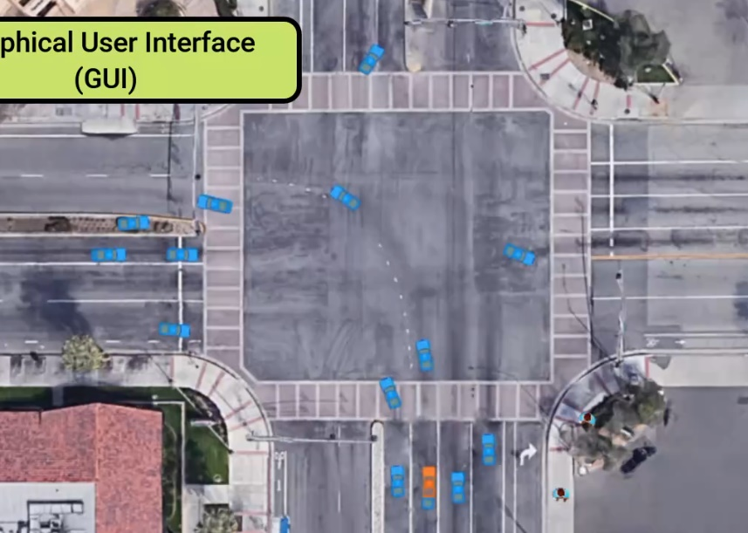
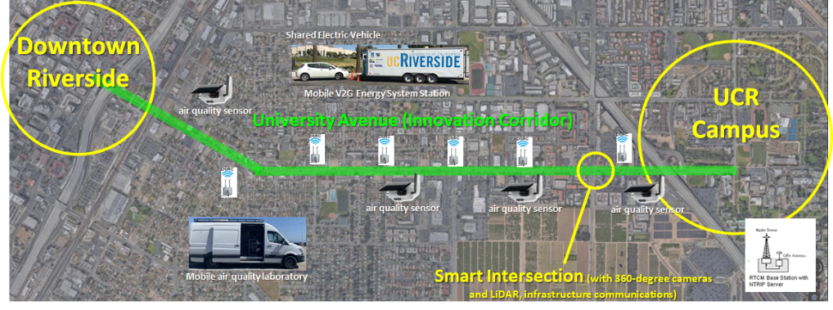
City of Riverside Innovation Corridor
Connected and Automated Vehicle testing
Cooperative Vehicle-Infrastructure Systems
Smoother traffic flow
15% less emissions
Partners:
City of Riverside
Toyota
Honda
UC-ITS
NCST
Caltrans

Slide 3
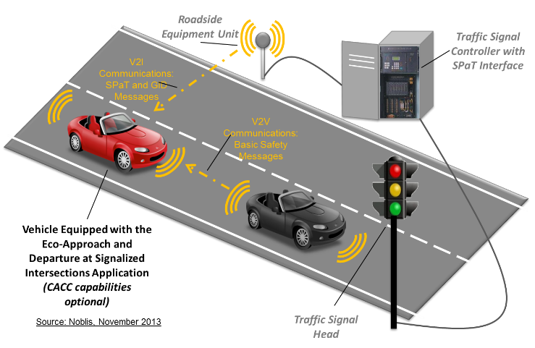
Improving Longitudinal Vehicle Dynamics: Eco-Approach and Departure at Signalized Intersections (aka GLOSA, TOSCo, Intelligent Signals, etc.)
Application utilizes traffic signal phase and timing (SPaT) data to provide driver recommendations that encourage “green” approaches to signalized intersections
Example scenarios:
  Coast down earlier to a red light;
  Modestly speed up to make it (safely) through the intersection on green
Mobility Improvements: 5% - 20%
Energy Savings: 10% - 20%

Slide 4
Eco-friendly Cooperative Traffic Optimization
at Signalized Intersections (ECoTOp)
Co-optimizes connected vehicle trajectories AND signal timing
Some inherent conflict when pursuing their own optimality in operation
David Oswald, Peng Hao, Guoyuan Wu, and Matthew Barth, “Eco-friendly Cooperative Traffic Optimization (EcoTOp) at Signalized Intersections with Mixed Connected Traffic”, Transportation Research Board Annual Meeting, Washington, DC, January 2023.
Notes:
Need to expand the names

Slide 5
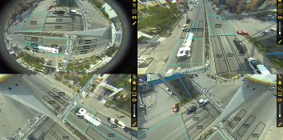
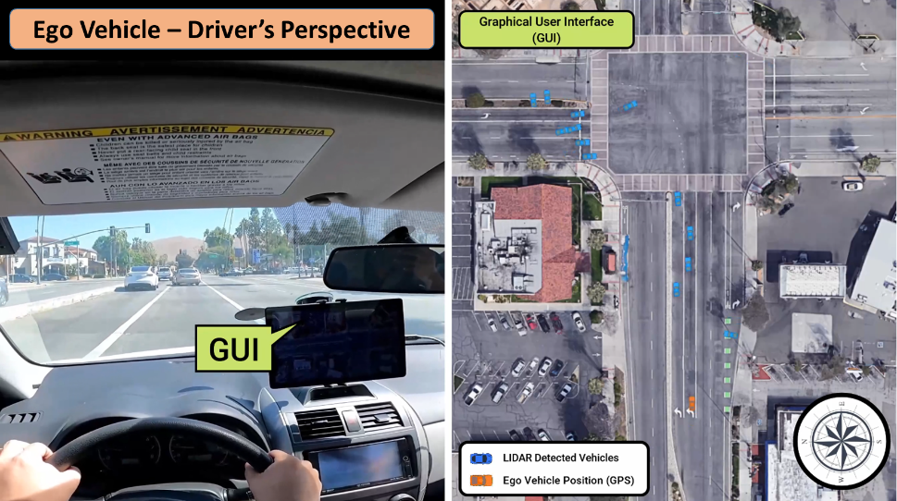
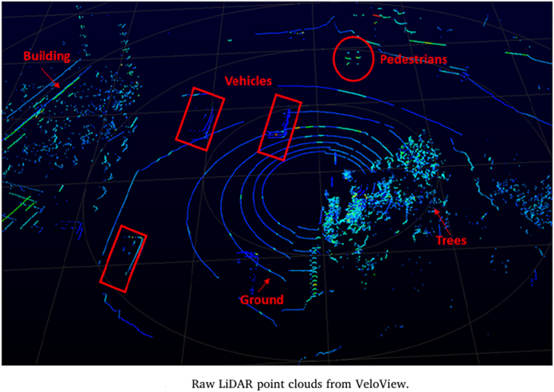
City of Riverside Smart Intersection
Connected and Automated Vehicle testing
Cooperative Vehicle-Infrastructure Systems
Improved safety Smoother traffic less emissions

Slide 6
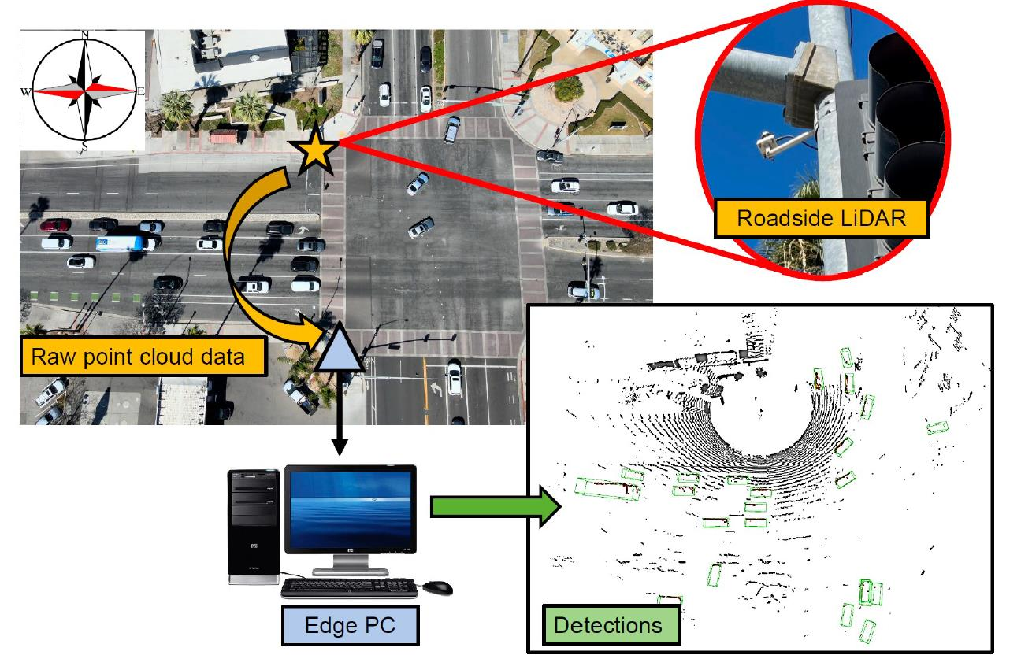
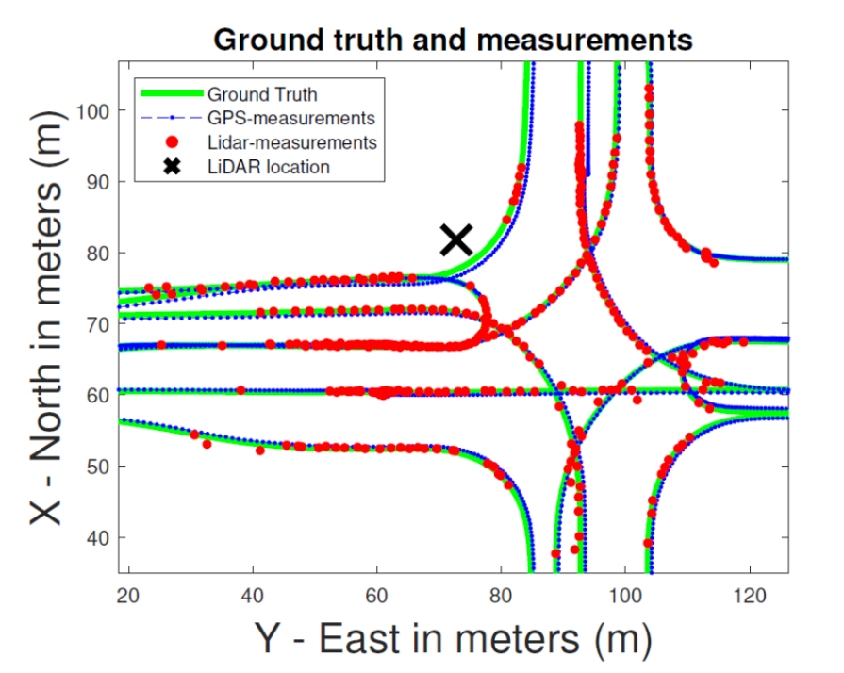
Infrastructure-based Perception at Intersection
Partners & Programs:
City of Riverside
Toyota
Caltrans
EcoCAR
Bai, Z., Nayak, S. P., Zhao, X., Wu, G., Barth, M. J., Qi, X., … Oguchi, K. (2023). Cyber Mobility Mirror: A Deep Learning-Based Real-World Object Perception Platform Using Roadside LiDAR. IEEE Transactions on Intelligent Transportation Systems.
https://www.youtube.com/watch?v=0egpmgkzyG0

