Slide 1
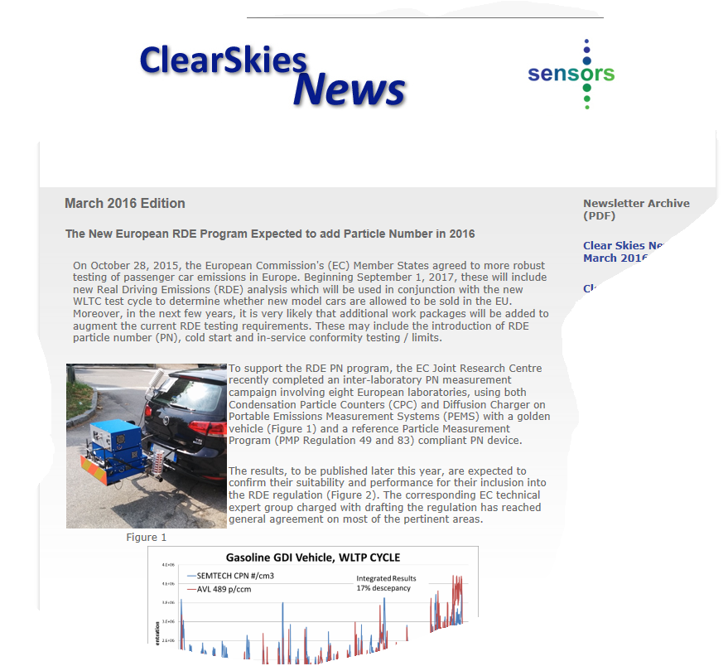
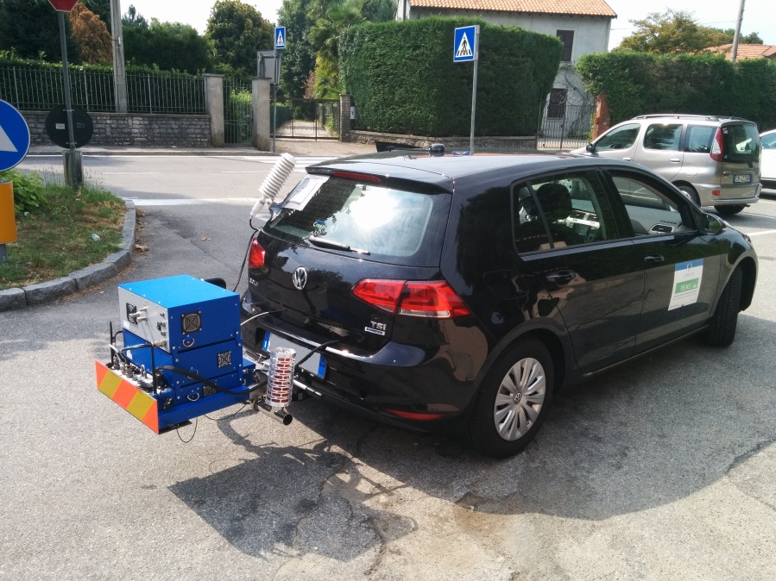

Challenges for PEMS under RDE Regulations
Dr David Booker, Sensors Inc.
CECERT PEMS Conference March, 2016

Slide 2
Introduction
Background to the EU Legal Process
State of the Play with the RDE Program
Challenges for PEMS
  Gaseous
  PN

Slide 3
Comitology in the EU
Comitology in the EU references a process by which the EU law is modified or adjusted and takes place within "comitology committees" that assist in the making, adoption, and implementation of EU laws. Broadly speaking, before it can implement an EU legal act, the Commission must consult, for the detailed implementing measures it proposes, a committee where every EU country is represented. For example, the Technical Committee Motor Vehicles (TCMV) committee. In addition “Expert Groups” are formed to develop the scope, legal text and “tools” (eg EMROAD / CLEAR).
Regulation (EC) 715/2007
Five Key Reasons behind Comitology

Slide 4

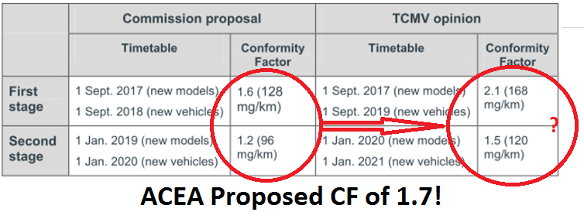
RDE - TCMV 2015
On 19th May 2015, the 1st package (testing procedures) and on 28 October 2015, (conformity factors) the TCMV voted / passed the implementing measures to introduce Real Driving Emission (RDE) tests for emissions from light duty vehicles, under the framework of Regulation (EC) No 715/2007.1 with a clear majority 28 EU Member States (only the Netherlands opposed the 2nd package).
Conformity Factor 2.1 (2017) > 1.5 (2020)
Client Earth, 2015

Slide 5
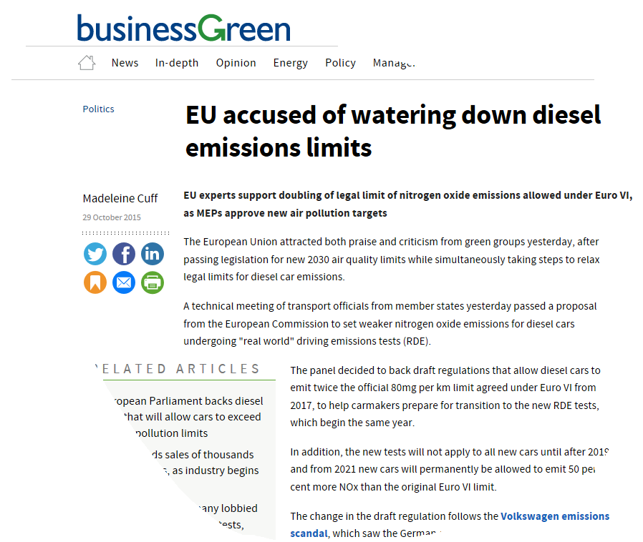
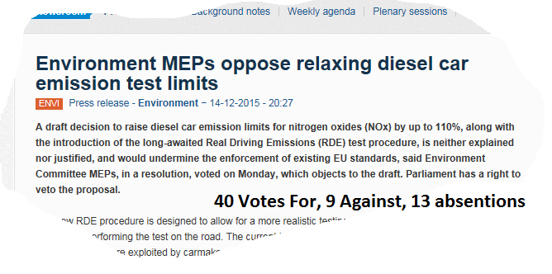
What Happened in the EP
The European Parliament has the power to oppose the implementing measures adopted by the Commission, if they exceed the implementing powers granted by the EU legislature or are not compatible with the aim or the content of the Euro 6 Regulation.
After TCMV voted in October 2015 the Opposition Stated to gain momentum.

Slide 6
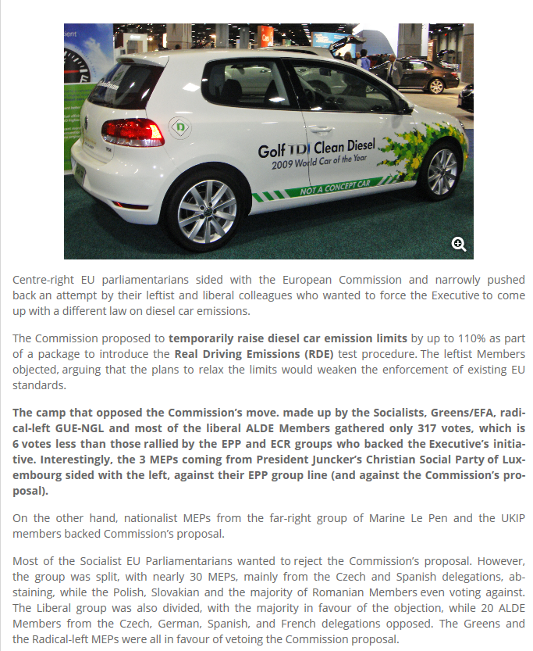
The EP Vote
2nd February 2016
For: 323
Against: 317
Most of the Socialist EU Parliamentarians wanted to reject the Commissions Proposal. If they had succeeded the EC would have had 3 choices:
Go back to TCMV (unlikely)
Legally challenge the EP (very unlikely), or
Implement the regulation in Euro VII
All could have resulted in a 3-5 year delay!

Slide 7
EC Major Concessions:
European Commission agreed to review the Conformity Factors on an annual basis. Any revisions would be enforceable 4 years later
  Expert Group (First meeting Feb 2016)
European Commissioner speech to Parliament states that aim is to have cars designed to meet a CF of 1.0 by 2023

Slide 8
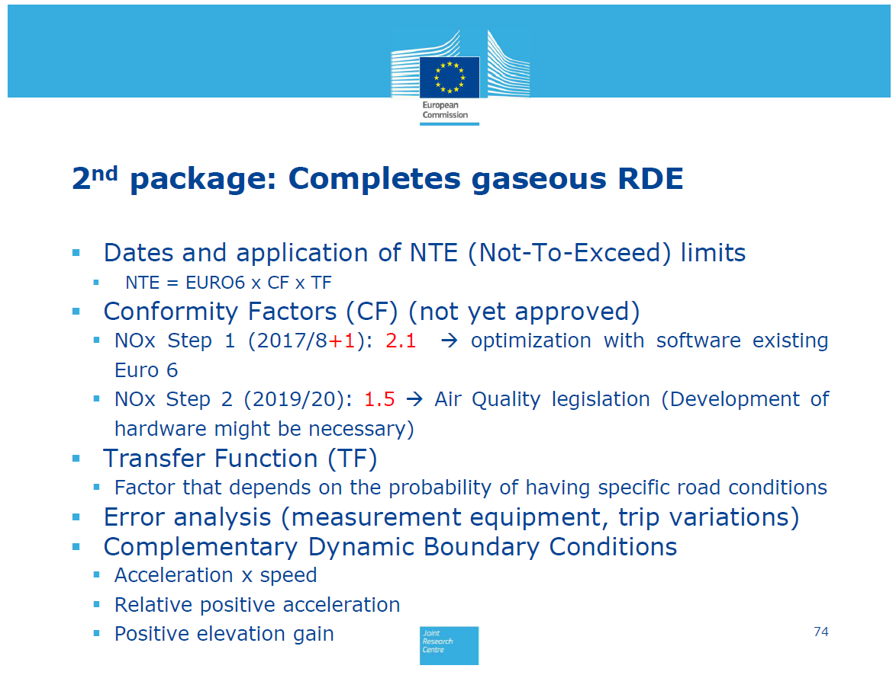
What’s Next

Slide 9
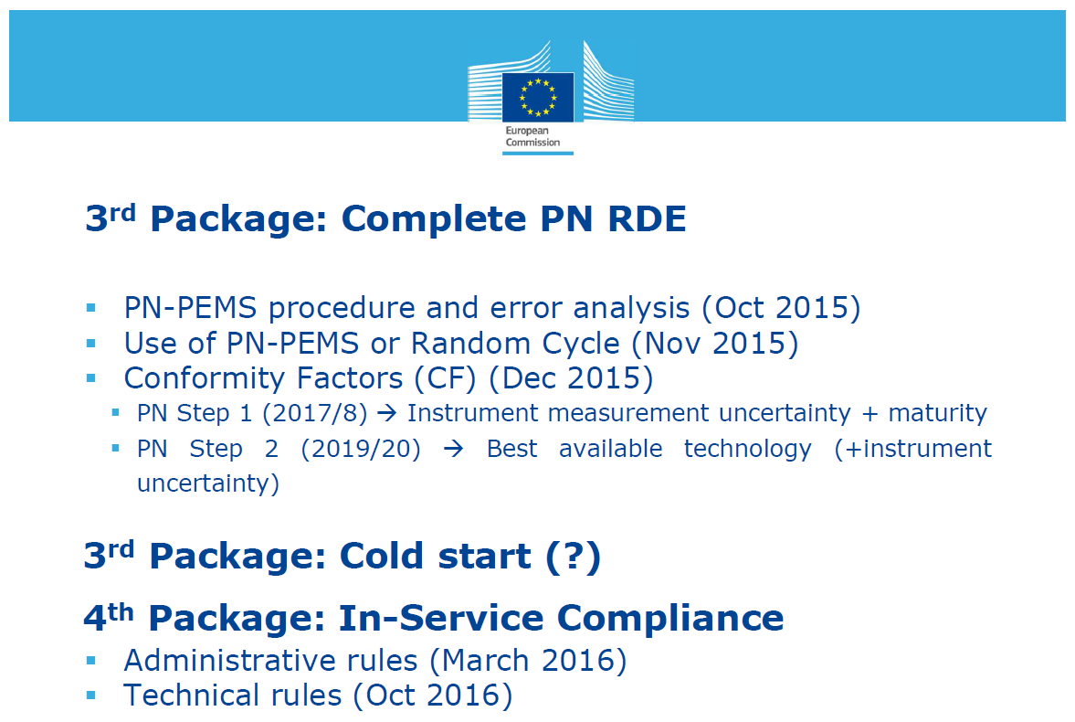

Slide 10
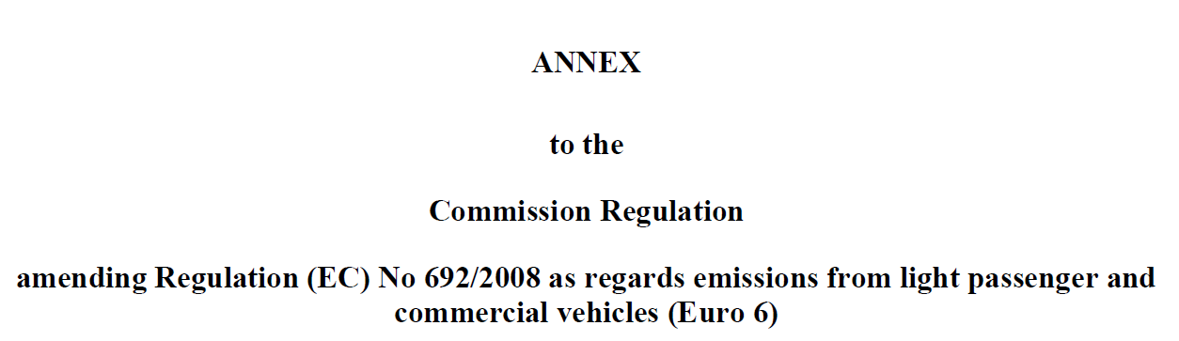
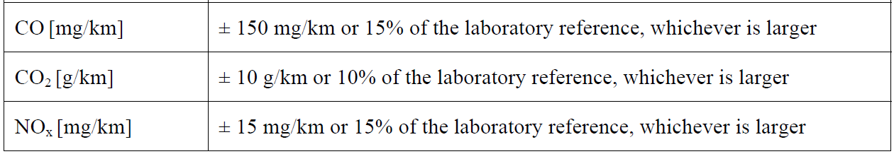
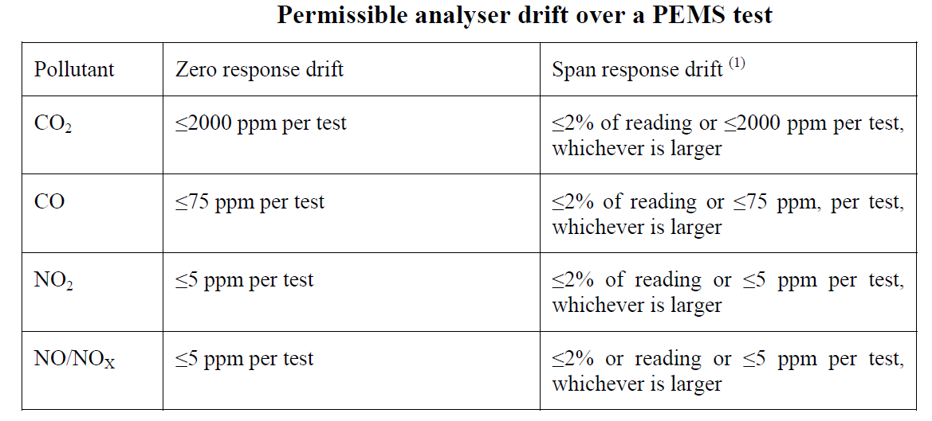
NDUV NOX (NO +NO2 )Error
Question - 5+5 or 10ppm
CLD NOX <5ppm

Slide 11


PEMS Measurement Uncertainty
ACEA and JRC Analysis for Gaseous Measurements ONLY to date.

Slide 12
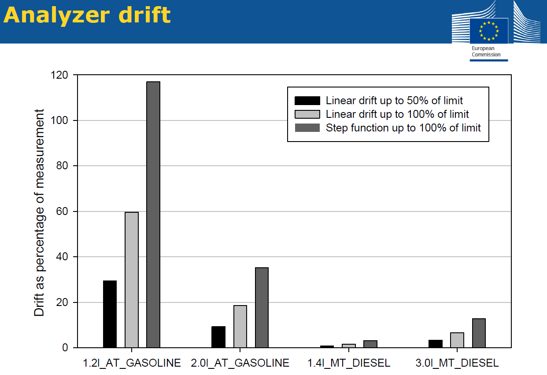
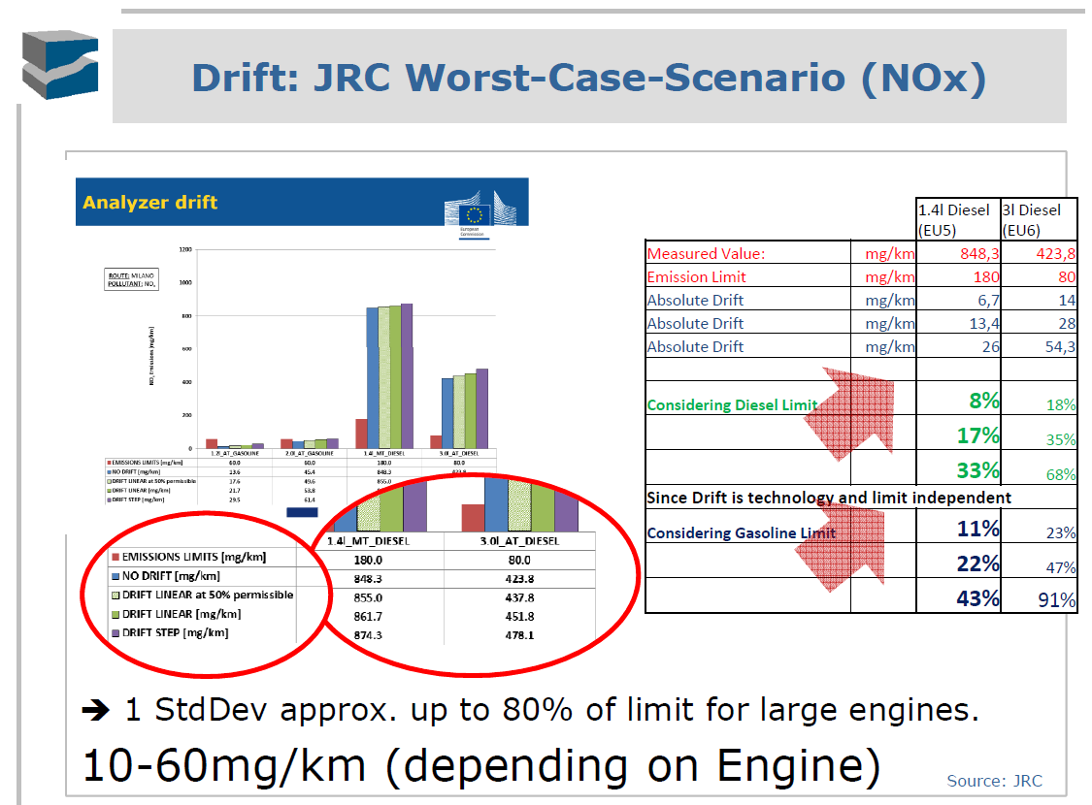
Drift (No drift Correction Allowed)

Slide 13
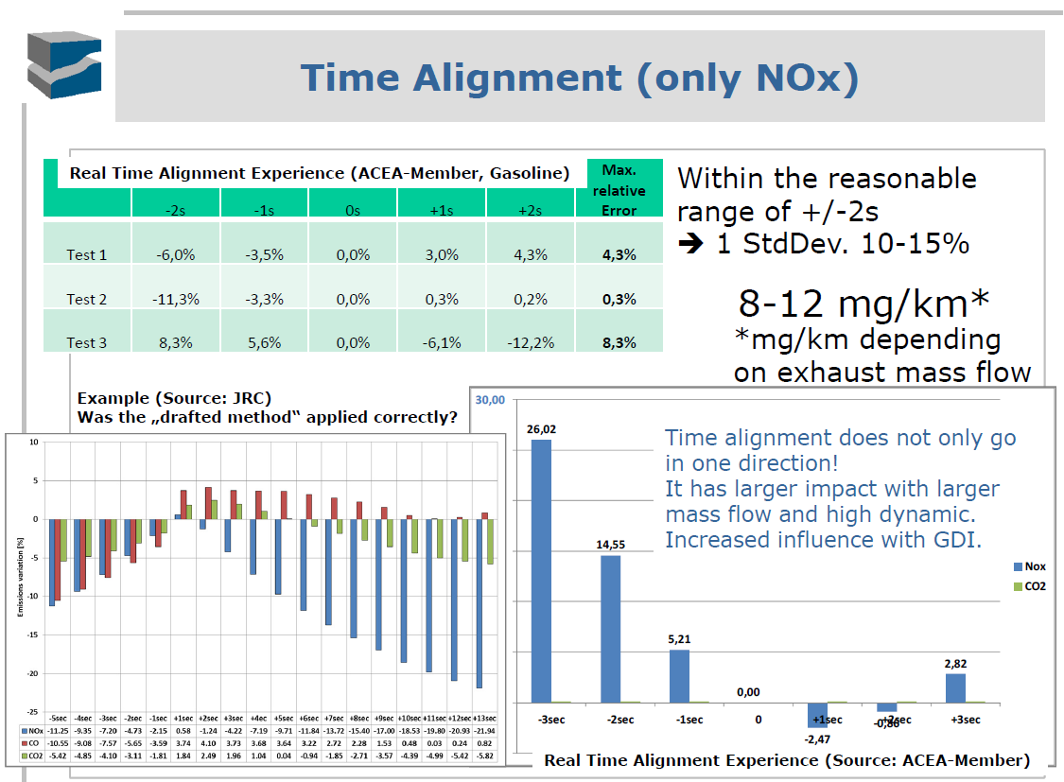
Time Alignment

Slide 14
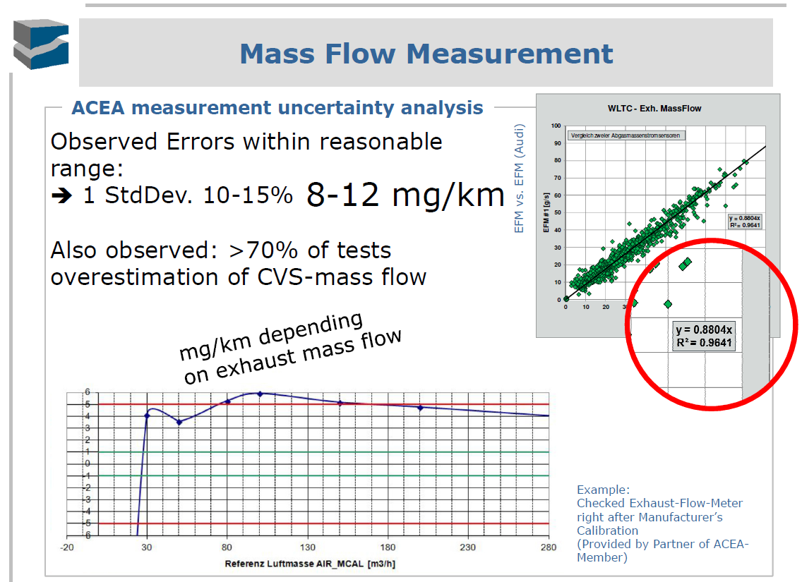
Exhaust Flow Measurement

Slide 15
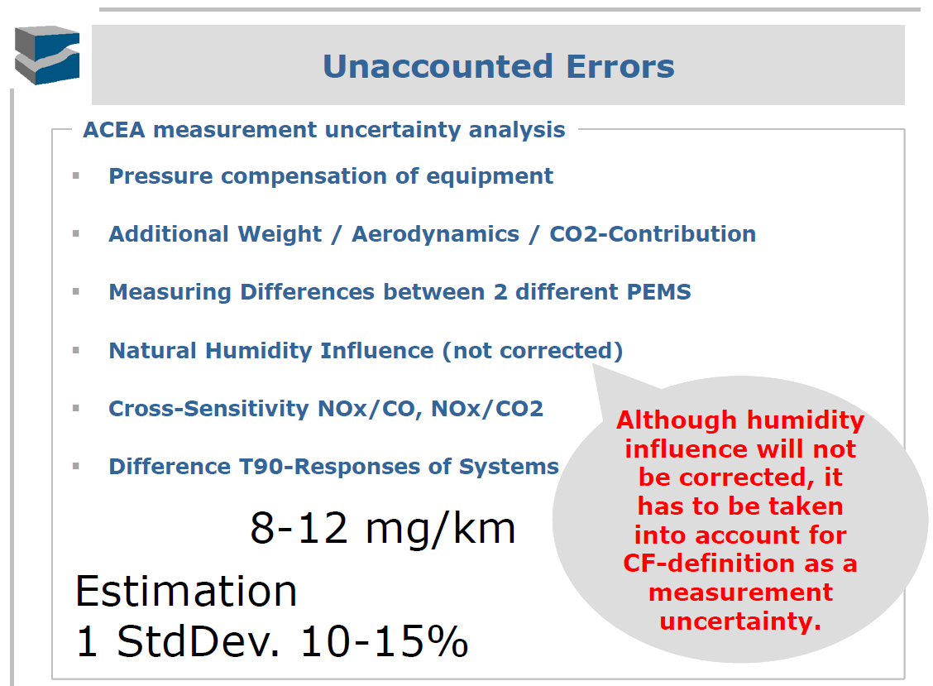
Other Errors

Slide 16
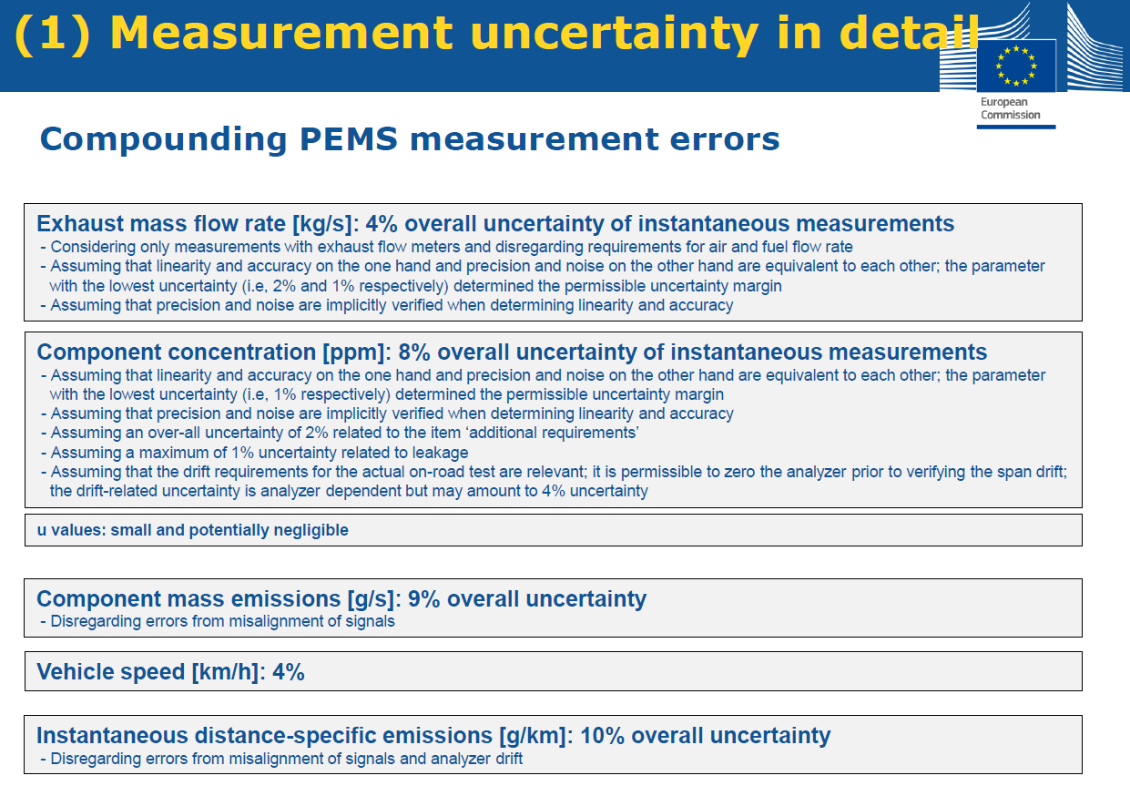
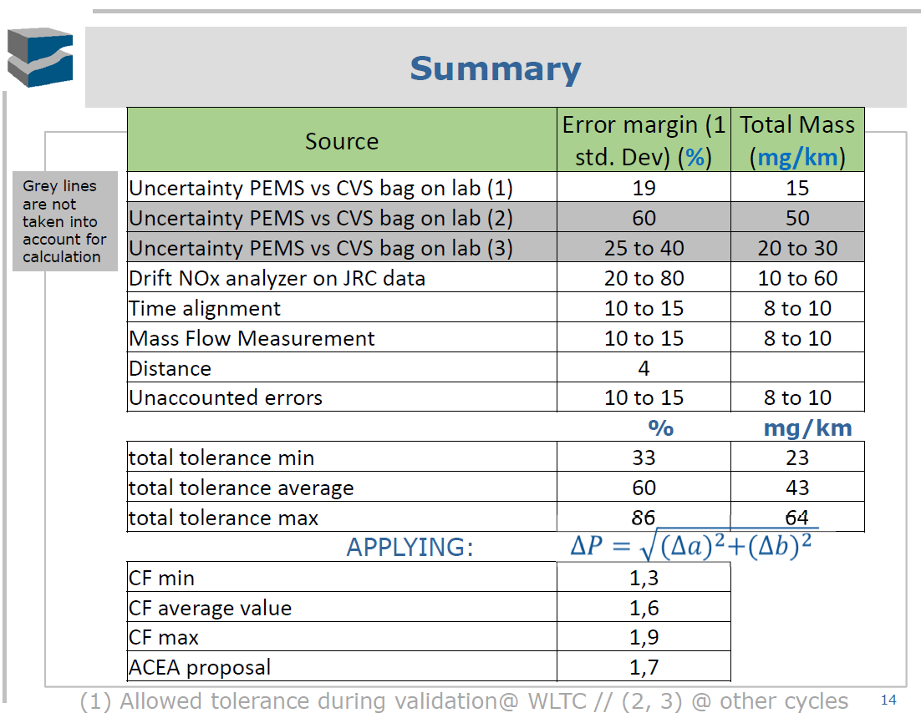
CF ACEA (1.7), EC 1.6 (2017) > 1.2 (2020). Current Regulation 2.1 > 1.5

Slide 17
Background
Correlation / Validation testing over WLTC “highly recommended” for Packages 1 & 2 RDE testing
  Limits (% and Absolute) provided in proposed regulations
  Example Correlation testing performed at UTAC on 1.6 liter diesel vehicle

Slide 18

Correlation to Laboratory – WLTC Cycle
1.6 liter Diesel at UTAC, 10/29/2014

Slide 19
Correlation to Laboratory – WLTC Cycle
1.6 liter Diesel at UTAC, 10/29/2014

Slide 20
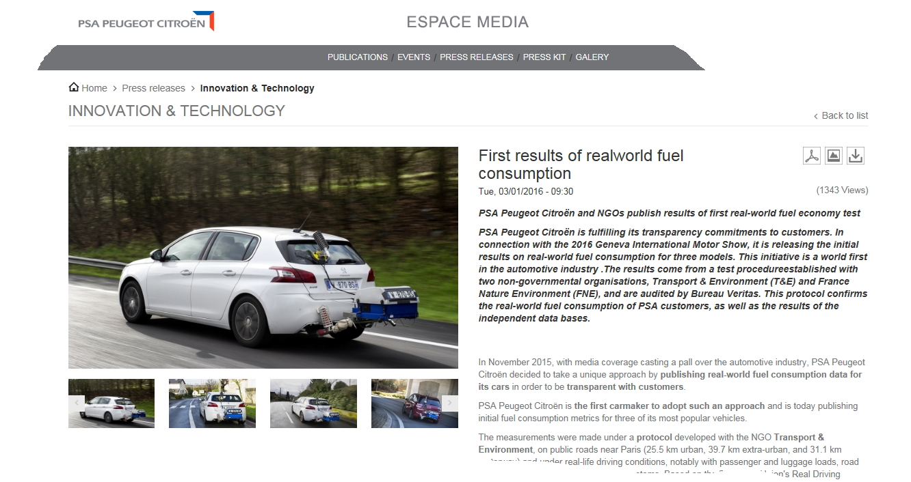
PEMS Testing – RDE, Development, Fuel Economy
Requirement: Errors <5%
A Factor of 2 better than the current RDE validation test criteria.

Slide 21
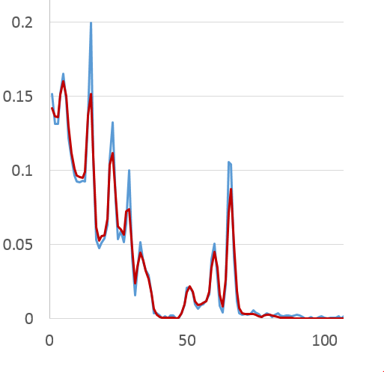
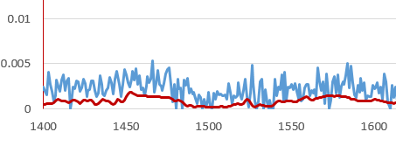
Correlation to Laboratory – WLTC Cycle
1.6 liter Diesel at UTAC, 10/29/2014

Slide 22
Correlation to Laboratory – WLTC Cycle
1.6 liter Diesel at UTAC, 10/29/2014

Slide 23
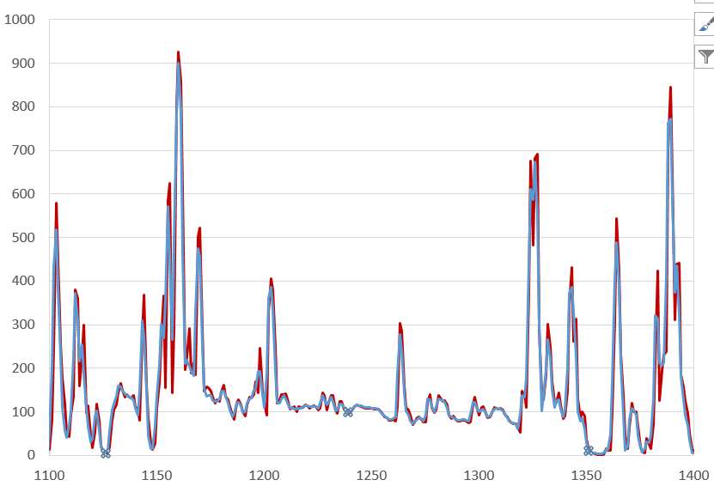
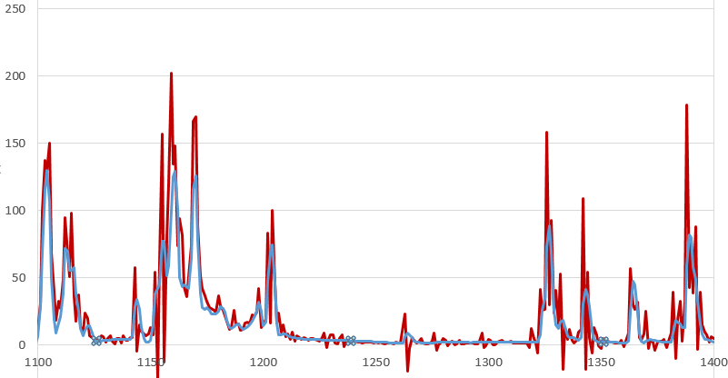
Correlation to Laboratory – WLTC Cycle
1.6 liter Diesel at UTAC, 10/29/2014

Slide 24
Correlation Evaluation: PEMs vs CVS Bag
Pass
Pass
Pass
All gases pass requirements. Low CO levels result in higher %error, but well within the .15 g/km absolute tolerance.

Slide 25
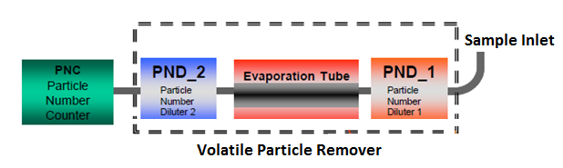
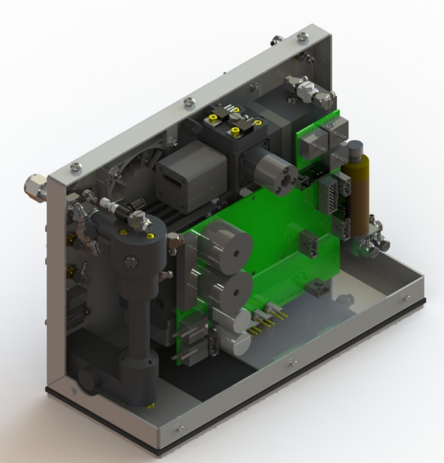
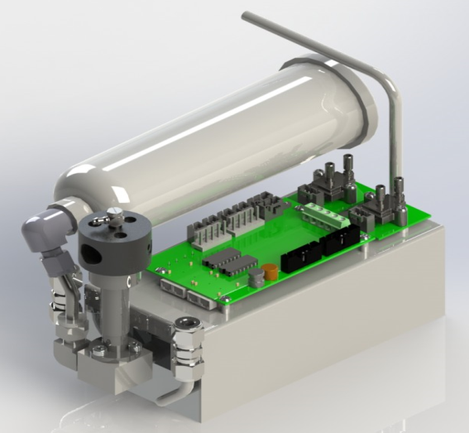
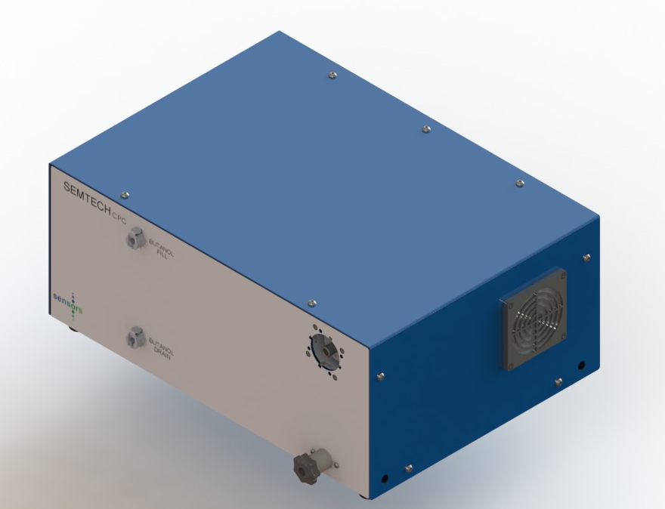
SEMTECH CPN compliant to the PMP Standard - UNECE Reg. 83
SENSORS CPC Module

Slide 26
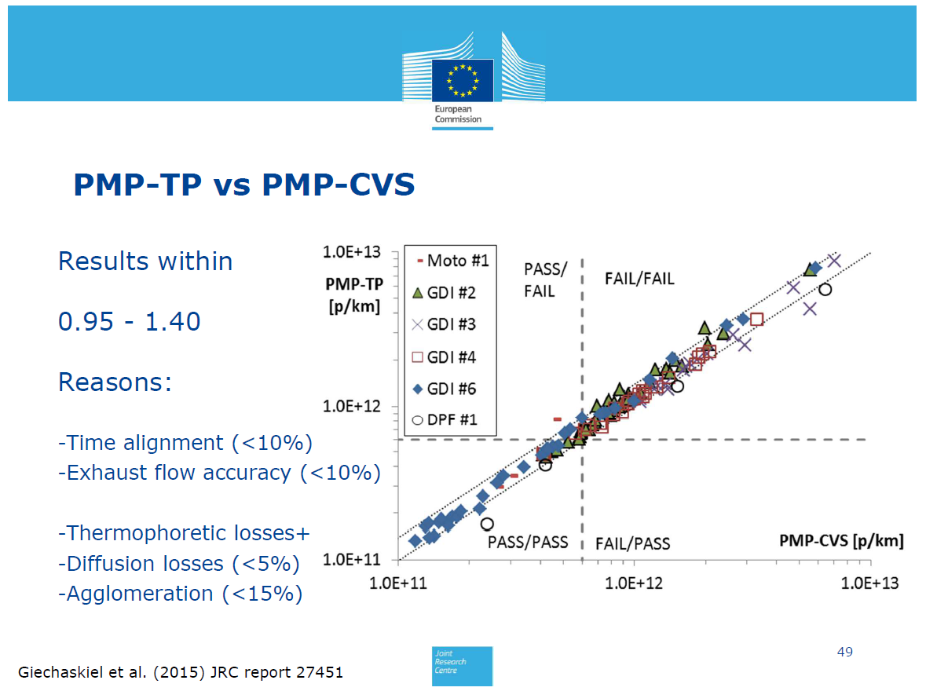
Ref. Technology (Tail-pipe to CVS)

Slide 27
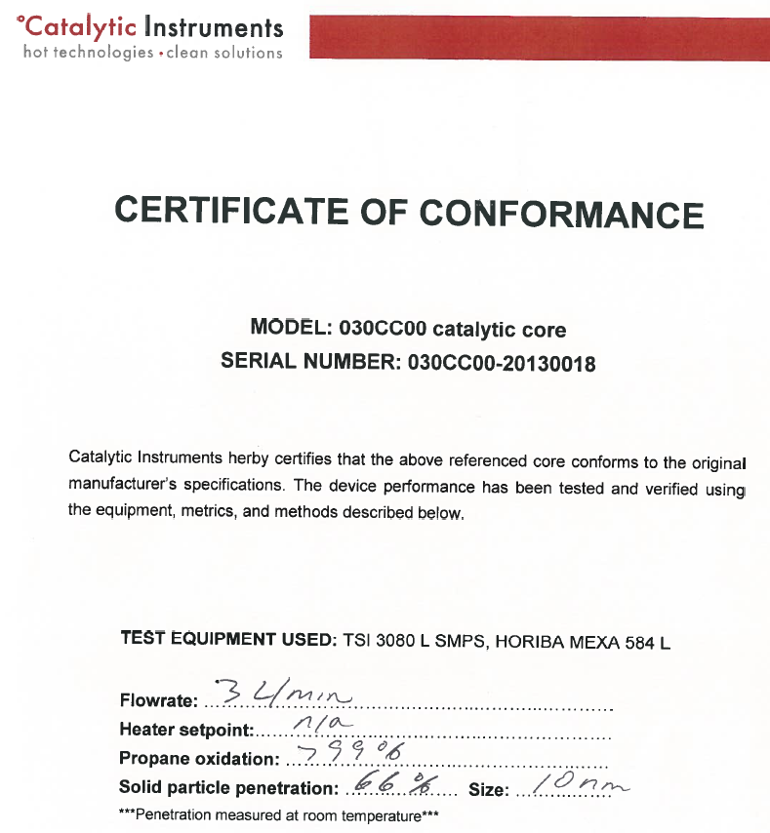

VPR-Catalyst
Catalyst from Catalytic Instruments
  PMP Specifications
  67% penetration at 10 nm
PND1 Heated Dilution
10-20:1
Picture - Feasibility study on the extension of
the Real Driving Emissions (RDE)
procedure to Particle Number (PN), JRC 2014
Heated Catalyst
300 °C

Slide 28
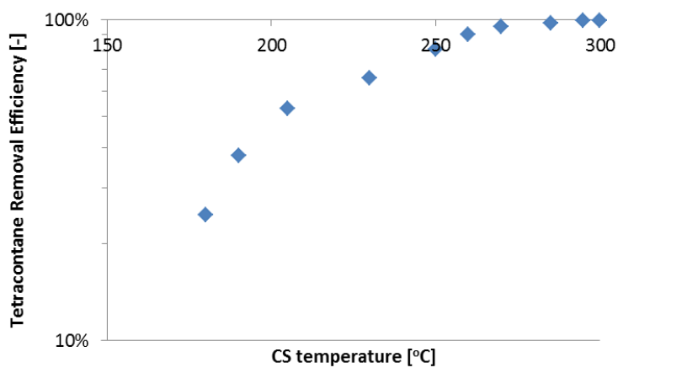

VPR-Catalyst – Experimental Verification
Catalyst from Catalytic Instruments
  PMP Specifications
  67% penetration at 10 nm
Source - Feasibility study on the extension of
the Real Driving Emissions (RDE)
procedure to Particle Number (PN), JRC 2014
Stage 1 Heated Dilution
10-20:1
Heated Catalyst
300 °C

Slide 29
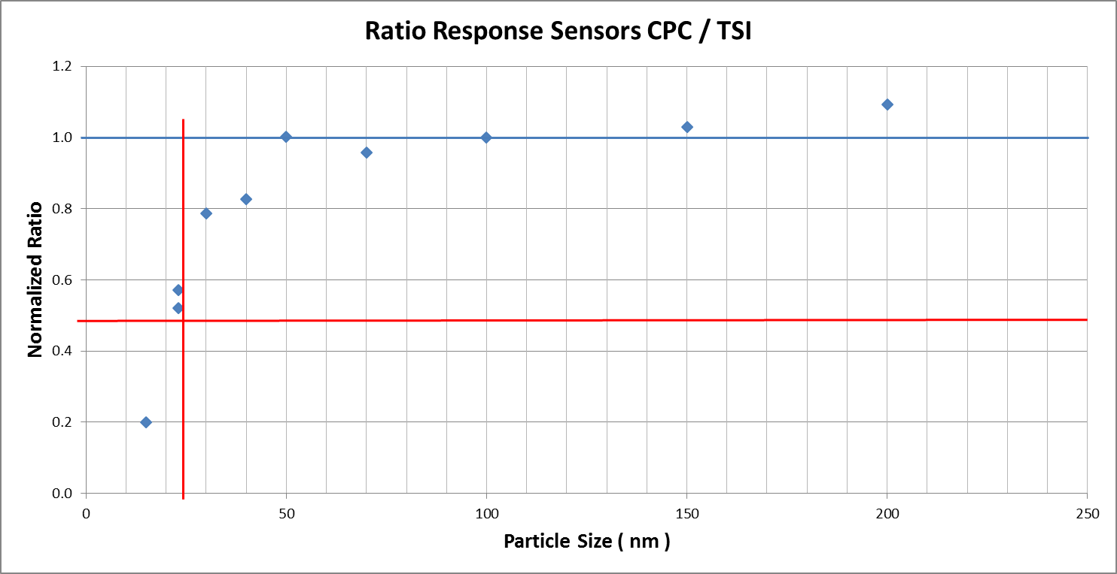
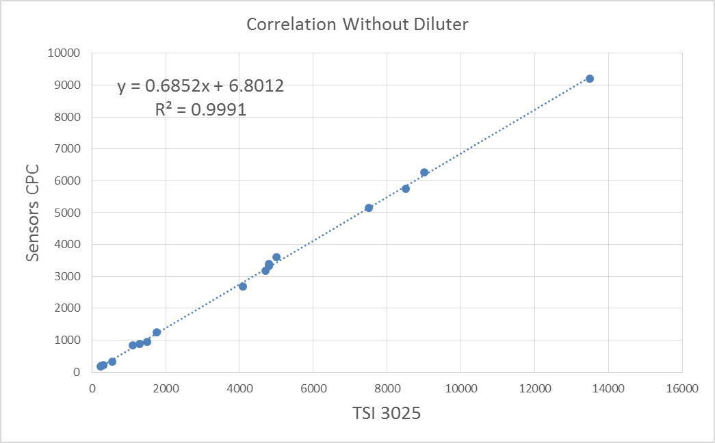
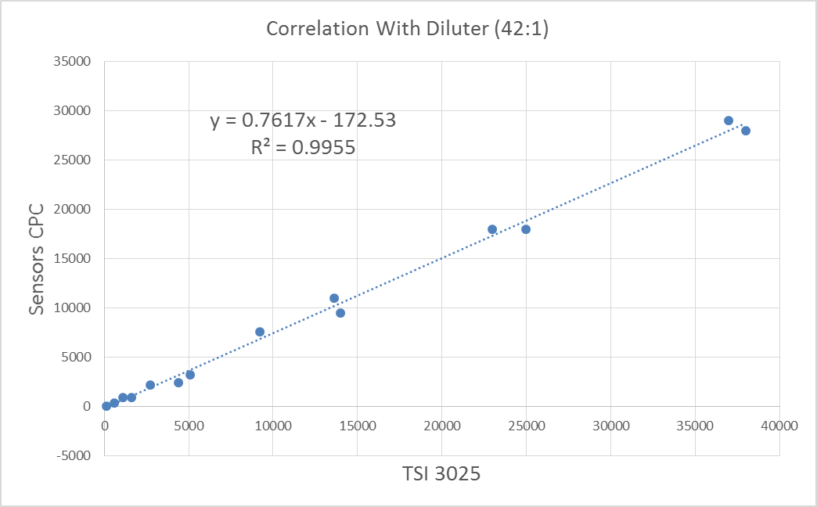
Aerosol Laboratory Evaluation
Size Classification
D50 ca 23 nm,
No Loss correction
applied during Study
Linearity of CPC
Correlation with Diluter

Slide 30
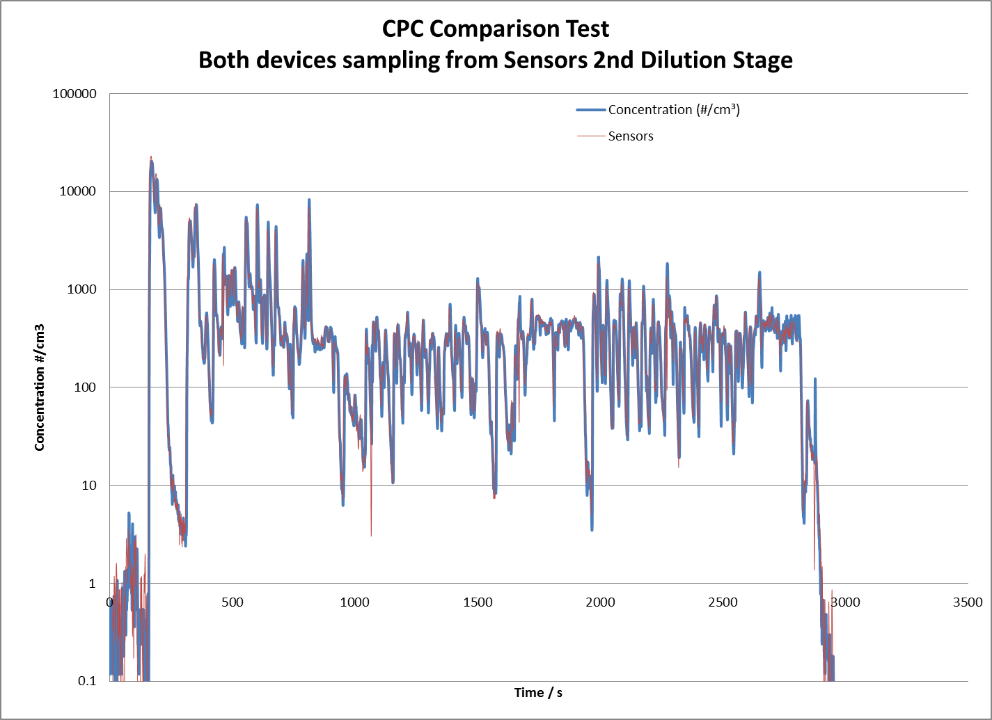
SEMTECH CPN vs TSI SPC
Note LOG Axis
(Highlights dynamic range and excellent correlation)
Data obtained at JRC ISPRA
CPC Evaluation:
Exhaust of CPN module measured simultaneously by TSI CPC and Sensors CPC during chassis dyno testing

Slide 31
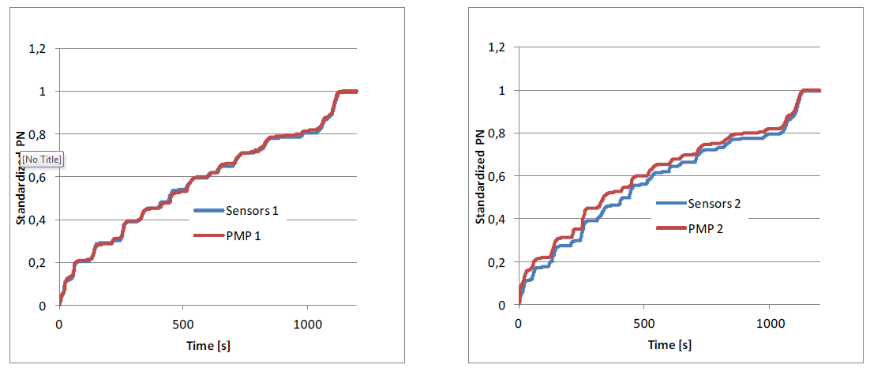
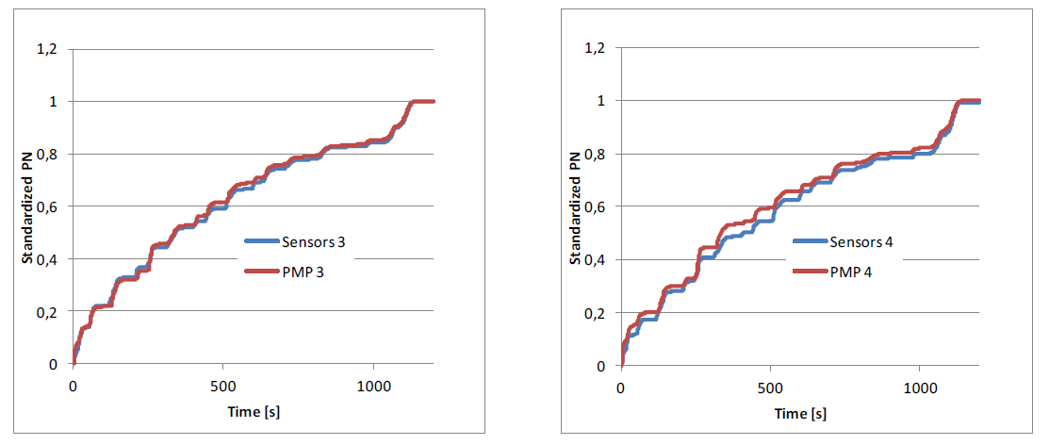
Test Cell Comparison
SEMTECH CPN and Horiba PMP
Data Supplied by
..Source Confidential......
The charts are normalized
Cycle averages within 20% to reference PMP

Slide 32

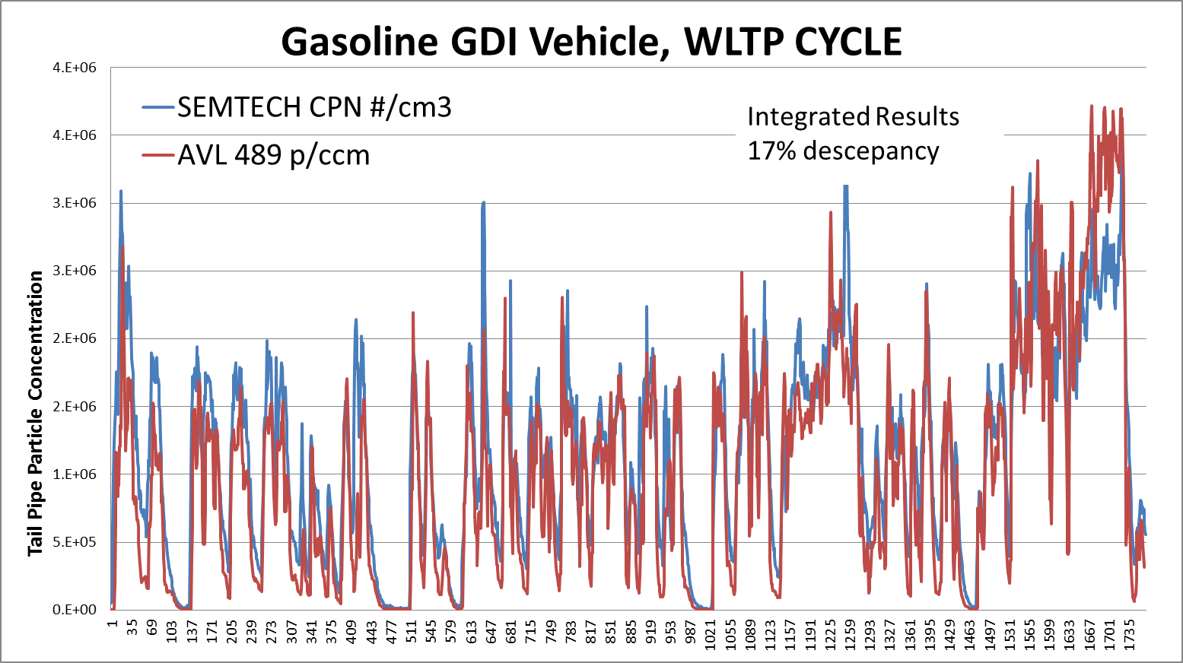
Test Cell Comparison
SEMTECH CPN and AVL 489 PMP
Data Supplied by JRC Dr.Francesco Riccobono
Cycle averages within <20% to reference PMP

Slide 33
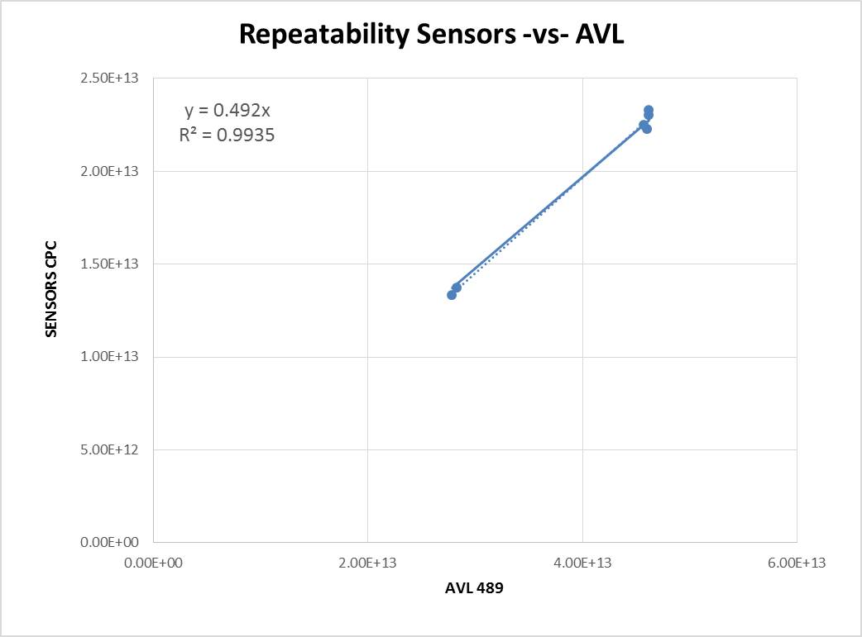
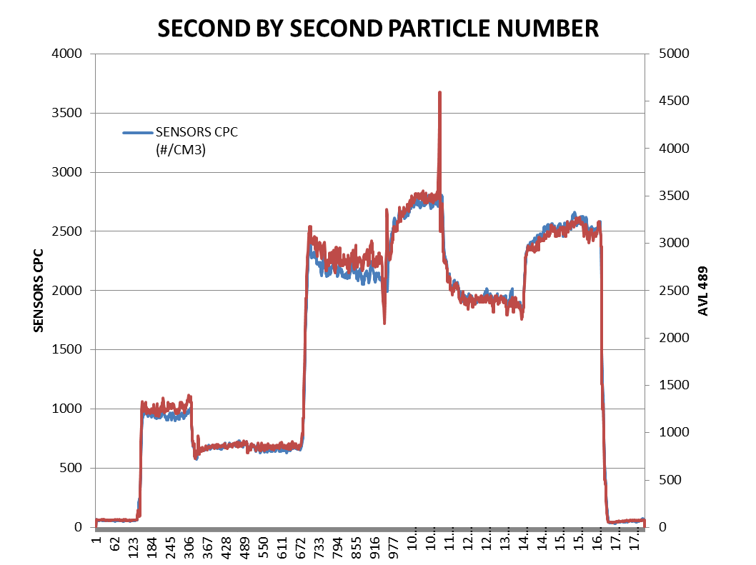
Heavy Duty Test Cell Comparison
SEMTECH CPN and AVL 489 PMP
Data Supplied by Cummins
Dr. Shirish Shimpi
Demonstrated excellent Linearity and repeatability

Slide 34
Thank You For Your Attention

