Slide 1
Vocation-Specific Activity Patterns and Temperature Effects of On-Road Heavy-Duty Diesel Vehicles in California
George Scora¹, Kanok Boriboonsomsin¹,
Kent Johnson¹, Seungju Yoon², and Kathy Jaw²
¹University of California at Riverside
²California Air Resources Board
6th International PEMS Conference
Riverside, CA
March 18, 2016

Slide 2
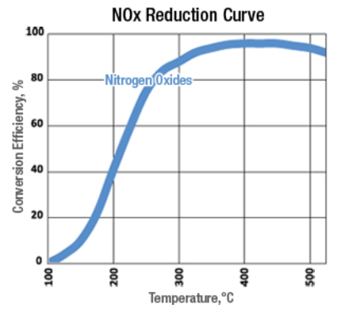
Background
Selective Catalytic Reduction (SCR) is used in most diesel engines to meet 2010 NO_{x} emission standards.
NO_{x} Conversion is highly dependent on SCR temperature.
Typically, SCR needs to be at least 200°C before significant NO_{x} reduction is achieved.
There are several situations where SCR may not be at the required temperature:
Cold start
Idling
Low load engine operation
The fraction of these situations in heavy-duty diesel vehicle (HDDV) operation varies by vocational use.

Slide 3
Project Objectives
Characterize HDDV activity profiles (e.g., duty cycles, starts, and soak time).
For different types of vocational use (line haul, drayage, construction, delivery, etc.)
Identify fraction of vehicle operation that SCR effectiveness may be compromised.
Low SCR inlet temperature
Compare results with emission certification test cycle.
Analyze the representativeness of the certification cycle in reflecting real-world emissions of NO_{x}

Slide 4
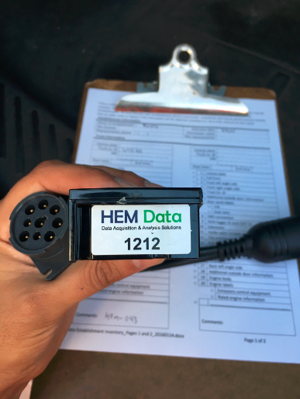
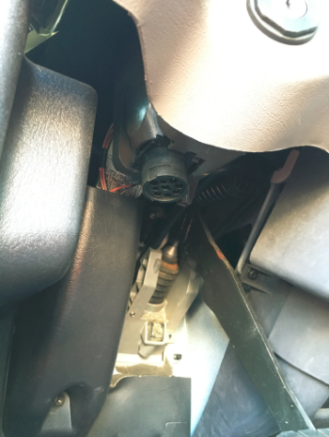
Approach
Collect real-world vehicle activity and engine operation data from 100 trucks for minimum of one month each.
Cellular-based GPS & ECU data loggers
1 Hz data frequency
170 SPNs in J1939 format
Vehicle and engine information
Engine & VIN labels
License plate
Odometer
Body (front, sides, rear)
Exhaust temperature probes
Etc.

Slide 5
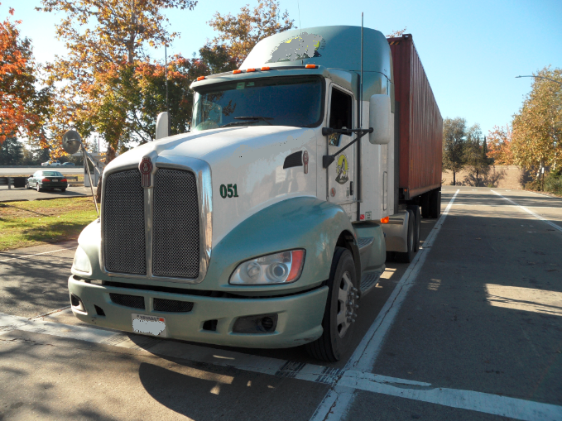
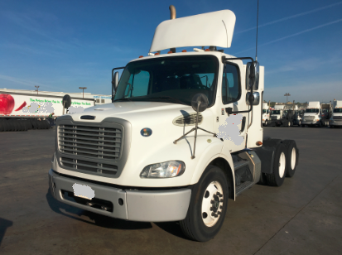
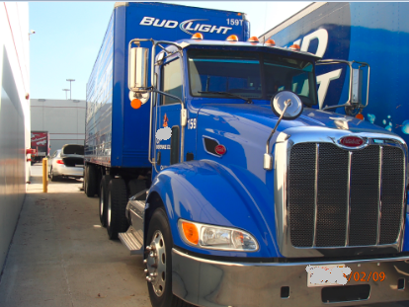
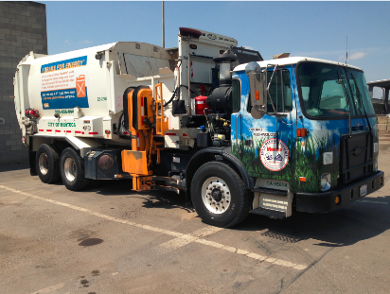
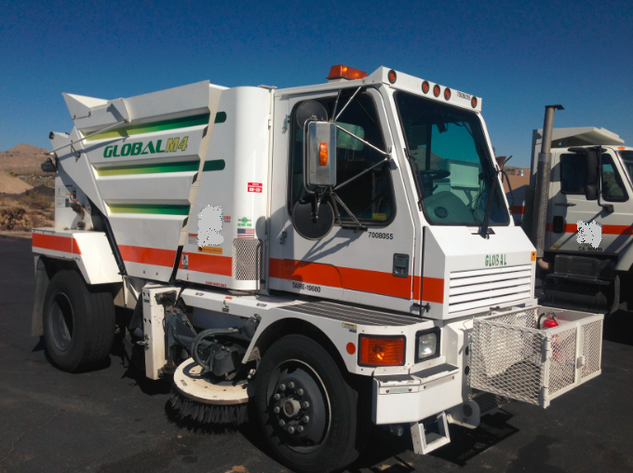
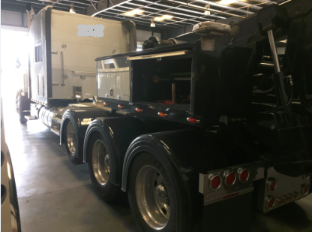
Targeted Truck Vocations
Line haul
Drayage
Agricultural
Construction
Food/beverage distribution
Shuttle
Refuse
Transit
Public work
Utility

Slide 6
Sample Data
One trip (engine on to off) of a dump truck
Cold Start
Long Idling
Low-Load Operation

Slide 7
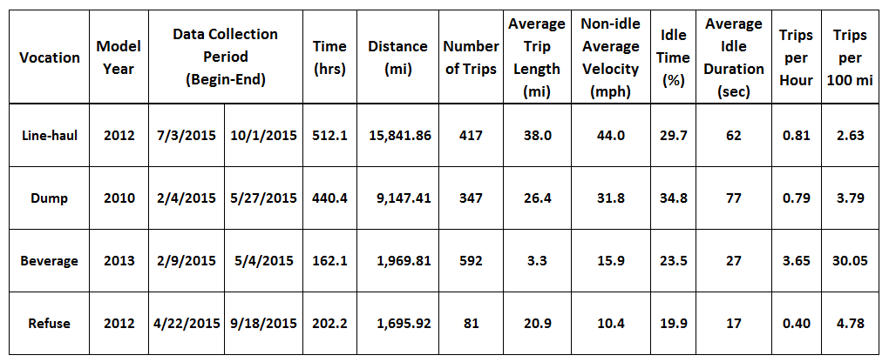
Vehicle Statistics for Four Selected Vehicles

Slide 8
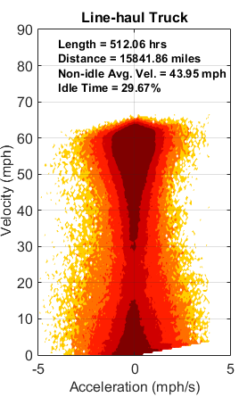
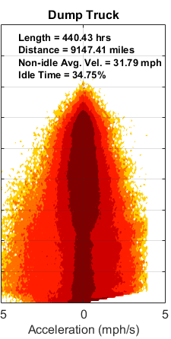
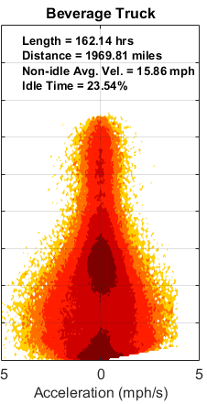
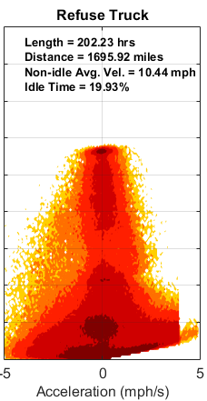
Joint Speed-acceleration Frequency Distribution by Vocation

Slide 9
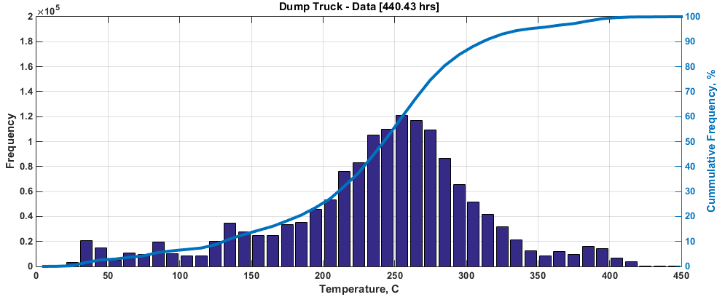
SCR Temperature Distribution
25.4% of the trip having SCR temp. lower than 200 °C

Slide 10
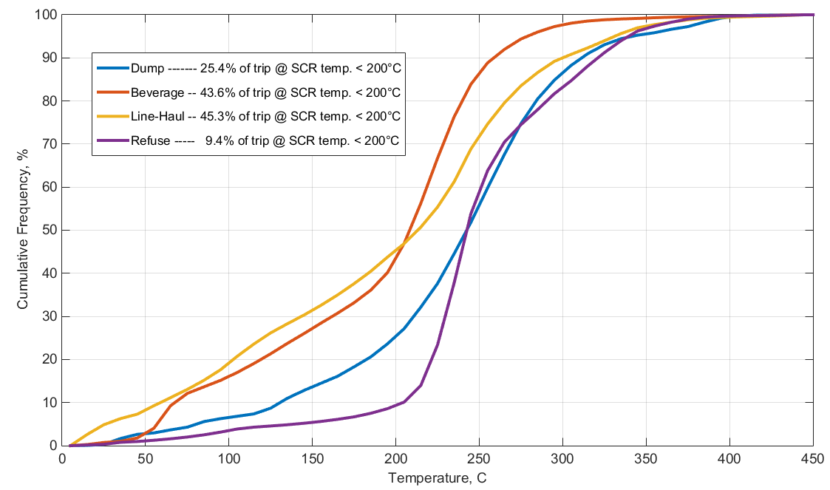
Cumulative Frequency for SCR Temperature by Vocation

Slide 11
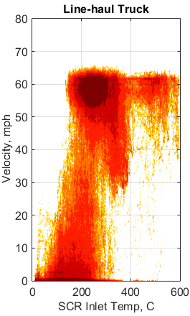
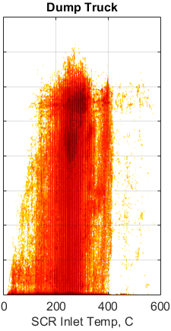
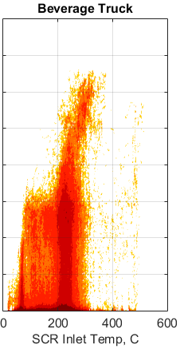
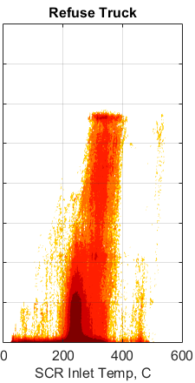
SCR Inlet Temperature vs. Velocity by Vocation

Slide 12
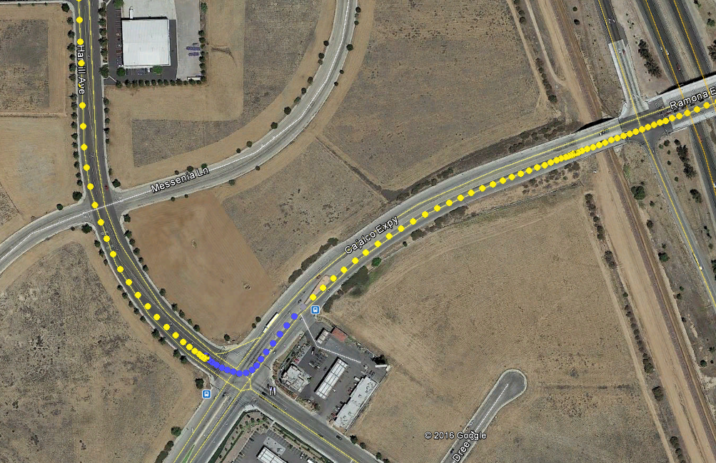
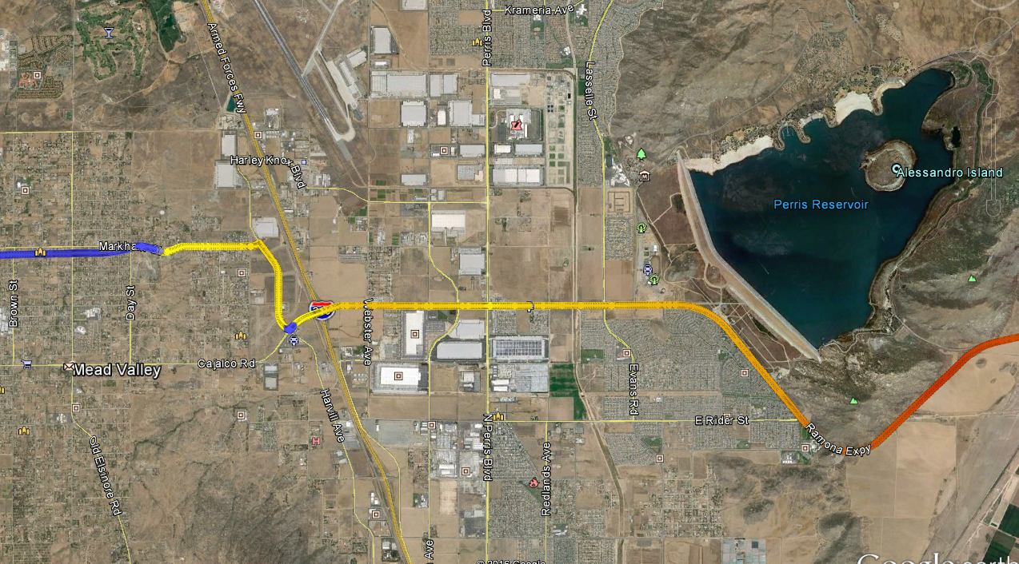
Cold Start and Idle Effect on Temperature

Slide 13
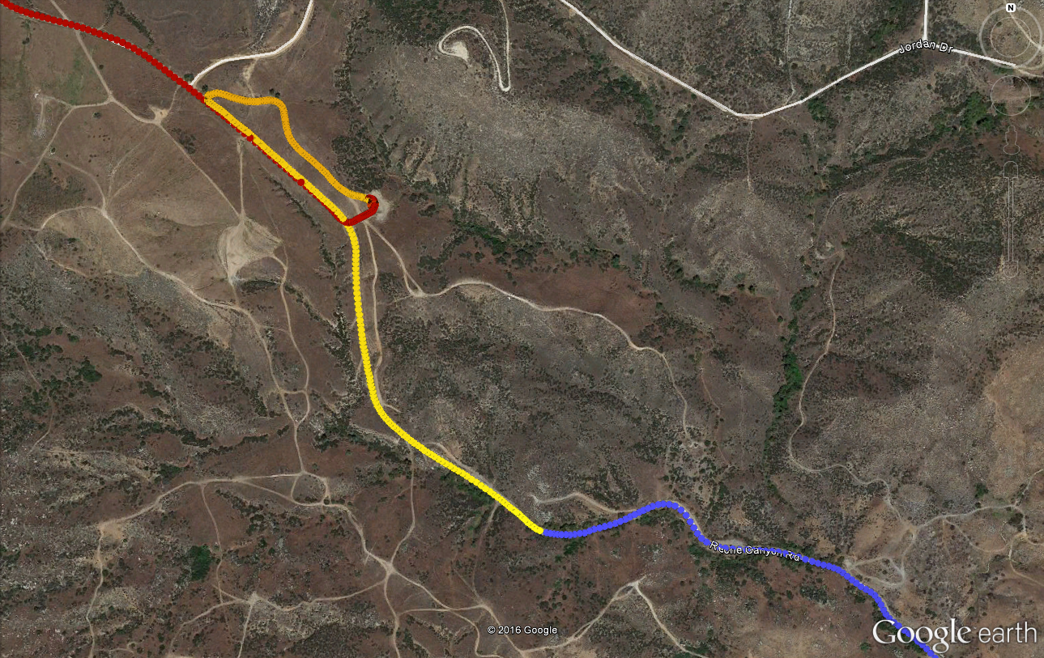
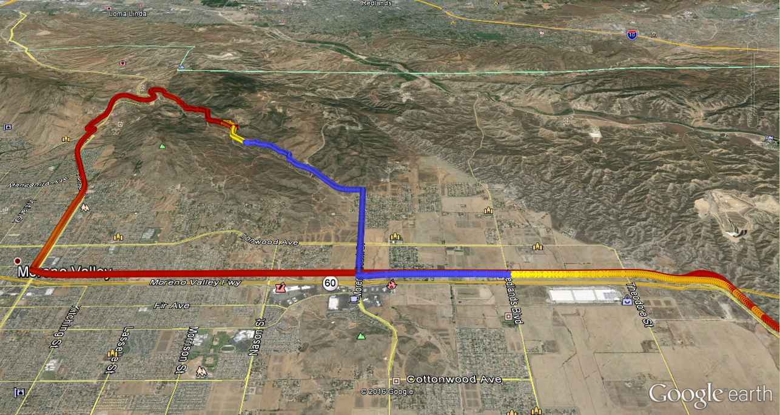
Low Load Effect on Temperature

Slide 14
Low Load SCR Cooling Effect Resulting from Negative Grade

Slide 15
Summary
This project is collecting a rich set of vehicle activity and engine operation data from a variety of HDDV vocations.
Data can be used to:
Characterize HDDV activity patterns.
Develop vocation-specific driving cycles.
Understand implications on SCR effectiveness, real-world NO_{x} emissions, and NO_{X} inventories.
Develop SCR temperature models.
Etc.
Project is still ongoing.
Data collection period ending in spring 2016.
Project completion in summer 2016.

Slide 16
Additional Information
Acknowledgements
California Air Resources Board
U.S. Environmental Protection Agency
Participating fleets
infoWedge
HEM Data
Contributing staff at CE-CERT, UC Riverside
Contacts
George Scora (gscora@cert.ucr.edu)
Kanok Boriboonsomsin (kanok@cert.ucr.edu)
Kent Johnson (kjohnson@cert.ucr.edu)
Seungju Yoon (seungju.yoon@arb.ca.gov)

Slide 17
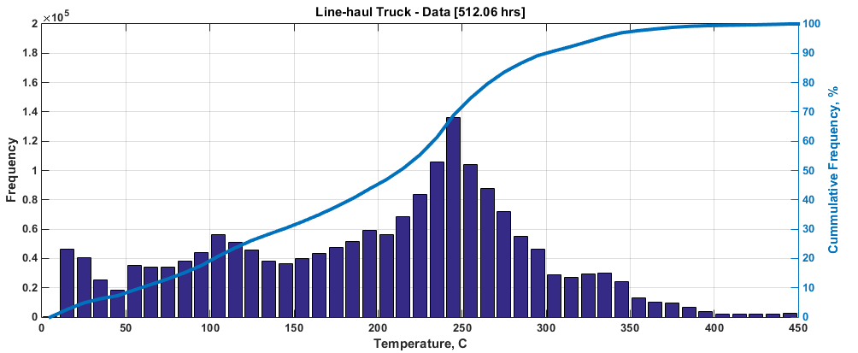
Extra

Slide 18
Extra

Slide 19
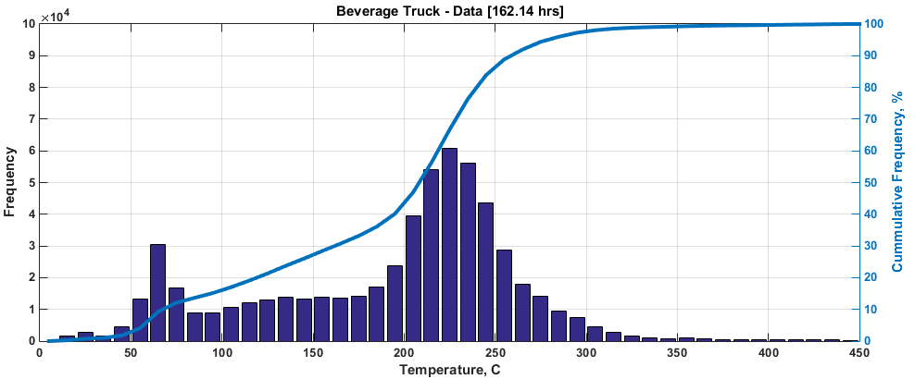
Extra

Slide 20
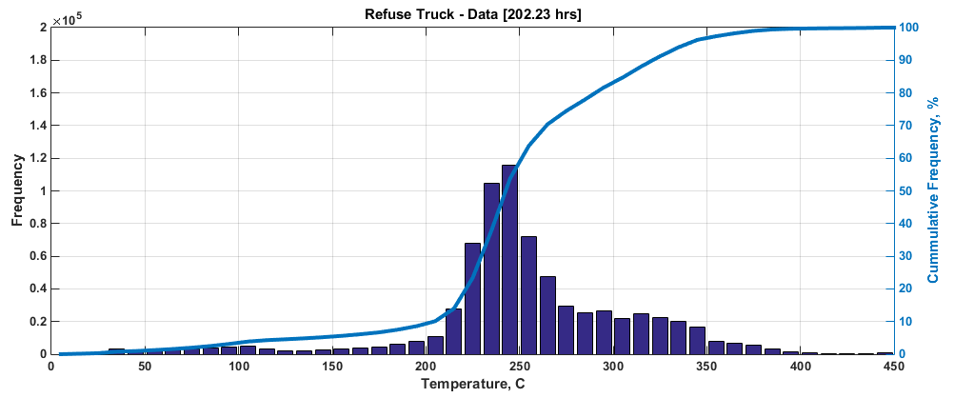
Extra

