Slide 1
Thinking Off-Cycle About the Future of PEMS
6th International PEMS Conference and Workshop (2016)
University of California, Riverside CE-CERT
March 18, 2016
Leo Breton
Department of Energy
Vehicle Technologies Program

Slide 2
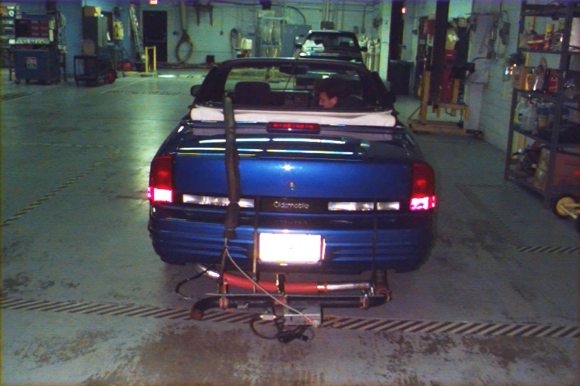
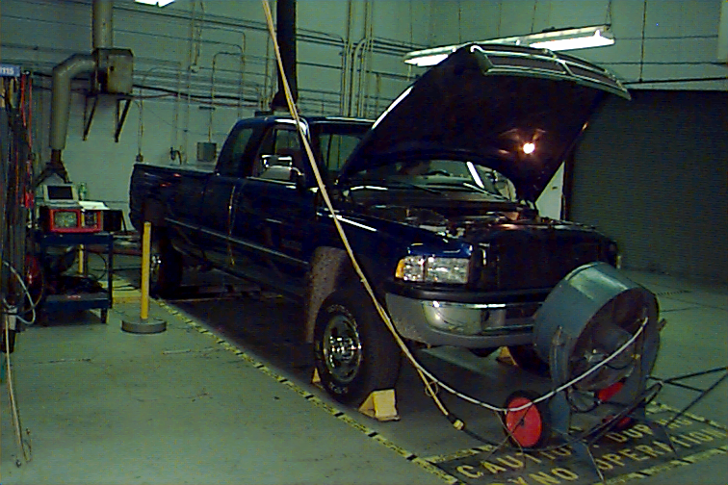
We have come a long way since 1995
1995 - Life Was Easy
Road Testing Impossible
No Equipment Available
Off-Cycle Denial
NAAQ Not Responding - Keep Reducing Stds.
2016 - Life Complicated
Commercial Equipment
Defeat Devices Don’t Pay
Off-Cycle Emissions On Everyone’s Radar
Calibration Headaches

Slide 3
Calibration Space Dimensions
Baro Pressure
Throttle Movement
Ambient Temp
Load
Coolant Temp
Aux. Loads
Throttle
Catalyst/Piston
Temps
Vehicle Speed
Boost
Engine Speed
?

Slide 4


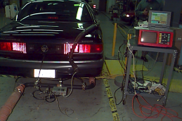
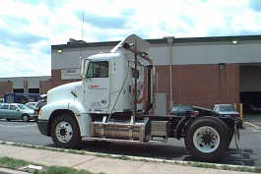
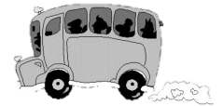




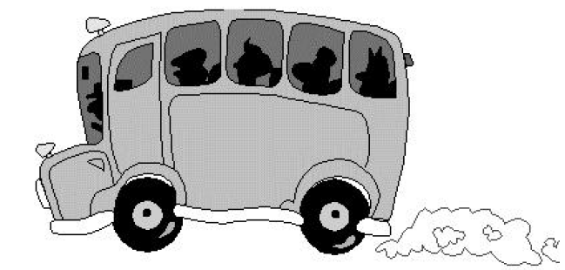



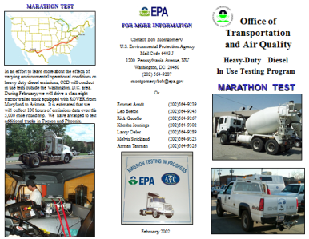

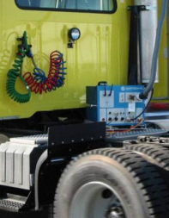

ROVER PEMS Timeline
FTP
1995
1998
2000
1st Patent
Issued
2002
2008
2002
Commercial
Notes:
Real world convertible testing.

Slide 5
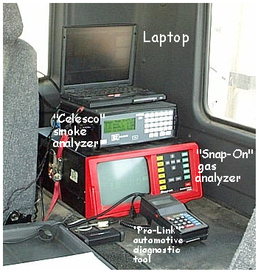
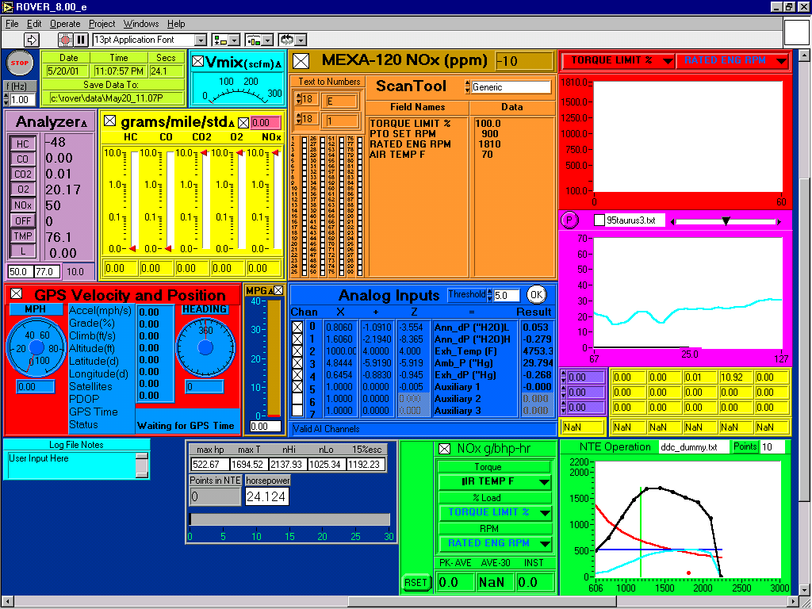
Flexible System Was Created
Converter Efficiency
Smoke
Drivers Trace
Route Playback On Dyno
NTE Realtime
Auxiliary Analog Inputs

Slide 6
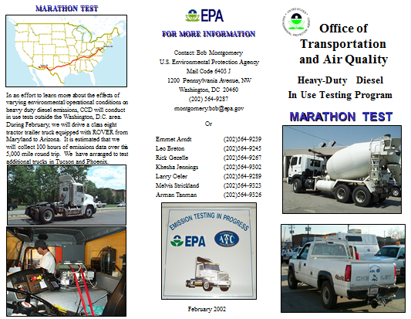
Marathon Testing

Slide 7
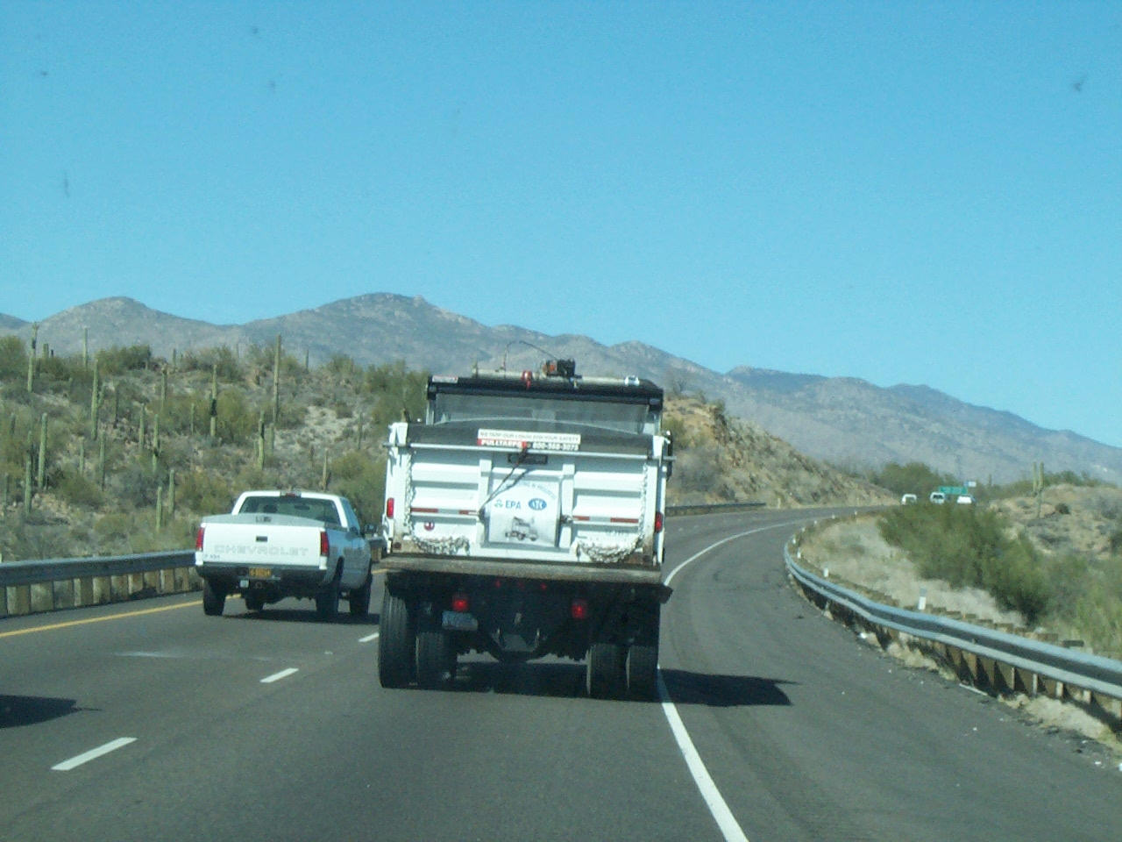
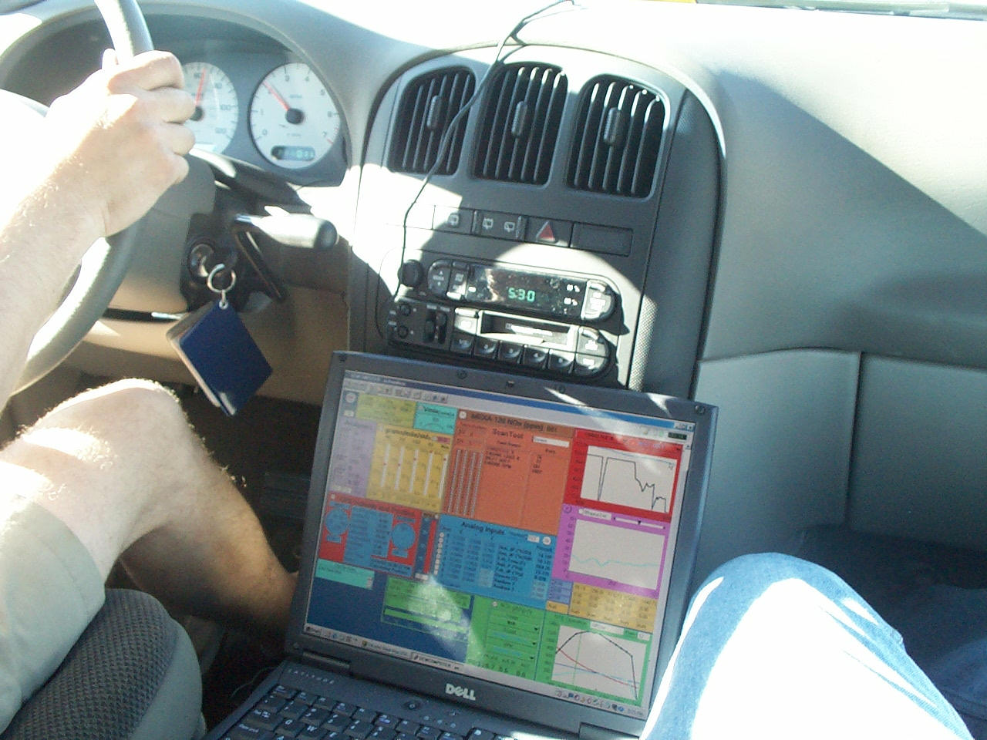
Monitoring From Chase Vehicle
Remote Monitoring Chase Vehicle

Slide 8
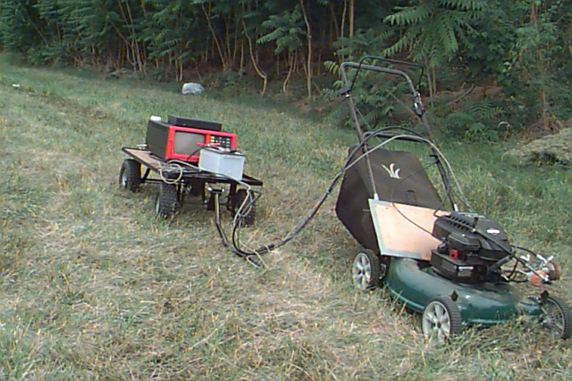
Still Other Engines Out There…

Slide 9
“Blind Testing” Concept Still Important
Mass emissions accurately determined by actual measurements of concentrations and exhaust flow rate
Data stream data reserved for diagnostics
No information is needed from manufacturer
The methodology is exactly the same for gas/diesel, all manufacturers, turbo/non-turbo, and any size engine from HDD to lawnmower.
Relying on OBD data or proprietary/manufacturer data is a slippery slope which should be avoided.

Slide 10
Future Cost / Quality Considerations
Of course lower cost is always good, all else being equal
PEMS is a low cost way of doing near-lab quality data acquisition but standards are needed and drive up cost
Don’t expect another defeat device in my lifetime – too costly
Most future uses will be for discerning small differences in fuel economy/emissions – high quality is needed for what WE do
Consider the OEM legal ramifications – your data will be used by others who don’t know limitations for purposes you cannot control
We fought the battle in the ’90s and prevailed – make sure we don’t regress…

Slide 11
Happy Testing!
Thank You!!

