Slide 1
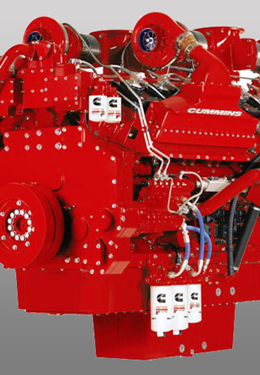
Comparison of the SEMTECH ECOSTAR CPM to AVL 483 MSS, AVL 489 APC, and CVS gravimetric PM
2014 PEMS Conference and Workshop
April 3rd 2014
Presented by: Tanfeng (Sam) Cao
Co-authors: Shirish Shimpi, Kevin Bouma, and David Booker

Slide 2
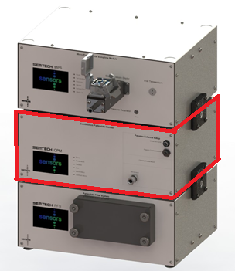
Background
  CPM Description
    Sensors’ version of the Pegasor M-Sensor
    Real time PM device to measure EITHER Particle mass OR number
    Can be a standalone device for dilute exhaust measurement or integrated together with the MPS/PFS for raw exhaust measurement (PEMS application)
  Cummins interest in CPM beyond PEMS
    Estimate PM using real time PM devices
    Sample from raw stack
    Sample from CVS tunnel
  Demo purpose
    Understand CPM functionality
    Correlation to CVS PM
    Correlation to AVL 483 MSS
    Correlation to AVL 489 APC
    Ease of use as a PEMS system
Dilution (MPS)
Continuous Particulate Monitor (CPM)
Gravimetric
Filter System
(PFS)
Source: Sensors

Slide 3
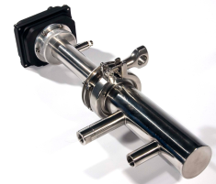

Pegasor Operating Principle
http://www.youtube.com/watch?v=yMe7k9NTDQI
ejector throat
out
sample in
+
clean air
pump flow
trap
corona discharge
+ ion
soot
Source: Sensors

Slide 4
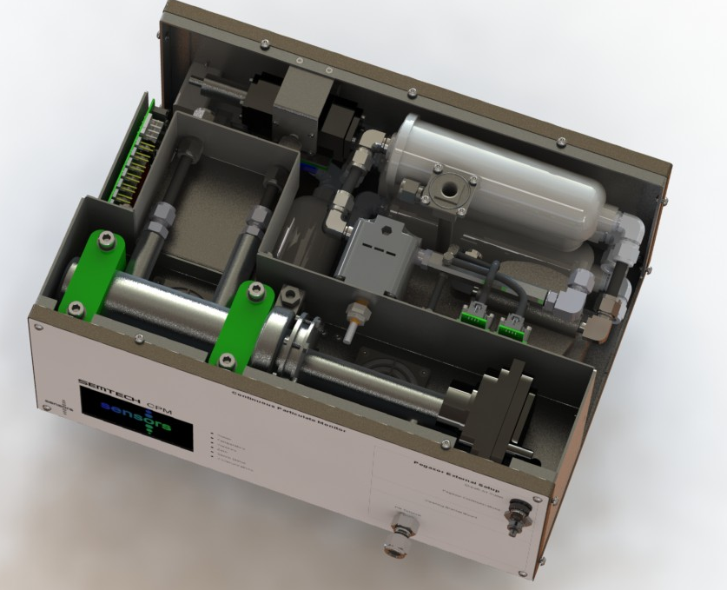
CPM Module Design
3-Way Sample /
Zero Air Solenoid
Purge Flow and Pressure Measurement
HEPA Filtration
(Purge, Zero Air, Exhaust, MPS Make-up)
Thermal Control (40-50 °C)
Pegasor M-Sensor
Source: Sensors

Slide 5
^{SEMTECH PPMD MPS}
Primary Mixing
Chamber (vacuum)
Secondary Mixing
Laminar flow Sample Capillary
Secondary Transport Tube
Qsample
0 - 2 lpm
Total Dilute Flow,
QMajor + QMinor + QSample
= 8 lpm (constant)
Raw Exhaust
Venturi creates vacuum
from Major Flow, Drawing Sample
Sample
Bypass
Qminor
0 - 4 lpm
Qmajor
4 - 8 lpm
Sample ΔP
Qminor adjusts vacuum
Adjust Sample from 0 – 2 lpm
In proportion to Exhaust Flow
*Sample taken from the exhaust MUST be proportional to the Exhaust Flow
All rights reserved 2010© Sensors, Inc.
Source: Sensors
Notes:
The MPS dilution system works under both Bernoulli equation and the equations for laminar flow in capillaries. These equations describe the analytical relationship between the sample flow, dilution flows (major and minor) as a function of the inlet temperature and pressure of the sample (exhaust) gas.
Bernoullis equation states that the pressure drop between the inlet and outlet of the diluter must equal the pressure drops across the sample capillary + second transport capillary and the venturi. Each of these pressure drops can be calculated from theory and the equations can be re-arranged to calculate the dilution flows (for an assumed total flowrate) for ANY sample flowrate at ANY temperature or Pressure.
For example, for a given major flowrate, the sample flow rate can be changed over a wide range by changing the minor flow rate. This is due to the change in pressure in the primary mixing chamber.
An example would be as follows: The major flowrate is set to 6 SLPM with generates a “suction pressure” in the venturi of 3 kPA (0.5rhov2). If Qminor is zero then the pressure in the primary mixing chamber will be equal to the balance 3kPa minus the pressure dropped across the secondary capillary

Slide 6
Experimental setup
  Engine and test cell setup
    CVS test cell at Cummins Technical Center
    2007 Cummins ISB 6.7 liters 295 hp, EGR only
    Equipment Installation
      AVL 483, raw exhaust (10:1 DR)
      Sensors CPM, raw exhaust (10:1 DR)
      AVL 489, dilute (1000:1 DR)
  Test matrix
    5 hotFTP + 3 RMCSET + 5 hotFTP
    CPM
      5 hotFTP + 2 RMC on 900V trap setting (PM)
      1RMC + 5 hotFTP on 400V trap setting (PN)
  Data logging/post-processing
    CPM logged via standalone ECOSTAR SW
    All others logged via test cell DAQ
    CPM conc. data aligned to test cell data and processed by hand

Slide 7
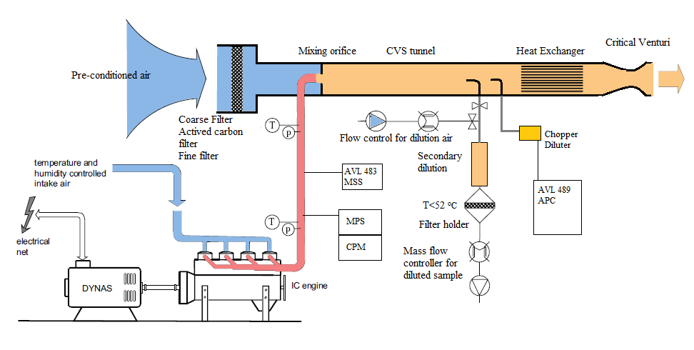
Experimental setup schematic
  Engine: 2007 Cummins ISB 6.7, 298 hp, EGR only
  Raw: AVL 483 MSS w/PRU, Sensors CPM w/MPS
  Dilute: Gravimetric PM, AVL 489 APC
  Others: Gaseous bench, smoke meter

Slide 8
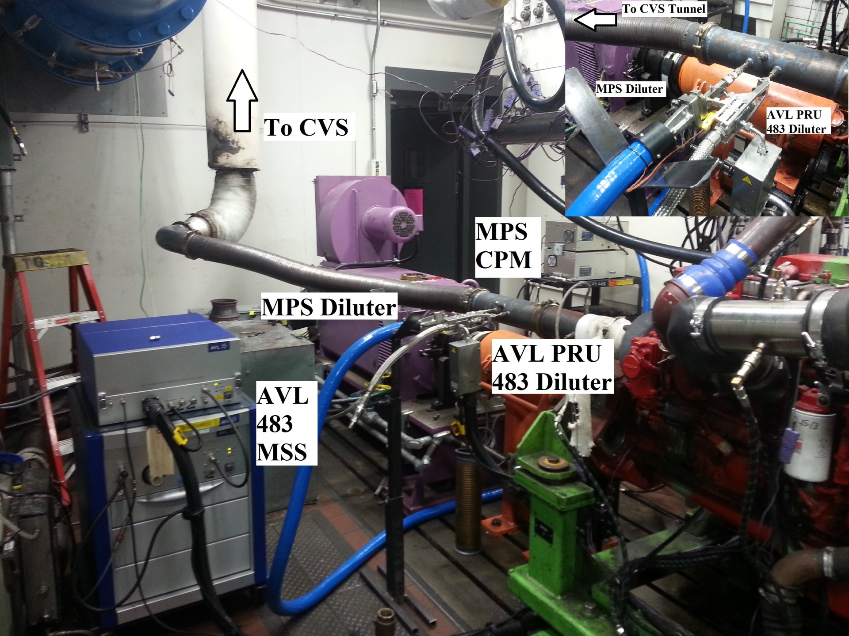
Test cell setup

Slide 9
Overall test summary showed excellent repeatability

Slide 10
Real time data confirmed excellent repeatability
  CPM COV 1.2% to 2.7%

Slide 11
CPM bsPM & bsPN slightly higher than reference
Mass
+19%
-8%
Number
+50%
+35%

Slide 12
Issue: bsPM comparison showed inconsistent deviations
  CPM deviations to CVS
    5 FTPs: +19%
    2 RMCSETs: -9%
  MSS deviations to CVS
    5 FTPs: -38%
    2 RMCSETs: -37%

Slide 13
bsPN comparison also showed inconsistent deviations
  CPM deviations to AVL 489
    5 FTPs: +35%
    1 RMCSET: +50%
  AVL 489 APC bsPN
    10 HTPs: 2.24*10¹⁴ p/bhp-hr
      1.2 % COV
    3 RMCSETs: 2.21*10¹⁴ p/bhp-hr
      0.5% COV

Slide 14
CPM trap voltage setting show strong influence on bsPN

Slide 15
CPM trap voltage setting show strong influence on bsPN

Slide 16
Conclusion
  SEMTECH CPM correlated well to all reference PM devices; it was relatively easy to use/setup and showed excellent measurement repeatability
  Issues
    Inconsistent CPM deviations between RMC and FTP cycle
      While AVL 483 & AVL 489 data showed the similar “soot” PM/PN levels
      Trap voltage setting?
    MPS losses? (raw stack losses)
  Future work
    Run tests using trap voltage between 400 V and 900 V
    Run tests on dilute (CVS tunnel) to minimize raw vs. dilute losses
    Run tests with CPM+MPS+PFS to get the full correlation
  Sensors Improvements since this study (PN)
    Integration of fixed hot dilution (PMP)
    Addition of VPR (PMP), catalytic stripper
    Automatic real-time trap voltage switching to improve PM & PN correlation

Slide 17

Acknowledgements
  Sensors Inc.
    Rob Wilson
  Cummins Emissions Development
    Shirish Shimpi
    Bill Martin
    Yusuf Khan
  Cummins Technical Center Test Operations
    Chet Mun Liew
    Cathal Cunningham
    James G. Wilson
    Kent Olsen
    Ron Robbins

Slide 18
Thank you for your attention!
Cummins Proprietary

Slide 19
Back up slides
Cummins Proprietary

Slide 20
AVL 483 vs. CPM vs. Celesco

Slide 21
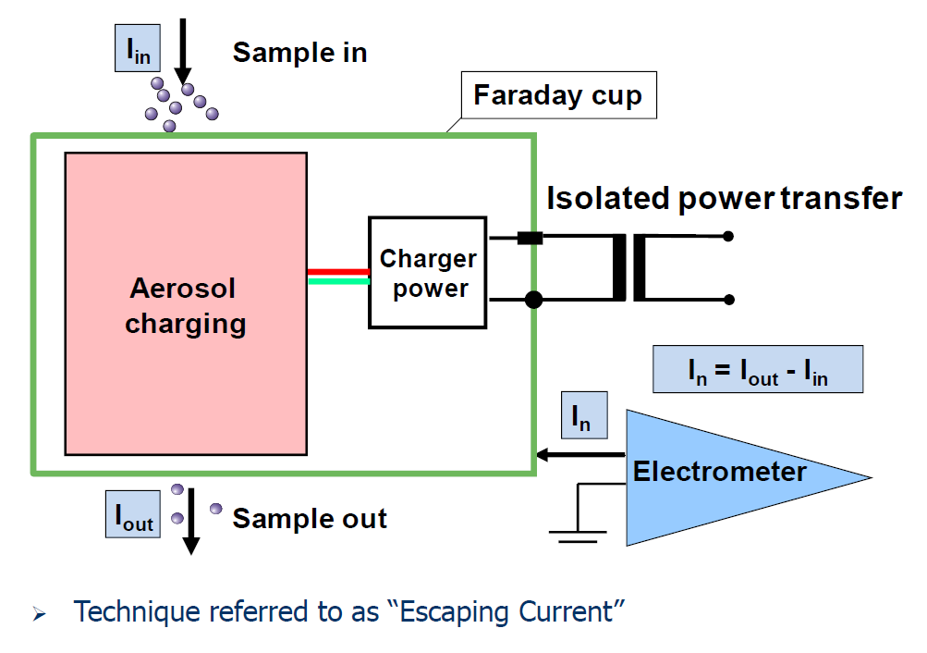
Pegasor Background/Operating Principle

Slide 22
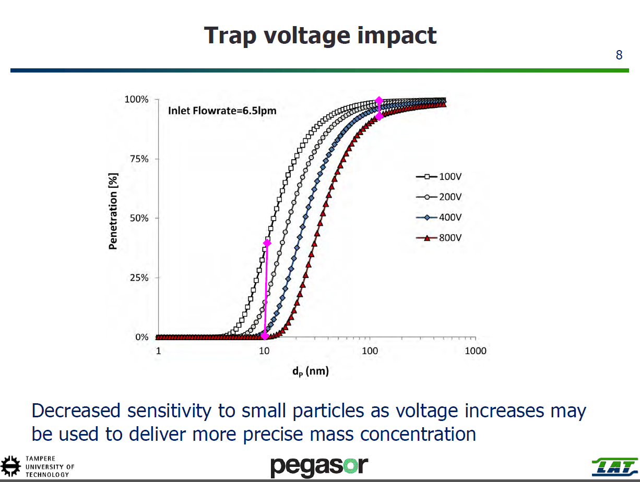
Pegasor Background/Operating Principle
Cummins Proprietary

Slide 23
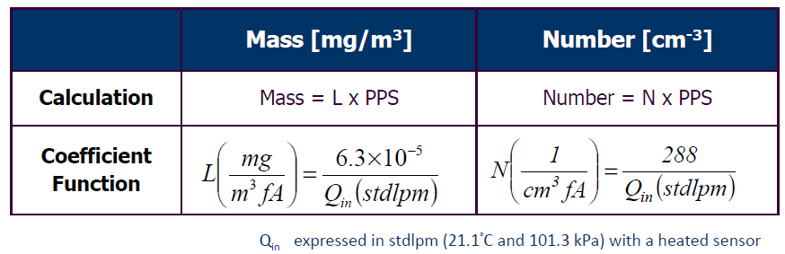
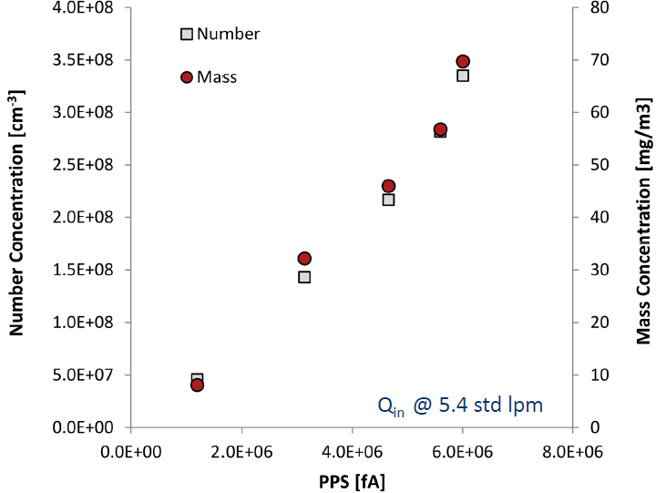
Pegasor Background/Operating Principle

Slide 24
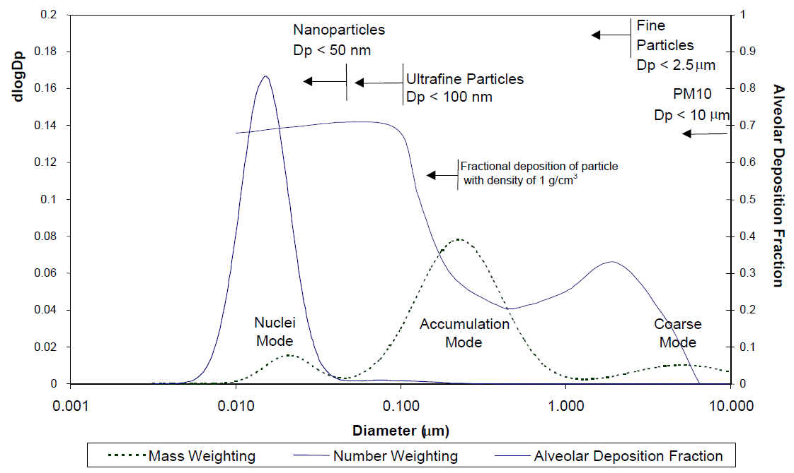
Particulate matter is one of six “criteria pollutants” for which the Regulators continue to impose tighter controls and is currently defined in the automotive industry as being:
  Number-based (eg EU Reg 582/2010 Euro 6), and
  Mass-Based Regulations (USEPA 1065)
The Euro VI standards also introduced particle number (PN) emission limits, stricter OBD requirements and a number of new testing requirements—including off-cycle and in-use testing.
Number- and Mass- measurements very different
  CVS or partial flow-based dilution preferred / regulated
    Mass –Don’t want to measure “nanoparticle artifacts” in real-time device and uses a gravimetric filter as a reference
    Number - measure all above a lower particle size (eg 20nm)
Ideal solution: One device, both Measurements
PM Device: Pegasor PPS-M Transducer

