Slide 1
PEMS Testing – Applications and Lessons Learned
2012 PEMS Conference and Workshop
March 29th, 2012
CE-CERT, Riverside, California
  Michael Block
  Saeed Abolhasani
  Filippo Toscano
  Eric Persson

Slide 2
Outline
About Emisstar
Four PEMS Testing Applications
What Have We Learned?

Slide 3
Emisstar LLC
“Energy and Emissions Technology, Policy, and Implementation”
Formed in April 2005
Dual focus
  Fossil-fuel emissions remediation
  Alternative energy sources
Over 90 years collective experience
  Testing Services – PEMS, laboratory, CFR Parts 86, 89, 1065, etc.
  Air quality science & engineering
  Engineering & project management
  Strategic planning for sustainability, goods movement and renewables
  Diesel engine, vehicles and emissions control technology assessment and implementation
  Three US facilities – New York, Texas, California
www.emisstar.com

Slide 4
Applications-1
Client | Application | Location | Why Unique?
AKRF/Columbia University | Cement Trucks | NYC
Capacity of Texas | Advanced Hybrid Yard Tractor | Longview, TX & POHA | Unique Test Cycle Development
Cerion Energy | Mississippi River Ferry Boats | New Orleans | Ferry -- side push embankment
Croton Water Treatment Project | Nonroad Construction Equipment | Bronx, NY
Cummins Power Systems | Natural Gas Gen Set for EPA NSPS | Allentown & Northumberland, PA
EcoPower Hybrid Systems | Advanced Hybrid Gantry Crane | POLA | Unique Test Cycle Development
EnerTeck LLC | Advanced Aftertreatment, Marine Vessels | Paducah, KY
Enviromagnetics Corporation | Fuel Additive (J1321) | New Jersey | On-Highway Truck -- J1321
Evans Cooling Systems | On-Highway Vehicles | North Carolina
Generator Services/D2G | Multi-fuelled Gen Sets | Rancho Cucamonga, CA
Hyundai Heavy Industries Ltd. | Large Marine Gen Set Engines | Ulsan, South Korea
MRCT/Ingram Marine Group | Loco Engine Powered Push Boats | Paducah, KY | Exhaust Flow; Engine Load
Komatsu America Corporation | Advanced Nonroad Hybrid Excavator | Cartersville, GA | Test Cycle Development
Navistar Corporation | EPA SCR HDIU Performance Testing | Sacramento, CA
Nett Technologies | Gantry Crane Aftertreatment | POHA
Schlumberger | Fracturing Trailers Petroleum Industry | Denton, TX | Strain gauge for load
Smith Electric Vehicles US Corp | On-Highway Elec Vehicle Range Testing | Milford, UK
University of Rochester | Alt-Fuelled School Buses | Rochester, NY

Slide 5
Applications-2
Capacity
EcoPower Hybrid Systems
MRCT/Ingram Marine Group
Komatsu America

Slide 6
Capacity – Terminal Tractor
TCEQ NTRD
Conventional vs. series hybrid
POHA (and CA) operation
Criteria emissions and fuel consumption
Dry run at Capacity facility
Then POHA

Slide 7
Capacity – PEMS Instrumentation
SEMTECH DS – Gaseous
SEMTECH EFM – 4” and 2.5”
MAHA MPM4 – PM
J1939 for both
7

Slide 8
Capacity – Terminal Tractor

Slide 9
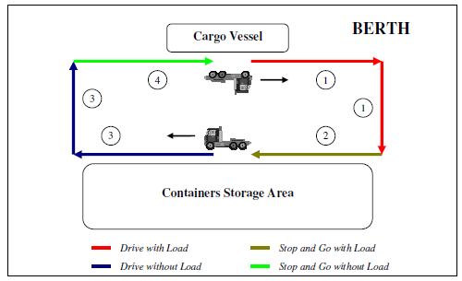
Capacity – Test Cycle
4 “sub-cycles”
Duty Cycle (1) – unloading containers from a vessel (via gantry)
Duty Cycle (2) – loading containers onto a vessel (via gantry)
9

Slide 10
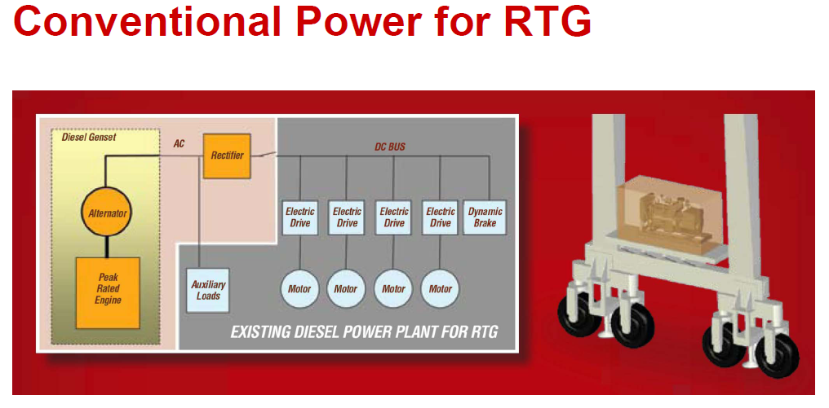
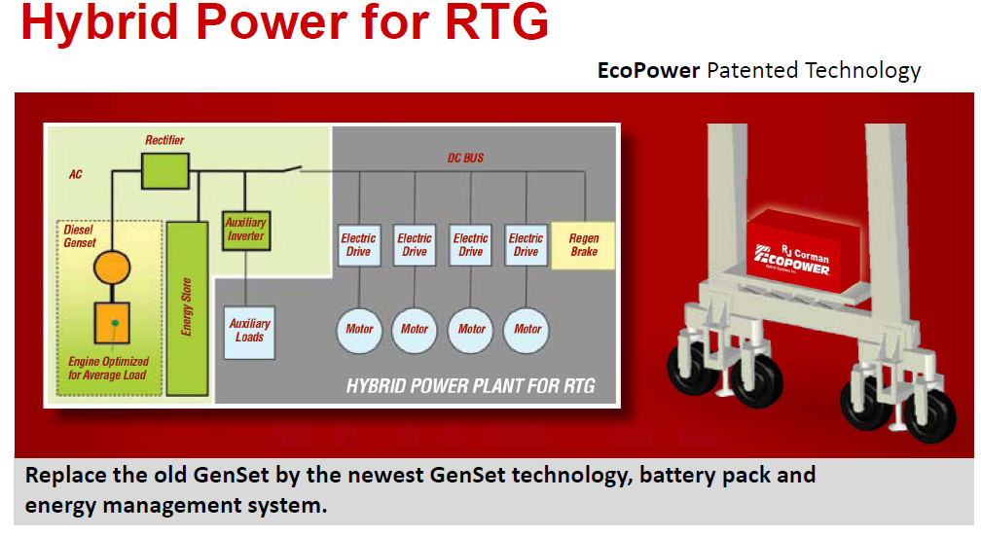
EcoPower - RTG Testing

Slide 11
EcoPower – PEMS Instrumentation
SEMTECH DS
AVL 494 PM PEMS
Kral fuel flow meter – onboard fuel flow measurement, temperature compensated (*)
* 40 CFR §86.345-79
11

Slide 12
EcoPower – Test Cycles - 1
7.5 lifts per hour followed by 20 min idle
15 lifts per hour followed by 20 min idle
Study “Rubber tired Gantry (RTG) crane load factor study” , Starcrest,
POLA & POLB, November 2009:
Two RTG cranes were monitored in for a total of 751.5 hours.
During this time 7376 moves are reported for an average of 10 container moves per hour or 20 lifts if you count empty hoisting.
12

Slide 13
EcoPower – Test Cycles - 2

Slide 14
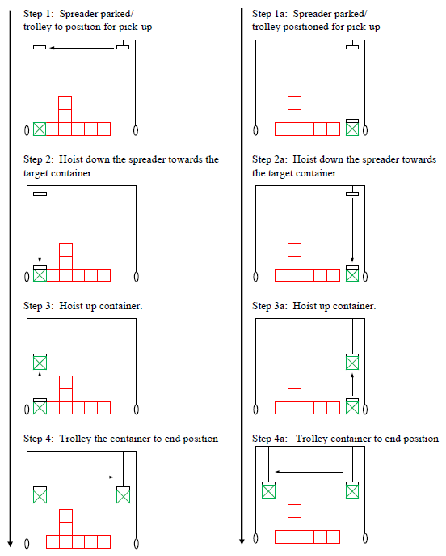
EcoPower – Test Cycles - 3
14

Slide 15
EcoPower – Test Cycles cont’d
15

Slide 16
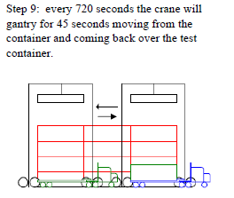
EcoPower – Test Cycles - 3
16

Slide 17
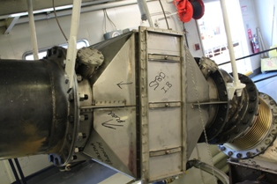
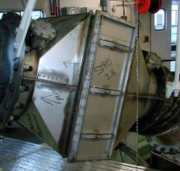
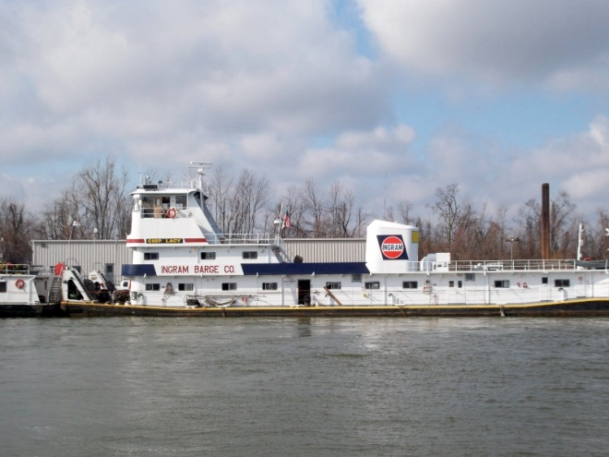
MRCT/Ingram – Objectives
Quantify the performance of a retrofitted DOC/CVS Kit

Slide 18
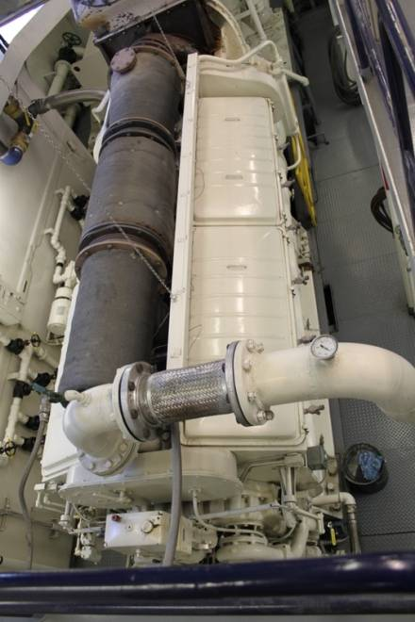
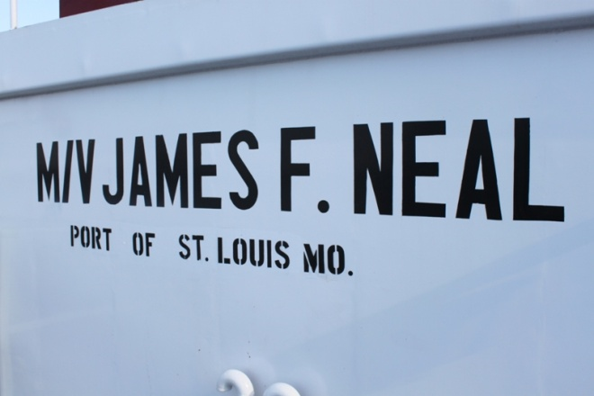
MRCT/Ingram – Application
Test Vessel and Engine
  James F. Neal
  Newly overhauled push-boat
  Two EMD 12V-710 engines
  Rated at 3000 hp per engine
  710 in³/cylinder
  Turbocharged

Slide 19
MRCT/Ingram - Instrumentation
Instrumentation Schematic
SEMTECH FPM-MPS
PM measurement
Exhaust
Analog Input
For testing configurations without XtrmCat™, DOC bricks were taken out
SEMTECH DS
NO_{x}, CO, THC, CO₂,
XtrmCat™ DOC
Exhaust
Recorded Manually
Engine
Crankcase Ventilation System
Fuel Flow Rate
RPM
Engine Load

Slide 20
MRCT/Ingram – HP Determination

Slide 21
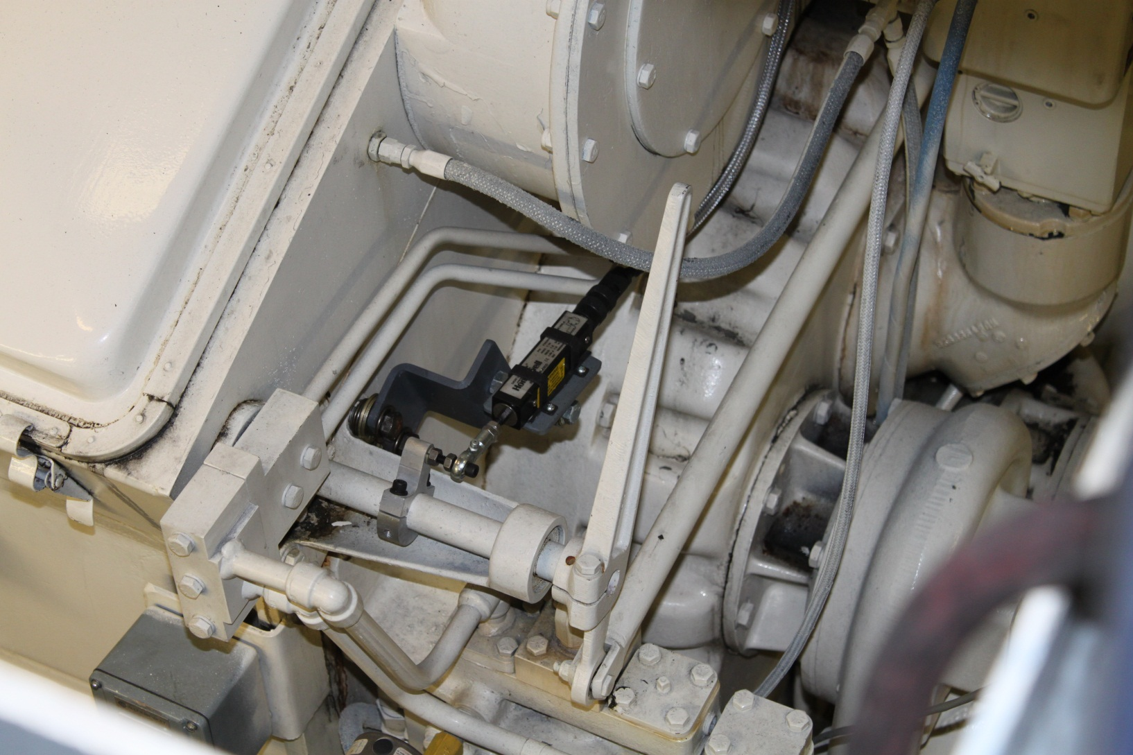
Injector Rack Position

Slide 22
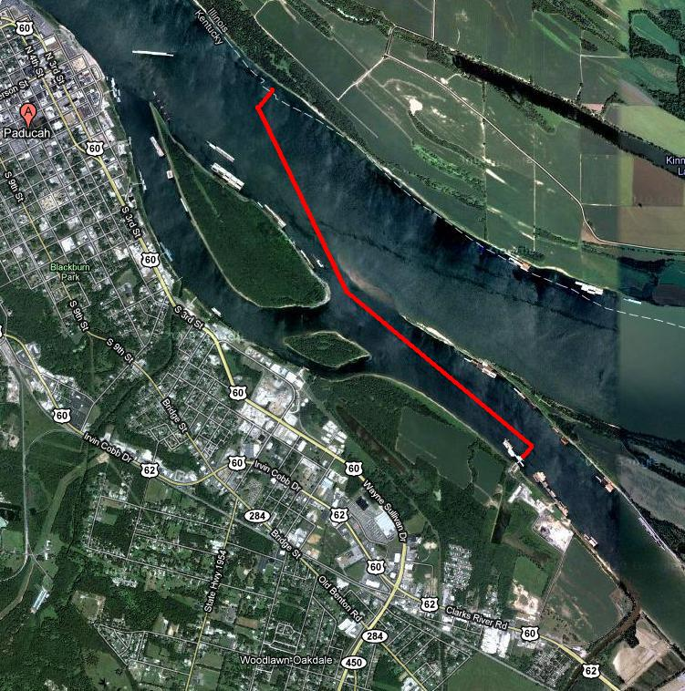
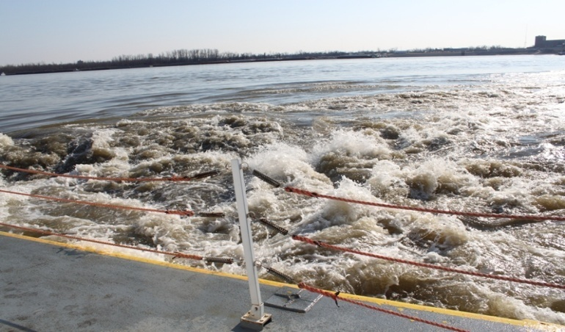
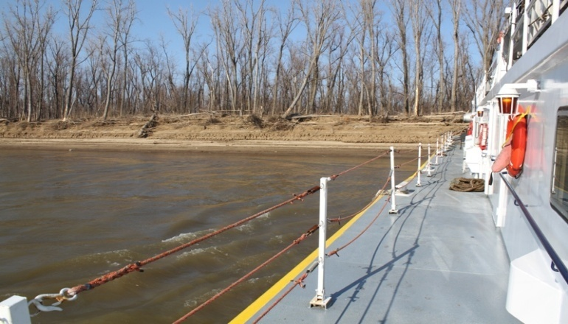
MRCT/Ingram – Embankment
Testing location and embankment
Back and front view of test vessel during the test
Embankment
Test Location
IBCO Dock Station

Slide 23
MRCT/Ingram – Test cycle
ISO 8178 E3 – Ideal vs. Actual
Test Sequence/ Mode | ISO 8178 E3 |  | MRCT E3 Test Cycle
 | RPM | Load | Actual RPM | Actual Load
1 | 100% | 100% | 94% | 86%
2 | 91% | 75% | 84% | 59%
3 | 80% | 50% | 74% | 36%
4 | 63% | 25% | 66% | 21%

Slide 24
Komatsu – Hybrid Excavator

Slide 25
Komatsu – PEMS Technique
SEMTECH DS – gaseous
Sensors PM
SEMTECH (EFM)
No load – cycle based data
25

Slide 26
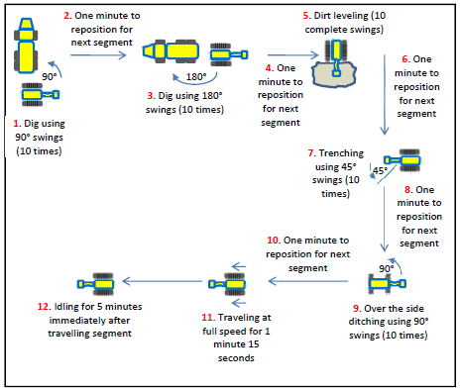
Komatsu – Test Cycle
26
Notes:
A synthesized test cycle was developed for this program to reflect events that are normally found in typical construction sites. The testing cycle included seven (7) modal segments, referred to as “microtrips”, described below:
Digging with 90° swings: Truck was positioned perpendicular excavator to facilitate consistent 90° swings;
One minute to reposition for next segment;
Digging with 180° swings: Truck was positioned behind excavator to simulate real world situations such as highway construction where only one lane of traffic is used. This also helps ensure consistent 180° swings;
One minute to reposition for next segment;
Dirt leveling: Spreading material was dumped by 1 truck in front of the machine;
One minute to reposition for next segment;
Digging a trench with 45° swings: Excavator dumped material on one side of the trench helping ensure consistent 45° swings;
One minute to reposition for next segment;
Ditching with 90° swings: Excavator will dig a U-shaped ditch “over the side” or with upper structure perpendicular to tracks. Material will be dumped 90° or in front of the machine for consistent swings;
One minute to reposition for next segment;
Traveling: Travel in low gear; and
Idling.

Slide 27
Challenges – 1
“Axiomatic” (i.e. self-evident truths)
When the engine or vehicle/equipment fails it is ALWAYS the fault of the PEMS
When delays are caused by human error it is ALWAYS the fault of the PEMS testing team
Corollary – blame those who are not immediately around (potty or pizza break)

Slide 28
Challenges – 2
Three entities
  Application owner
  Device owner
  Testing outfit
Testing entity is typically not the same as the “vehicle” application entity (Cap & Kom exceptions but Cap had to coord w/POHA))
Different goals
Different expectations
Different schedule!
May create issues

Slide 29
Lessons Learned - 1
Roles and responsibilities across all three (or more) entities
Need a champion (application)!
  The clearer the defined role of a committed champion the easier it all is….

Slide 30
Lessons Learned – 2
Instrument installation – plan!
Plan for instrument failures – “when” not “if
PM component tends to be more challenging and/or complex
  Filter media chain of custody
  Time align w/gaseous
  Counterpoint: cal gases
Logistics
  Ship, not truck requires tight logistics
  Bi-coastal
  Duplication where possible – ancillaries

Slide 31
Contact Information – Emisstar LLC
Michael C. Block, Principal
(949) 218-8229
michael.block@emisstar.com
www.emisstar.com

