Slide 1
Future Considerations for In-Use Compliance Testing
Future Considerations for In-Use Testing
Dan Carder
Center for Alternative Fuels, Engines and Emissions
Department of Mechanical and Aerospace Engineering
West Virginia University

Slide 2
Impetus
PEMS = MEMS = Consent Decrees
“The objective of this paper is to discuss the design features and practicality of a Mobile Emissions Measurement System (MEMS) which can be used to measure exhaust emissions from heavy-duty vehicles operating in the field. It is desirable to develop an on-board portable instrument system which can be used to measure the levels of certain regulated exhaust constituents. The levels measured by the MEMS should be representative of the levels which would be measured if the engine were removed from the vehicle and tested in accordance with the federal test procedures for engine certification which are prescribed in government regulations and further prescribed in the recent "Consent Decree" between the government and six settling heavy-duty diesel engine (S-HDDE) manufacturing companies. In order to examine the practicality of MEMS, West Virginia University has gathered and consolidated information on the currently available emissions measurement technologies and their ability to provide accurate, repeatable, and reliable mass emissions rates of gaseous exhaust pollutants (oxides of nitrogen, carbon monoxide, total hydrocarbons, and carbon dioxide) of heavy-duty vehicles”

Slide 3
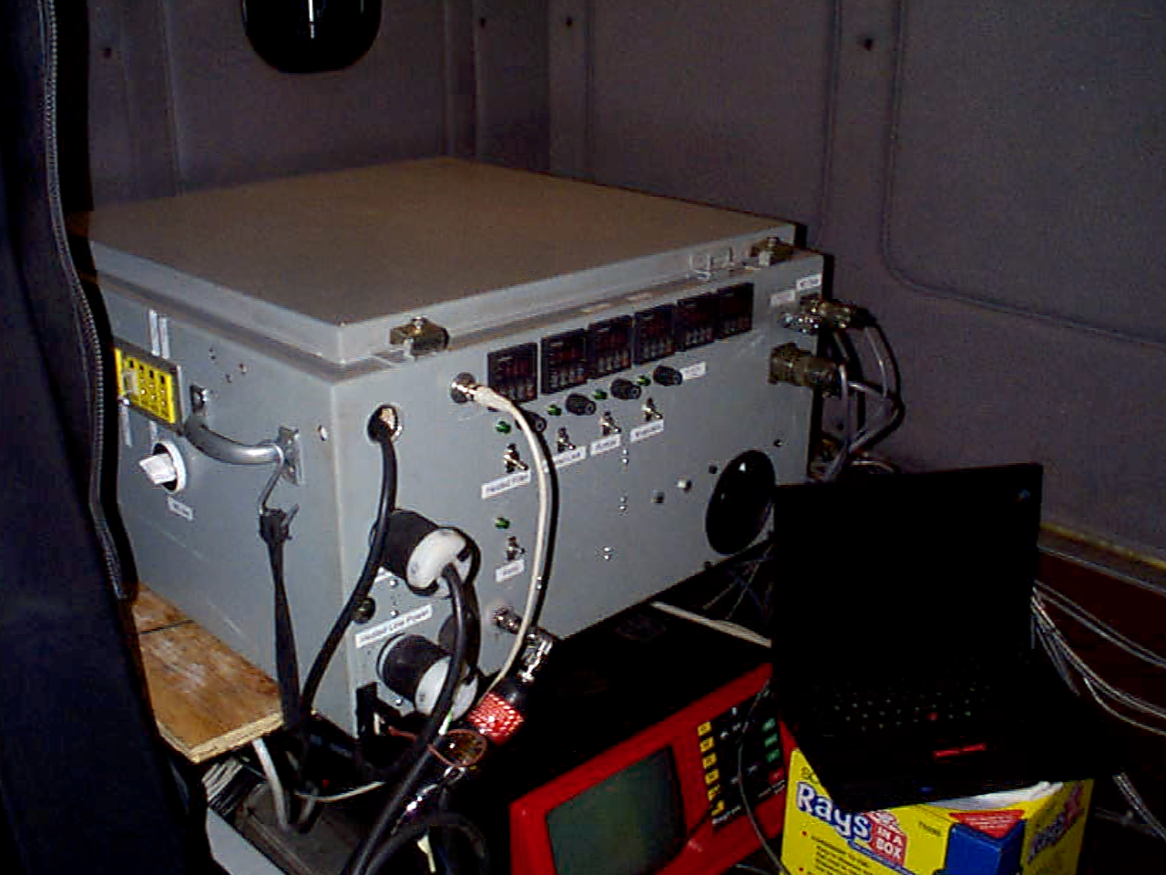
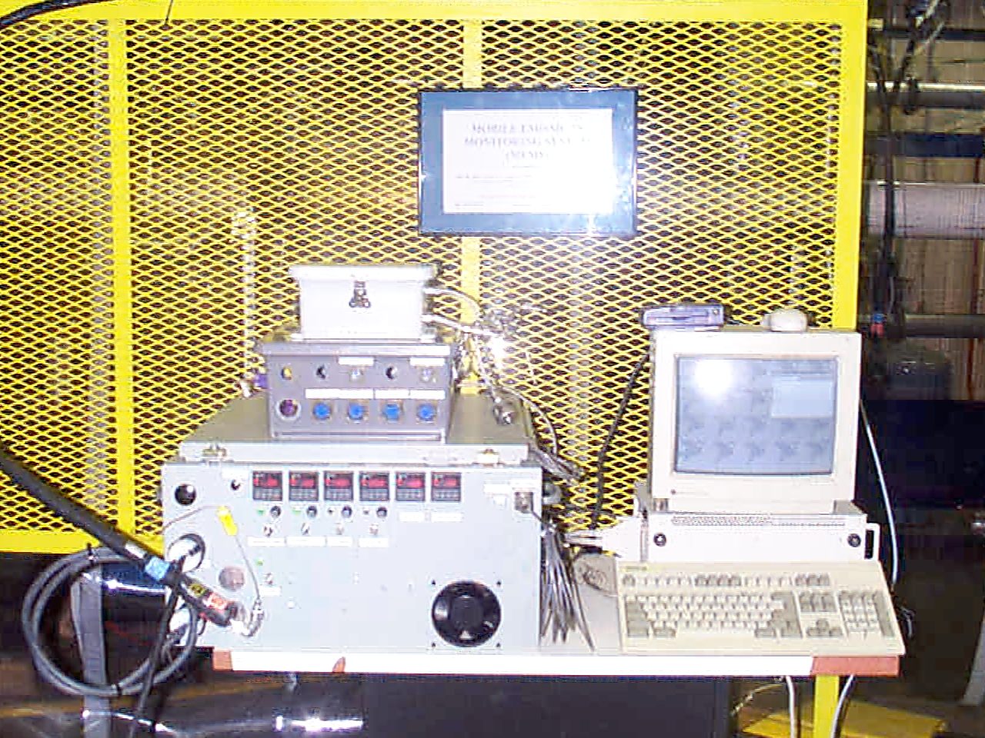
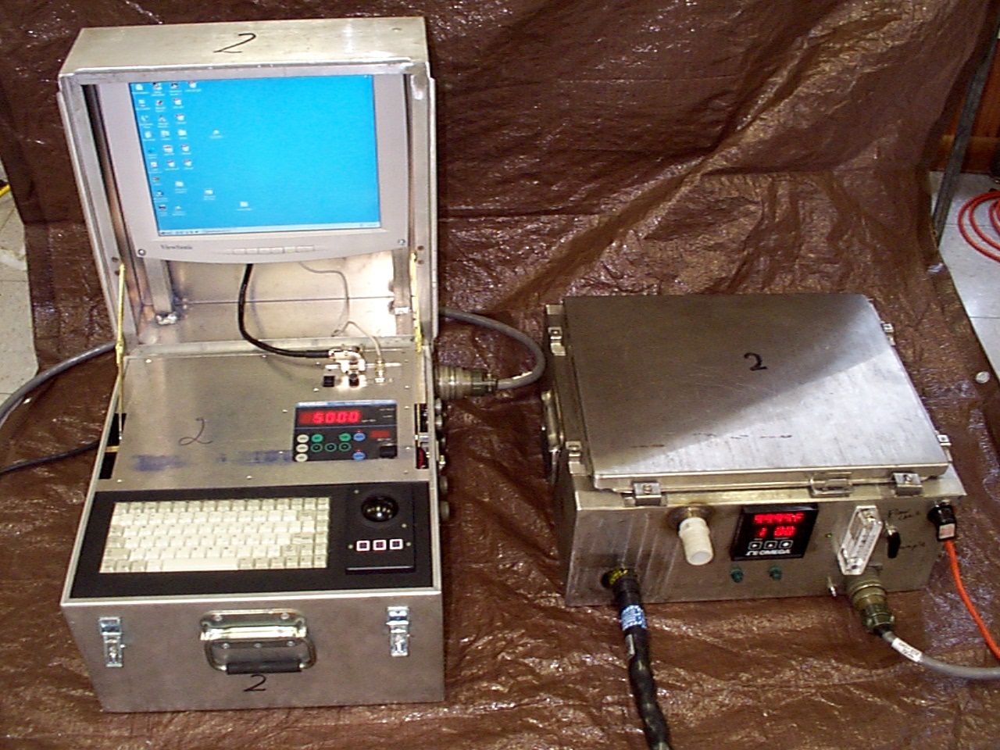
A Brief History… in Pictures

Slide 4
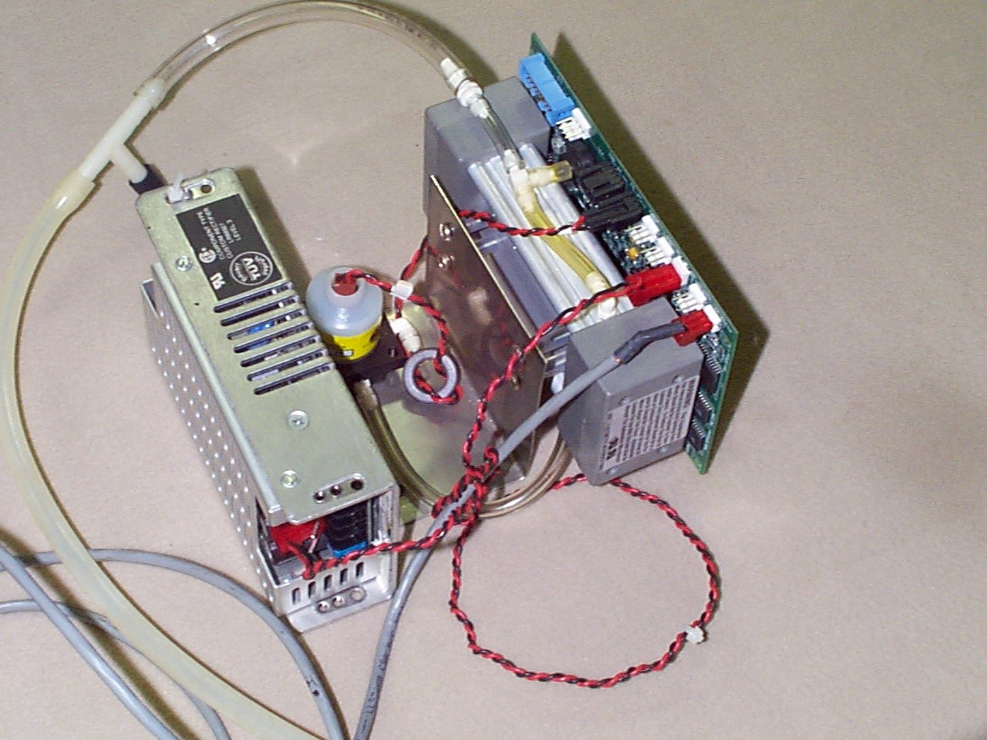
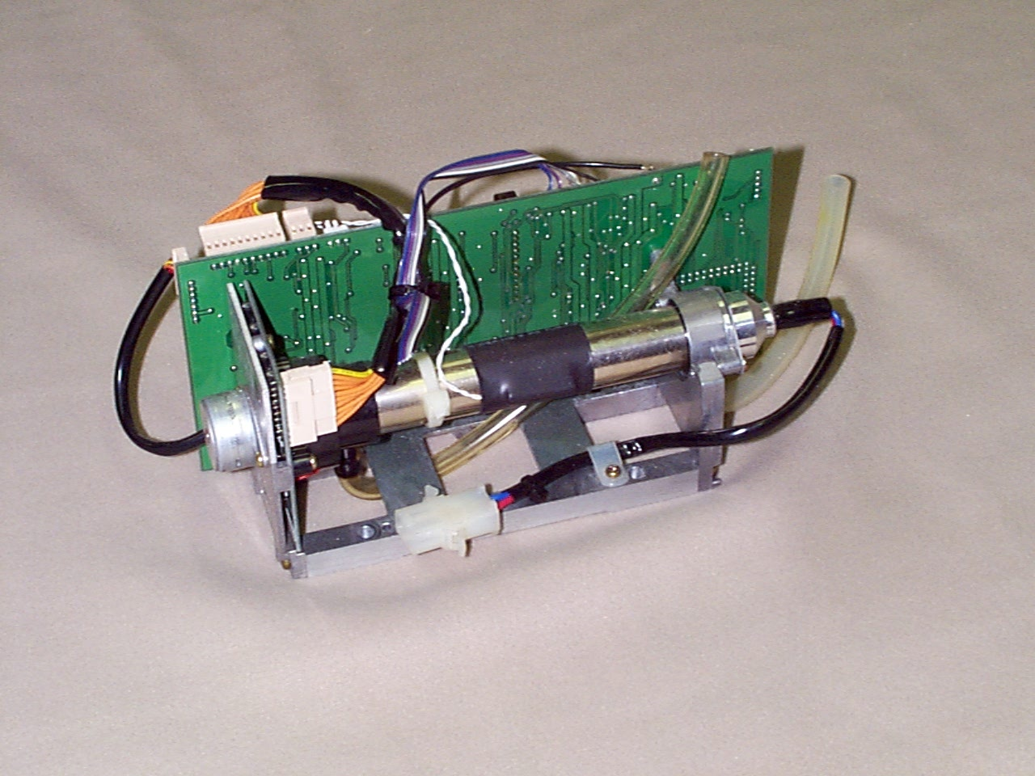
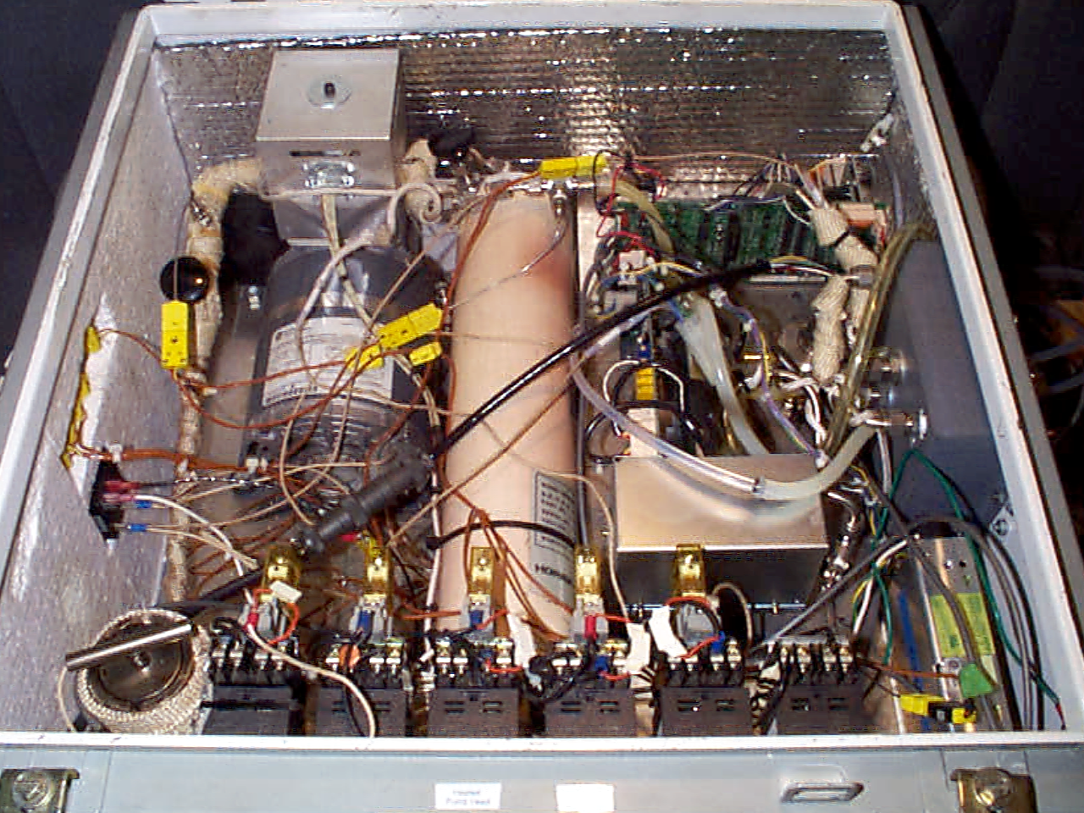
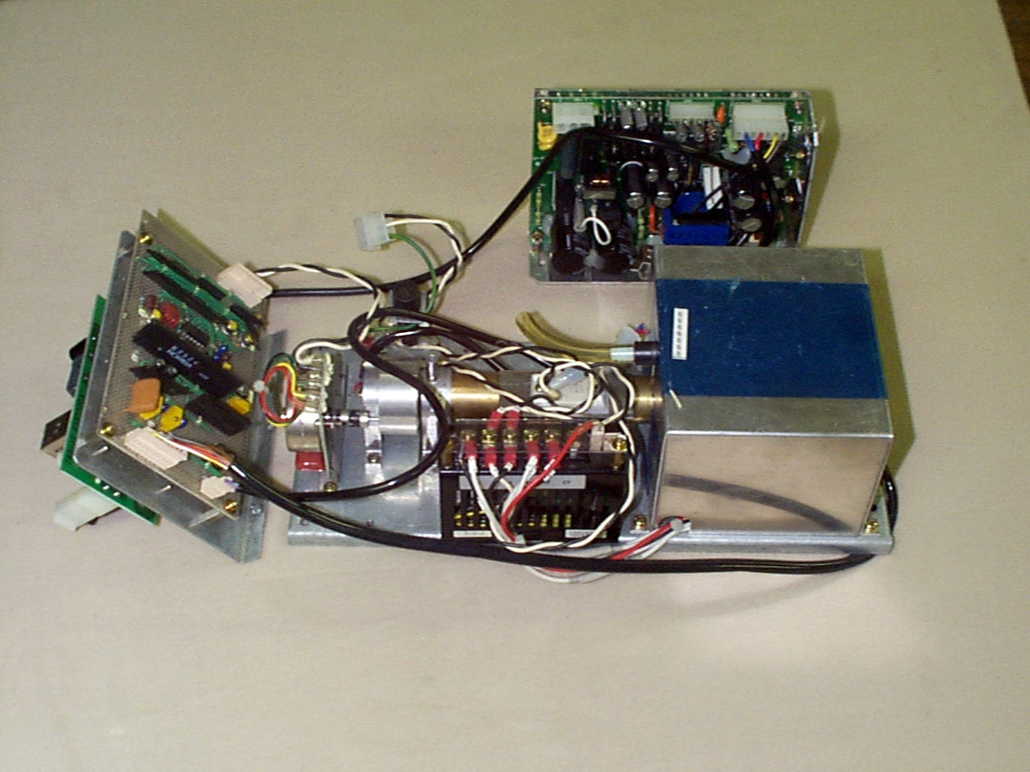
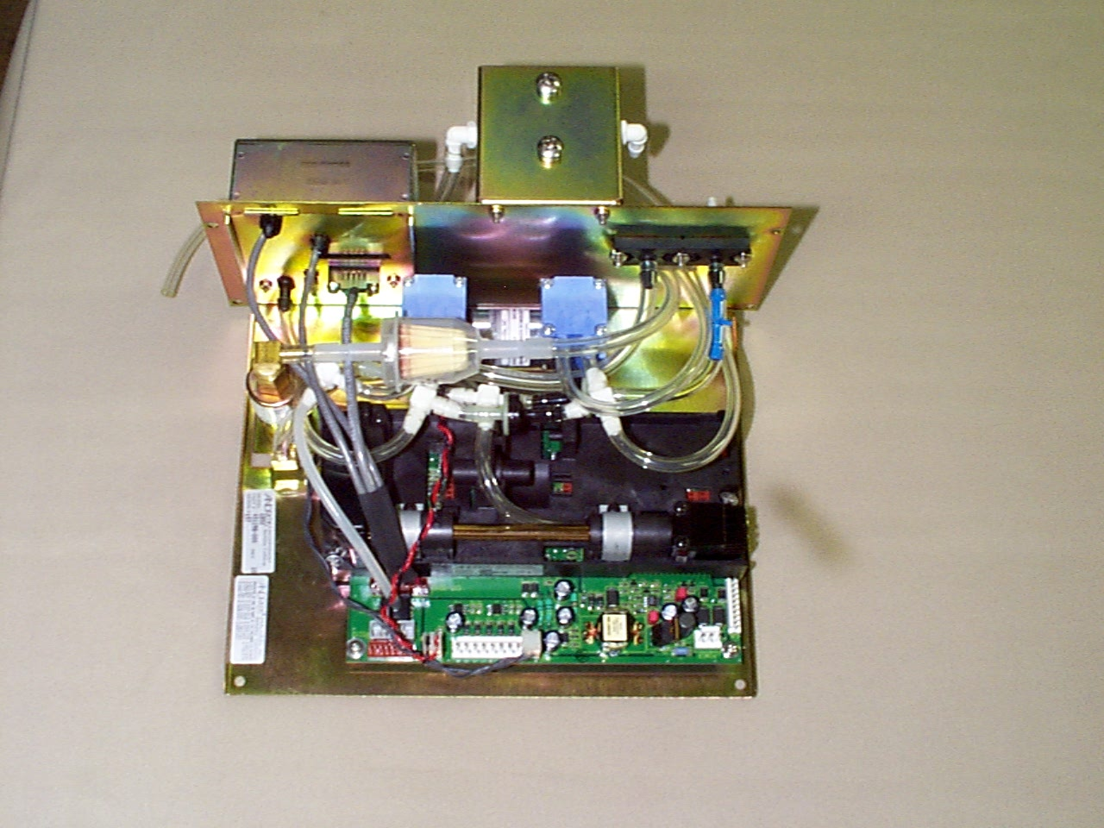
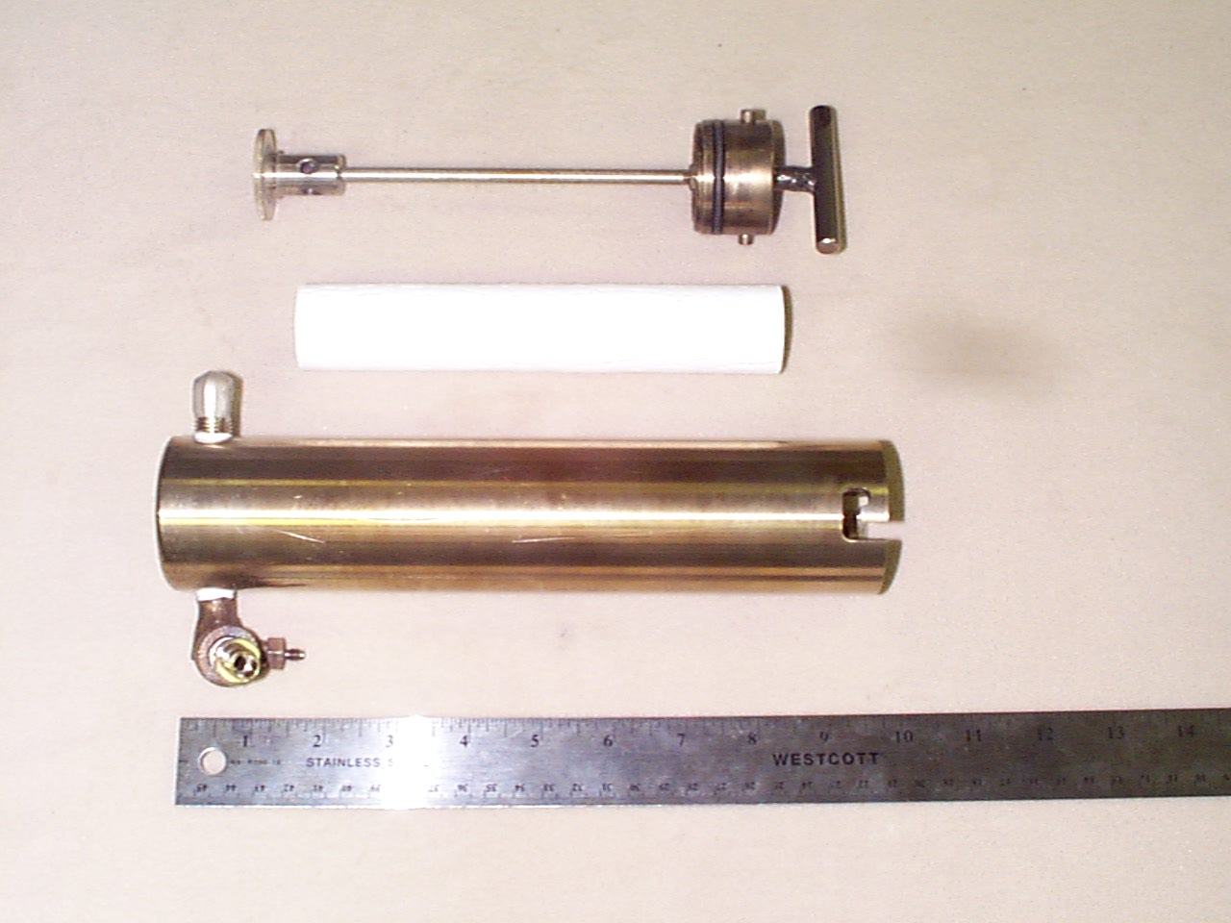
A Bit More….

Slide 5
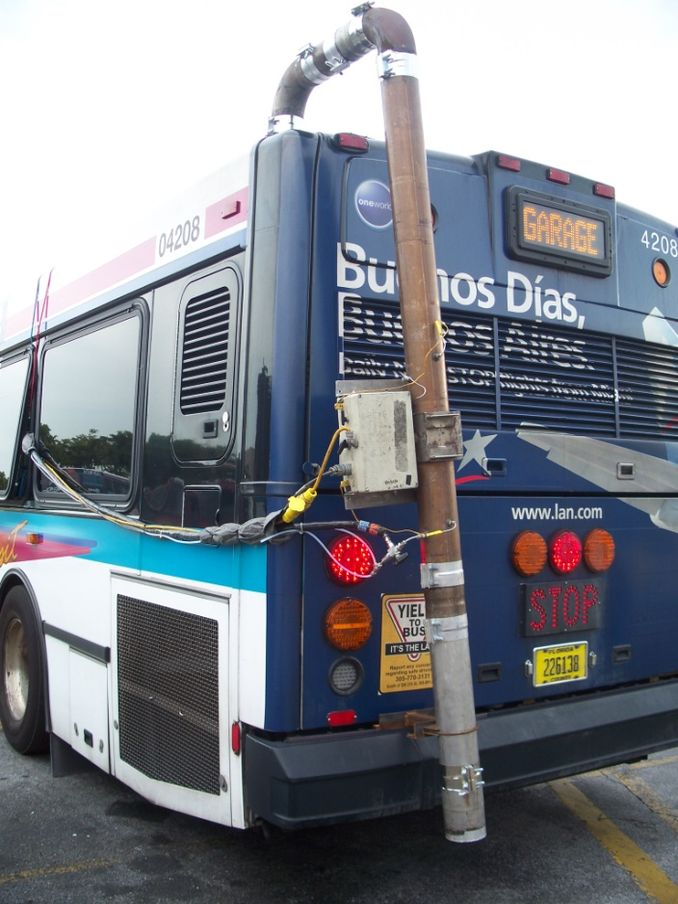
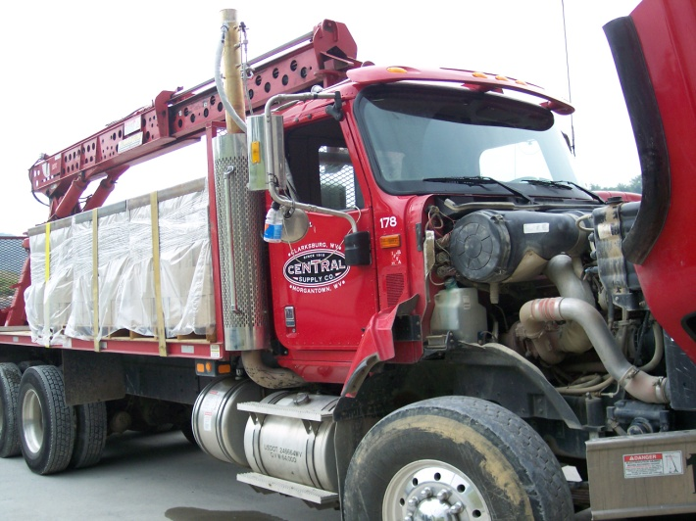
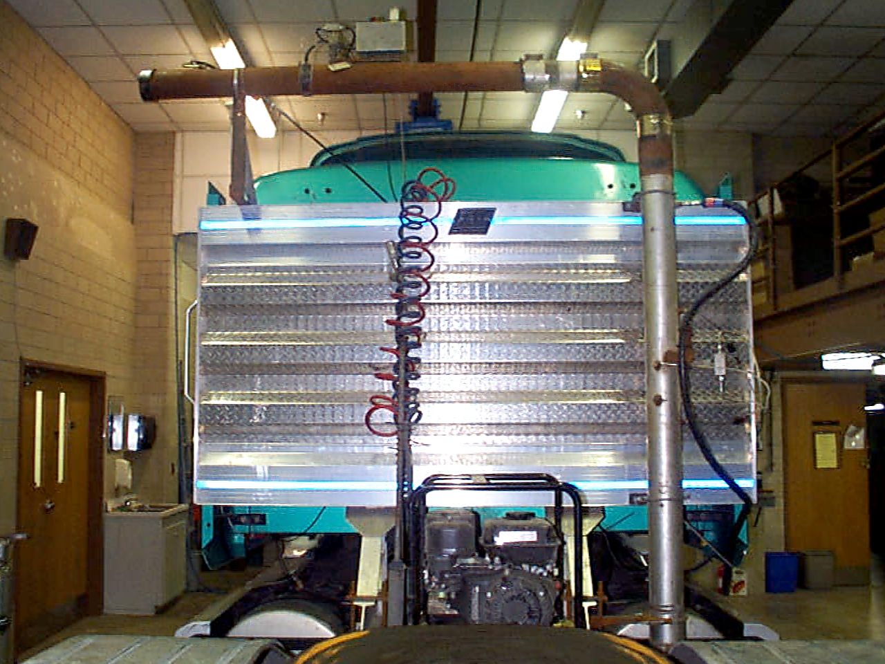
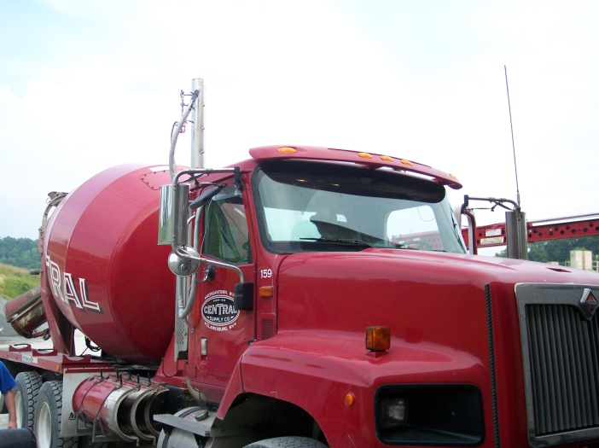
Yes, There Was Testing

Slide 6
Original Lessons Learned
Flow Rate Measurement Problems
Reliability/Repeat Runs
Heating/Cooling/Environmental
Data QC/QA
Component Failures
ECM Connection/Interrogation Problems
……..Has Anything Really Changed?

Slide 7
Current Uses
In-Use Compliance
In-Use Development
Demonstration Projects
Modeling Enhancement

Slide 8
Future Measurement Capabilities
N₂O
NO₂*
NH₃
NMHC
Particle Size Distribution
Accurate Road Grade (Barometric)
Wind Loading

Slide 9
Future Data Capabilities
Auxiliary T/C and Pressure Input
Analog/Digital I/O for Event Stamp/Time Alignment

Slide 10
Data Analysis
Customizable Data Review
Vehicle Energy Summation

Slide 11
Future Wish List
More Field-Friendly
Environmental Conditions
Quick Data Review
Ease of Installation
Modular Heated Lines (?)
More User Control of Interference/Linearizations, Etc.
Wireless Interrogation and Data Review
“COMPLETE ELIMINATION of metric compression fittings/pipe fittings”

Slide 12
Conclusions
“We’ve come a long way, baby….”
Reliability, Reliability, Reliability….
Power
Modularity

Slide 13
Thank You! Questions?
CAFEE
Center for Alternative Fuels, Engines and Emissions

