Slide 1
Lessons and Applications in PEMS for on-highway Measurements
2012 PEMS Conference and Workshop - UCR/CE-CERT

Slide 2
Background (Experience and Equipment)
Most of Cummins PEMS experience from conducting on-highway testing through the EPA HDIUT program
Our group has performed over 350 in-use test missions
Currently employee 4 test engineers in our group
Sensors SEMTECH-DS Gaseous Analyzer
Good reliability and data yield (improvements have been implemented over the years)
Updated NDUV are reliable and stable
Difficult to pass CO linearity
Sensors PPMD (quartz crystal micro balance with proportional dilution)
Gives quick results with no need for filter weighing
Reliability has been an issue but has improved as we have worked through issues
Careful attention to setup is required for quality data and good yield
Remote dilution option offers installation flexibility
Proprietary data logger
Ruggedized PC, data link adapter, and proprietary logging software
Honda 2k inverter generator (if needed)
This is enough power to run the SEMTECH and PPMD standalone (no vehicle power) at steady state conditions

Slide 3
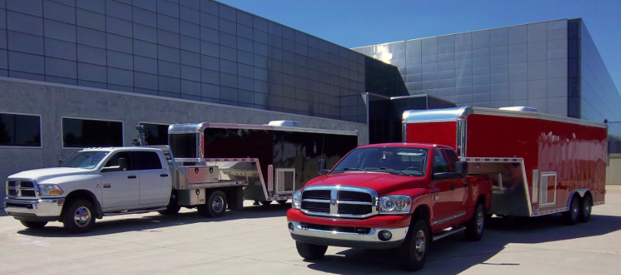
Transporting Equipment to the Field
Started with a box truck
Difficult to getting in and out and did not function well as a mobile lab/workshop
Moved to ¾ ton pickup pulling 16 foot tag trailer
Worked fairly well and was in service for 6+ years, but outgrew the trailer size
Full ton cab-chassis pickup with 24 foot goose neck trailer
7K generator for on site power
Air-conditioned and heated to give PEMS equipment dry environment during service and checks
Customer chassis accommodates boom crane for testing rig lifts

Slide 4
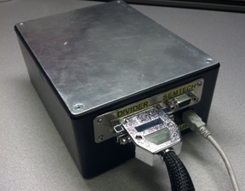
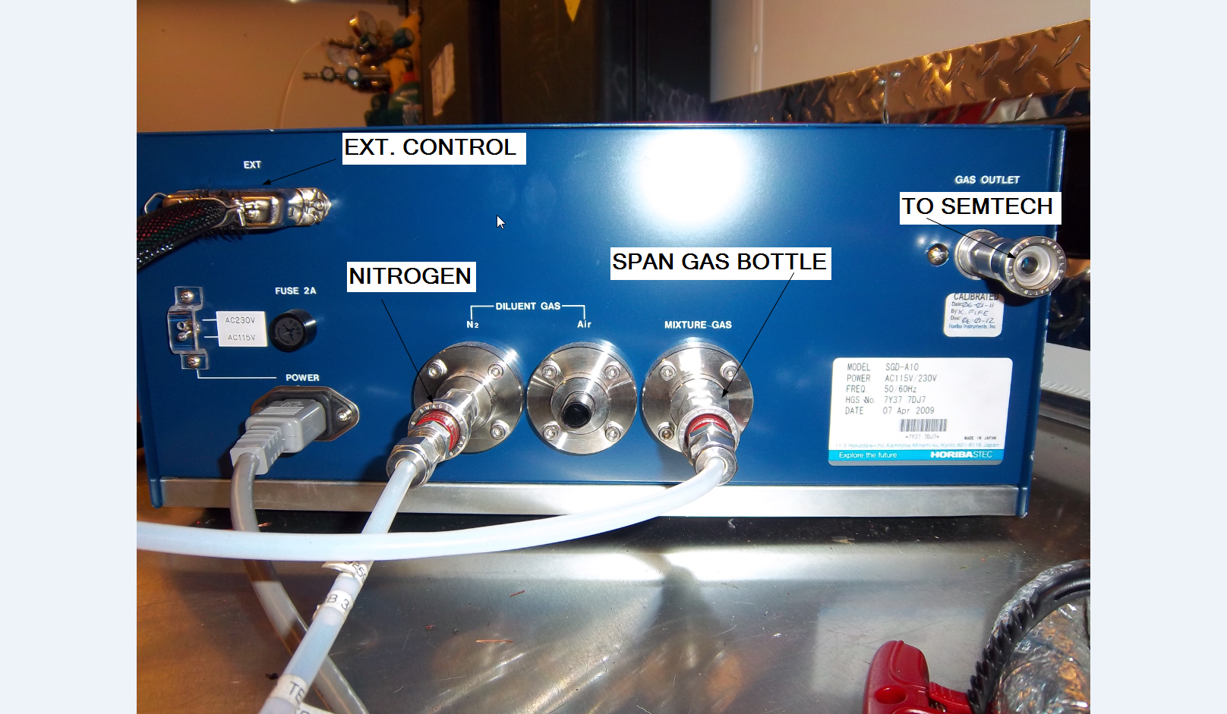
Setup and Equipment Readiness
Good organization is key to expedient setup
Have a plan for setup
If you have more than on engineer or technician working the setup, logically group tasks for efficient work
Be sure your equipment is ready
Analyzers don’t seem to like sitting idle. Best to have them running and fully checked out before the actual setup with the vehicle begins. Some of our missed testing opportunities in the past could have been avoided by better advanced checking of the equipment.
Complete warm-up, calibrations and checks the day before testing is optimal
Automating linearity can save you some time
We automated the functions of a Horiba/STEC SGD-A10 push button divider

Slide 5
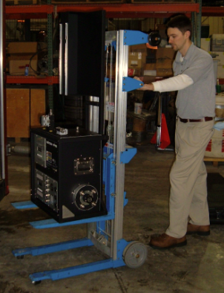
Setup and Equipment Readiness (cont.)
Have proper equipment to lift PEMS
Portable hand crank lifts work well for lifting PEMS into cab of other vehicle locations
Give yourself adequate time for equipment warm up and calibrations before vehicle mission launch.
Although analyzers can warm up in less than an hour in some cases, you want extra time for complete stabilization and any unexpected issues.
2 hours minimum is a good rule of thumb for people working setup.
In some cases, leaving PEMS running over-night can save time

Slide 6
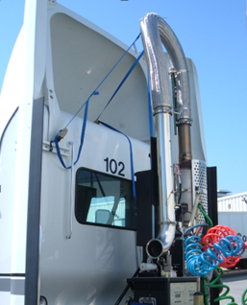
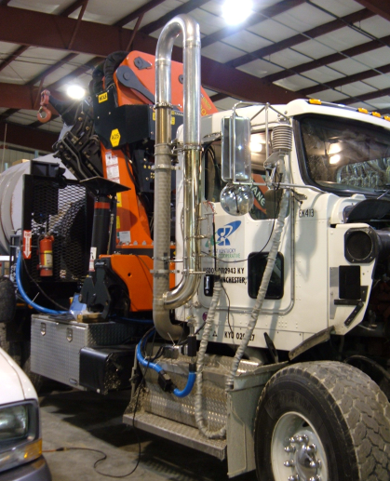
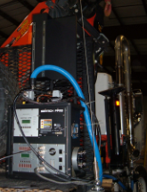
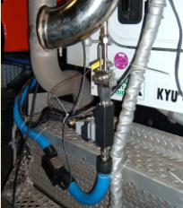
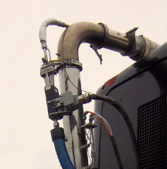
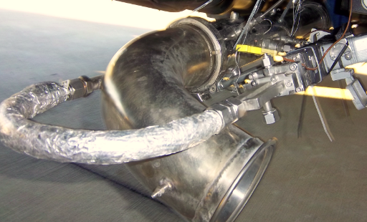
Raw Exhaust Handling
Flexible Exhaust Transport
Rigid Exhaust Transport
PPMD
No Remote Dilution, PPMD Exposed to outside elements
Remote Diluter
90 and 180 degree insulated smooth radius bends help orient the diluter for different applications

Slide 7
Running Test
Do a thorough review of real time data stream upon start of test/recording.
You can often spot something that is wrong before the vehicle mission is launched and driver can not be stopped.
VI data, concentrations, exhaust flow, power supply voltage etc.
Do an rpm sweep and observe transient response and proportionality
It is advisable to continue monitoring data if possible or make frequent checks in order to catch any problems that might otherwise cause reason for retest (second shift day)
Avoid shutting vehicle off if possible.
Continuous ECM data is easier to work with
Minimizes risk of data logger failure

Slide 8
Data Processing and Quality
Perform quality checks on data
Review 1hertz report file for accuracy
Check transport delay/time alignment
Compare proprietary ECM data against CAN collect by analyzers
Check torque curves for errors
Check for transcription errors

Slide 9
What can go wrong?
Can’t find adequate customers in time for compliance testing, customer procurement is a big driver in meeting schedule
Start your customer procurement as early as possible
Plan for customer driven delays
Have back up options
PEMS breakdown
Best if you can have back up units available if possible
Arrange for PEMS supplier to provide support
Power supply to PEMS insufficient
If running equipment without a generator, make sure your test vehicles charging system can keep up with the demand
Dilution Proportionality is poor
Carefully setup and choose user set parameters i.e. maximum expected exhaust flow
Eliminate any leaks in sampling systems

Slide 10
What can go wrong? (cont.)
Vehicle Interface (ECM data) is intermittent, slow, or unavailable.
Be sure to avoid any floating grounds with CAN communication equipment
Exhaust Flow Meter hardware doesn’t fit application
Best if you can investigate the test vehicle in advance of the test day so that you can prepare for any unexpected exhaust configurations
Stock a variety of exhaust hardware
Exhaust stack very rusty or deformed at silencer/after-treatment connection
Use superior penetrating oil products on rusty bolts (off the shelf at local retailers are not as effective as commercial account type products)
Use heat (torch) only if necessary and follow all safety precautions
Cut off exhaust stack using “saws all” then extract the remaining piece of stack

Slide 11
What can go wrong? (cont.)
Extreme environmental conditions (heavy rain, excessive heat, cold, vibration)
Mount equipment in the cab as much as possible,
When mounting outside environmental enclosures can protect from rain, but can be more difficult to cool in hot weather.
Excessive heat or cold can limit equipments ability to regulate critical temperatures
Avoid heat rejection sources from vehicle or insulate components as needed
Implement vibration dampening as needed
Data processor or report compiling software makes error
Develop data quality check/review process

Slide 12
What recommendations/ improvements should be made?
PEMS reliability has improved substantially in recent years, however we hope for continued improvement
Any emerging technologies that allow for reduction in power consumption and size while not compromising measurement quality
Regulatory language proposed revisions
CFR 86.1370-2007(g) after-treatment warm-up

Slide 13
Questions?

